Slide 1
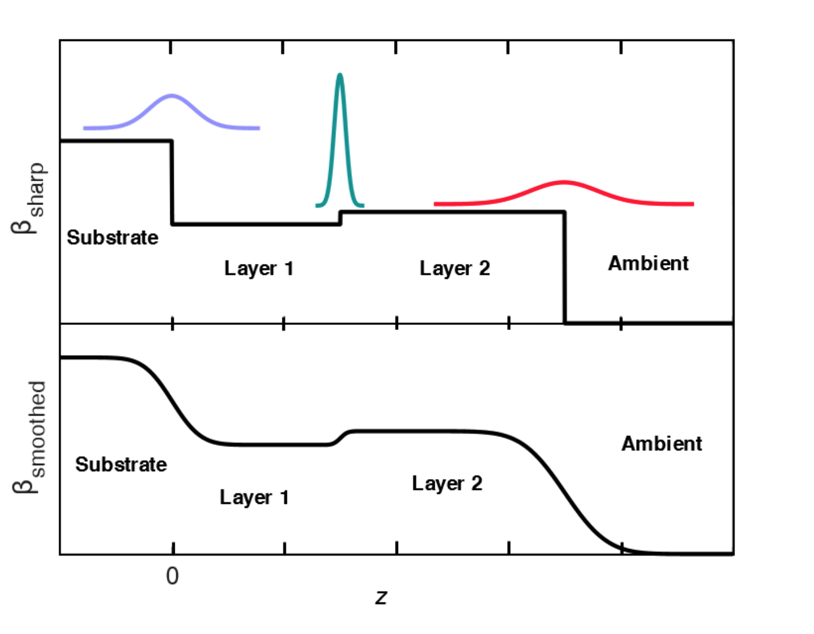
Plotting the SLD profile
The SLD
The Scattering Length Density (SLD) is what determines the ability of a layer of material to interact with X-rays.
It is sometimes given the symbol β.
It is given by the product of the scattering length (which depends only on the atoms in the material) and the number density of atoms (how many are there per cubic metre).
It is in general a complex number. The imaginary part determines how strongly the layer absorbs X-rays. The real part determines how well it scatters X-rays.
The refractive index n is related to the SLD via n = 1 - βλ²/2π
The SLD is what we are interested in! Determining the SLD is the main point of an XRR experiment.
Generating the SLD from thin film parameters.
If we know layer thicknesses, densities, and roughnesses, we can plot the SLD.
We usually plot the real and imaginary parts separately.
For the case of zero roughness, this is trivial (top panel of figure).
z = 0 is the substrate interface, and z increases as we move through the layers.
For non-zero roughness, we calculate Gaussian profiles (with the roughness parameter σ determining their width) centred on each interface. Integrating these Gaussians provides a smoothing profile (similar to a sigmoid).
We can iteratively blend in successive layers, starting from the substrate.

Slide 2
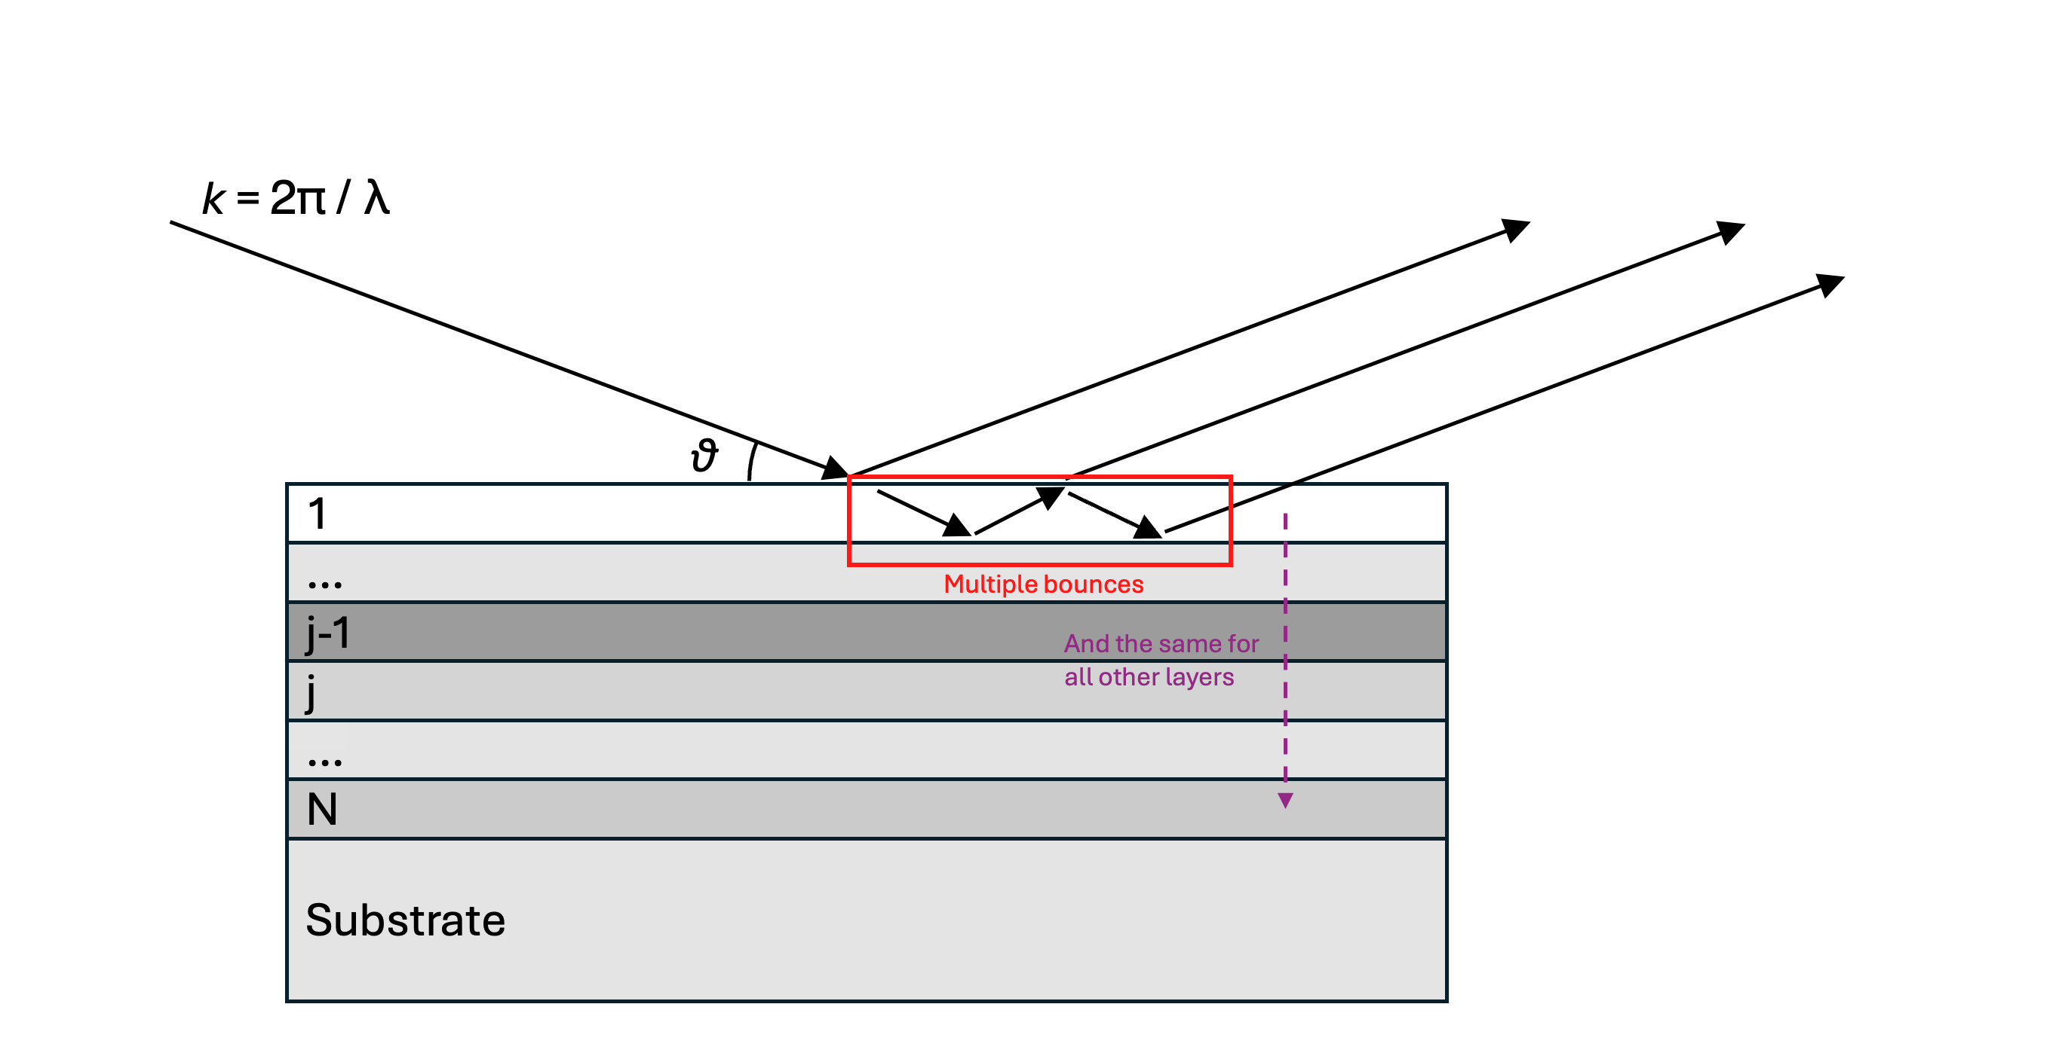
Parratt Recursive Approach
Variables and calculations:
n_{j} = 1−δ_{j} + iβ_{j} = (complex) refractive index of layer j (where i = sqrt(-1) )
σ_{j} = roughness of top interface of j^{th} layer
t_{j} = thickness of j^{th} layer
λ = 1.54x10⁻¹⁰ m = X-ray wavelength
θ = Angle of incidence relative to sample surface
k = vector along X-ray path with magnitude 2π / λ
k_{z} = |k| sinθ
Q = (4π / λ) sin(θ) = 2k_{z}
θ_{j} = Angle of X-ray in j^{th} layer relative to sample surface
Q_{j} = sqrt(Q² – 8k²δ_{j} + 8ik²β_{j})
k_{zj} = z-component of k in j^{th} layer = sqrt(k_{z}² - 2 δ_{j} k² + 2iβ_{j} k²)
r’_{j-1,j} = [(Q_{j-1} – Q_{j}) / (Q_{j-1} + Q_{j})] * exp(2σ_{j}²k_{zj-1}k_{zj}) = reflected intensity at interface between j-1 and j if we ignore multiple bounces
r_{N,sub} = r’_{N,sub} (for substrate interface, there are no multiple bounces)
Then, starting with r’_{N,sub}, we can calculate the reflectivity including multiple bounces for the j-1th layer:
r_{j-1,j} = [r’_{j-1,j}+ r_{j,j+1} exp(2i k_{zj-1}t_{j-1}) ] / [1 + r_{j} r’_{j-1}exp(2i k_{zj-1}t_{j-1})]
Strategy:
For each value of the input θ
Calculate k = |k|, k_{z}, and Q
Then calculate r_{N,sub}
Iterate from j = N to 0, calculating r_{j-1,j} for each j
The total reflectivity coefficient will be r_{0,1}
The final measured reflectivity (at a given θ) is R = abs(r_{0,1}²)
Loop over θ to produce the curve R(θ).

Slide 3
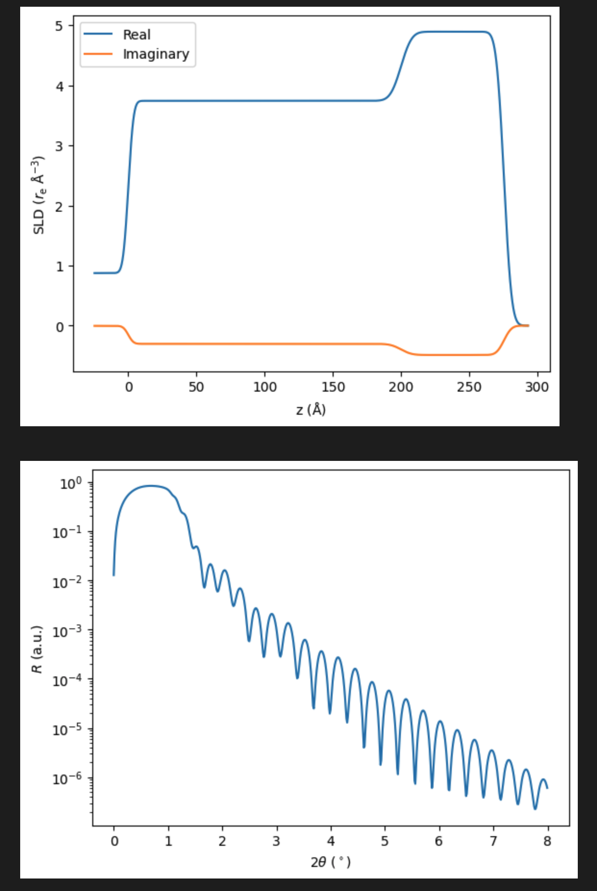
Combining the two
The idea is to begin with a list of:
N+2 scattering length densities (in Å⁻², where 1 Å = 10⁻¹⁰ m)
N thicknesses (in Å)
N+1 Gaussian roughnesses (in Å)
From these, it should be possible to produce the R(θ) curve (say, from θ = 0˚to 4˚) and the corresponding SLD profile.
Something like this:

Slide 4
k = 2π / λ
θ
1
…
Multiple bounces
j-1
And the same for all other layers
j
…
N
Substrate

