Slide 1
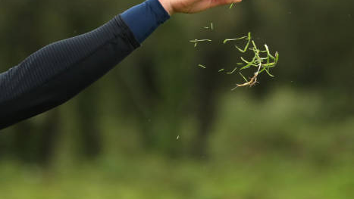
How Does Weather Affect Golf?
Jason Carless
DA7 Capstone

Slide 2
Background Information
A caddie's job is to factor in all types of conditions including weather and adjust as needed
The data used is tournament summaries, so both the weather and PGA stats used is a 4-day average
Data gathered from the PGA tour and from the National Centers for Environmental Information
Used both excel and SQL to explore and work through the data, and Tableau to create all visuals

Slide 3
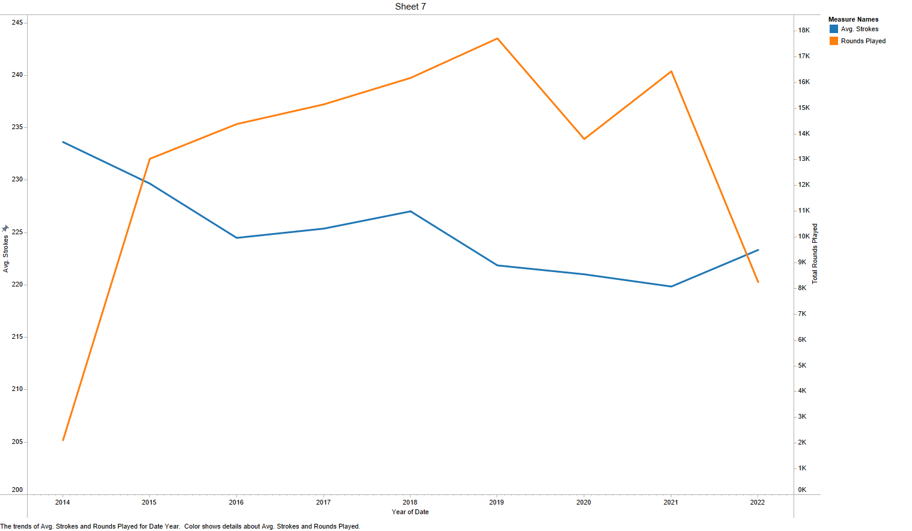
Exactly How Much Golf?
Average number of strokes per tournament is trending down over the years
There’s over 13,000 rounds played every year at 40 – 50 different events
Tournaments are played across the U.S. and in 7 different countries

Slide 4
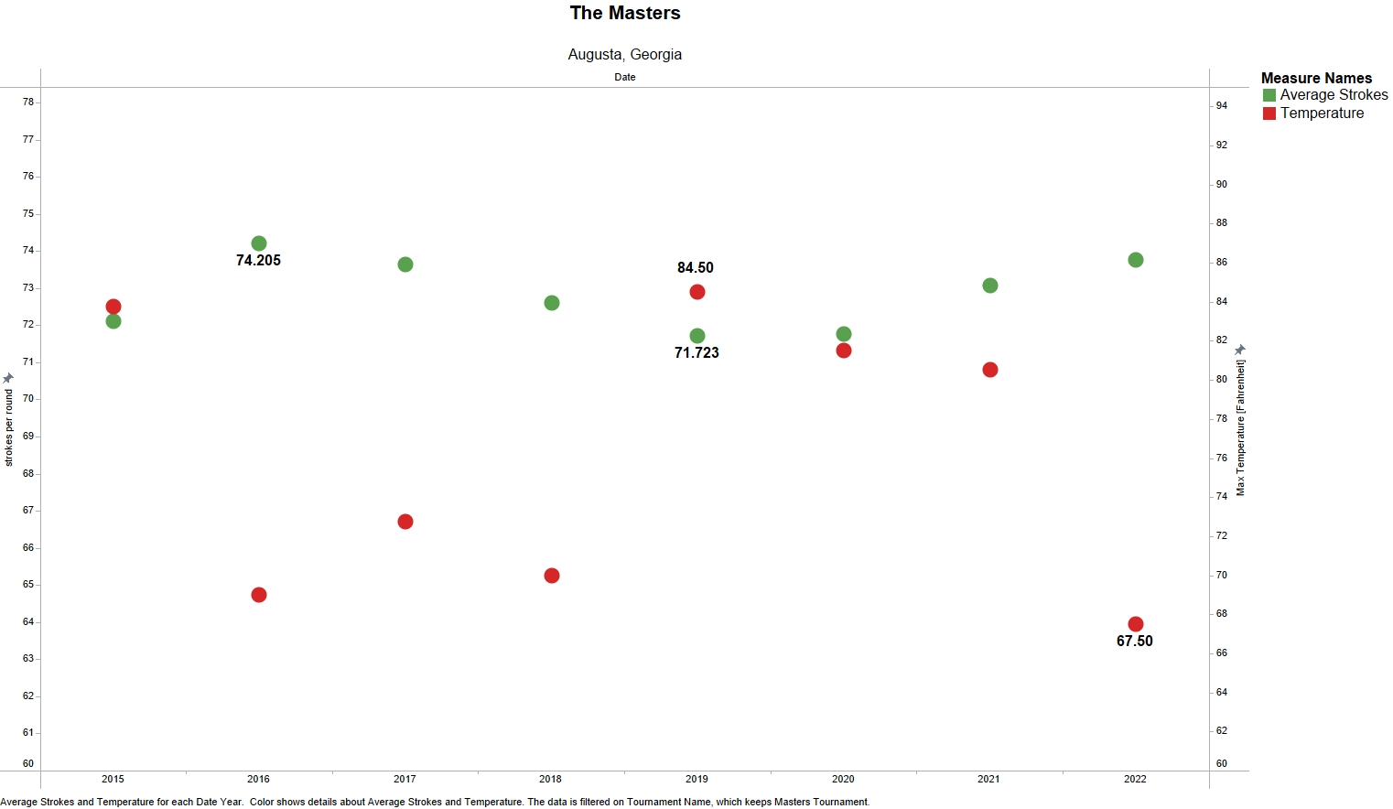
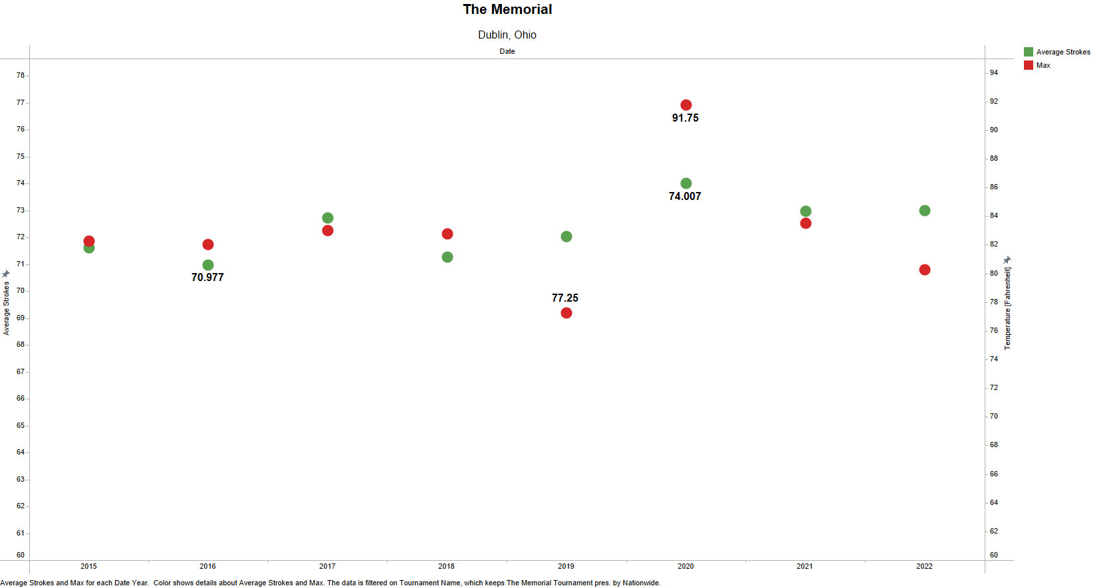
Heat Impact
Both the Masters and Memorial are played at the same golf course every year, and around the same date
Temperature plays more of a role on the golfer than the golf itself
For the Masters, the hottest day was the easiest, but opposite for the Memorial

Slide 5
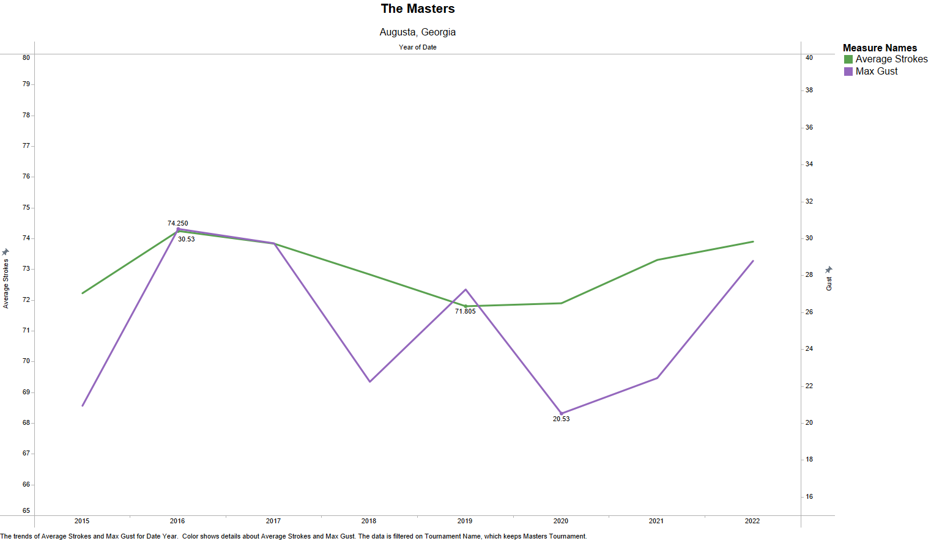
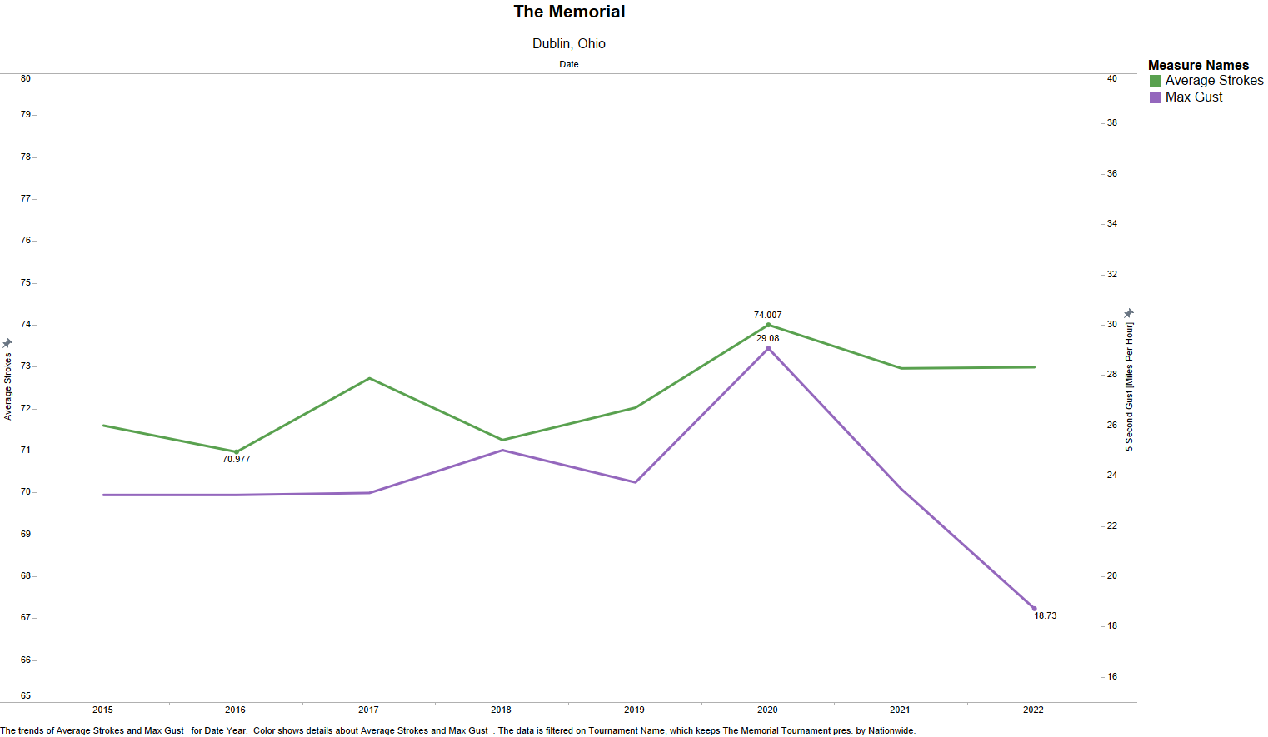
Wind Impact
The gust(mph) is a measure of the maximum 5 second gust of wind over the span of the tournament
Used gust over sustained wind due to its unpredictability
Both tournaments had the highest average stroke count in the year with the strongest gusts of wind

Slide 6
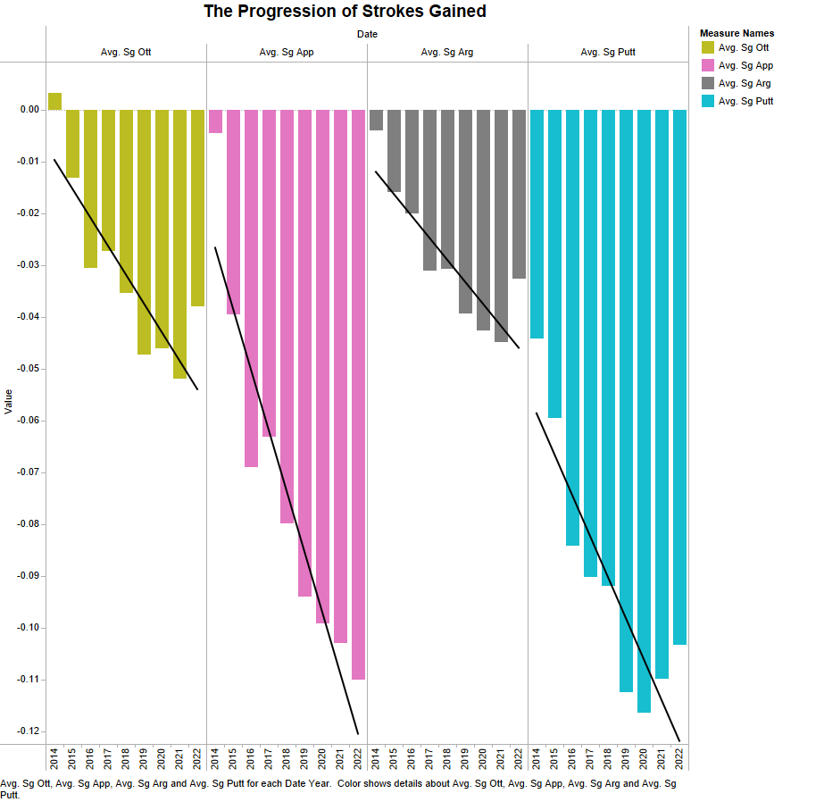
What is Strokes Gained?
Strokes gained is a measure of each shot in comparison to a benchmark the PGA tour created
OTT: Off the tee
APP: Approach to the green
ARG: Around the green (chipping)
Putt: Putting

Slide 7
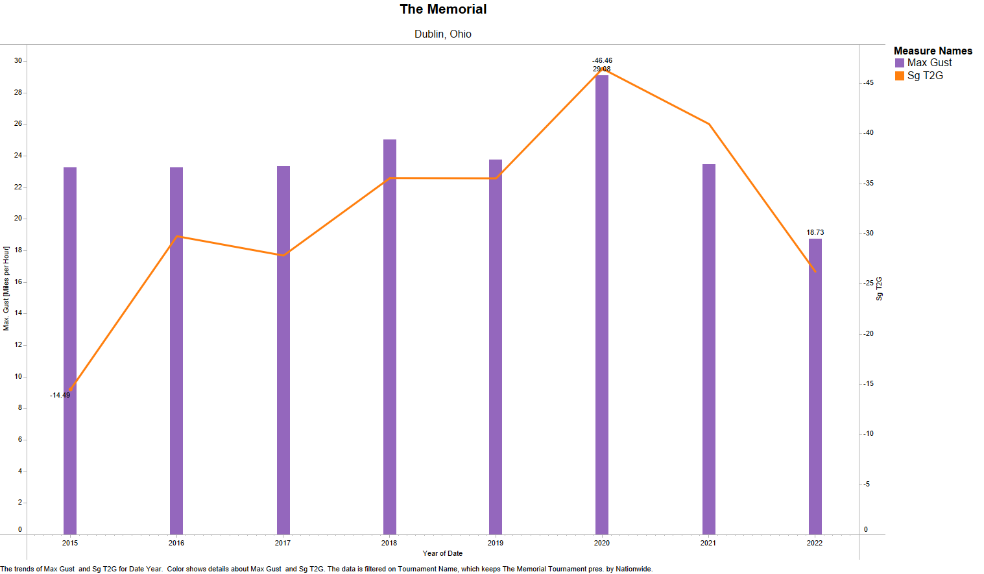
Another Look at Wind Impact
Sg T2G: Strokes gained tee to green, a combination of off the tee and approach. Measured as the sum for the tournament
Again, the windiest day proved to be the toughest with a 3o stroke difference over the lowest scoring year

Slide 8
Takeaways and Further Questions
There is a clear correlation on the days with the more extreme conditions.
I’d like collect more data to see exactly how much an impact weather plays, and if there are other conditions that affect the scoring.
Is there a certain number or threshold at which weather starts to impact shots?

