Slide 1
HW6 Requirement

Slide 2
Class: Keyword
Keyword is a data structure defined as:
{
String name;
double weight;
}

Slide 3
Class: WebPage
WebPage is a data structure defined as:
{
String url;
String name;
KeywordCounter counter; //from HW3
Double score; // score is calculated from a given Keyword set
}

Slide 4
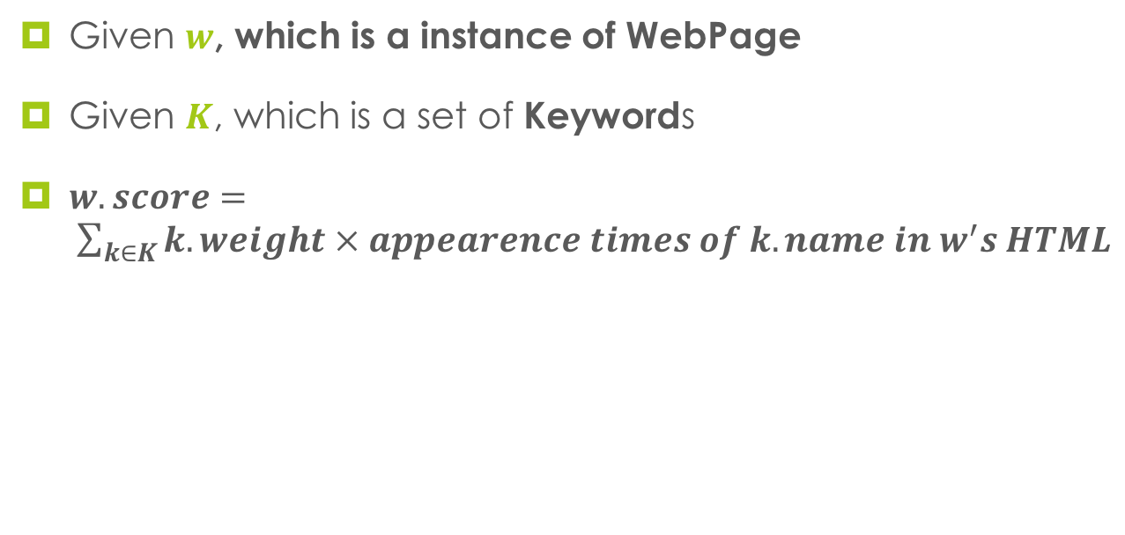
How to: calculate WebPage’s scroe

Slide 5
Class: WebNode
WebNode is a tree node structure defined as:
{
WebNode parent;
List<WebNode> children;
WebPage webPage;
double nodeScore; // = webPage.score + all children’s nodeScore
}

Slide 6
Class: WebTree
WebTree is a data structure defined as:
{
WebNode root;
}

Slide 7
I/O Example
Input: A set of keywords, the size of this set is N
[N] [keyword.name1 keyword.weight1] [name2 weight2] […]…
2 Fang 3.3 Yu 4.4

