Slide 1

Legacy (semi)Agentic PT Pipeline
Agentic Performance Testing Pipeline
System Architecture, Pipeline Flow & Phase Diagrams
CTx CQE Performance Engineering & Cybersecurity
AT&T | March 2026
1
Agentic Workflow for Performance Engineering / March 2026 / © 2026 AT&T Intellectual Property - AT&T Proprietary (Internal Use Only)

Slide 2
What is the Legacy Agentic Pipeline?
Semi-agentic performance testing for legacy systems
7
Pipeline phases
Story analysis through postmortem, each with HITL gate
The Legacy Agentic Pipeline is an LLM-powered system that automates the end-to-end performance testing lifecycle for AT&T’s CTx legacy stack — spanning OPUS frontends, Middleware (CSI, BPM, CAS etc.) , and backend systems (BSSe, TLG, etc).
✓
Analyst as gatekeeper
Reviews, approves, or modifies every phase output
The system is designed as a human-in-the-loop collaboration, not a fully autonomous agent. A performance test analyst serves as the gatekeeper at every phase — reviewing LLM-generated outputs, approving or modifying plans, and making the final call on go/no-go decisions. The AI handles the repetitive, data-intensive work (context gathering, script generation, real-time monitoring, report assembly); the human provides judgment, institutional knowledge, and accountability.
22+
Legacy systems in scope
OPUS, CSI, TLG, BSSe, GDDN, and 17+ more
AI
Azure OpenAI GPT-4o
As confidence grows through successive test cycles, the HITL gates can be progressively relaxed — moving from mandatory approval to exception-based review — but the analyst always retains override authority.
Reasoning + code generation within AT&T’s Azure tenant
↻
Self-improving
Lessons from each cycle feed back into future runs via RAG
Target deployment: end of Q3 2026
2
Agentic Workflow for Performance Engineering / March 2026 / © 2026 AT&T Intellectual Property - AT&T Proprietary (Internal Use Only)

Slide 3
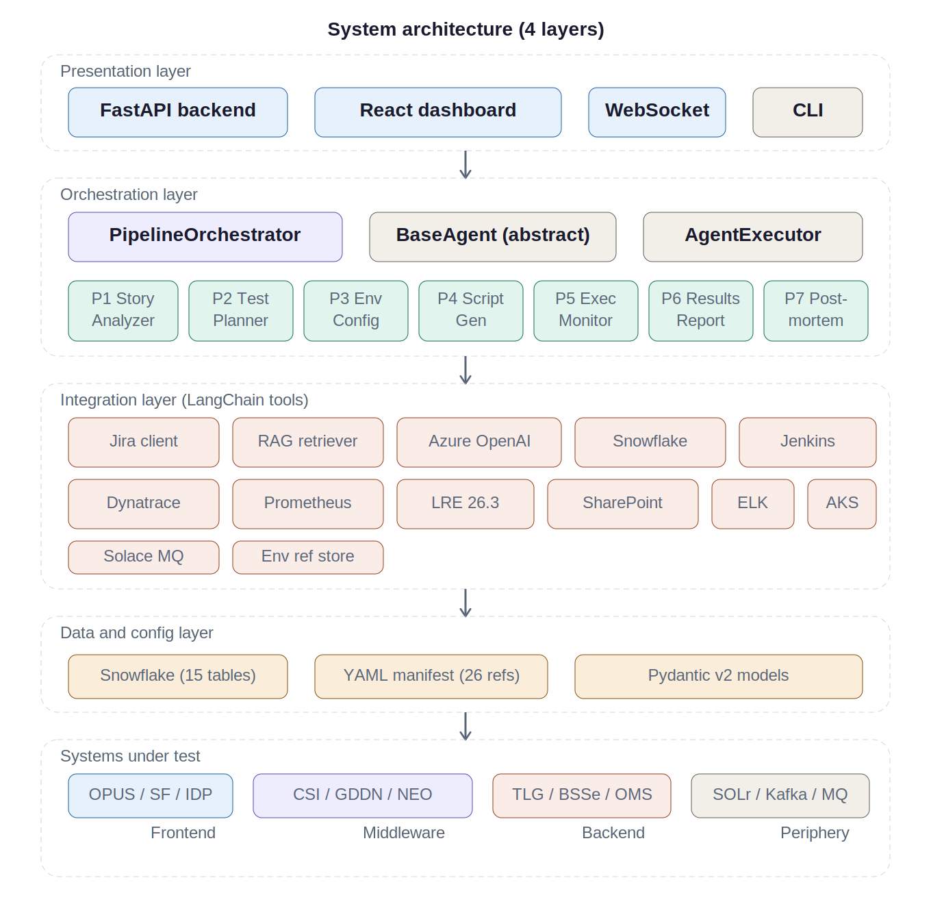
System architecture — 4-layer stack
Presentation
FastAPI + React + WebSocket + CLI
Orchestration
PipelineOrchestrator + 7 BaseAgent subclasses
Integration
13 LangChain tool-wrapped clients
Data / Config
Snowflake (15 tables) + YAML manifest (26 refs)
5
Agentic Workflow for Performance Engineering / March 2026 / © 2026 AT&T Intellectual Property - AT&T Proprietary (Internal Use Only)

Slide 4
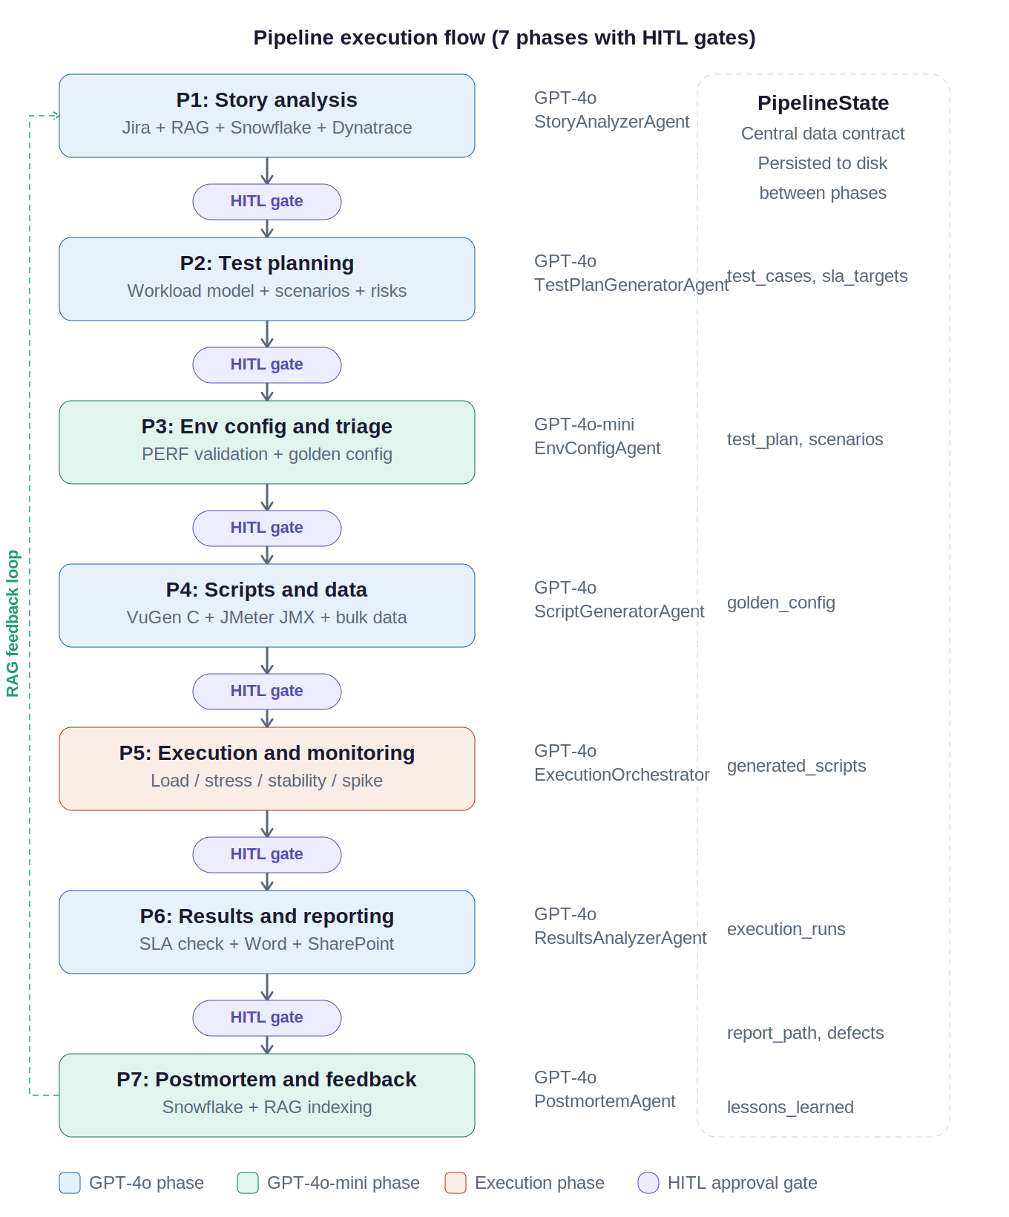
Pipeline flow — 7 phases with HITL gates
P1
Story analysis
Jira → RAG → Snowflake → Dynatrace
P2
Test planning
Workload model + 4 scenario types
P3
Env config
PERF validation + golden config
P4
Scripts & data
VuGen C + JMeter JMX + bulk data
P5
Execution
Load → Stress → Endurance → Spike
P6
Results
SLA analysis + GO/NO-GO verdict
P7
Postmortem
Snowflake + RAG feedback loop
8
Agentic Workflow for Performance Engineering / March 2026 / © 2026 AT&T Intellectual Property - AT&T Proprietary (Internal Use Only)

Slide 5
Current project status — progress, roadblocks & path forward
COMPONENT READINESS
HITL Dashboard (React + FastAPI)
90%
Agent Codebase (LangChain / Azure OpenAI)
50%
Tools / Environment Integrations
5%
Active Roadblocks
Feasible — Not Yet Integrated
MS Graph API not exposed internally
No MCP path to SharePoint, tWiki, or Teams artifacts. AskATT API lacks access to these systems. No timeline for exposure.
Workaround: Analyst pastes docs into Dashboard context artifacts.
Jira iTrack API — read-only access
Agents can pull existing stories/defects for analysis but cannot create or update tickets programmatically.
LRE APIs not currently exposed
LRE 26.3 upgrade (planned H2 2026) should enable MCP connectivity, subject to governance approval.
AI Governance approval pending
Full agentic workflow must be reviewed and approved before production deployment.
APIs are accessible or proven; not yet wired into the agent pipeline:
Azure OpenAI (GPT-4o)
Core LLM reasoning engine. AT&T Azure tenant available.
Snowflake Data Warehouse
Baselines, golden configs, execution results, postmortem archival.
Dynatrace + Prometheus + ELK
Real-time monitoring, service topology, log/resource analysis.
Jenkins (Config Checker + JMeter trigger)
Automated daily drift checks and test execution orchestration.
Primary bottleneck is tool/environment integration — the codebase and dashboard are ahead of the connectivity layer.
5
Agentic Workflow for Performance Engineering / March 2026 / © 2026 AT&T Intellectual Property - AT&T Proprietary (Internal Use Only)

Slide 6
Dependency matrix — API, infrastructure & governance
Phase | Azure OpenAI | Jira | RAG | Snow- flake | Dyna- trace | LRE | Jenkins | Prome- theus | ELK | Share- Point | AKS | App GW | Solace | AI Gov | CSTEM | LRE Slot
P1 Story | C | C | R | R | R |  |  |  |  |  |  |  |  | C
P2 Plan | C | R | R | R | R
P3 Env | C |  |  | R |  |  | O |  |  |  | C | R | O |  | C
P4 Scripts | C |  |  |  |  | O
P5 Exec | C | R |  |  | C | C | C | C | R |  |  |  |  |  |  | C
P6 Results | C | R | R | C |  |  |  |  |  | C
P7 Postmort | C |  | C | C
C Critical path R Required O Optional / conditional
Phase 5 is the dependency bottleneck — 6 critical-path deps. RAG write access is Phase 7 only. Phase 3 owns infra validation (AKS, App GW, Solace). CSTEM coordination is a human dependency — often the longest wall-clock delay.
17
Agentic Workflow for Performance Engineering / March 2026 / © 2026 AT&T Intellectual Property - AT&T Proprietary (Internal Use Only)

Slide 7
Individual Phase Details
Target deployment: end of Q3 2026
CTx CQE Performance Engineering & Cybersecurity AT&T
18
Agentic Workflow for Performance Engineering / March 2026 / © 2026 AT&T Intellectual Property - AT&T Proprietary (Internal Use Only)

Slide 8
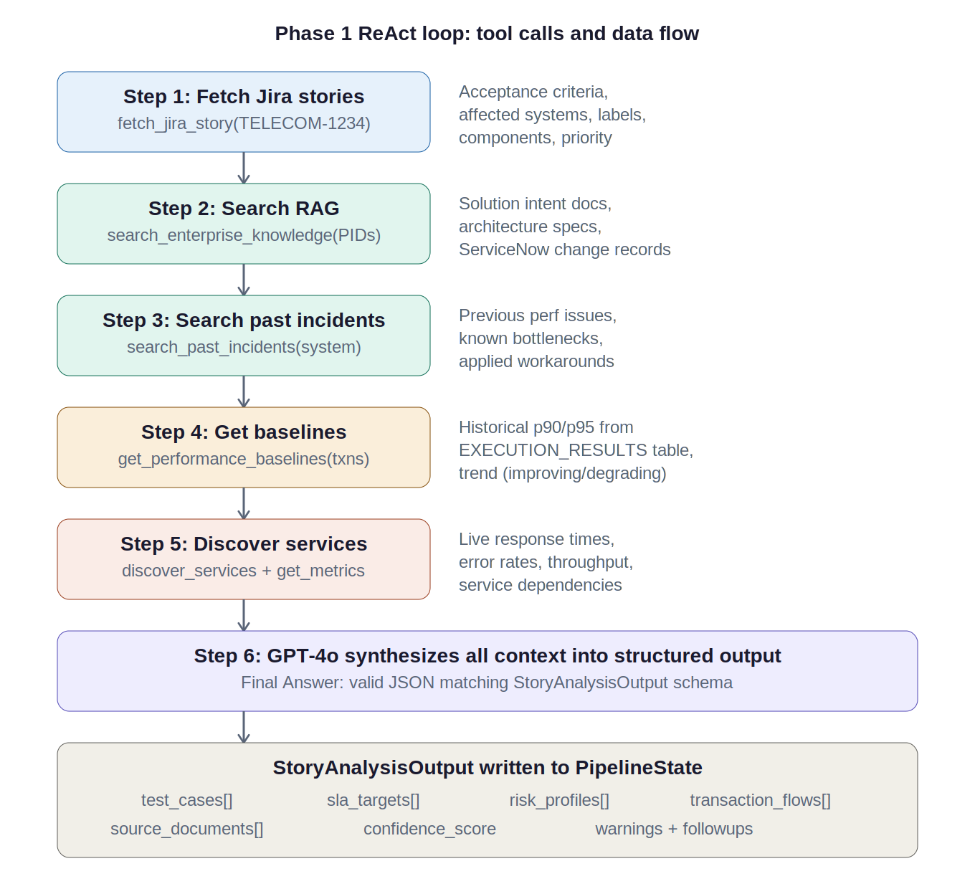
Phase 1 — Story analysis: ReAct loop and data flow
Jira fetch
REST /api/2/issue/{key} with renderedFields
RAG search
Azure AI Search, semantic ranking, 4K char truncation
Past incidents
ServiceNow-filtered search for degradation history
Baselines
Snowflake 10-run rolling avg + trend detection
Dynatrace
Service topology + 24hr p50/p90/p95 metrics
LLM synthesis
TestCase objects with SLA, risk, harness, data reqs
9
Agentic Workflow for Performance Engineering / March 2026 / © 2026 AT&T Intellectual Property - AT&T Proprietary (Internal Use Only)

Slide 9
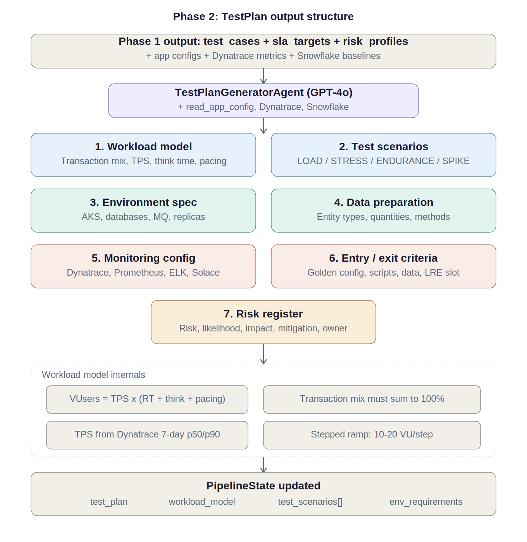
Phase 2 — Test planning: TestPlan output structure
Workload model
VUsers = TPS × (RT + think + pacing). Mix sums to 100%.
Test scenarios
LOAD (30m) / STRESS / ENDURANCE (1–4hr) / SPIKE (3×)
Environment spec
AKS namespaces, replicas, DB connections, MQ
Risk register
Mandatory: TLG connection pool. Per-system risks.
10
Agentic Workflow for Performance Engineering / March 2026 / © 2026 AT&T Intellectual Property - AT&T Proprietary (Internal Use Only)

Slide 10
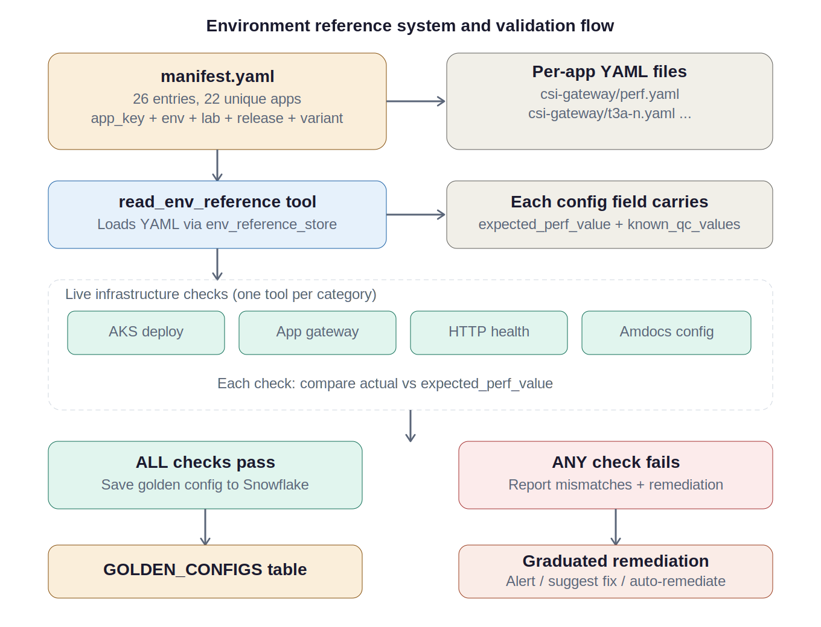
Phase 3 — Environment config: validation and golden config
Critical QC detection rule
ALL configs must point to PERF, not QC. Any qc2/qc3/QC3QM/qc-vpn pattern = CRITICAL mismatch.
Manifest
26 entries, 22 apps, multi-lab support
Validation
AKS, App Gateway, Amdocs, Solace, HTTP health
Golden config
Saved to Snowflake GOLDEN_CONFIGS if all pass
Drift checks
Jenkins cron 06:00 UTC, daily after golden config
Remediation
ALERT_ONLY → SUGGEST_FIX → AUTO_REMEDIATE
11
Agentic Workflow for Performance Engineering / March 2026 / © 2026 AT&T Intellectual Property - AT&T Proprietary (Internal Use Only)

Slide 11
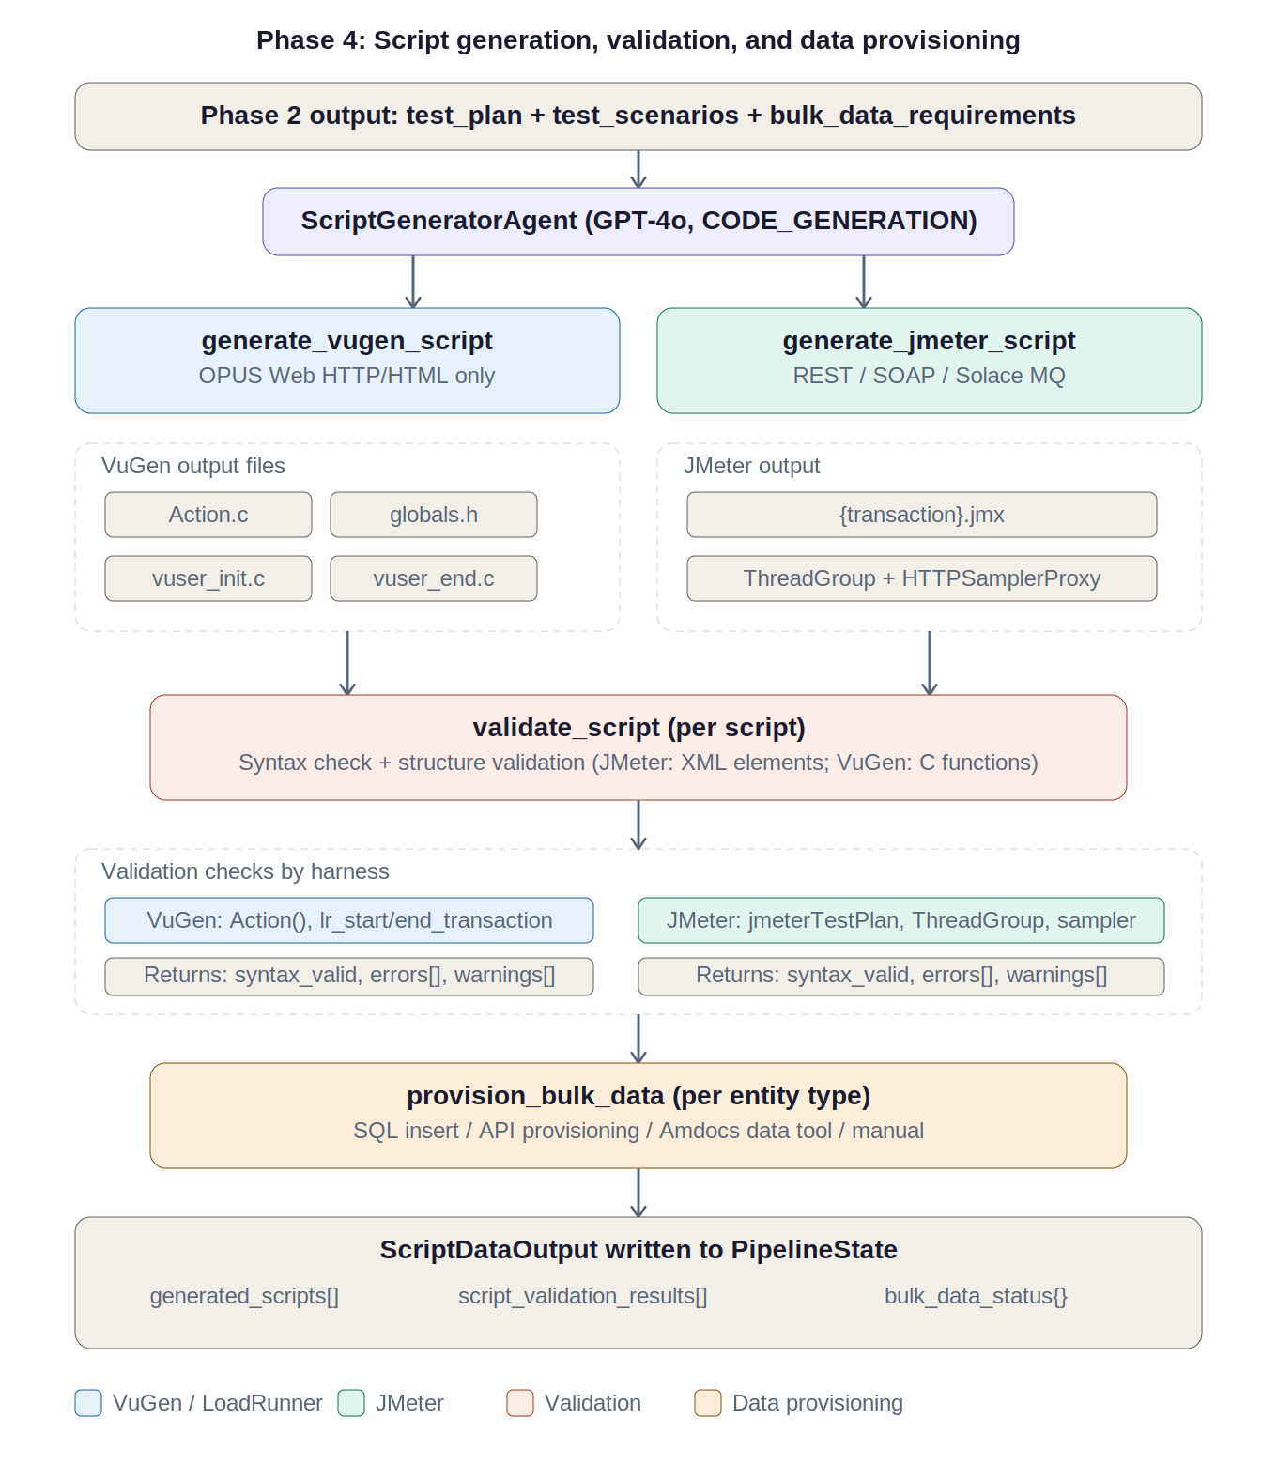
Phase 4 — Script generation, validation & data provisioning
VuGen C
Action.c, globals.h, vuser_init.c, vuser_end.c with correlation + transactions
JMeter JMX
ThreadGroup with ${__P()} properties, HTTPSamplerProxy, CSV Data Set
Validation
Syntax + structure check per harness (XML elements / C functions)
Data provisioning
SQL Insert / API / Amdocs Tools / Manual. 100/batch rate limit.
Design choice
LLM reasons about what to generate; helper functions build the code.
12
Agentic Workflow for Performance Engineering / March 2026 / © 2026 AT&T Intellectual Property - AT&T Proprietary (Internal Use Only)

Slide 12
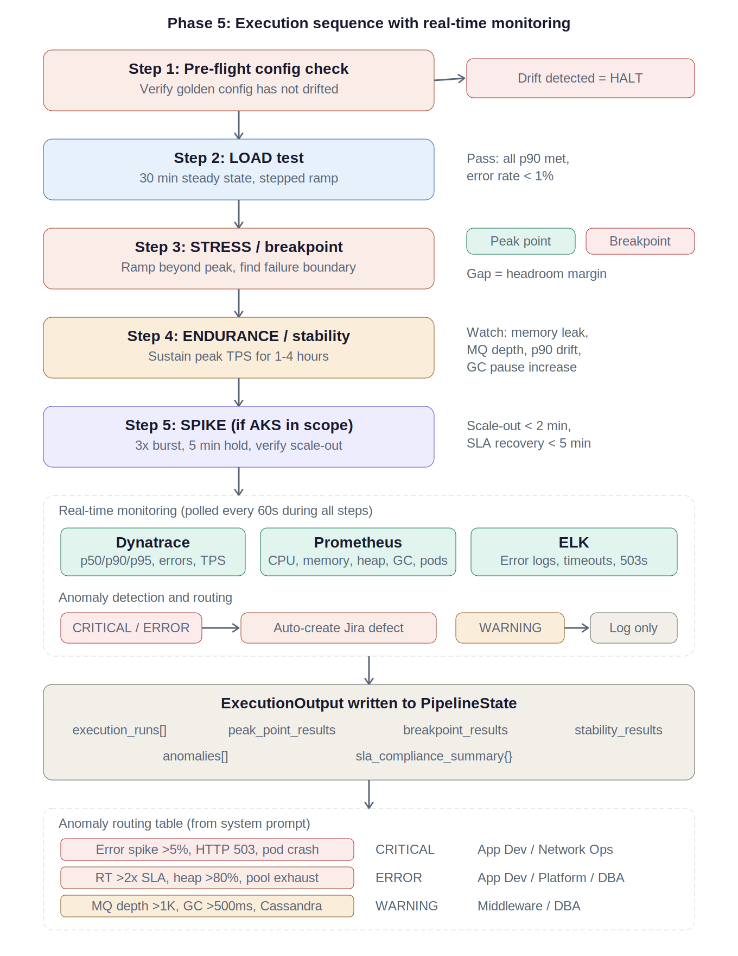
Phase 5 — Execution sequence with real-time monitoring
Pre-flight
Verify golden config. Drift = HALT.
LOAD (30 min)
All p90 met, error <1%. Stepped ramp.
STRESS
Peak Point + Breakpoint. Gap = headroom.
ENDURANCE
1–4 hr. Memory, MQ depth, p90 drift, GC.
SPIKE
3× burst if AKS. Scale-out <2min.
Monitoring
Dynatrace + Prometheus + ELK every 60s.
13
Agentic Workflow for Performance Engineering / March 2026 / © 2026 AT&T Intellectual Property - AT&T Proprietary (Internal Use Only)

Slide 13
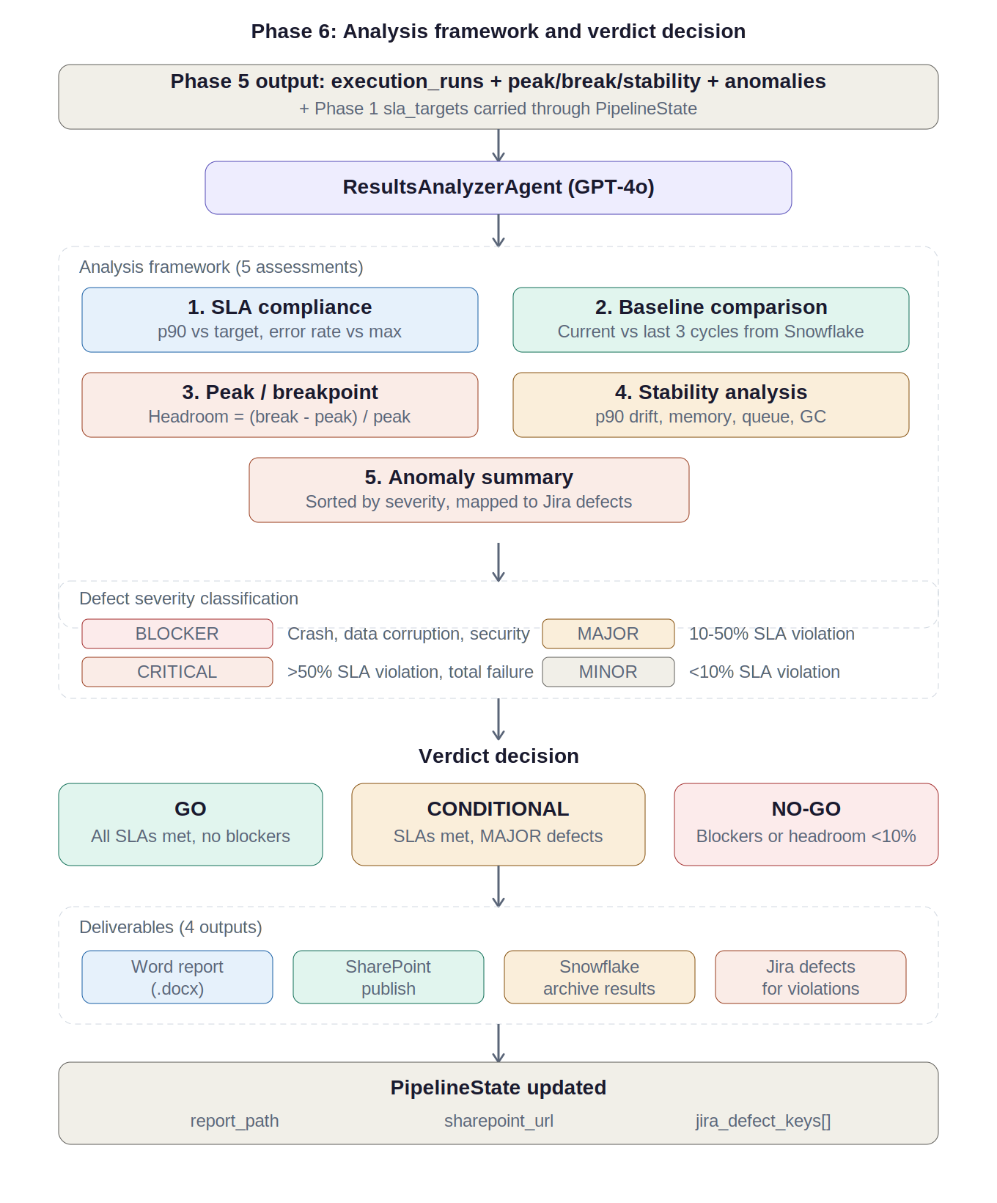
Phase 6 — Results analysis: framework and verdict
GO
COND.
NO-GO
All SLAs
>20% head
MAJOR
defects
Blockers
<10% head
1. SLA compliance — deviation per transaction
2. Baseline comparison — IMPROVING / STABLE / DEGRADING
3. Peak/breakpoint — headroom margin calculation
4. Stability drift — p90, memory, MQ, GC trends
5. Anomaly summary — sorted, mapped to Jira defects
Deliverables: Word → SharePoint → Snowflake → Jira defects
14
Agentic Workflow for Performance Engineering / March 2026 / © 2026 AT&T Intellectual Property - AT&T Proprietary (Internal Use Only)

Slide 14
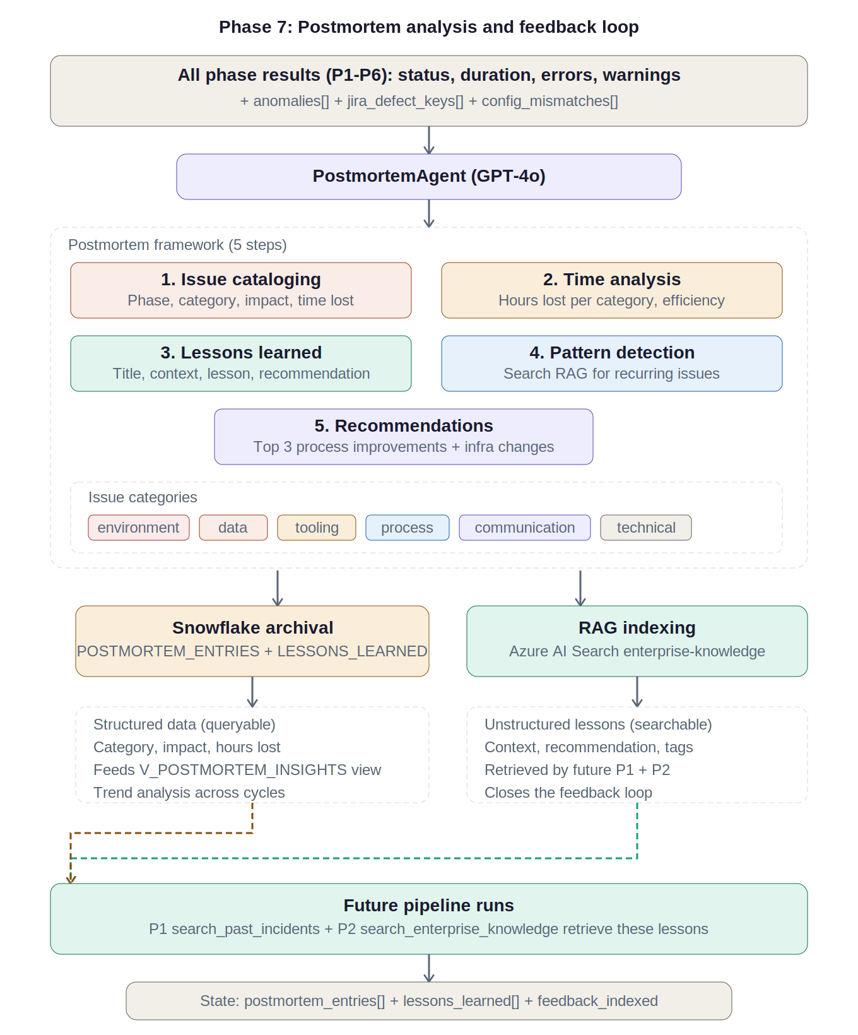
Phase 7 — Postmortem analysis and feedback loop
Issue cataloging
6 categories: env, data, tooling, process, comm, technical
Time analysis
Efficiency ratio target >80%. Hours lost per category.
Lessons learned
Structured: title, context, lesson, recommendation, tags
Pattern detection
Searches RAG for recurring issues across prior cycles
Dual archival
Snowflake (structured) + RAG (searchable). Closes the loop.
15
Agentic Workflow for Performance Engineering / March 2026 / © 2026 AT&T Intellectual Property - AT&T Proprietary (Internal Use Only)

