Slide 1
Legacy Agentic Pipeline v2.0
Agentic Performance Testing Pipeline
System Architecture, Pipeline Flow & Phase Diagrams
CTx CQE Performance Engineering & Cybersecurity
AT&T | March 2026

Slide 2
What is the Legacy Agentic Pipeline?
Semi-agentic performance testing for legacy telecom systems
7
Pipeline phases
Story analysis through postmortem, each with HITL gate
The Legacy Agentic Pipeline is an LLM-powered system that automates the end-to-end performance testing lifecycle for AT&T’s CTx legacy telecom stack — spanning Salesforce/Mulesoft frontends, Azure AKS microservices, and Amdocs backends (BSSe, TLG, OMS).
✓
Analyst as gatekeeper
Reviews, approves, or modifies every phase output
The system is designed as a human-in-the-loop collaboration, not a fully autonomous agent. A performance test analyst serves as the gatekeeper at every phase — reviewing LLM-generated outputs, approving or modifying plans, and making the final call on go/no-go decisions. The AI handles the repetitive, data-intensive work (context gathering, script generation, real-time monitoring, report assembly); the human provides judgment, institutional knowledge, and accountability.
22
Legacy systems in scope
OPUS, CSI, TLG, BSSe, GDDN, and 17 more
AI
Azure OpenAI GPT-4o
As confidence grows through successive test cycles, the HITL gates can be progressively relaxed — moving from mandatory approval to exception-based review — but the analyst always retains override authority.
Reasoning + code generation within AT&T’s Azure tenant
↻
Self-improving
Lessons from each cycle feed back into future runs via RAG
Target deployment: end of Q3 2026
CTx CQE Performance Engineering & Cybersecurity | AT&T | March 2026

Slide 3
Agenda
01
System architecture
4-layer stack, technology choices, LLM task routing
02
Pipeline flow
7-phase execution with HITL gates and PipelineState
03
Phase 1 — Story analysis
Jira + RAG + Snowflake + Dynatrace context gathering
04
Phase 2 — Test planning
Workload model, scenarios, environment spec, risk register
05
Phase 3 — Env config
PERF validation, golden config, QC detection, drift checks
06
Phase 4 — Scripts & data
VuGen C + JMeter JMX generation, validation, provisioning
07
Phase 5 — Execution
Load, stress, endurance, spike with real-time monitoring
08
Phases 6–7 — Results & postmortem
GO/NO-GO verdict, feedback loop, RAG indexing
09
Dependency matrix
External system and governance dependencies per phase
CTx CQE Performance Engineering & Cybersecurity | AT&T | March 2026

Slide 4
System architecture
4-layer component stack with 13 integration clients
Legacy Agentic Pipeline v2.0

Slide 5
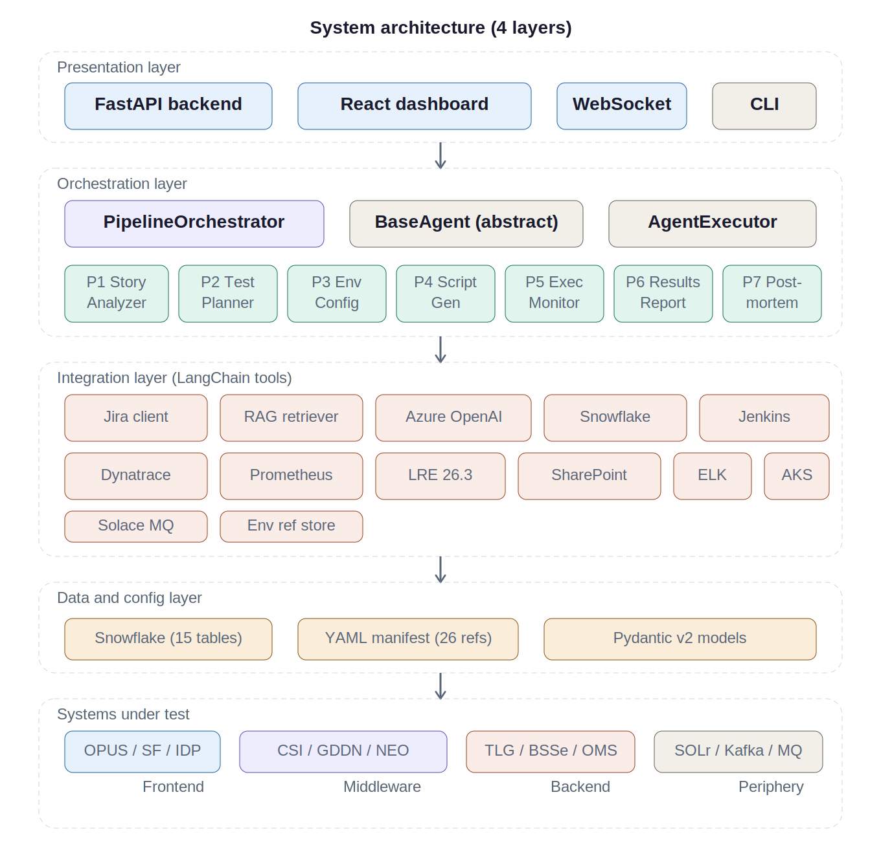
System architecture — 4-layer stack
Presentation
FastAPI + React + WebSocket + CLI
Orchestration
PipelineOrchestrator + 7 BaseAgent subclasses
Integration
13 LangChain tool-wrapped clients
Data / Config
Snowflake (15 tables) + YAML manifest (26 refs)
CTx CQE Performance Engineering & Cybersecurity | AT&T | March 2026

Slide 6
LLM task routing — cost-optimized model selection
Task type
Model
Max tokens
Used in
COMPLEX_REASONING
GPT-4o
8,192
Phases 1, 2, 5, 6, 7
CODE_GENERATION
GPT-4o
8,192
Phase 4
EXTRACTION
GPT-4o-mini
4,096
Phase 3
CLASSIFICATION
GPT-4o-mini
1,024
Routing, triage
FORMATTING
GPT-4o-mini
4,096
Reports, tickets
Temperature fixed at 0.1 across all tasks. Azure OpenAI tenant constraint requires all LLM interactions to stay within AT&T's Azure environment. BaseAgent handles lazy LLM initialization, 15-iteration ReAct loop, tenacity retry (3 attempts, 2s–30s exponential backoff), JSON output parsing against Pydantic models, and reasoning trace extraction.
CTx CQE Performance Engineering & Cybersecurity | AT&T | March 2026

Slide 7
Pipeline execution flow
7 phases in strict sequence with HITL approval gates
Legacy Agentic Pipeline v2.0

Slide 8
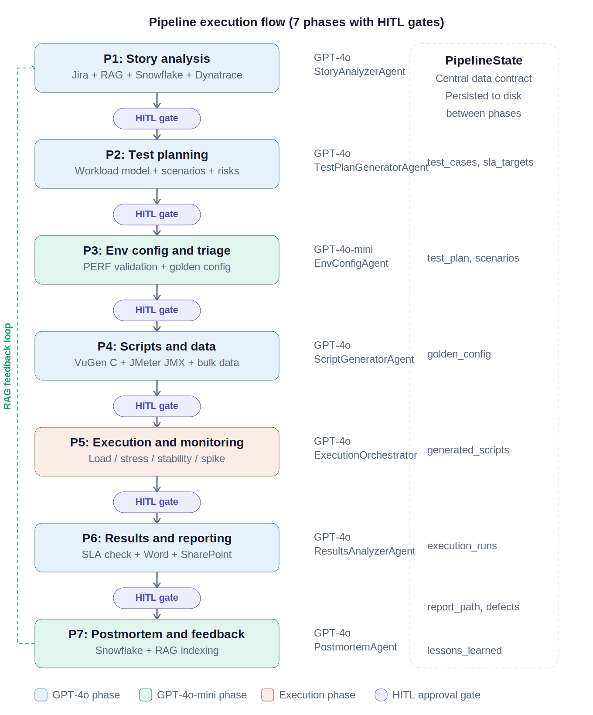
Pipeline flow — 7 phases with HITL gates
P1
Story analysis
Jira → RAG → Snowflake → Dynatrace
P2
Test planning
Workload model + 4 scenario types
P3
Env config
PERF validation + golden config
P4
Scripts & data
VuGen C + JMeter JMX + bulk data
P5
Execution
Load → Stress → Endurance → Spike
P6
Results
SLA analysis + GO/NO-GO verdict
P7
Postmortem
Snowflake + RAG feedback loop
CTx CQE Performance Engineering & Cybersecurity | AT&T | March 2026

Slide 9
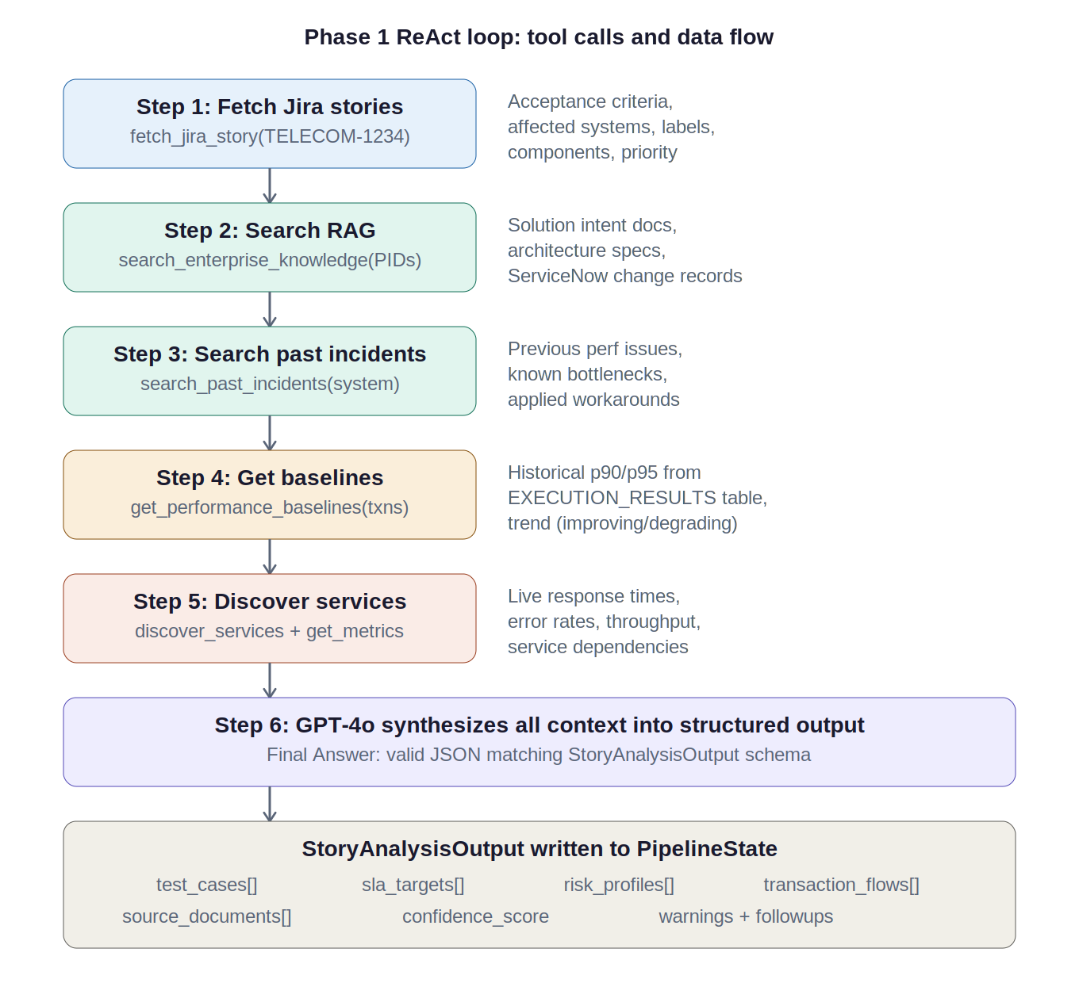
Phase 1 — Story analysis: ReAct loop and data flow
Jira fetch
REST /api/2/issue/{key} with renderedFields
RAG search
Azure AI Search, semantic ranking, 4K char truncation
Past incidents
ServiceNow-filtered search for degradation history
Baselines
Snowflake 10-run rolling avg + trend detection
Dynatrace
Service topology + 24hr p50/p90/p95 metrics
LLM synthesis
TestCase objects with SLA, risk, harness, data reqs
CTx CQE Performance Engineering & Cybersecurity | AT&T | March 2026

Slide 10
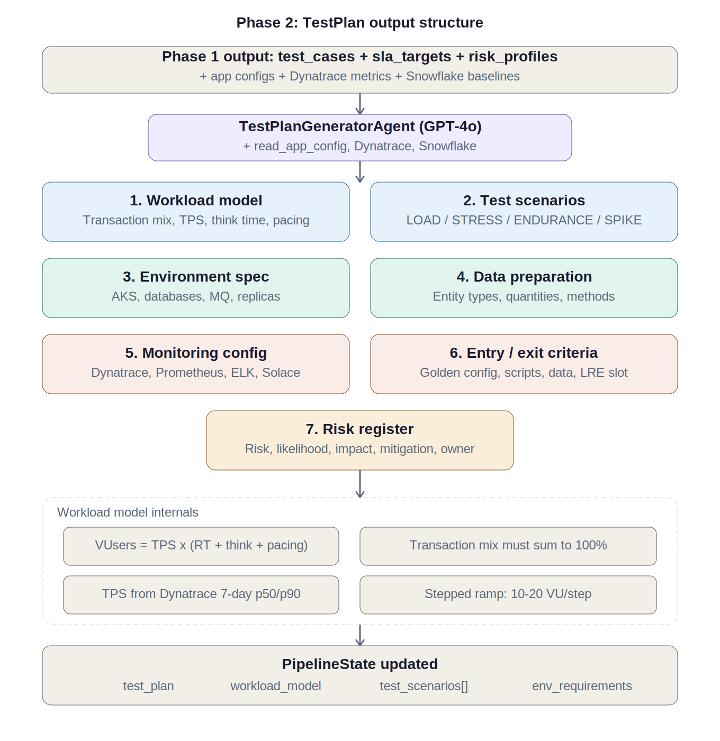
Phase 2 — Test planning: TestPlan output structure
Workload model
VUsers = TPS × (RT + think + pacing). Mix sums to 100%.
Test scenarios
LOAD (30m) / STRESS / ENDURANCE (1–4hr) / SPIKE (3×)
Environment spec
AKS namespaces, replicas, DB connections, MQ
Risk register
Mandatory: TLG connection pool. Per-system risks.
CTx CQE Performance Engineering & Cybersecurity | AT&T | March 2026

Slide 11
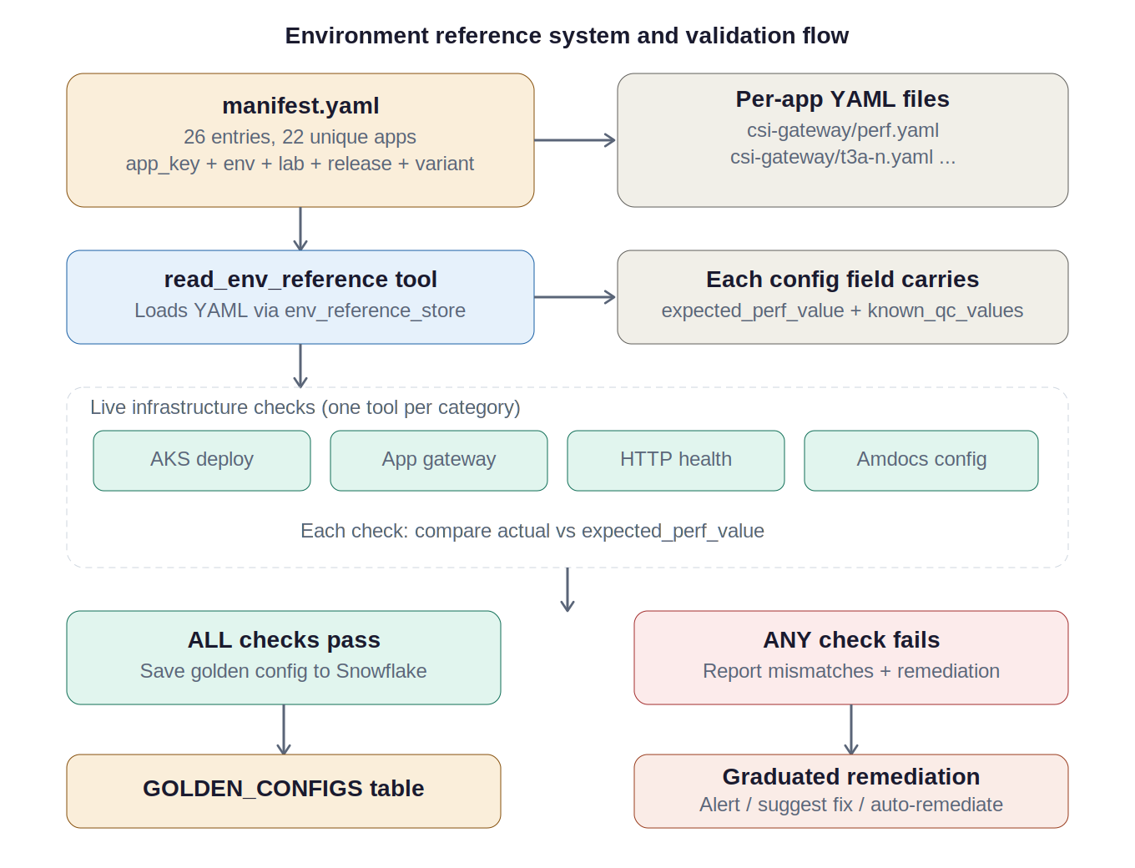
Phase 3 — Environment config: validation and golden config
Critical QC detection rule
ALL configs must point to PERF, not QC. Any qc2/qc3/QC3QM/qc-vpn pattern = CRITICAL mismatch.
Manifest
26 entries, 22 apps, multi-lab support
Validation
AKS, App Gateway, Amdocs, Solace, HTTP health
Golden config
Saved to Snowflake GOLDEN_CONFIGS if all pass
Drift checks
Jenkins cron 06:00 UTC, daily after golden config
Remediation
ALERT_ONLY → SUGGEST_FIX → AUTO_REMEDIATE
CTx CQE Performance Engineering & Cybersecurity | AT&T | March 2026

Slide 12
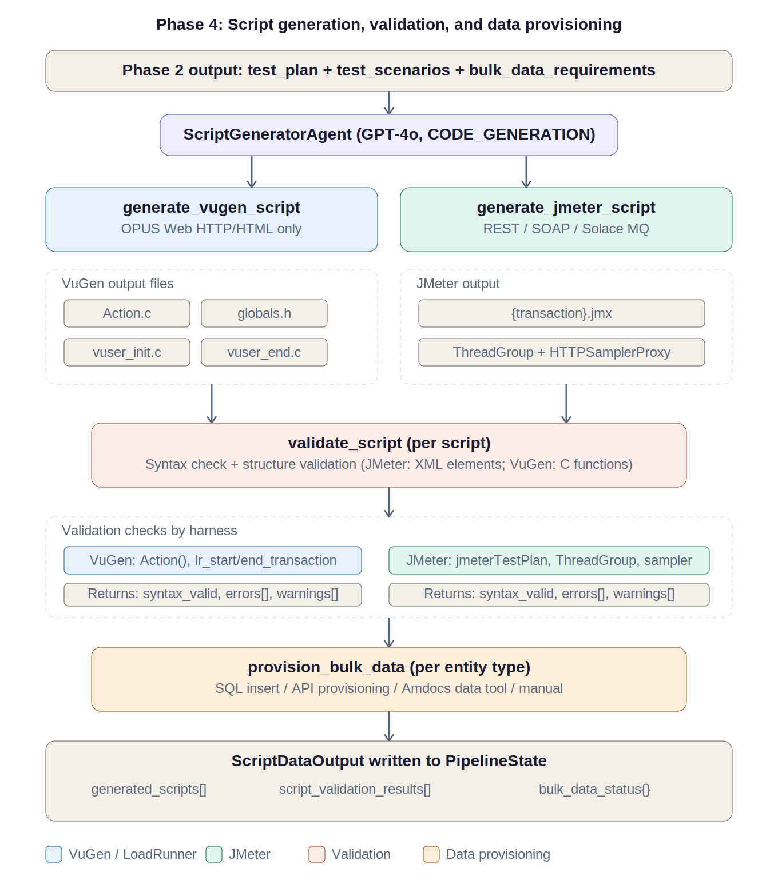
Phase 4 — Script generation, validation & data provisioning
VuGen C
Action.c, globals.h, vuser_init.c, vuser_end.c with correlation + transactions
JMeter JMX
ThreadGroup with ${__P()} properties, HTTPSamplerProxy, CSV Data Set
Validation
Syntax + structure check per harness (XML elements / C functions)
Data provisioning
SQL Insert / API / Amdocs Tools / Manual. 100/batch rate limit.
Design choice
LLM reasons about what to generate; helper functions build the code.
CTx CQE Performance Engineering & Cybersecurity | AT&T | March 2026

Slide 13
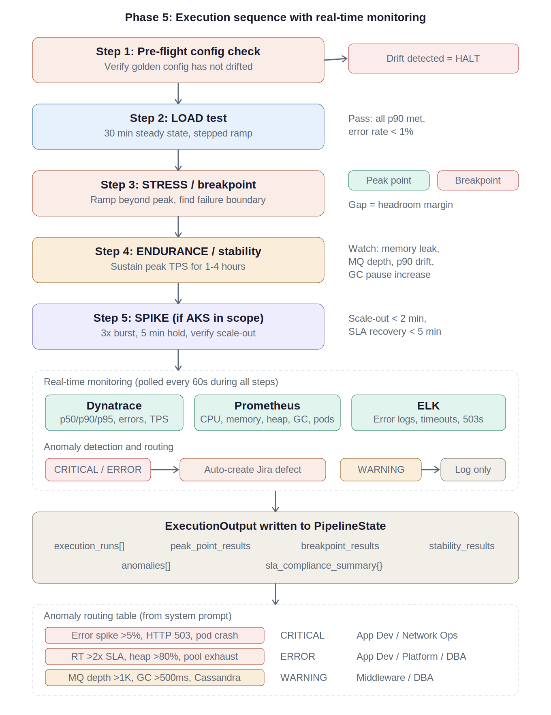
Phase 5 — Execution sequence with real-time monitoring
Pre-flight
Verify golden config. Drift = HALT.
LOAD (30 min)
All p90 met, error <1%. Stepped ramp.
STRESS
Peak Point + Breakpoint. Gap = headroom.
ENDURANCE
1–4 hr. Memory, MQ depth, p90 drift, GC.
SPIKE
3× burst if AKS. Scale-out <2min.
Monitoring
Dynatrace + Prometheus + ELK every 60s.
CTx CQE Performance Engineering & Cybersecurity | AT&T | March 2026

Slide 14
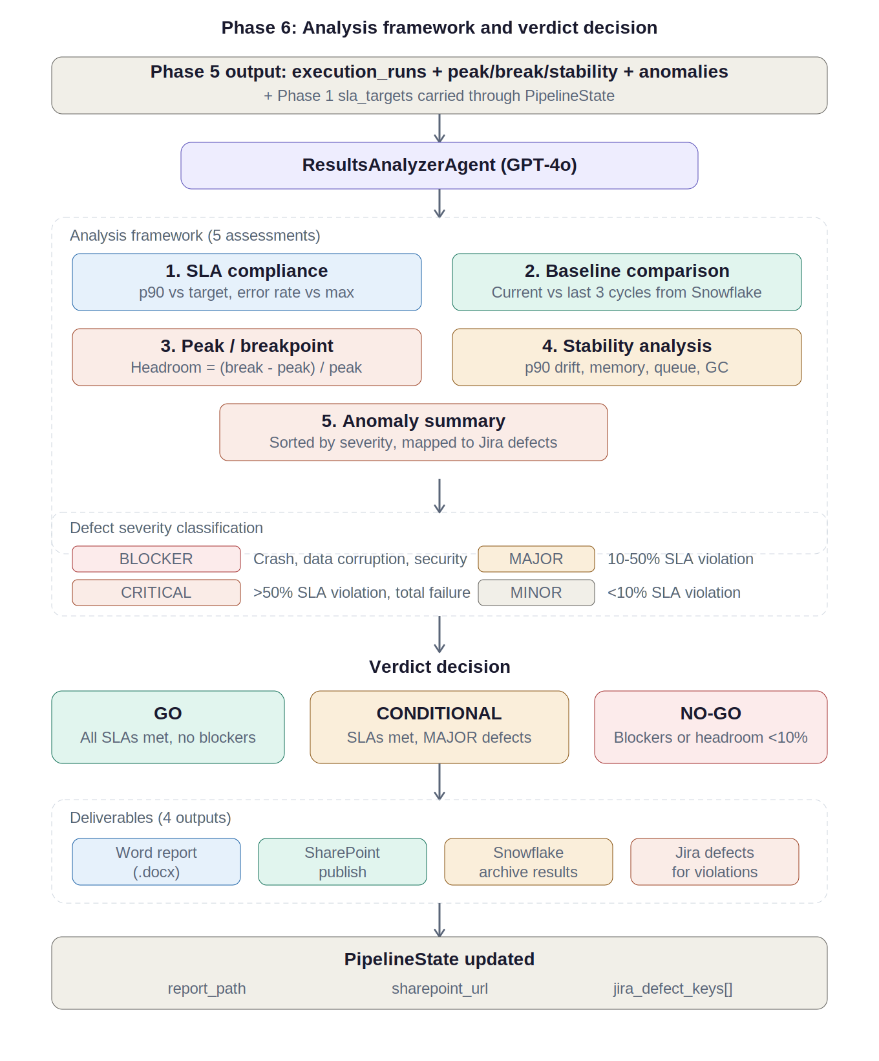
Phase 6 — Results analysis: framework and verdict
GO
COND.
NO-GO
All SLAs
>20% head
MAJOR
defects
Blockers
<10% head
1. SLA compliance — deviation per transaction
2. Baseline comparison — IMPROVING / STABLE / DEGRADING
3. Peak/breakpoint — headroom margin calculation
4. Stability drift — p90, memory, MQ, GC trends
5. Anomaly summary — sorted, mapped to Jira defects
Deliverables: Word → SharePoint → Snowflake → Jira defects
CTx CQE Performance Engineering & Cybersecurity | AT&T | March 2026

Slide 15
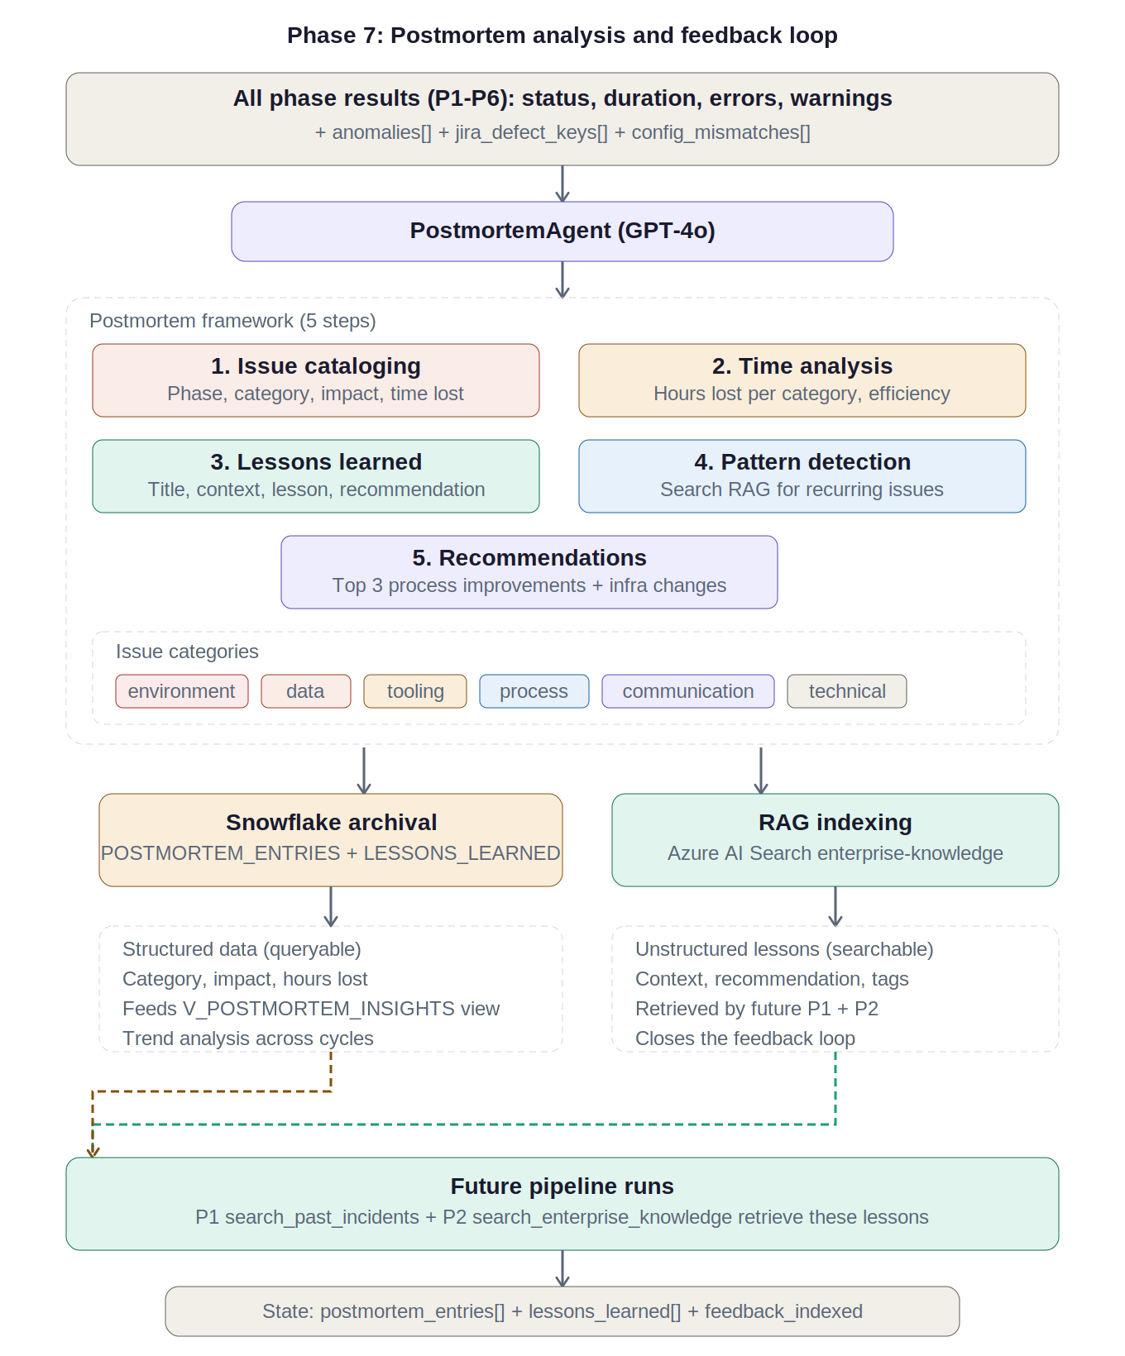
Phase 7 — Postmortem analysis and feedback loop
Issue cataloging
6 categories: env, data, tooling, process, comm, technical
Time analysis
Efficiency ratio target >80%. Hours lost per category.
Lessons learned
Structured: title, context, lesson, recommendation, tags
Pattern detection
Searches RAG for recurring issues across prior cycles
Dual archival
Snowflake (structured) + RAG (searchable). Closes the loop.
CTx CQE Performance Engineering & Cybersecurity | AT&T | March 2026

Slide 16
Dependency matrix
External system and governance dependencies per phase
Legacy Agentic Pipeline v2.0

Slide 17
Dependency matrix — API, infrastructure & governance
Phase | Azure OpenAI | Jira | RAG | Snow- flake | Dyna- trace | LRE | Jenkins | Prome- theus | ELK | Share- Point | AKS | App GW | Solace | AI Gov | CSTEM | LRE Slot
P1 Story | C | C | R | R | R |  |  |  |  |  |  |  |  | C
P2 Plan | C | R | R | R | R
P3 Env | C |  |  | R |  |  | O |  |  |  | C | R | O |  | C
P4 Scripts | C |  |  |  |  | O
P5 Exec | C | R |  |  | C | C | C | C | R |  |  |  |  |  |  | C
P6 Results | C | R | R | C |  |  |  |  |  | C
P7 Postmort | C |  | C | C
C Critical path R Required O Optional / conditional
Phase 5 is the dependency bottleneck — 6 critical-path deps. RAG write access is Phase 7 only. Phase 3 owns infra validation (AKS, App GW, Solace). CSTEM coordination is a human dependency — often the longest wall-clock delay.
CTx CQE Performance Engineering & Cybersecurity | AT&T | March 2026

Slide 18
Legacy Agentic Pipeline v2.0
Target deployment: end of Q3 2026
CTx CQE Performance Engineering & Cybersecurity AT&T

