Slide 1
UML ALERT
SAFETY FIRST!
Over 3500 reports of forcible sex offenses on college campuses across America, up by 50% in 3 years.

Slide 2
MEMBERS
Udit Bhansali
Jason Downing
John(JT) Shepple

Slide 3
OUTLINE
Introduction
Android in short
Problem addressed
Why a smartphone app?
Why UML Alert?
Problem definition
Our Solution
Features
Conclusion

Slide 4
INTRODUCTION
UML Alert is an Android application. It is designed to provide safety to students in hazardous situations.
It helps the users to reach UML Police in an emergency situation at a click of a button.
It uses Android’s Peer-to-Peer (P2P) text, location and data communication protocols.
GPS based tracking of the victims location for up to 1 hour from the moment help was requested.
Notes:
<number>

Slide 5
PROBLEMS ADDRESSED
Being stalked when walking
Attempted assault in a deserted area
Being robbed
Accident
Medical emergency
Being followed by a strange vehicle at night

Slide 6
WHY A SMART PHONE APP?
Over 89% of smartphone users use their smart phones throughout the day
Out of the world’s 4 billion mobile phones in use, 3.05 billion are SMS enabled.
Android has the highest market share of 46.9% among all smart phone platforms.

Slide 7
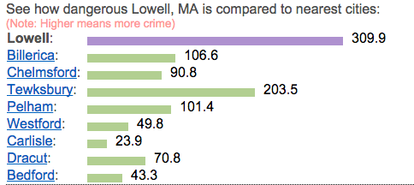
WHY WE NEED UML ALERT??
The crime rate chart comparing Lowell and neighboring cities.

Slide 8
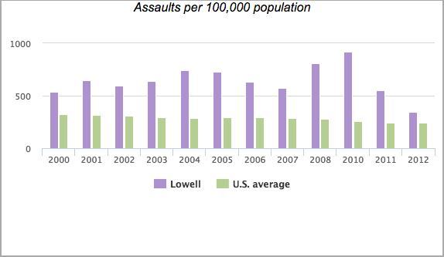
CONTD…

Slide 9
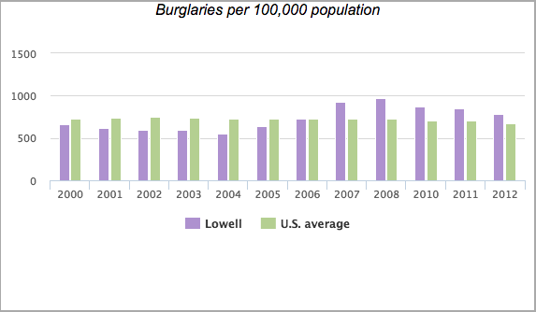
CONTD…

Slide 10
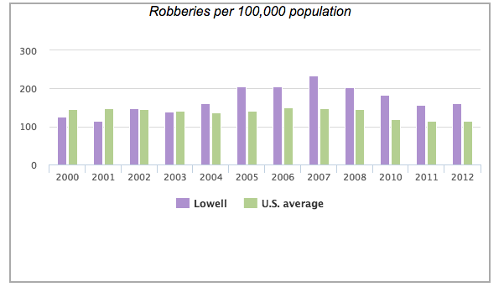
CONTD…

Slide 11
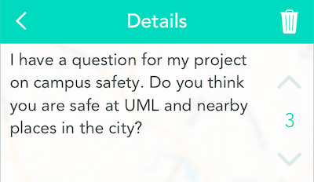
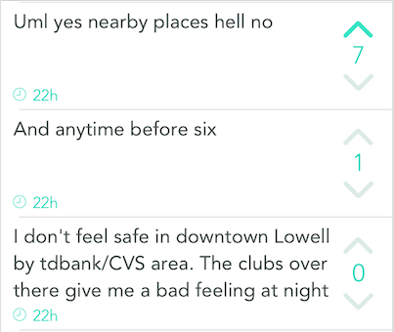
STUDENT RESPONSE ON “YIK YAK”

Slide 12
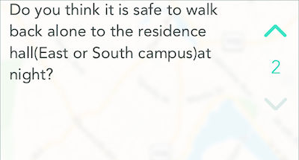
CONTD…

Slide 13
PROBLEM DEFINITION
To develop an application that uses network protocols to speedily send our location(via GPS service provided by the smartphones) to UML Police. The location tracking will be active for 30 mins from the moment when notification is sent, so that Police can track the path. The application can help rescue people from dangerous situations by sending out the location.

Slide 14
OUR SOLUTION
Use of pre-defined emergency messages to be sent when notify button is pressed.
Use of maps to track the victims location for up to 30 mins from the moment the notify button is pressed. The location is sent to UML Police via SMS or network protocol.
You just have the select the message that describes your problem and click on the notify button while you’re busy protecting yourself, running away etc.
Our solution can get help as fast as possible. You don’t have to wait on the phone or look around for a landmark to describe the place.
Notes:
<number>

Slide 15
FEATURES
User can create a profile and add up to 3 photos of themselves for identification purpose. This would help UML Police to identify the victim.
Personal information like name, phone number, blood type will be shared when the police is notified.
User can create its own custom messages and save them. During an emergency the traumatized victim doesn’t have to worry about typing the message.
User Interface will be simple and neat. UML Police will not be required to use a 3rd party device to get the emergency notification.
Possibility of linking student’s UML id# with the account which would help the police to look at students behavior history.

Slide 16
CONCLUSION
UML Alert application can prove to be very useful for student’s safety. Seconds can save a life when minutes are not enough. This application can rescue students who are stuck in a deserted part of the city or in a dangerous situation. As a lot of the people have started using a smartphone, an Android application will be a good way to start with

