Slide 1
HERMES: Using Commit-Issue Linking to Detect Vulnerability-fixing Commit
Truong-Giang Nguyen, Hong Jin Kang, David Lo Singapore Management University
Abhishek Sharma, Andrew E. Santosa, Asankhaya Sharma, Ming Yi Ang
Veracode

Slide 2
Content
Motivation and Challenge
Approach
Experimental result

Slide 3






Motivation
Modern software relies on third-party libraries
Open Source Software (OSS) users are exposed to vulnerabilities (e.g., Log4Shell)
Remote
Code
Execution
Malicious String

Slide 4


Motivation
OSS users must keep up-to-date with vulnerabilities by monitoring public vulnerabilities advisories

Slide 5



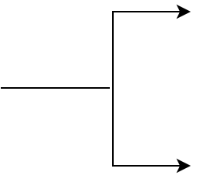

Motivation
Vulnerability disclosure can vary from days to years
CVE-2018-11766 was disclosed two months later after patching
Solution for in-time vulnerability monitoring => Automatically identify vulnerability-fixing commits
Vulnerability-fixing
Non-vulnerability-fixing
Commit

Slide 6
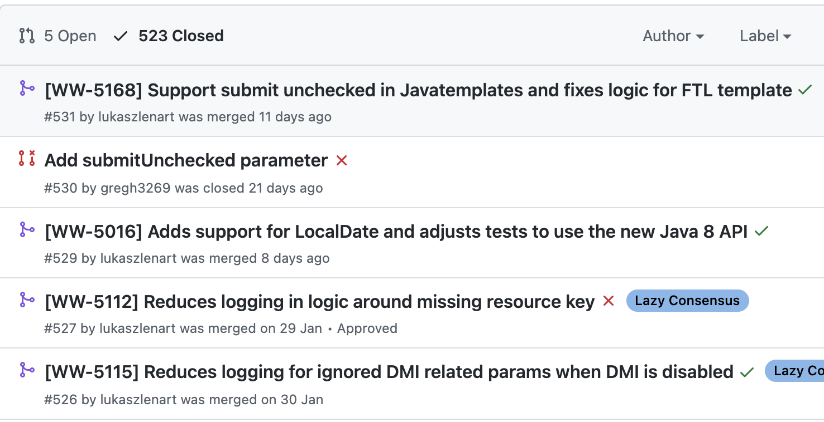
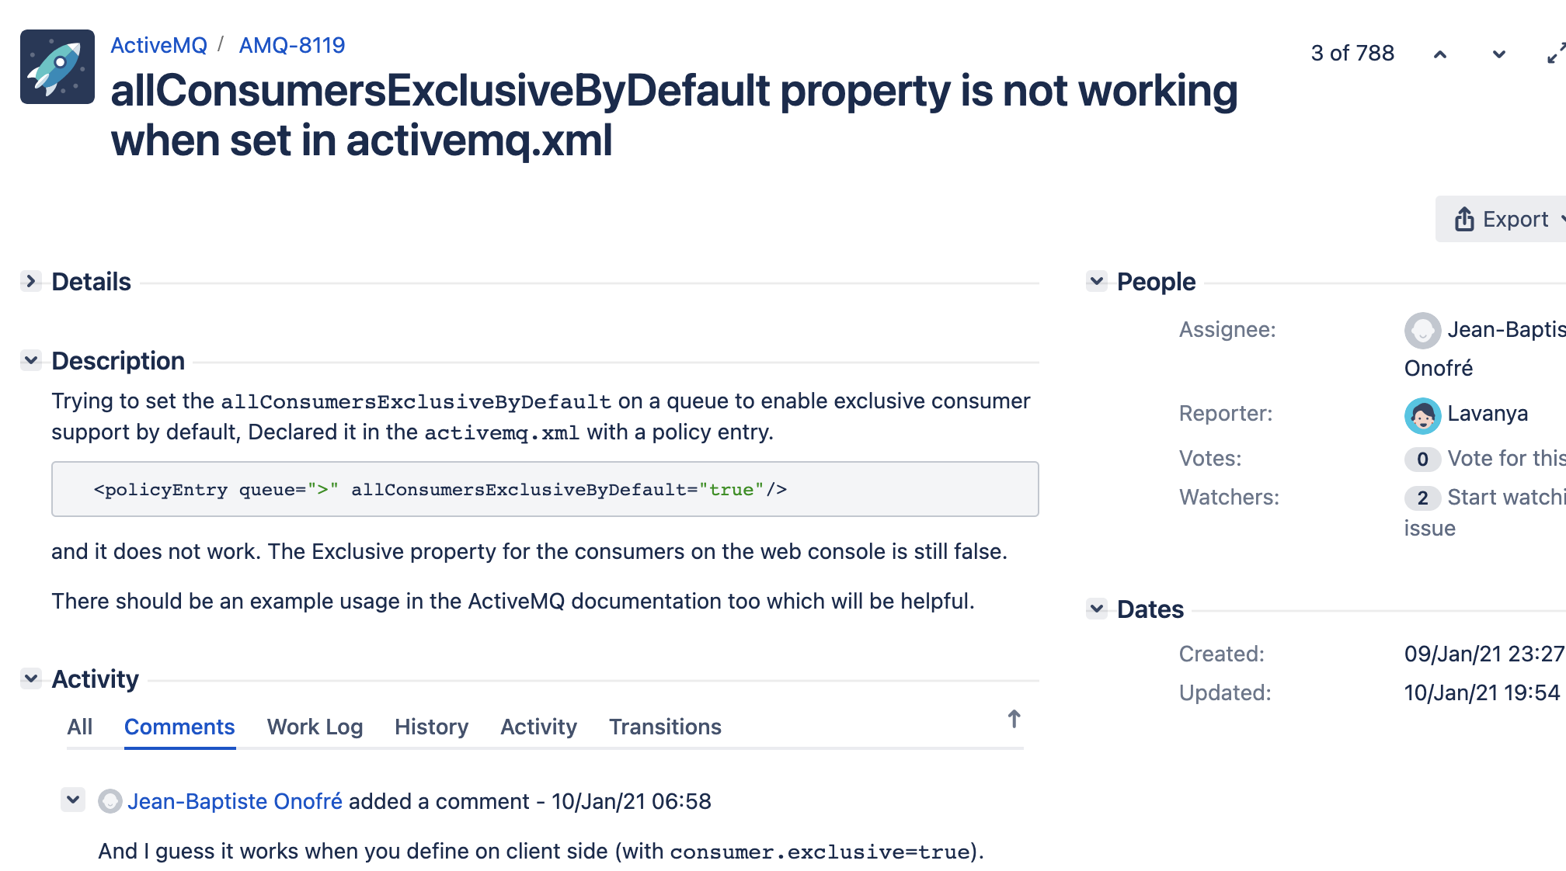
Motivation
Propose techniques rely on commit messages and code changes
Issue trackers contain rich source of information
GitHub issue
JIRA

Slide 7
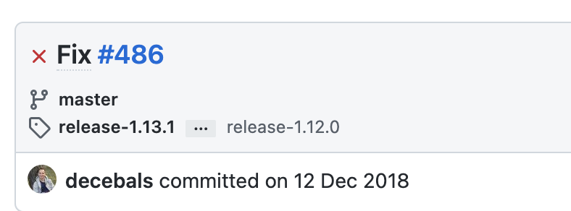
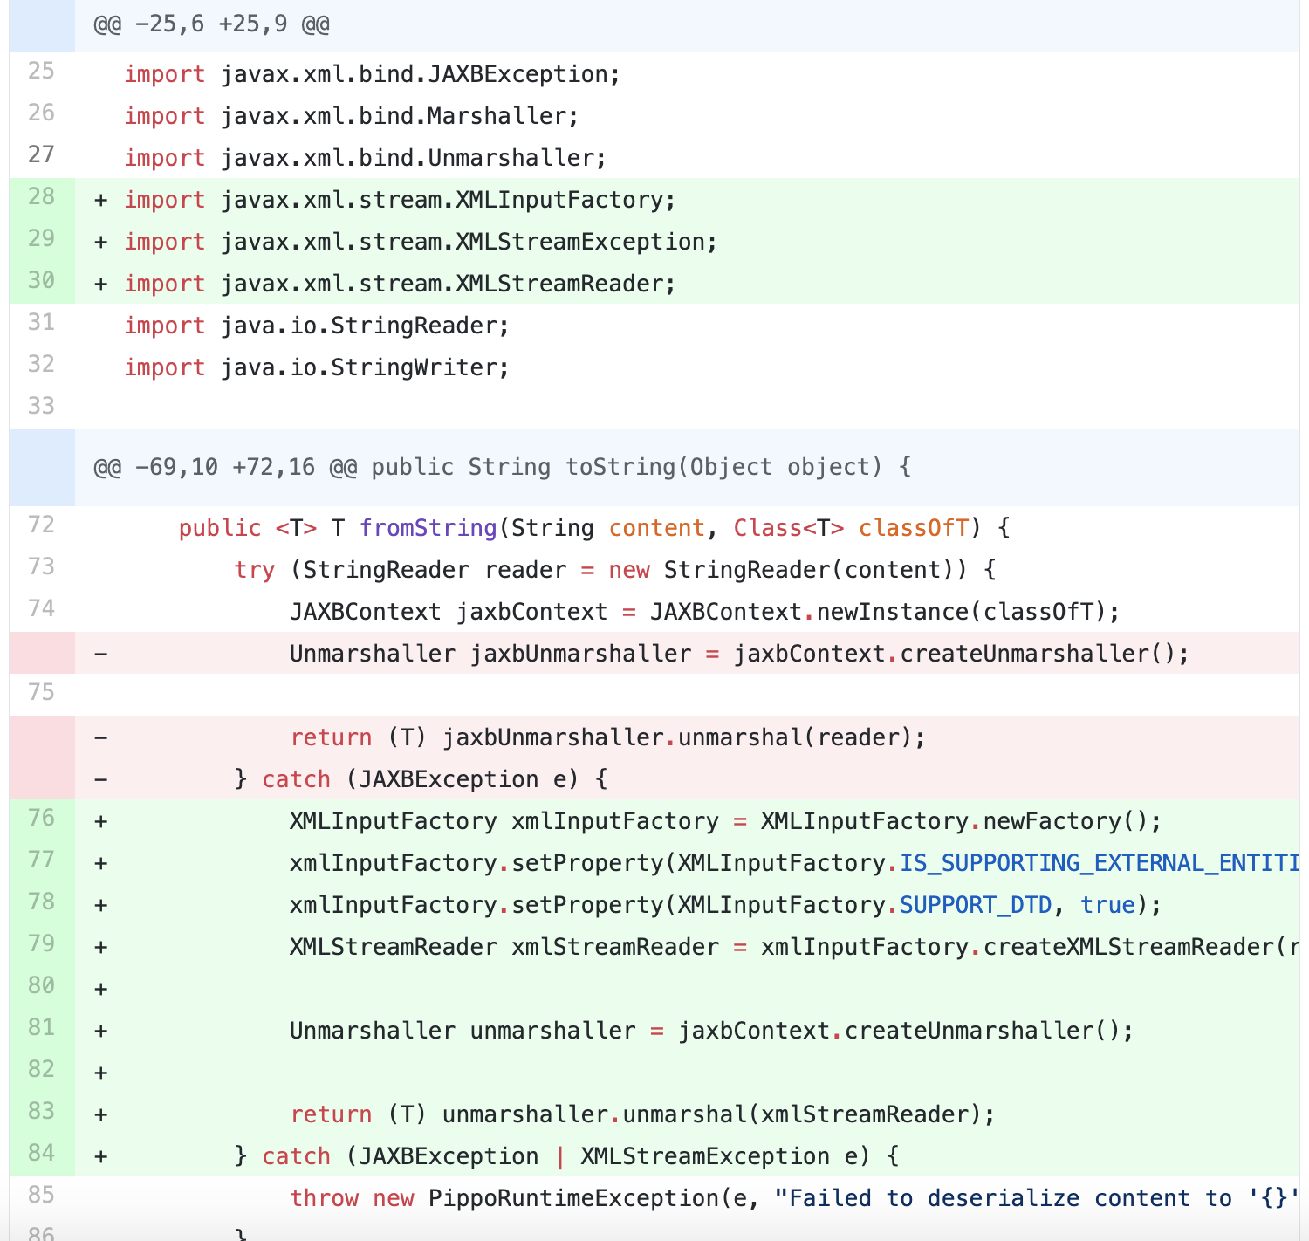
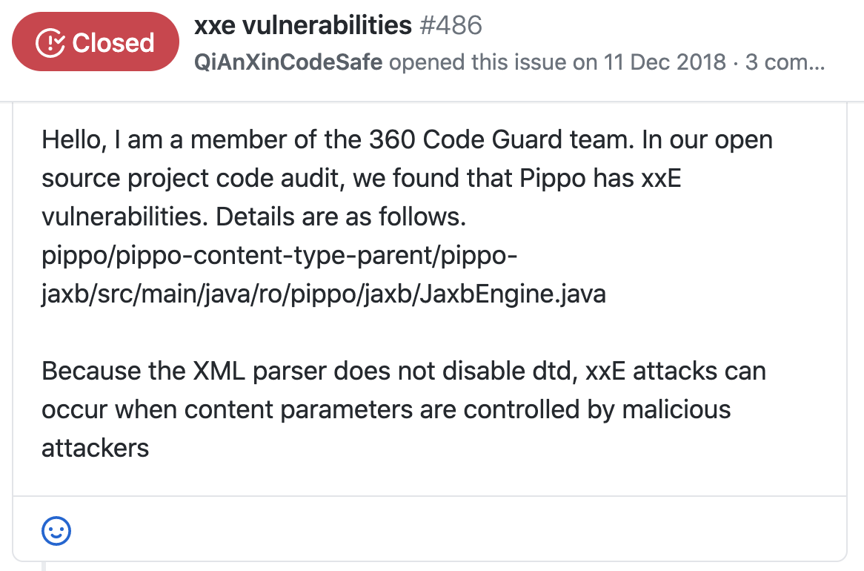
Motivation - Example

Slide 8
Challenge
However, many commits are not linked to issues
The proportion of unlinked commits have been reported from 35% to 40%
In our dataset, nearly 63% of commits are unlinked
Solution: HERMES uses existing commit-issue link recovery technique to infer links between each unlinked commit and an issue that best matches it

Slide 9
Approach
High-level design of HERMES consists of:
An issue linker
Three base classifiers (message classifier, code change classifier, issue classifier)
A joint classifier

Slide 10
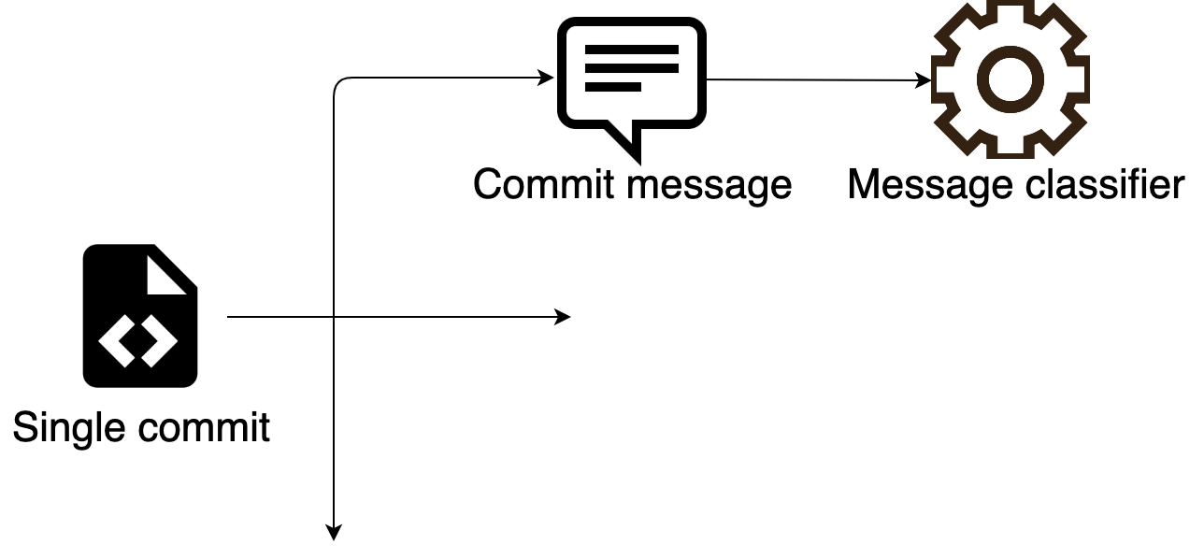
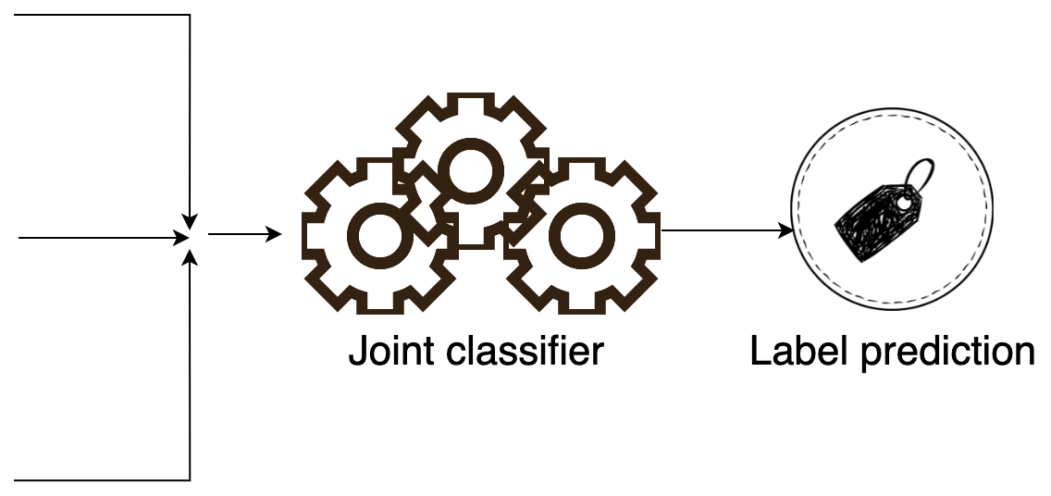

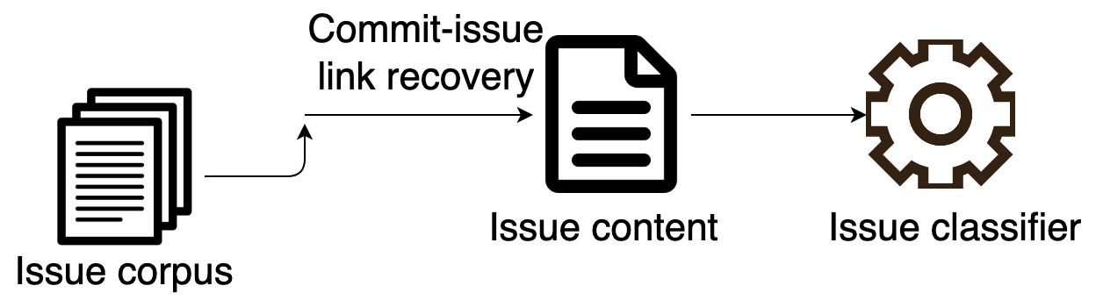
Approach

Slide 11
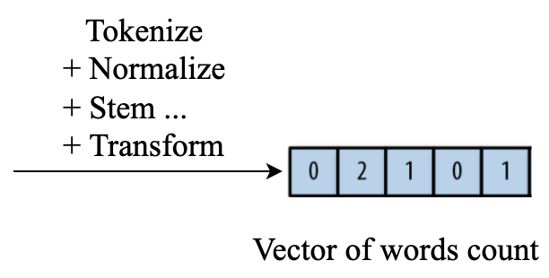
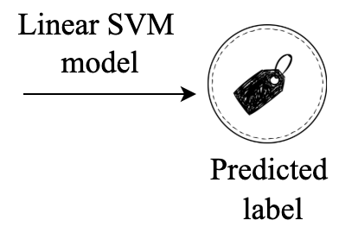
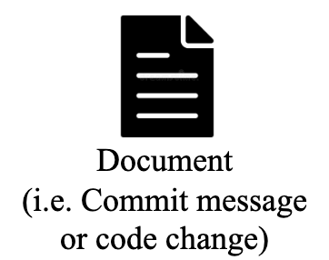
Approach
Message Classifier + Patch Classifier
Proposed by Sabetta et al. [1]
[1] Sabetta, A., & Bezzi, “A practical approach to the automatic classification of security-relevant commits”, ICSME 2018

Slide 12
Approach
Issue Classifier
Commit with explicit links to issues
Manually identify relevant issue trackers
Use regular expression for matching issue ID in commit message (e.g. CAMEL-16527”, ”WW-4348”, ”STS-262”)
Commit without explicitly link to any issue
Build a corpus of over 290k issues from multiple projects in the dataset
Implement FRLink[1] as an issue linker
[1] Sun, Yan and Wang, Qing and Yang, Ye, “Frlink: Improving the recovery of missing issue-commit links by revisiting file relevance”, Information and Software Technology 2017

Slide 13

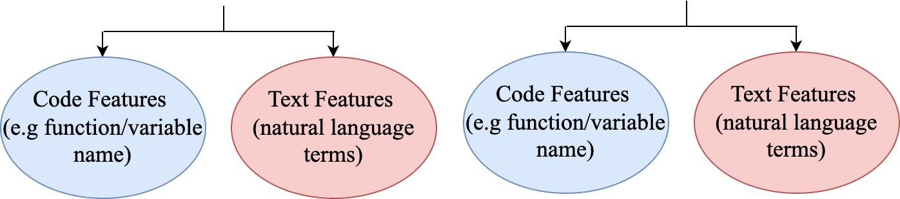

Approach
Issue linker
Highest similarity score => Link inferred

Slide 14
Approach
Issue Classifier (follow up)
Issue content extraction
GitHub issue: Title, Body, Comment(s)
JIRA issue: Summary, Description, Comment(s)
Joint classifier
Employs a Logistic Regression Classifier to combine outputs of three base classifier

Slide 15
Experimental Result
How effective is HERMES for commits with explicit links?
Evaluate HERMES on subset of dataset where commit and issue are linked by commit authors
Model | Precision | Recall | F1
Sabetta el al. [1] | 0.54 | 0.82 | 0.64
HERMES | 0.8 | 0.67 | 0.72
[1] Sabetta, A., & Bezzi, “A practical approach to the automatic classification of security-relevant commits”i, ICSME 2018

Slide 16
Experimental Result
How effective is HERMES when leveraging commit-issue link recovery technique?
Evaluate HERMES on the full dataset after performing commit-issue linking
Model | Precision | Recall | F1
Sabetta el al. [1] | 0.52 | 0.81 | 0.63
HERMES | 0.74 | 0.66 | 0.70
[1] Sabetta, A., & Bezz, “A practical approach to the automatic classification of security-relevant commits”i, ICSME 2018

Slide 17
Thank for watching

