Slide 1
Sealing Darkness
By Vinny Vencill

Slide 2

Millennia Ago…

Slide 3
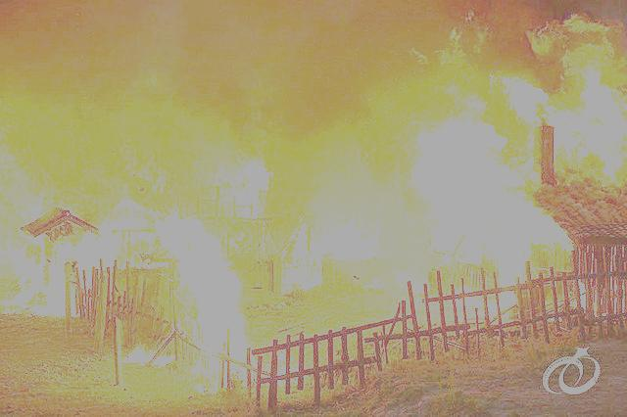
The dragon known as ‘Deathbringer’ nearly brought the end of life to the world. All life allied together and was at war against this enemy… …They still stood no chance, and were quickly losing the war.

Slide 4
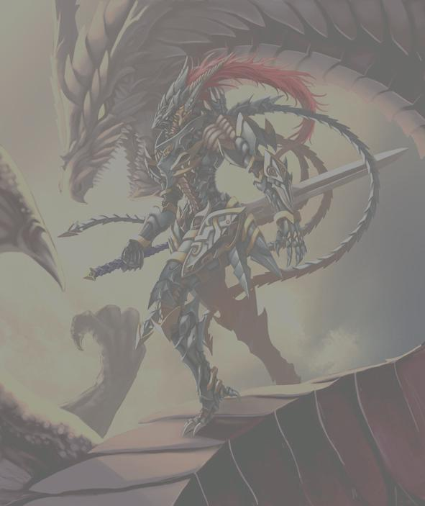
Deathbringer was only stopped by a chosen dragon knight who eternally imprisoned him in an artifact called The Seal. The knight was deemed a savior by all life, and became eternally known as ‘The Catalyst’.

Slide 5
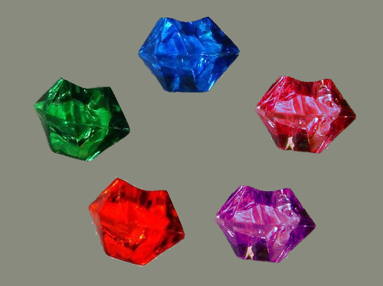
Five immortal jewels on The Seal are the keys that keep Deathbringer in his prison.

Slide 6
Nine-Hundred years later, Deathbringer’s five dragonoid children have obtained the jewels and Deathbringer is free once more to wreck havoc on the world.

Slide 7
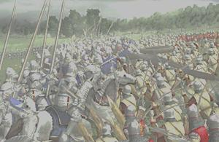
Fearing annihilation, many beings have joined Deathbringer for the sake of survival. Humanity stood strong and chose to fight against him and his new allies.

Slide 8
However, humanity is overwhelmed by the immense numbers of Deathbringer’s armies. Once Deathbringer regains all his strength, there will be no hope left for humanity. Their only hope now is The Seal.

Slide 9
Presently, humanity is devoting all resources to recovering the jewels to reseal Deathbringer while also defending against attacks on the kingdom.

Slide 10
A prophecy is said that The Catalyst is reborn every millennia. Humanity believes that have found that man.

Slide 11
You are tasked with going behind enemy lines and finding clues to find the jewels for The Seal. Once they are found, it is up to The Catalyst to stop Deathbringer.

Slide 12
Main Characters:
The Catalyst Reborn (Drayt) - the man believed to be the one to reseal Deathbringer and save the world
King Spire – ruler of the humanity’s final kingdom
General Infernus – leads humanity’s armies and helps King Spire with military decisions and strategies
Obsidian – philosopher and historian of the hidden archives of life
Azurewing – an ancient dragon directly related to Deathbringer
(Player) – soldier sent behind enemy lines to obtain The Seal’s jewels

Slide 13
Main Enemy Characters:
Deathbringer – a hellbent, nearly invincible dragon whose only desire is to destroy all life and rebuild the world in his own image
Five children:
-Bloodflight – overseer of the red jewel in volcano
-Skyekraken – overseer of the purple jewel in glacier
-Stormfire – overseer of the blue jewel at sea
-Darkwind – overseer of the green jewel in forest
-Furyclaw – overseer of the pink jewel in wastelands

Slide 14
Main Events
Start in Spire Kingdom, talk to General Infernus who sends player to King Spire
King Spire tasks you with finding the jewels for The Seal
General Infernus sends player to forest to see if there are any clues about the jewels
Find and kill Darkwind to get obtain the green jewel
Return to General Infernus with first jewel, sends player to the sea after hearing about the sighting of Stormfire
Find Stormfire and him to obtain the blue jewel
Return to General Infernus with the second jewel, sends player to glacier region after an increase in enemy activity

Slide 15
Main Events (cont…)
Player gets ambushed by enemy, saved by Obsidian
Obsidian takes player to the hidden archives under the glaciers, tells player of Deathbringer and The Seal, tells player The Catalyst Reborn is not the chosen one
Challenge Skyekraken, kill him to obtain the purple jewel
Return to General Infernus with third jewel, player tells the General of Obsidian and gets sent to wastelands
Kill Furyclaw and obtain the pink jewel
Return to General Infernus with the fourth jewel, General sends most of forces to volcano to find the last jewel
Discover Bloodflight’s location, drive him out of hiding

Slide 16
Main Events (cont…)
Kill Bloodflight and obtain the red jewel
After killing Bloodflight, a dragon comes from the sky and takes the player to Obsidian
Obsidian tells player of Azurewing and The Catalyst, the duo that sealed Deathwing nearly millennia ago
Azurewing takes player to Spire Kingdom and presents the jewels to King Spire
King Spire sends player to Doom’s Chasm, where Drayt, The Catalyst Reborn, waits for the jewels
Player gives the jewels to Drayt, then he reveals his true identity as Commander Drayt of Deathbringer’s armies

Slide 17
Main Events (cont…)
Drayt destroys The Seal and the jewels, and challenges the player
Near death, Drayt regains his strength from Deathbringer, but the Spirit of the Catalyst strikes him down
The Catalyst says the player is the Catalyst Reborn, humanities last hope, and the only way to save the world now was to kill Deathbringer
Azurewing takes the player to Obsidian, who tells the player of the only weapon capable of killing Deathbringer, and gives the player the Lifesavior
Azurewing takes the player deep into Doom’s Chasm to fight Deathbringer

Slide 18
Main Events (cont…)
Once near death, Deathbringer speaks to the player and Azurewing, who is his mother
Deathbringer casts an Armageddon spell to kill the player, but Azurewing sacrifices herself to protect the player
After surviving the spell, the player finishes of Deathbringer in a one-on-one fight
After killing Deathbringer, the player is teleported back to Obsidian
Obsidian and the spirits of The Catalyst and Azurewing thank the player for saving the world from imminent destruction

