Slide 1
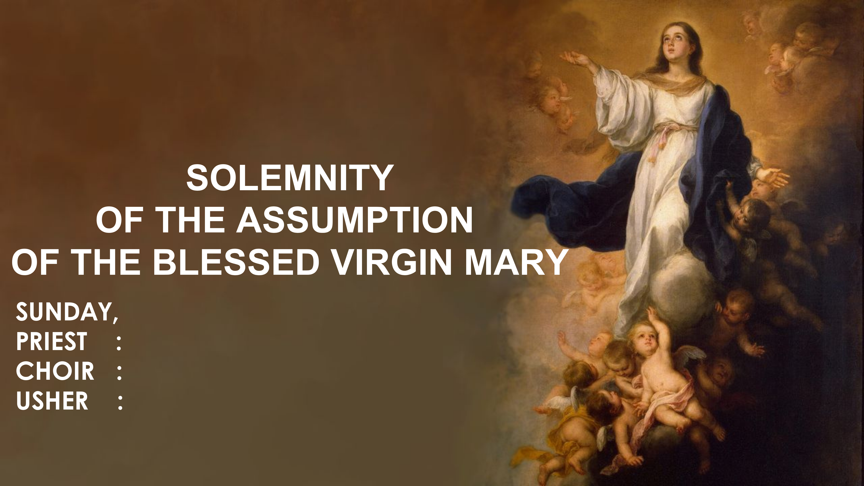
AUGUST 16, 2026 / 9.00
Fr. Yulius Edyanto, MSF
D'Angels, the Philippines, & St. Michael English Choir
Nazareth

Slide 2
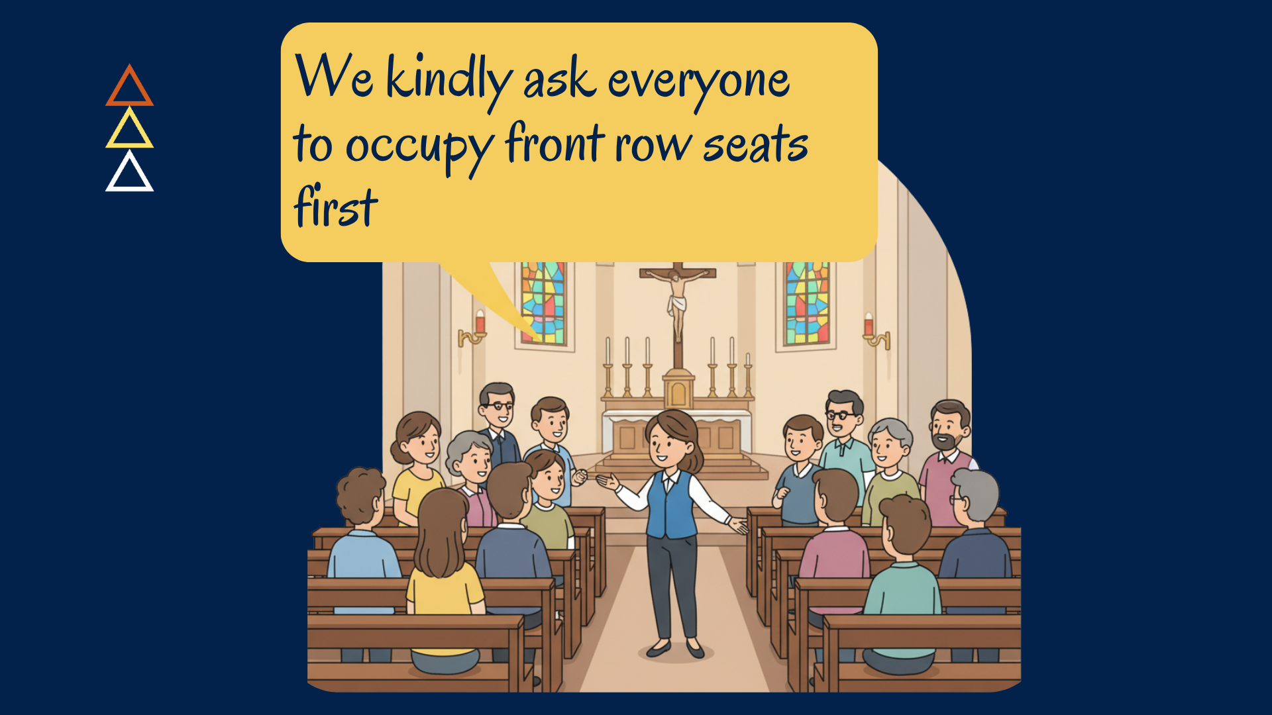

Slide 3
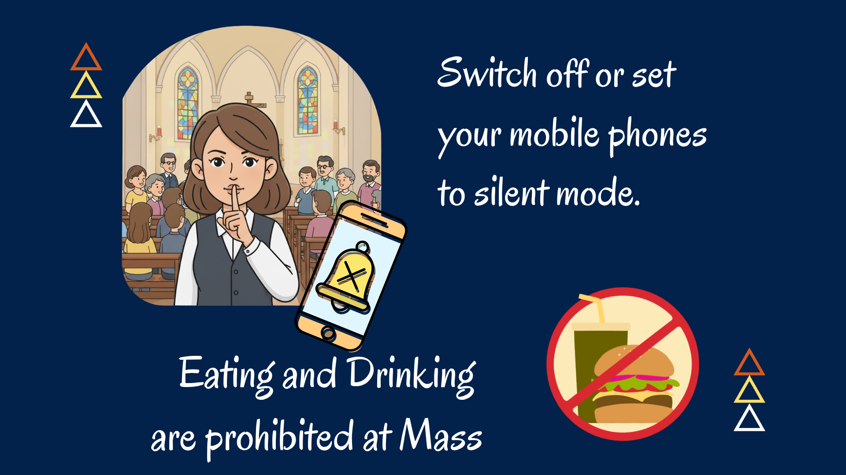

Slide 4
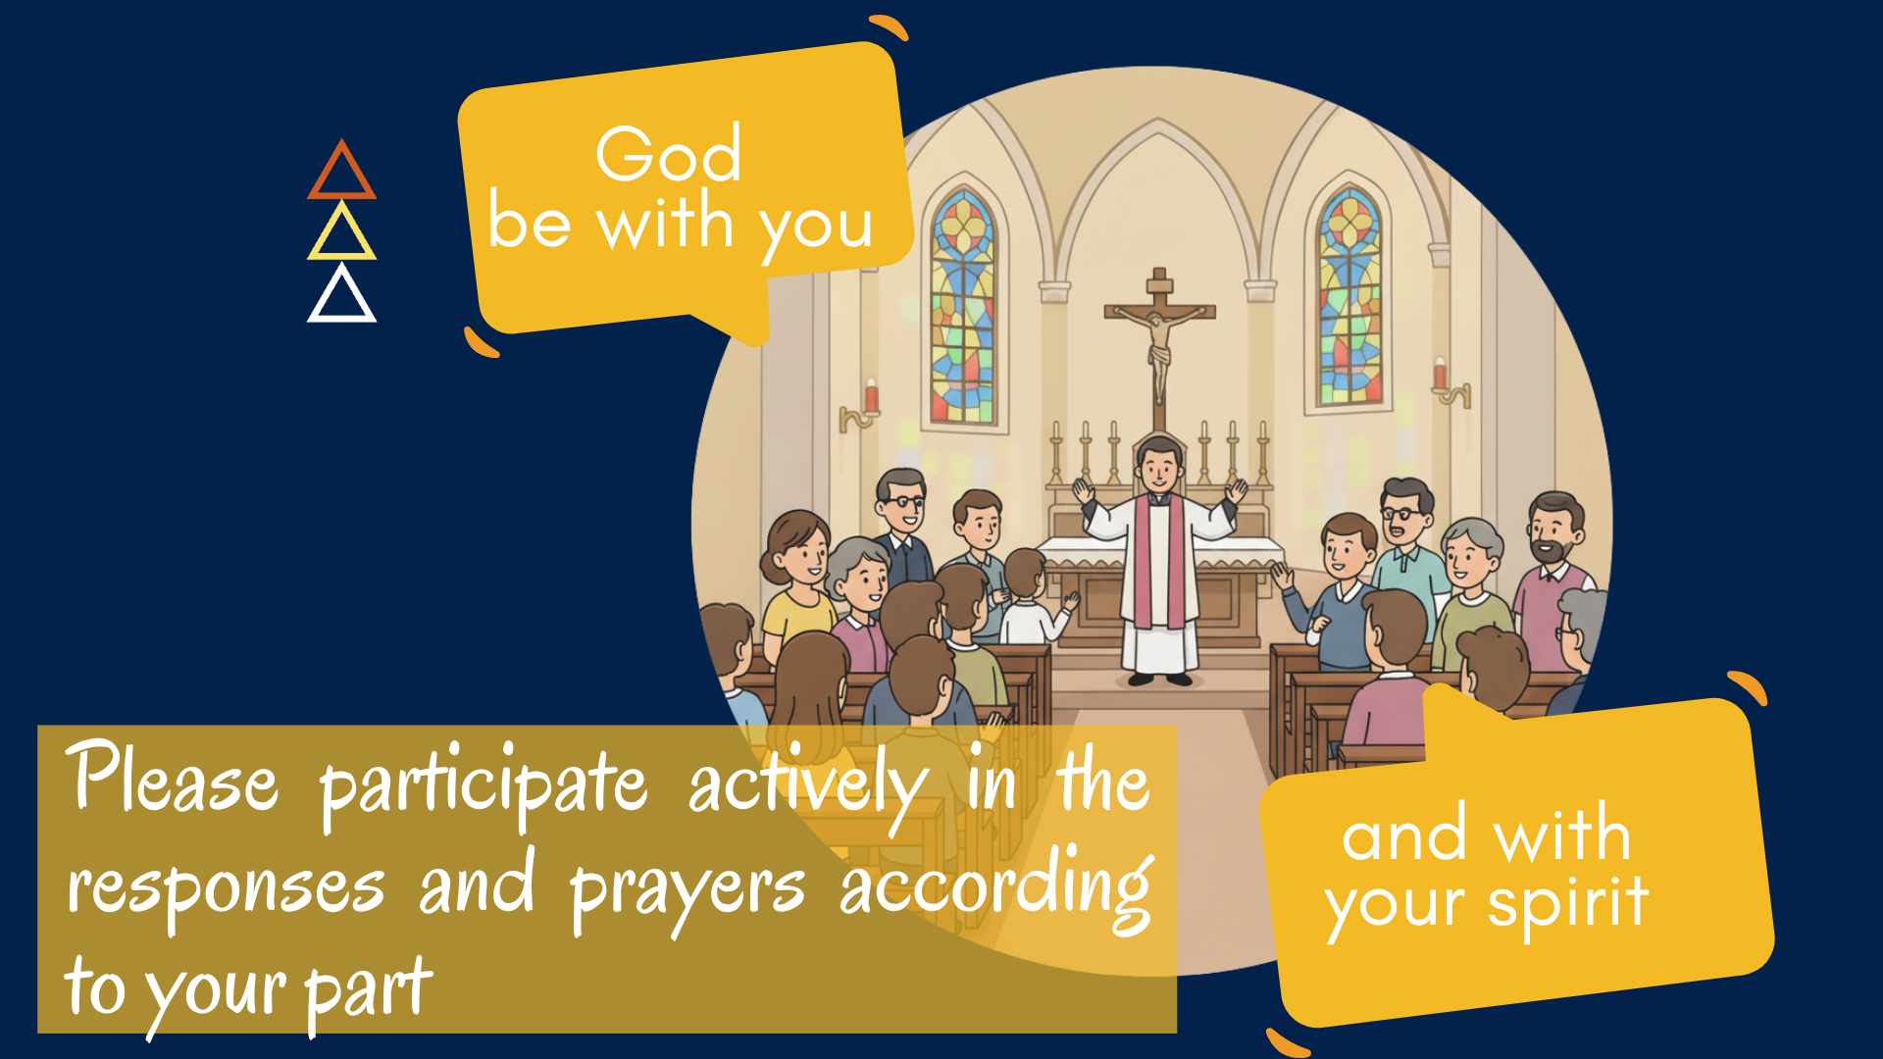

Slide 5
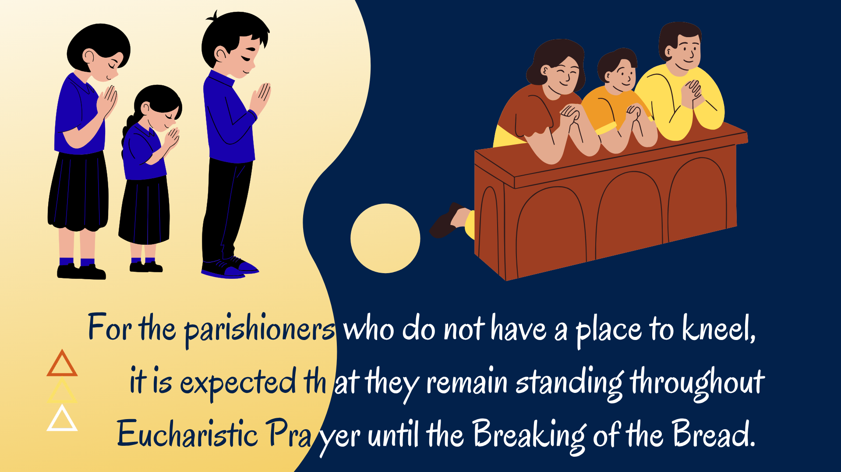

Slide 6
PRAYER FOR ST. MIKAEL’S HALL CONSTRUCTION
( stand )

Slide 7
(†) In the name of the Father, and of the Son, and of the Holy Spirit. Amen.
Cs : Loving God, our Father, we, the parishioners of St. Mikael, Semarang Indah Parish, give thanks for the growing faith, fellowship, and service that continue to flourish in our parish.

Slide 8
At this time, we are striving to realize the construction of St. Mikael’s Hall, which will become a place for us to gather and carry out activities to glorify Your name and to be a sign of Your presence — especially in nurturing the faith of our young people, the future of our Church.

Slide 9
Pour out Your blessings and send forth Your Holy Spirit, so that all of us in the parish may move forward together in supporting the completion of St. Mikael’s Hall through all the efforts we can offer— our time, energy, talents, resources, and prayers.

Slide 10
Keep us from anything that may hinder the smooth progress of this work, so that this hall may be completed in due time.
May we one day use St. Mikael’s Hall as a place to bring about the Civilization of Love, in accordance with the Pastoral Direction of the Archdiocese of Semarang.

Slide 11
Through our Lord Jesus Christ, who lives and reigns with You in the unity of the Holy Spirit, now and forever.
Mother Mary, pray for us…
Saint Michael, pray for us…
Amen.
(†) In the name of the Father, and of the Son, and of the Holy Spirit. Amen.

Slide 13
INTRODUCTORY RITES
ENTRANCE SONG
( stand )

Slide 14
(JUDUL)
(teks)

Slide 15
GREETING
Main Celebrant (MC):
In the name of the Father, and of the Son, and of the Holy Spirit.
Celebrants (Cs): Amen.

Slide 16
MC: The grace of our Lord Jesus Christ, and the love of God, and the communion of the Holy Spirit be with you all.
Cs: And with your spirit.

Slide 17
OPENING
The themes of mission and suffering intersect in today's readings from Jeremiah and the Gospel of Matthew. Jeremiah's confession reveals the depth of his suffering in serving God's word, but also the depth of his trust that God is with him.

Slide 18
This trust is based on his knowledge of God as a mighty defender of the weak and poor. The so-called "mission discourse" in Matthew 10 assumes that some suffering is inevitable for those who share Jesus' mission. In these few verses, Jesus repeats the phrase "do not be afraid" no less than three times,

Slide 19
and he encourages his disciples to put their trust in God based on their knowledge of God's care for all creation, even the smallest sparrow.

Slide 21
SPRINKLING AND BLESSING
WITH HOLY WATER
( stand )

Slide 22
THANKS BE TO GOD
We give You thanks O Lord, our God
Source of all grace and blessing
Even though we are without merit
You have chosen and bear us up
Sins and transgressions You forgive
You give us hope and divine mercy
We are Your sons and daughters

Slide 23
You plant in our hearts the seeds of hope and faith
And nurture them with Your loving care
You kindle the fire of love so pure
And a spirit of self sacrifice
Your grace make us reborn again
To live our life in pure happiness
In Your heavenly kingdom

Slide 24
We want to follow the footsteps of Jesus
Footsteps of our gentle Redeemer
Spreading the good news to all nations
Of His salvation of mankind
We give You thanks O Lord, our God
Your work of salvation so divine
Sign of Your grace and Your faith in us.

Slide 25
( stand )
LORD HAVE MERCY
MC : (teks)
Choir : Lord have mercy.
Cs : Lord have mercy.

Slide 26
MC : (teks)
Choir : Christ have mercy.
Cs : Christ have mercy.

Slide 27
MC : (teks)
Choir : Lord have mercy.
Cs : O Lord have mercy.

Slide 28
( stand )
PENITENTIAL RITE
MC : Brothers and sisters, let us acknowledge our sins, and so prepare ourselves to celebrate the sacred mysteries.

Slide 29
Cs : I confess to almighty God and to you, my brothers and sisters, that I have greatly sinned, in my thoughts and in my words, in what I have done and in what I have failed to do,

Slide 30
(striking your breast, say:)
through my fault, through my fault, through my most grievous fault;
(Then continue with:)
therefore, I ask blessed Mary ever-Virgin, all the Angels and Saints, and you, my brothers and sisters, to pray for me to the Lord our God.

Slide 31
LORD HAVE MERCY
Lord have mercy. Lord have mercy.
Christ have mercy. Christ have mercy.
Lord have mercy. Lord have mercy.
( stand )

Slide 32
MC : May almighty God have mercy on us, forgive us our sins, and bring us to everlasting life.
Cs: Amen.

Slide 33
GLORIA
( stand )

Slide 34
Glory to God in the highest,
and on earth peace
to people of good will.
We praise You, we bless You,
we adore You, we glorify You,
we give You thanks for Your great glory.
Lord God, heavenly King.
O God, almighty Father.

Slide 35
Lord Jesus Christ, Only Begotten Son,
Lord God, Lamb of God, Son of the Father,
You take away the sins of the world, have mercy on us;
You take away the sins of the world, receive our prayer;
You are seated at the right hand of the Father, have mercy on us.

Slide 36
For You alone are the Holy One,
You alone are the Lord,
You alone are the Most High,
Jesus Christ, with the Holy Spirit,
in the glory of God the Father. Amen.

Slide 37
OPENING PRAYER
MC: Let us pray.
(teks)
Cs: Amen.

Slide 38
LITURGY OF THE WORD
( sit )

Slide 39
FIRST READING
(teks)
A reading from the (teks)

Slide 40
(teks)

Slide 41
R : The word of the Lord.
Cs : Thanks be to God.

Slide 42
RESPONSORIAL PSALM
(teks)
(teks)

Slide 43
(teks)
(teks)

Slide 44
SECOND READING
(teks)
A reading from the (teks)

Slide 45
(teks)

Slide 46
R : The word of the Lord.
Cs : Thanks be to God.

Slide 47
( stand )
GOSPEL ACCLAMATION
Alleluia! Alleluia! Alleluia!
(teks)

Slide 48
GOSPEL
MC: The Lord be with you.
Cs : And with your spirit.
MC: A reading from the (teks)
Cs : Glory to you, Lord.
(teks)

Slide 49
(teks)

Slide 50
R : The Gospel of the Lord.
Cs : Praise to you, Lord Jesus Christ

Slide 51
HOMILY
( sit )

Slide 52
(teks)

Slide 54
PROFESSSION OF FAITH
NICENE CREED
( stand )

Slide 55
I believe in one God, the Father almighty, maker of heaven and earth, of all things visible and invisible.
I believe in one Lord Jesus Christ, the Only Begotten Son of God, born of the Father before all ages. God from God, Light from Light, true God from true God, begotten, not made, consubstantial with the Father;

Slide 56
through him all things were made. For us men and for our salvation he came down from heaven,
(bow)
and by the Holy Spirit was incarnate of the Virgin Mary, and became man.
(raise from bow)

Slide 57
For our sake he was crucified under Pontius Pilate, he suffered death and was buried, and rose again on the third day in accordance with the Scriptures. He ascended into heaven and is seated at the right hand of the Father. He will come again in glory to judge the living and the dead and his kingdom will have no end.

Slide 58
I believe in the Holy Spirit, the Lord, the giver of life, who proceeds from the Father and the Son, who with the Father and the Son is adored and glorified, who has spoken through the prophets.

Slide 59
I believe in one, holy, catholic and apostolic Church. I confess one Baptism for the forgiveness of sins and I look forward to the resurrection of the dead and the life of the world to come.
Amen.

Slide 60
PRAYER OF THE FAITHFUL
( stand )

Slide 61
(teks)

Slide 62
(teks)
(teks)

Slide 63
MC : We pray for those intentions offered for the Mass…….
We also pray for our personal intentions …….
Let us pray to the Lord…
Cs : Lord, graciously hear us.

Slide 64
MC : (teks)
Cs : Amen.

Slide 65
LITURGY OF EUCHARIST
OFFERTORY SONG
( sit )

Slide 66
(JUDUL)
(teks)

Slide 67
INVITATION TO PRAYER ( stand )
MC: Pray, brothers and sisters, that my sacrifice and yours may be acceptable to God, the almighty Father.
Cs : May the Lord accept the sacrifice at your hands for the praise and glory of his name, for our good and the good of all his holy Church.

Slide 68
PRAYER OVER THE OFFERINGS
MC: (teks)
Cs : Amen.

Slide 69
THE EUCHARISTIC PRAYER ( stand )
MC: The Lord be with you.
Cs : And with your spirit.
MC: Lift up your hearts.
Cs : We lift them up to the Lord.
MC: Let us give thanks to the Lord,
our God.
Cs : It is right and just.

Slide 70
PREFACE
( stand )

Slide 71
ACCLAMATION
Holy, holy, holy, Lord God of hosts,
Heaven and earth are full of Your glory.
Hosanna in the highest.
Blessed is He who comes
in the name of the Lord.
Hosanna in the highest.

Slide 72
EUCHARISTIC PRAYER
( kneel )
(Parishioners without a kneeling spot,
please stand)

Slide 73
MC : The mystery of faith.
Cs : When we eat this Bread and drink this Cup, we proclaim your Death,
O Lord, until you come again.

Slide 75
COMMUNION RITE
( stand )

Slide 76
( stand )
THE LORD’S PRAYER
MC: At the Savior's command and formed by divine teaching, we dare to sing:

Slide 77
Our Father, who art in heaven,
hallowed be Thy name.
Thy kingdom come, Thy will be done,
on earth as it is in heaven.

Slide 78
Give us this day our daily bread.
And forgive us our debts, as we forgive our debtors.
And lead us not into temptation,
but deliver us from evil.
For thine is the Kingdom, and the power, and the Glory, Forever, ever.

Slide 79
MC: Deliver us, Lord, we pray, from every evil, graciously grant peace in our days, that, by the help of your mercy, we may be always free from sin and safe from all distress, as we await the blessed hope and the coming of our Savior, Jesus Christ.
Cs : For the kingdom, the power and the glory are yours now and for ever.

Slide 80
SIGN OF PEACE
MC: Lord Jesus Christ, who said to your Apostles: Peace I leave you, my peace I give you; look not on our sins, but on the faith of your Church, and graciously grant her peace and unity in accordance with your will. Who live and reign forever and ever.
Cs : Amen.

Slide 81
MC: The peace of the Lord be with you always.
Cs : And with your spirit.
MC: Let us offer each other the sign of peace.

Slide 82
LAMB OF GOD
( stand )

Slide 83
( stand )
Lamb of God, You take away the sins of the world, have mercy on us
Lamb of God, You take away the sins of the world, have mercy on us
Lamb of God, You take away the sins of the world, grant us peace

Slide 84
BREAKING OF THE BREAD
( kneel )
(Parishioners without a kneeling spot, please stand)

Slide 85
( kneel )
MC: Behold the Lamb of God, behold him who takes away the sins of the world. Blessed are those called to the supper of the Lamb.
Cs : Lord, I am not worthy that you should enter under my roof, but only say the word and my soul shall be healed.

Slide 86
MC: May the Body of Christ keep me safe for eternal life.
Cs : Amen.
MC: May the Blood of Christ keep me safe for eternal life.
Cs : Amen.

Slide 87
COMMUNION

Slide 88
COMMUNION SONG
(JUDUL)
(teks)

Slide 90
HAIL MARY
Hail Mary, full of grace,
the Lord is with thee;
blessed art thou among women, and blessed is the fruit of thy womb, Jesus.
Holy Mary, Mother of God, pray for us sinners, now and at the hour of our death. Amen.

Slide 91
PRAYER AFTER COMMUNION ( stand )
MC: Let us pray.
(teks)
Cs : Amen.
Notes:
Doa Ardas hanya minggu kedua dan ke empat.

Slide 92
PRAYER FOR ARDAS IX KAS
( stand )

Slide 93
MC : Let’s pray the Ninth Ardas Prayer together
O God, our most faithful Father, we offer You our praise and thanksgiving. Through the guidance of Jesus Christ, the Good Shepherd, You continually accompany us as we journey together to build a civilization of love, a sign of the presence of Your Kingdom.

Slide 94
You also guide us, together with the people of Indonesia, to strive for a shared way of life that is prosperous, just, and dignified, founded upon Pancasila.
O God, our most wise Father, send forth Your Holy Spirit to kindle our resolve and renew our spirit, that we may become a joyful, inspiring, and life-giving Church.

Slide 95
Therefore, empower us to cultivate a living faith, to take the first steps in building a dialogical and compassionate society, and to cooperate with all people in striving for just and equitable prosperity. May we, by following the example of the faithfulness of the Blessed Virgin Mary and the perseverance of Saint Paul,

Slide 96
bring this Your will to fulfilment. Through Christ our Lord and Mediator.
Amen.

Slide 97
ANNOUNCEMENT
Solemnity of the Assumption of the Blessed Virgin Mary
( sit )

Slide 98

Notes:
“Ayo 17-an” Event
To commemorate the 81st Anniversary of the Independence of the Republic of
Indonesia, the Youth Group (OMK) invites the entire parishioners—along with their families
and relatives.
On: Monday, 17 August, starting at 6:00 AM.
Enjoy a variety of exciting activities: a Fun Walk, Thanksgiving Celebration, “Tumpeng”
competition antar wilayah and performances by the OMK band, line dancers, and an
Independence-themed parody act.

Slide 99

Notes:
The Mass for the Independence Day of the Republic of Indonesia
On: Monday, 17 August A: 5:30 PM
Without a Morning Mass

Slide 100

Notes:
The Catholicism Workshop
On: Tuesday, 18 August At: 7.00 PM In: Fransiskus Room

Slide 101
3. THE 8TH OF NOVENA MASS OF
MARIA LA SALETTE
On: Wednesday, 19 August
At: 6.00 PM
In: La Salette Prayer Garden

Slide 102
4. KURSUS PERSIAPAN HIDUP BERKELUARGA (KPHB)
On: Friday - Sunday, 11-13 September 2026
Register at the secretariat office no later than 4 September.

Slide 103
THE BANNS OF MARRIAGE
We publish the banns of marriage between:

Slide 104
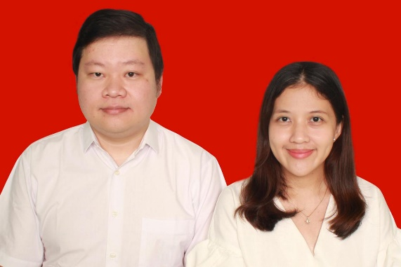
STEFANUS ANTHONY NIRWANA
from St. Monika – Yerusalem,
with
BONIFATIA ANDREA FINKA HENDRATANTULAR
from the Parish of St. Ambrosius Tangerang

Slide 105
This is for the THIRD TIME of asking

Slide 106
If any of you know cause or just impediment why these persons should not be joined together in Holy Matrimony, you are to declare it.

Slide 107
The total amount of money collected from all the Masses
From 5 – 11 August 2026
The offering from the faithfuls | : Rp. 26.326.300
For building construction | : Rp. 16.480.300
Social Funds | : -

Slide 108
Those offerings can be transferred using the QR Code sticked on every pew.

Slide 109
SUNDAY, 23 AUGUST 2026
(21st Sunday in Ordinary Time)
English Mass
Time | : 9.00 AM
Priest | : Fr. YF Bagas Pamungkas, MSF
Choir | : Friends Voice

Slide 110
Sunday School Activities
Time | : 8.45 AM
Place | : Fransiskus Room, Pastoral Building

Slide 111
Sunday School Activities
There will be NO Sunday School Activities. Children are expected to attend Mass at church with their parents.

Slide 112
THANK YOU
( no clapping )
Notes:
Ada video

Slide 114
CONCLUDING RITE
BLESSING AND DISMISSAL
( stand )

Slide 115
MC: The Lord be with you.
Cs : And with your spirit.
MC: May almighty God bless you, the Father, (†) and the Son, and the Holy Spirit.
Cs : Amen.

Slide 116
MC: Go in peace, glorifying the Lord by your life.
Cs : Thanks be to God.

Slide 117
CLOSING SONG
( stand )

Slide 118
(JUDUL)
(teks)

Slide 119
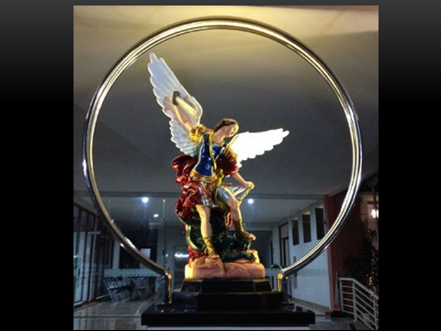
GOD BLESS YOU

