Slide 1
IMS Project
By Jason Fyfe

Slide 2
Introduction
Who am I?
How did I approach the spec?
Breakdown (MVP)
Design
Documentation
Jira
Implementation

Slide 3
Consultant Journey
What have I learned?
Jira
MySQL
Java - JDBC, JUnit, Mockito
Git

Slide 4
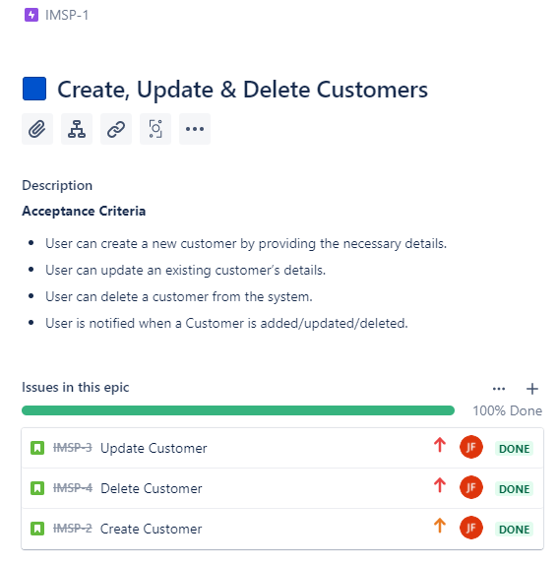
Continuous Integration
Git Branches
Agile methodology
Jira Management
Git Version Control
Jira Epic with User Stories

Slide 5
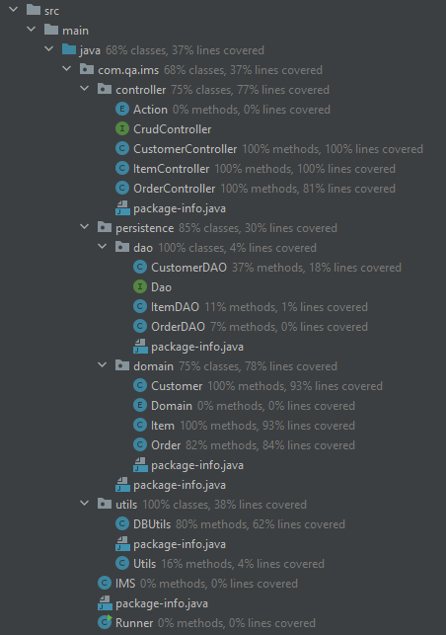
Testing
What was tested?
Manual Tests
Unit Tests
Integration Tests
Current 37% - Target 80% Minimum

Slide 6
Demonstration

Slide 7
Sprint Review
What was completed:
All User Stories
Create Customer, Update Customer, Delete Customer
Create Item, Update Item, Delete Item
Create Order, Delete Order
View All Customers, Items, Orders
Add an Item to an Order
Remove an Item from an Order
Cost of an Order
Save System Data
Partial Testing
Partial Documentation
What was left Behind:
Unit Testing
Integration Testing
Updated Documentation

Slide 8
Sprint Retrospective
What Happened?
What went well?
What could be improved?

Slide 9
Conclusion
Future Steps
Complete Testing
Documentation
Additional Features
Questions?

Slide 10
Thank You!
Do you have any Questions?

