Slide 1
Choonz Application
Jacob, Jason and Malik

Slide 2

Sprint Zero Initial planning
Initial documentation:
BOSCARD, Risk Assessment, Prioritization…
Generate epics from requirements
Generate user stories from requirements
Sprint planning for sprint one

Slide 3
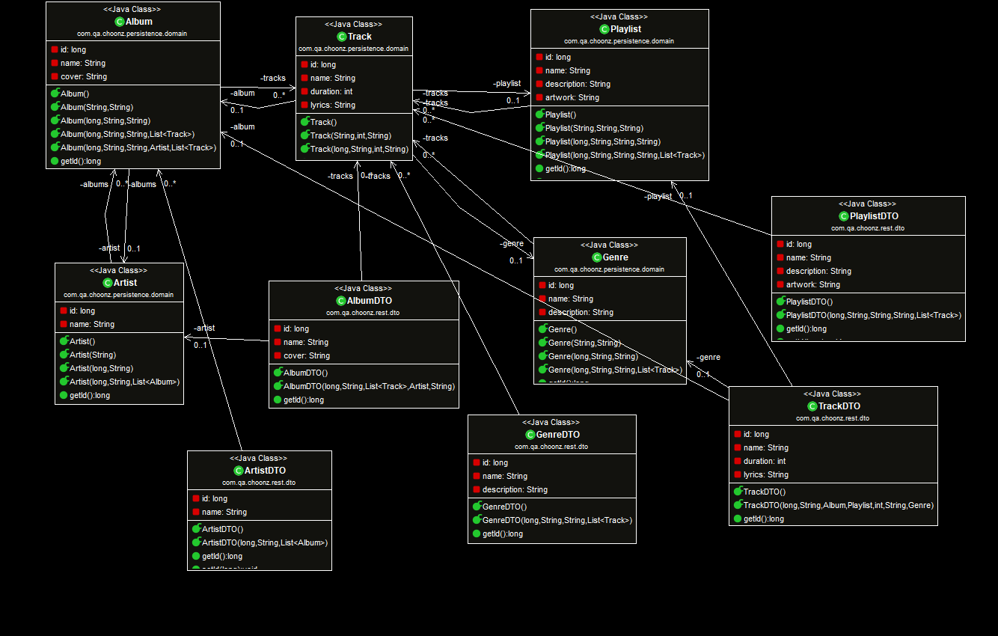

Initial UML

Slide 4
Sprint One Backend refactor
Implement authorization
Implement HATEOAS design

Slide 5
Spring Security
Hides endpoints from unauthorized users
Handles logging and registration of users
Handles user roles
User, Admin…
Improvement:
Enable CSRF prevention

Slide 6
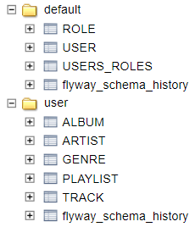
User-as-Schema
Inspired by Oracle
Hibernate manages multi-tenant connection
Flyway manages schemas
Advantages:
Segregates data
Faster lookups for each user

Slide 7
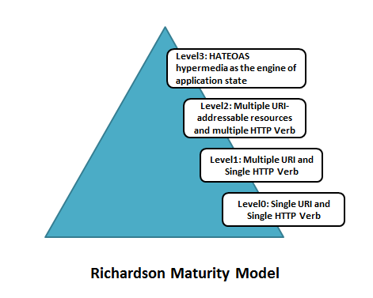
HATEOAS

Slide 8
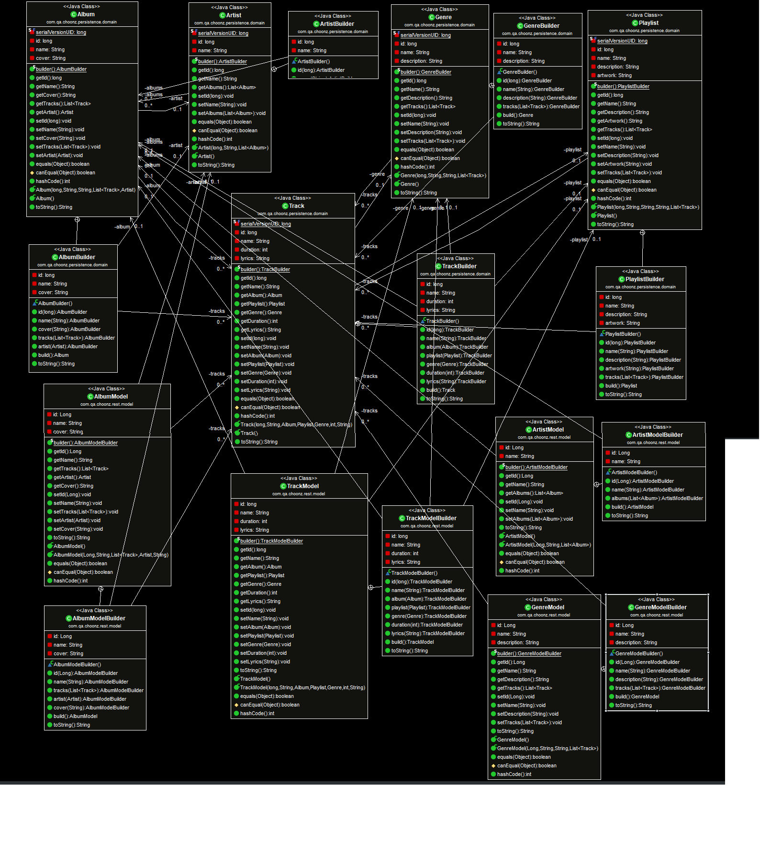
Post Refactor UML

Slide 9
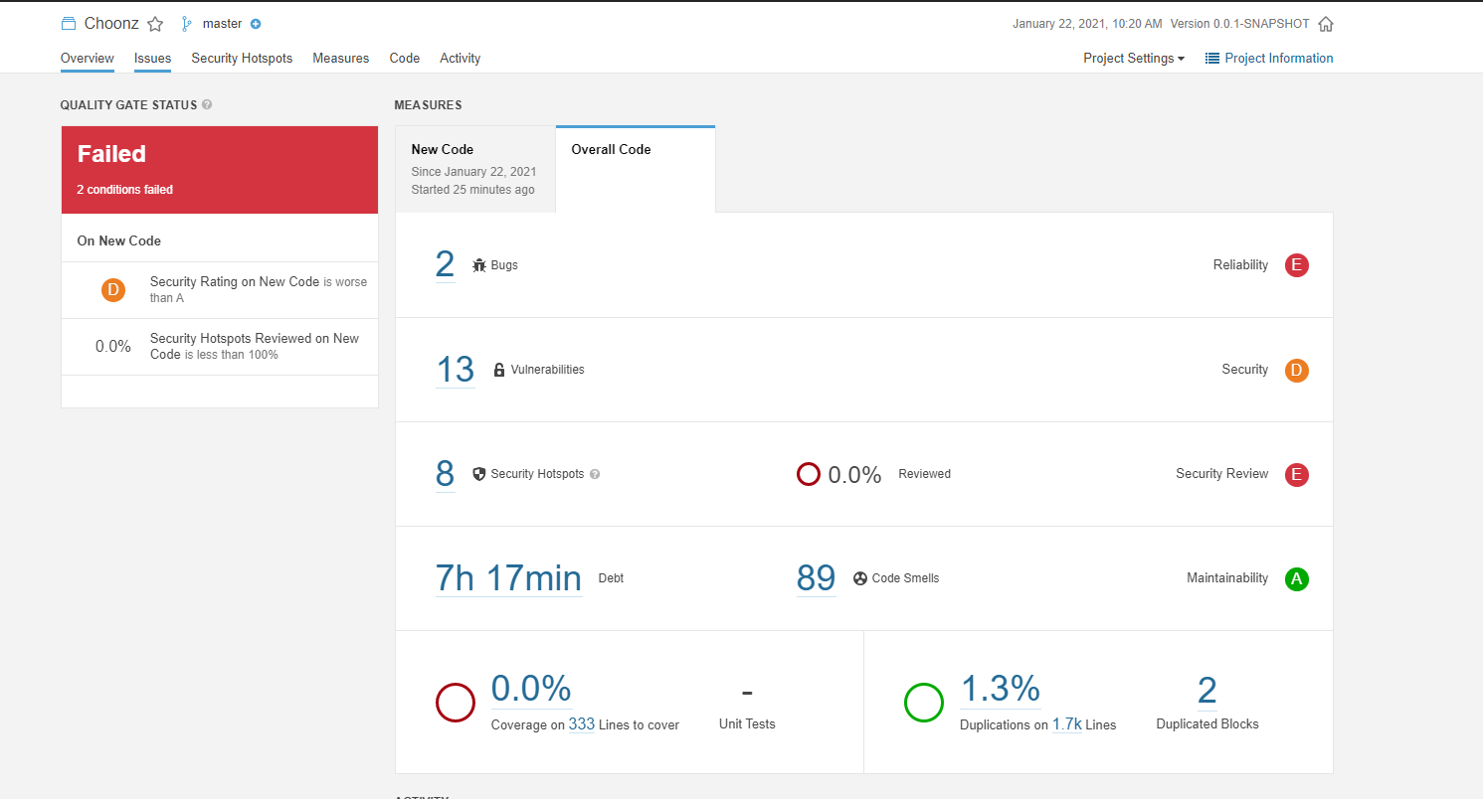
Static Analysis

Slide 10
Retrospective
What should we start doing?
Communication, organization…
What should we stop doing?
Working late, long morning meetings…
What should we keep doing?
Jira, documentation…

Slide 11
Sprint Two Frontend refactor
How could we improve on sprint one?
Implement full CRUD functionality
Implement Search functionality
Implement navigation functionality
Style:
Low priority

Slide 12
Retrospective
TBD

Slide 13
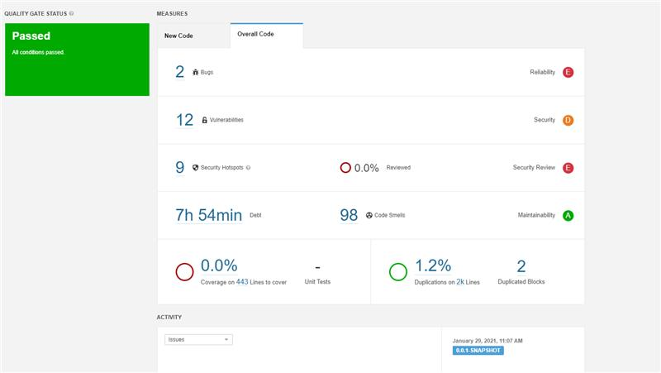
Static Analysis
TBD

Slide 14
Final Application
Demo

Slide 15
Testing
Functional testing:
JUnit (unit and integration)
Non-functional:
JMeter (load, stress, spike, soak)
User acceptance:
Selenium

Slide 16
Functional
Demo

Slide 17
Non-Functional
Demo

Slide 18
User Acceptance
Demo

Slide 19
Future Improvements
More robust authentication (oAuth)
Thymeleaf implementation
Improved styling

Slide 20
Thanks For Listening
Any questions?

