Slide 1
Code Generation: An Introduction to Typed EBNF
Tuesday, April 28th
Jason Young

Slide 2
Why Code Generation?
Improve the software development process by generating well-organized code.
Reduce implementation errors and inconsistencies.
Well-known code generation tools:
Lexical Analyzer (Scanner) Generators
Lex, Flex
Parser Generators
Yacc, Bison, ANTLR, Hyacc
Many tools accept grammars as input.

Slide 3
New Input Specification and Tool
New input specification based on Extended Backus-Naur Form (EBNF) called Typed-EBNF (TEBNF)
Prototype Code Generation Tool generates C++ code from TEBNF

Slide 4
Key Features of TEBNF
Can describe input patterns that include a mixture of strings, numbers, and/or raw groupings of bytes.
Can integrate grammar rules with states and actions.
Can specify different methods of receiving input and sending output.
Can declare how raw input data should be unmarshaled into well-known types of specific sizes (in bytes).
Can declare how well-known types should be marshaled back into their original format.

Slide 5
Key Features of TEBNF (continued)
Can declare how well-known types should be marshaled back into their original format.
Provides typed and non-typed EBNF terminals.
Supports arithmetic and non-arithmetic operations inside grammar rules.
Grammars match specic pieces of a given input to well-known types of varied sizes (in bits or bytes).
Supports the use of variables.
Is Turing complete.
The prototype code generation tool will demonstrate that it can generate a console.

Slide 6
Overview of the TEBNF Code Generation Tool
Generates code to create console applications that:
Parse data from different kinds of inputs
Process data to produce specific output(s)
Direct output(s) to a network destination (UDP/IP), file, or console-based user-interface
Support custom network protocol handling and interaction (UDP/IP)
Provide a console-based user interface

Slide 7
Design

Slide 8
The TEBNF Language
Elements in TEBNF
Input methods: a method of receiving data as input.
Output methods: a method of outputting data.
Grammar sections: parses input data.
Actions: action code to execute using data from other elements.
State transition tables: defines the behavior of the program.
Each element is represented as a class in generated code.

Slide 9
Element-Related Design Decisions
Singleton Paradigm
Input and Output Elements
Actions Elements

Slide 10
Singleton Paradigm – why?
Lazy Instantiation
Avoids allocating memory for element classes until they are actually used in generated code.
Thread Synchronization
Lock a synchronization mechanism (mutex) in the getter function as it returns a static singleton object.
Instance Control
Prevents other objects from instantiating their own copies of the singleton, ensuring that all objects access the same instance.
Flexibility
Control over instantiation gives singletons flexibility to control how it interacts with other objects in generated code.

Slide 11
Input and Output (I/O) Elements
Supported methods for performing I/O:
Console
File
UDP/IP
Requests input from user as needed for configuration and/or interaction as needed.
The “AS” keyword
Indicates I/O should occur using the same mechanism employed by a given I/O element.
More efficient because it causes the code generator to generate one object instead of two.
Example: send and receive on same UDP socket instance.

Slide 12
Actions Elements
Similarities to C++ functions
Can accept parameters
Can contain multiple instructions
Essentially a C++ code block with a few important differences
Loose parsing requirements in the TEBNF code generation tool in order to permit the C++ compiler to catch complex errors.
Allows direct references to TEBNF elements and subelements.
Cannot return values—maintains clarity when used in state tables since they are not intended to be used as the input or condition of a state.

Slide 13
The TEBNF Code Generation Tool
Generates the lexical analysis, parsing, and actions code of a basic console application using a single TEBNF grammar as input
Outputs a set of classes that:
Accept input data through console, file, or UDP/IP.
Provide a set of functions that unmarshal raw data into human-readable types such as numbers and strings, and can marshal it back into its original form.
Use these unmarshal functions to match input data to pattern(s) specified in the grammar and convert them to human-readable values.
Run one or more state machines with each on its own thread to receive data through input methods described in the grammar. As input data arrives, the state machine finds matches to grammar patterns and executes actions that produce the desired output.
Provide a console-based user interface that prompts for input as needed and provides status.

Slide 14
Architecture of the Tool

Slide 15
Stage 1: Read arguments
The Tool is a console application that accepts three arguments:
The path of the file containing a TEBNF grammar
The path of directory where the tool will write generated code,
The name to give to the generated application.

Slide 16
Stage 2: TEBNF Scanner
Grammar is scanned to generate a list of tokens.
Tokens have some metadata attached as needed.

Slide 17
Stage 3: TEBNF Parser
Syntactically analyzes tokens using a recursive descent algorithm.
A pointer to each element discovered by the parser is added to a parse table for quick look up and inserted into a parse tree.
Subelements discovered during this parsing stage are added to their parent elements and subelements as they are found in the parse table and parse tree.

Slide 18
Stage 4: TEBNF Resolver
TEBNF Resolver traverses the tree to is furthest extent.
Resolving means to simplify or break down subelements into types or literal values.

Slide 19
Stage 5: TEBNF Code Generator
Iterates through each element in order of declaration.
Generates a C++ class or other appropriate C++ code for each element.
Name of each C++ source file corresponds to the element it was generated from.
A CMakeLists.txt file is generated with these C++ source files so that CMake can be used to generate Microsoft Visual Studio 2013 solution and project files.
A clang-format file is generated so that any clang-formatting (optional) follows the intended format.

Slide 20
I/O Code Generation
A class is generated for each I/O element (method).
I/O classes only send or receive data, do not perform any lexical analysis.
TEBNF Code Generator tool supports several methods of I/O:
Console
Files
UDP/IP
Tool automatically integrates code to do I/O using these methods.
Complexities of usage are abstracted by the tool because of TEBNF.
Commonly used tools do not provide this built-in I/O capability.

Slide 21
Lexical Analysis and Parsing Code Generation
Lexical analysis and parsing is done by generated code in one step.
Possible because of the way patterns are described in TEBNF grammar elements.
Grammar element pattern is composed of groupings of bytes broken into subgroupings of bytes.
Subgroupings can be translated (unmarshaled) into specific types:
Numbers
Strings
Literal values
Size in bits or bytes is defined based on its type.

Slide 22
Matching Patterns using Grammar Elements
Matching user-defined grammar patterns to incoming data requires one or more literal values be defined in a grammar element.
Value of a literal makes it possible to find it in the input data.
Size and type of literal is defined implicitly or explicitly.
Given the initial reference offset of a_{f} the literal f and its size z_{f}
Offset of the literal or type immediately following it is defined as a_{f+1}, where a_{f+1} = a_{f +} z_{f} .
Offset of the literal or type immediately before f can be defined as a_{f-1}, where a_{f-1} = a_{f -} z_{f-1} and z_{f-1} ≥ a_{f} .
Data offsets of subsequent literals or types found before and after the initial reference offset are calculated based on the one after and before it, respectively.
Separate grammar elements must be written for each pattern
Allows reference to specific patterns by their grammar element name.

Slide 23
Grammar Element Code Generation
The code generation tool translates grammar elements into classes that:
Unmarshal raw input data into specific user-defined types.
Verify matches to byte patterns in the raw input data.
Marshal the values stored in the grammar class back into their original form and byte ordering.
Lexical analysis and parsing in one step:
As data arrives through an input method, patterns are recognized and simultaneously unmarshaled by these grammar classes.
Different from traditional methods
Typically require use of a lexical analyzer generator tool and parser generator tool.
Each tool has its own input specification format.

Slide 24
State Machine and Actions Code Generation
Program behavior is defined in TEBNF as state machines.
State machines are represented with state transition table elements.
State machines describe order of tasks executed by a single application thread as a series of six steps:
A unique name for the state that allows other states to reference it.
A Boolean condition that can be a grammar to match to input data or an explicit Boolean condition.
Method of input for receiving input data (console, file, or UDP/IP).
Next state to jump if the Boolean condition evaluates to true.
Output to send through the output method, execute a code action, or nothing.
Output method to send output specified in the fifth step. If an action or nothing was provided for the fifth step, this step is empty as well.
Actions are executed on transitions.

Slide 25
Order of Execution for Code Generated by TEBNF Code Generation Tool
State steps shape the way TEBNF elements interact with each other and input data by determining:
What input method data is received on.
What parts of the received data match defined grammar patterns.
What code actions are executed.
What method is used to output data.

Slide 26
Order of Execution for Code Generated by TEBNF Code Generation Tool
State steps shape the way TEBNF elements interact with each other and input data by determining:
What input methods data is received on.
What parts of the received data match defined grammar patterns.
What code actions are executed.
What method is used to output data.

Slide 27
Order of Execution for Code Generated by TEBNF Code Generation Tool
State steps shape the way TEBNF elements interact with each other and input data by determining:
What input methods data is received on.
What parts of the received data match defined grammar patterns.
What code actions are executed.
What method is used to output data.

Slide 28
Order of Execution for Code Generated by TEBNF Code Generation Tool
State steps shape the way TEBNF elements interact with each other and input data by determining:
What input methods data is received on.
What parts of the received data match defined grammar patterns.
What code actions are executed.
What method is used to output data.

Slide 29
Implementing Tools with TEBNF

Slide 30
Example Applications
A real-world example using a TEBNF grammar to parse National Imagery Transmission Format (NITF) 2.1 data
Implementation of two test cases
Testing and verification of these test cases
Results of testing

Slide 31
NITF 2.1 File Format
Part of a suite of standards established by the US government for formatting digital imagery.
Used by members of the intelligence community (e.g. US Department of Defense) as an interoperable means of transmission or storage of imagery data.
Software used by the intelligence community to exploit NITF data:
VANTAGE software suite from Space Dynamics Laboratory (SDL)
SOCET Services suite from BAE Systems
The NITF 2.1 file format is composed of a file header and one or more segments.
Segments contain:
Subheaders
Data fields of varying types and sizes, specified in the NITF 2.1 standard documentation
Conditional data and/or data characteristics can be added to NITF 2.1 files using conditional fields in the indicating the existence of Tagged Record Extensions (TREs) and Data Extension Segments
TREs contain data fields, while extension segments can contain data in new formats.

Slide 32
Exploitation of NITF Data

Slide 33
NITF File Parsing using TEBNF
TRE information taken from the NITF 2.1 standard documentation.
TEBNF Implementation of the NITF 2.1 USE00A TRE.

Slide 34
NITF File Parsing using TEBNF
TRE information taken from the NITF 2.1 standard documentation.
TEBNF Implementation of the NITF 2.1 USE00A TRE.

Slide 35
NITF File Parsing using TEBNF
Advantages
Convenience
No need to track offset of each data field—determined by size of types
Readability
Looks similar to actual specification
Self-documenting
Size of data fields tied to size of subelement types.

Slide 36
NITF File Parsing using TEBNF
Advantages
Convenience
No need to track offset of each data field—determined by size of types
Readability
Looks similar to actual specification
Self-documenting
Size of data fields tied to size of subelement types.

Slide 37
NITF File Parsing using TEBNF
Advantages
Convenience
No need to track offset of each data field—determined by size of types
Readability
Looks similar to actual specification
Self-documenting
Size of data fields tied to size of subelement types.

Slide 38
Test Cases
Verify the functionality of the TEBNF language
Test cases:
Basic Calculator
NITF 2.1 UDP/IP File Transfer Client

Slide 39
Test Case 1: A Basic Calculator
Supports addition, subtraction, multiplication, and division of integers
Required the TEBNF code generation tool to generate code that can:
Parse numeric data received over a console input.
Make calculations based on the data received from that console input.
Sends the results of those calculations to console output.
Allow user to exit when finished.

Slide 40
Basic Calculator State Machine
State 1 of 5 (Init):
Sets ongoing result value for subsequent math operations.
User is prompted to enter initial number.
Actions element is then executed while transitioning to next state:
Sets result static variable equal to unmarshaled value while the machine transitions to next state.

Slide 41
Basic Calculator State Machine
State 2 of 5 (StateNum):
State machine uses input element to prompts user to enter a number again.
Number is unmarshaled from input and stored.

Slide 42
Basic Calculator State Machine
State 3 of 5 (StateOp):
User is prompted using console input element to enter a supported math operator.
Machine moves through a series of else-if states.
Each else-if state uses a grammar element to check for a supported operator.
If a +, -, *, or / was entered, an actions element is executed while transitioning to Print state
Action applies math operator to the result and unmarshaled number and assigns to result.
Else if ‘=‘ is entered, executes action as it transitions to Done state that assigns stored number to the result and prints result to console.

Slide 43
Basic Calculator State Machine
State 4 of 5 (Print):
Reached if a supported math operator was entered in the last state.
Immediatley transitions to StateNum, executing an actions element that prints result from action executed in transition to this state.
Note: A cycle repeats until user enters ‘=‘ to exit, which causes machine to transition to the Done (finish) state.

Slide 44
Basic Calculator State Machine
State 5 of 5 (Done):
Exits machine.

Slide 45
Basic Calculator: Sample input and output data
Operand | Operator | Result
5
10 | + | 15
95 | - | -80
110 | + | 30
10 | / | 3
111 | * | 333
33 | - | 300
20 | / | 15
5 | * | 75
0 | = | 75
Sample inputs: operands and operators
Sample outputs: the expected results

Slide 46
Test Case 2: A NITF 2.1 UDP/IP File Transfer Client
Receives NITF 2.1 file over UDP/IP socket upon requesting them from a file server
The file server sends a message to the client telling it when it is done sending files so the client knows when to exit.
Required the TEBNF code generation tool to generate code that can:
Asks the server to send it a file by sending it a message over a UDP/IP output.
Receives the NITF 2.1 file from the server over a UDP/IP input.
Uses the file length data field in the NITF 2.1 file to determine that it has received the entire file from the server as it was sent over UDP/IP.
Writes that file to disk using a file output.
Quits upon receiving message from the server that says it is done sending files.

Slide 47
NITF File Transfer Client State Machine
State 1 of 3 (Init):
During transition from this state to the next (Start), an action is executed that sends the “send” message to the server.

Slide 48
NITF File Transfer Client State Machine
State 2 of 3 (Start):
Looks at data received from file server over UDP/IP input elements.
If incoming data contains a NITF file (matched using grammar element), executes action during transition back to Init that writes the NITF file to disk using file output element.
Else if incoming data contains a “done” message sent from the server, machine executes an action while transitioning to Quit that writes message to console telling user it received all of the files

Slide 49
NITF File Transfer Client State Machine
State 3 of 3 (Quit):
Exits state machine.

Slide 50
NITF File Transfer Client: Sample input and output data files
Sample inputs: NITF files with the sizes in the table sent over UDP/IP to the file client.
Sample outputs: NITF files with the sizes in the table received and written to disk.
NITF 2.1 File Size (bytes)
828710
4021118
912294
3516054
998822

Slide 51
Results and Analysis

Slide 52
Results
C++ code was successfully generated by the TEBNF code generation tool for each of the test cases.
A CMakeLists.txt file was correctly generated by the TEBNF code generation tool for each test case.
CMake version 3.0.2 was run using those CMakeLists files to generate Microsoft Visual Studio 2013 solution and project files.
The project files generated by CMake for both test cases were successfully opened and built in Microsoft Visual Studio 2013.

Slide 53
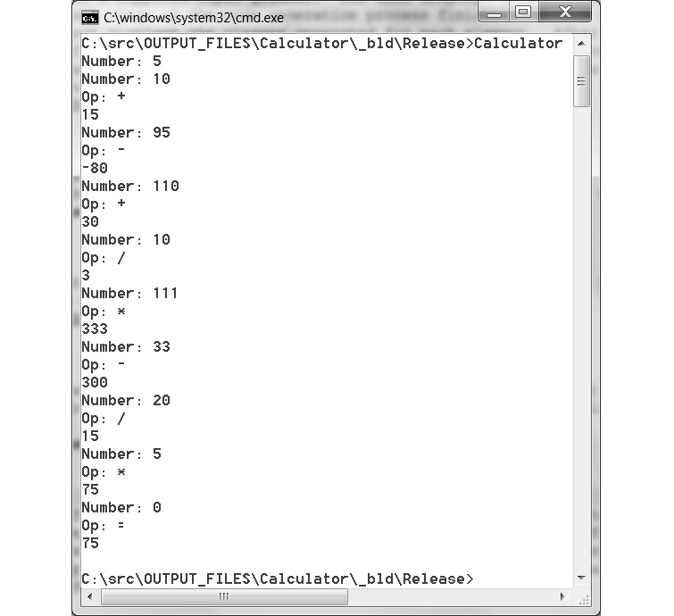
Results: Calculator Test Case
Run using sample test data shown in a table in earlier slide.
Matched expected output shown that table.
Operand | Operator | Result
5
10 | + | 15
95 | - | -80
110 | + | 30
10 | / | 3
111 | * | 333
33 | - | 300
20 | / | 15
5 | * | 75
0 | = | 75

Slide 54
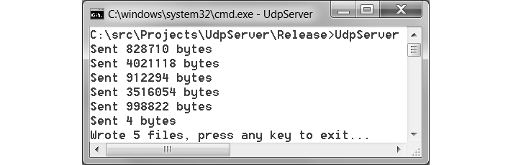
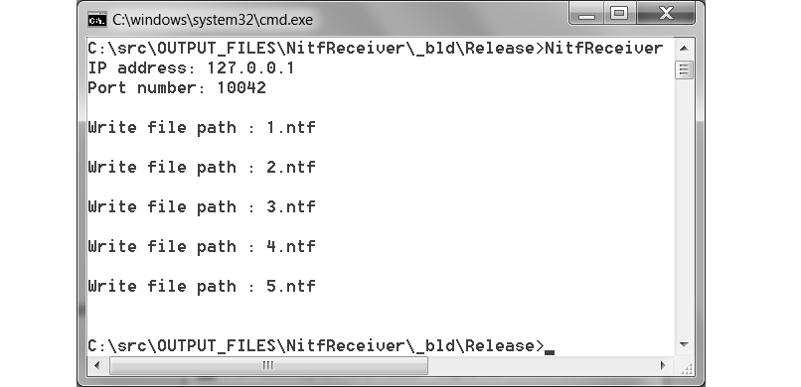
Results: NITF 2.1 File Transfer Client
Run using sample test case data presented in a table in an earlier slide. Settings:
Send and receive over UDP/IP on localhost port 10042.
Matched expected output shown that table.
Five files sent by server
Five NITF files received by client and written to disk
Each file was the expected size.

Slide 55
Comparing C++ to TEBNF
A non-generated C++ implementation of each test case was also written.
Using same design as the generated test cases, a baseline was established for more direct comparisons.

Slide 56
Test Case Analysis
Need more than one participant to conduct tests that are statistically significant, but the observed trends are interesting and worth further investigation.
Used Lizard tool to analyze the code of each test case.
Metrics acquired from Lizard for each test case:
Average Cyclomatic Complexity Number (CCN) per function.
Average token count per function.
(McCabe’s) Cyclomatic complexity has been employed to predict the presence of defects in code.
Measures control flow paths in a code module.
Calculated as e – n + 2
e = number of edges in the control flow graph.
n = number of nodes.
CCN values ≤ 10 fit into the low risk category.

Slide 57
Analysis Results
NITF File Client Test Case | Average CCN | Upper Limit of IQR (U_{CCN}) | Average Token Count | Function Count
Generated | 2.00 | 3 | 54.49 | 136
Non-generated | 3.38 | 6 | 101.81 | 16
Calculator Test Case | Average CCN | Upper Limit of IQR (U_{CCN}) | Average Token Count | Function Count
Generated | 1.89 | 3 | 49.50 | 135
Non-generated | 3.42 | 7 | 81.42 | 12

Slide 58
Analysis Conclusions
Non-generated test cases are comparable to their generated counterparts because:
Non-generated test cases were built specifically to mimic the behavior of the generated test cases
The average CCN values for all of the test cases fall into the low risk category,
The average CCN values for all of the test cases are close to one another in value
Leads to likely conclusion that none of the test cases were purposely made worse than the others.

Slide 59

Analysis Conclusions (continued)
Prove data sets are different by finding p-values given:
Two-tailed analysis.
Two independent means.
Null hypothesis is that both sets are the same.
Since p-values are significant at p < 0.05, the null hypothesis can be rejected—the test cases are provably different from each other.

Slide 60
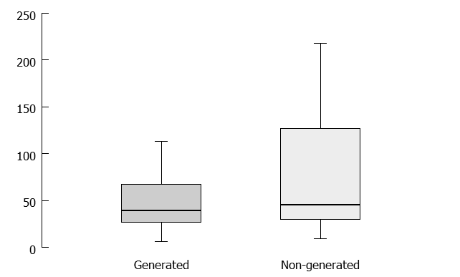
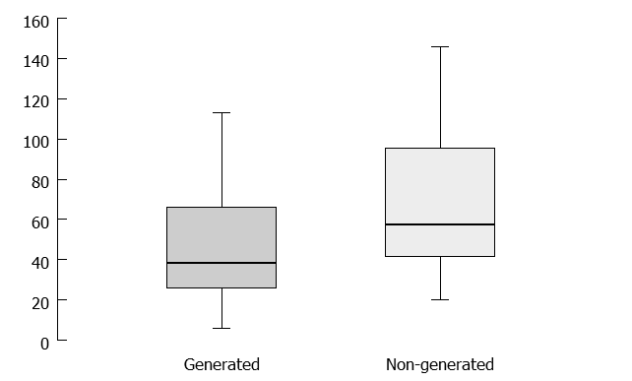
Token Count Analysis
File Client
Calculator
Lower median values within smaller data spreads point to greater number of functions with lower token counts.
Conclusion: generated code is splitting larger computational problems into smaller tasks than the non-generated code.

Slide 61
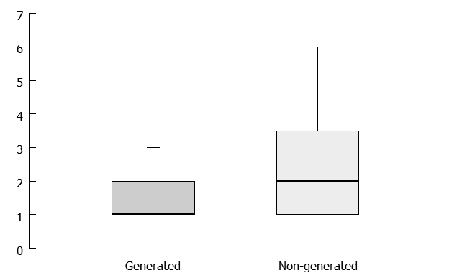
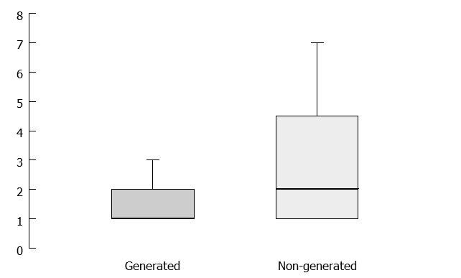
Cyclomatic Complexity Analysis
File Client
Calculator
Lower average CCN for generated code is strongest indicator that larger computational problems are being broken down into smaller ones.
Median CCN for generated test cases are ≤ lowest values of the non-generated test cases.

Slide 62
Cyclomatic Complexity as an indicator of defects
Zhang and Zhang were able to effectively predict defects in code based on higher the cyclomatic complexity values.
Generated code has
Shorter interquartile ranges.
Medians ≤ lowest quartiles of the non-generated code.
Conclusion: a greater number of functions in the code generated from TEBNF have fewer defects than non-generated code.
This correlation means it is likely that as applications increase in size and scope, number of defects will remain lower in code generated from TEBNF.

Slide 63
Questions?

Slide 64
Extra

Slide 65
Test Case Experience
Calculator Test Case
Item to Implement | C++ (hours) | TEBNF (hours)
Console I/O | 1 | 0.1
State Machine | 1 | 0.5
Total | 1 | 0.6
Non-generated C++ implementations were verified using same procedures (sample data) used for the generated test cases.
The non-generated C++ implementations had fewer lines of code than their counterparts generated from TEBNF.
These results were expected because the TEBNF code generation tool does not yet perform optimization.
Writing code to handle I/O and input verification took longer in C++ than TEBNF.
Time inconvenience was most notable while writing the file client.
File Client Test Case
Item to Implement | C++ (hours) | TEBNF (hours)
Console I/O | 1 | 0.1
File I/O | 1 | 0.1
UDP/IP I/O | 4 | 0.5
State Machine | 4 | 1
Total | 10 | 1.7

Slide 66
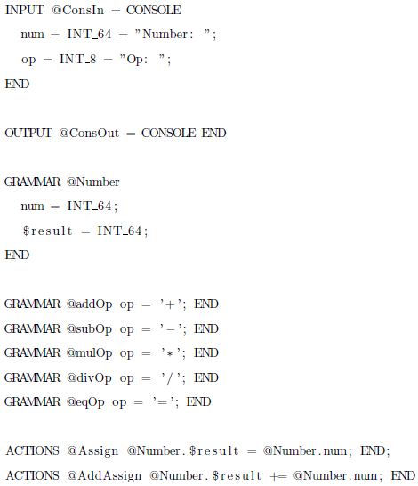
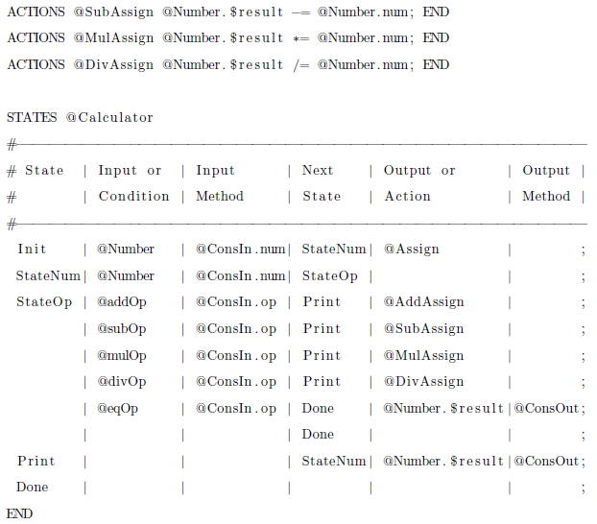
TEBNF Example: Calculator

Slide 67
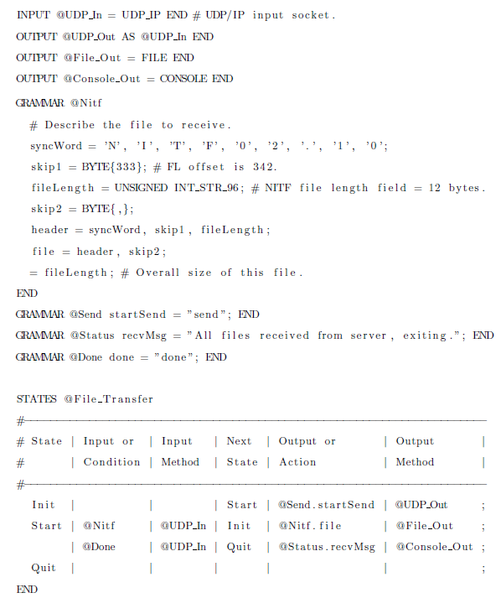
TEBNF Example: NITF File Client

