Slide 1
Spotify Mood Search
Jason Gilman, Dawson Abner, Elnaz Marediya, Elin Maredia, Ilhan Raja

Slide 2
Motivation
Wanted to create an application that lets people find music to suit their mood
Provide a comprehensive and unique way to search for new music
Encourage listening to music that people would not normally listen to

Slide 3
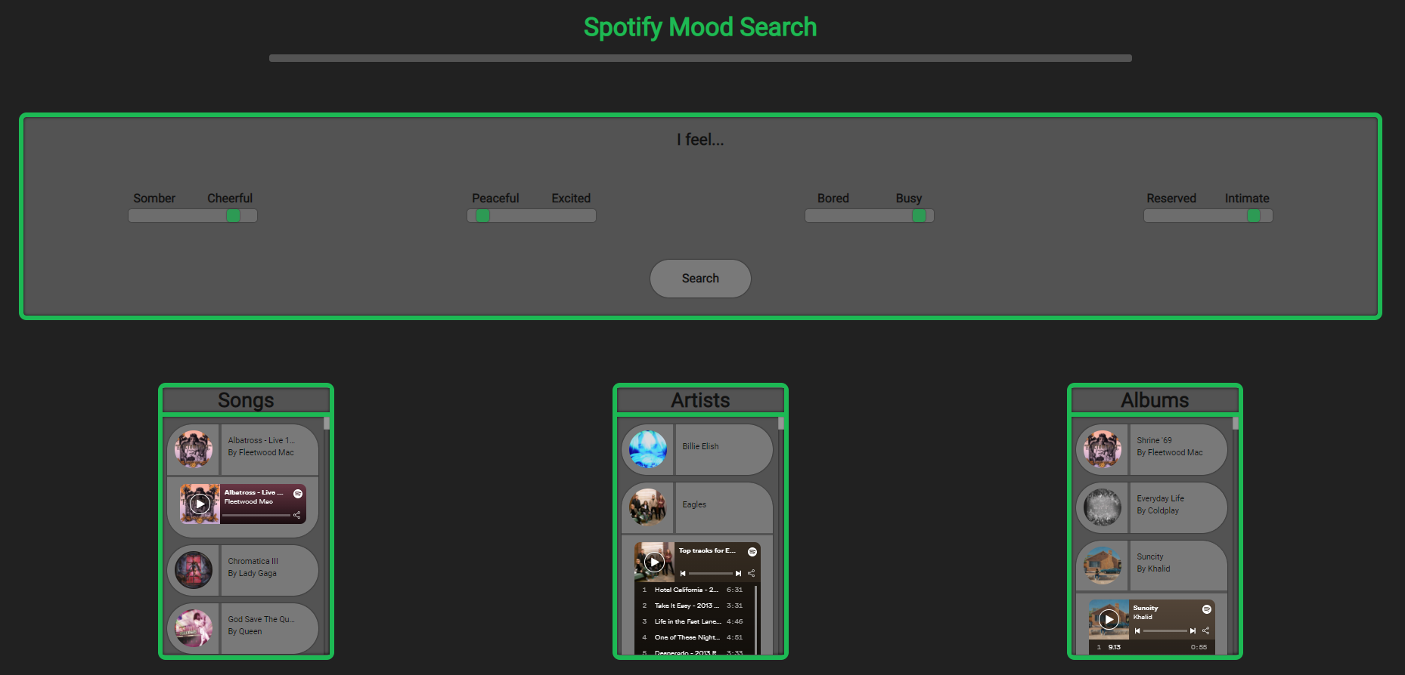
https://spotify-mood-search.herokuapp.com/

Slide 4
Technical Approach
Spotify provides songs rated with metrics like danceability, energy, instrumentalness
Our Algorithm:
Create input mood vector based on user’s selections on UI
Create and normalize centroids for every album and artist in the dataset
Compute cosine similarity for input and each song, artist, and album
Sort ranked lists based on similarity to input mood

Slide 5
Evaluation
Evaluation dataset created with 1000 songs
Relevance labels assigned to each song based on % similarity to input vector
Ex) .97<similarity%<=1 assigns relevance label of 8. .94<similarity%<=.97 assigns relevance label of 7.
Song ranking NDCG score = .950945
Album ranking NDCG score = .882538
Artist ranking NDCG score = .867102
Album and Artist NDCG scores are lower because they might have high variance in how their songs sound

Slide 6
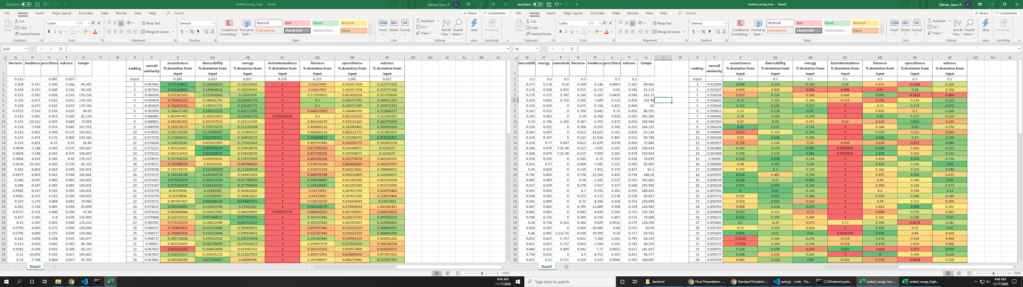
Error Analysis
Showing top 5 ranked songs from highly specified and unspecified input vectors
Greater deviance from input vector when inputs are not specified
Conclusion: Irrelevant sounding songs may be ranked highly when input is not specified
Non-musical songs and re-releases of albums affect ranking results
Remove documents with “Commentary”, “Remastered”, “Deluxe” in the name
Highly specified input vector
Unspecified input vector

Slide 7
Reflection
Had trouble deciding how to allocate user input to values
How to calculate and rank given user input
Decided to use sliders for users to compare their mood with the given bounds
Trouble with making the UI/Descriptions clear for the user
Added simple prompts for the user to select their mood from the description given
Good Understanding of Scope
Confidence/Familiarity with platform used
Great application of the similarity algorithm

Slide 8
Questions?

