Slide 1

Input, Output, and Automation in x86 Proved
Jason Gross
Hosted by Andrew Kennedy
Summer 2014

Slide 2
Verified I/O Programs
“
When doing formal verification, come up with the simplest non-trivial example you can. Then start with something simpler.
—Adam Chlipala (paraphrased)
”
Precondition
Postcondition
{true} {false}
while true do skip done
[]
I/O behavior

Slide 3
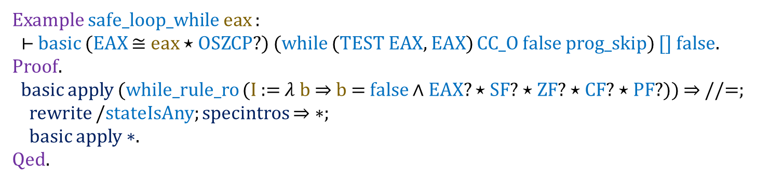
Verified I/O Programs: Trivial Loop
{true} {false}
while true do skip done
[]
Example safe_loop_while eax :
⊢ basic (EAX ≅ eax ⋆ OSZCP?) (while (TEST EAX, EAX) CC_O false prog_skip) [] false.
Proof.
basic apply (while_rule_ro (I := $λ$ b $⇒$ b = false ∧ EAX? ⋆ SF? ⋆ ZF? ⋆ CF? ⋆ PF?)) $⇒$ //=;
rewrite /stateIsAny; specintros $⇒$ $∗$;
basic apply $∗$.
Qed.

Slide 4
Verified I/O Programs: Trivial Loop
{true} {false}
while true do skip done
[]
I/O Spec
Precondition
Code
Postcondition
Example safe_loop_while eax :
⊢ basic (EAX ≅ eax ⋆ OSZCP?) (while (TEST EAX, EAX) CC_O false prog_skip) [] false.
Proof.
basic apply (while_rule_ro (I := $λ$ b $⇒$ b = false ∧ EAX? ⋆ SF? ⋆ ZF? ⋆ CF? ⋆ PF?)) $⇒$ //=;
rewrite /stateIsAny; specintros $⇒$ $∗$;
basic apply $∗$.
Qed.
Loop invariant

Slide 5
Verified I/O Programs: Eternal Output
{true} {false}
while true do out 1 done
1*
Kleene star
Example loop_forever_one channel :
⊢ basic ( AL?)
( MOV AL, 1;;
LOCAL LOOP;
LOOP:;;
OUT channel, AL;;
JMP LOOP)
1*
false.
Proof.
(elided)
Qed.

Slide 6
Verified I/O Programs: Eternal Output
{true} {false}
while true do out 1 done
1*
Example loop_forever_one channel :
⊢ loopy_basic ( AL?)
( MOV AL, (#1 : DWORD);;
LOCAL LOOP;
LOOP:;;
OUT channel, AL;;
JMP LOOP)
(starOP (outOP (zeroExtend n8 channel) (#1 : BYTE)))
lfalse.
Proof.
(still elided)
Qed.

Slide 7
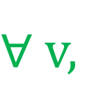
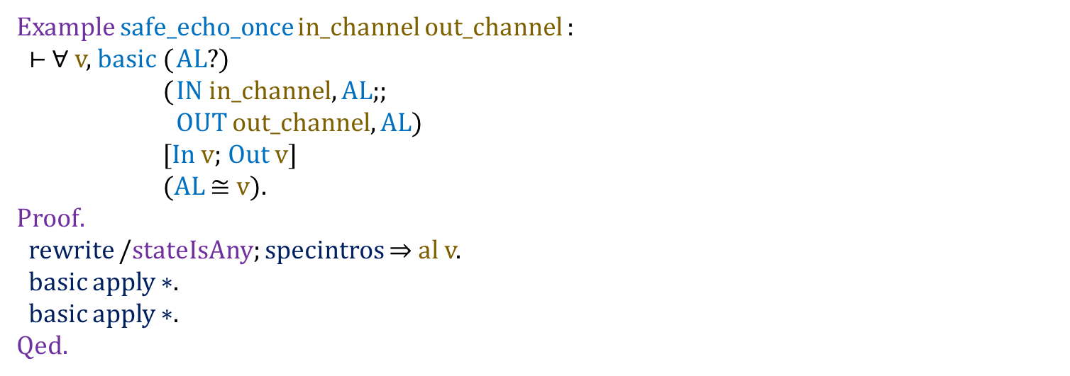
Verified I/O Programs: Echo Once
$∀$ v,
{true} {true}
v ← input; out v
In v; Out v
Example safe_echo_once in_channel out_channel :
⊢ ∀ v, basic ( AL?)
( IN in_channel, AL;;
OUT out_channel, AL)
[In v; Out v]
(AL $≅$ v).
Proof.
rewrite /stateIsAny; specintros $⇒$ al v.
basic apply $∗$.
basic apply $∗$.
Qed.

Slide 8
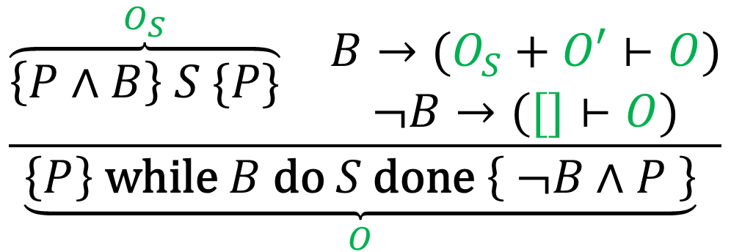
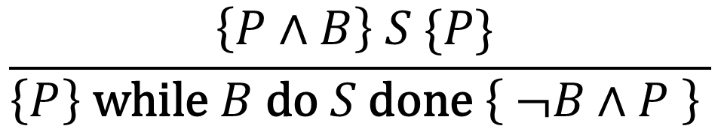

Digression: Hoare Rule for While
Standard rule from Wikipedia
$$\frac{\left\{P∧B\right\} S \{P\} }{\left\{P\right\} \text{while} B \text{do} S \text{done} \left\{ ¬B∧P \right\} }$$
The I/O doesn’t get to talk about state!
What’s $O′$?
Desired output annotations
$$\frac{\begin{matrix}\overset{O_{S}}{\overbrace{\left\{P∧B\right\} S \{P\}}} & \begin{matrix}B→(O_{S}+O′⊢O) \\ ¬B→([]⊢O)\end{matrix}\end{matrix}}{\underset{O}{\underbrace{\left\{P\right\} \text{while} B \text{do} S \text{done} \left\{ ¬B∧P \right\}}} }$$

Slide 9
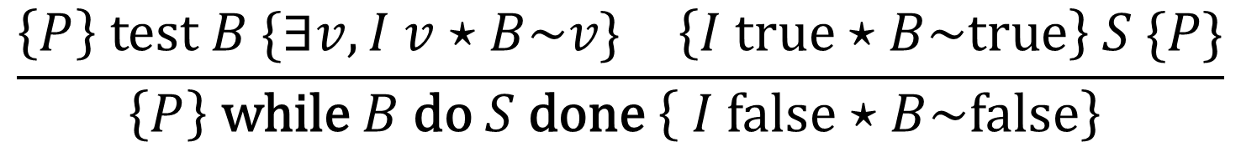
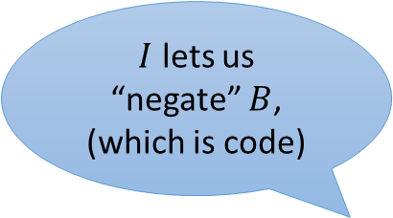
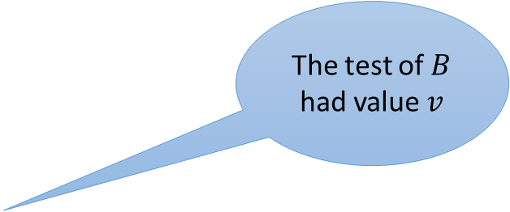
Digression: Hoare Rule for While
$$\frac{\left\{P∧B\right\} S \{P\} }{\left\{P\right\} \text{while} B \text{do} S \text{done} \left\{ ¬B∧P \right\} }$$
$I$ lets us “negate” $B$, (which is code)
The test of $B$ had value $v$
$$\frac{\begin{matrix}\left\{P\right\} test B \{∃v, I v⋆B\sim v\} & \left\{I true⋆B\sim true\right\} S \{P\}\end{matrix}}{\left\{P\right\} \text{while} B \text{do} S \text{done} \left\{ I false⋆B\sim false\right\} }$$

Slide 10
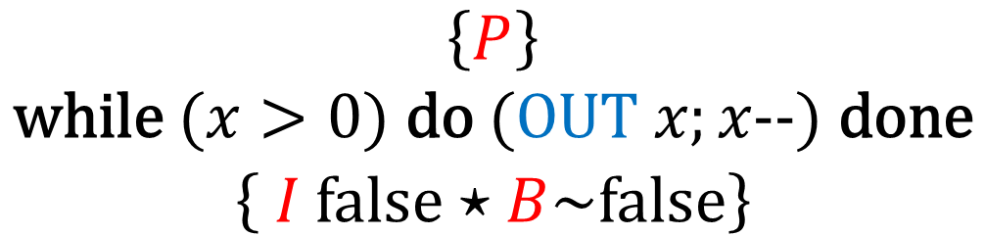
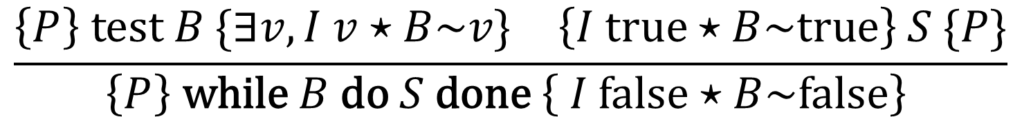
Digression: Hoare Rule for While
Example
$$\begin{aligned}\left\{P\right\} \\ \text{while} (x>0) \text{do} (OUT x;x\text{−−}) \text{done} \\ \left\{ I false⋆B\sim false\right\} \end{aligned}$$
We can drop B, which is technical info about flags
$$\frac{\begin{matrix}\left\{P\right\} test B \{∃v, I v⋆B\sim v\} & \left\{I true⋆B\sim true\right\} S \{P\}\end{matrix}}{\left\{P\right\} \text{while} B \text{do} S \text{done} \left\{ I false⋆B\sim false\right\} }$$

Slide 11
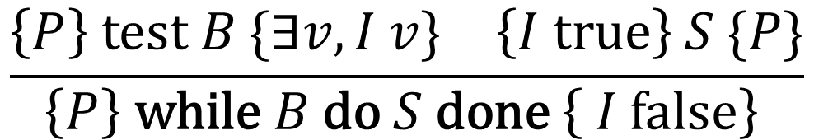
Digression: Hoare Rule for While
Example
$$\left\{P\right\} \text{while} (x>0) \text{do} (OUT x;x\text{−−}) \text{done} \left\{ I false\right\}$$
$$\frac{\begin{matrix}\left\{P\right\} test B \{∃v, I v\} & \left\{I true\right\} S \{P\}\end{matrix}}{\left\{P\right\} \text{while} B \text{do} S \text{done} \left\{ I false\right\} }$$

Slide 12



Digression: Hoare Rule for While
Example
$$\overline{\left\{true\right\} test (x>0) \{∃v, \left(x>0\right)=v\}}$$
$$\overline{\left\{x>0\right\} \left(OUT x;x\text{−−}\right) \{true\}}$$
$$\left\{true\right\} test (x>0) \{∃v, \left(x>0\right)=v\}$$
$$\left\{x>0\right\} \left(OUT x;x\text{−−}\right) \{true\}$$
$$\overline{\left\{true\right\} \text{while} (x>0) \text{do} (OUT x;x\text{−−}) \text{done} \left\{ x≤0\right\}}$$
$$\left\{true\right\} \text{while} (x>0) \text{do} (OUT x;x\text{−−}) \text{done} \left\{ x≤0\right\}$$
$$\frac{\begin{matrix}\left\{P\right\} test B \{∃v, I v\} & \left\{I true\right\} S \{P\}\end{matrix}}{\left\{P\right\} \text{while} B \text{do} S \text{done} \left\{ I false\right\} }$$

Slide 13
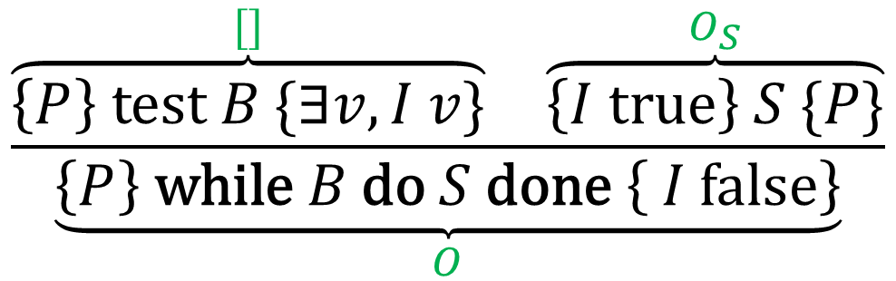
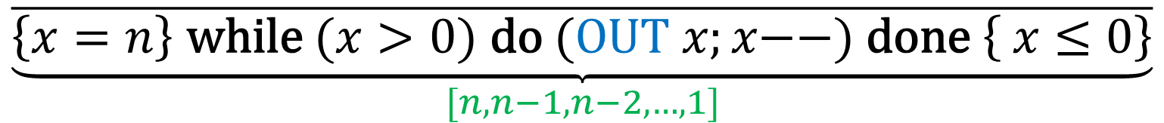

Digression: Hoare Rule for While
Example with output
$$\overline{\left\{true\right\} test (x>0) \{∃v, \left(x>0\right)=v\}}$$
$$\overline{\left\{x>0\right\} \left(OUT x;x\text{−−}\right) \{true\}}$$
$$\overline{\underset{[n,n−1,n−2,…,1]}{\underbrace{\left\{x=n\right\} \text{while} (x>0) \text{do} (OUT x;x\text{−−}) \text{done} \left\{ x≤0\right\}}}}$$
$$\frac{\begin{matrix}\overset{[]}{\overbrace{\left\{P\right\} test B \{∃v, I v\}}} & \overset{O_{S}}{\overbrace{\left\{I true\right\} S \{P\}}}\end{matrix}}{\underset{O}{\underbrace{\left\{P\right\} \text{while} B \text{do} S \text{done} \left\{ I false\right\}}}}$$
Worry about side conditions later

Slide 14

Digression: Hoare Rule for While
Example with output
Uh-oh!
$$\overline{\left\{x=n\right\} test (x>0) \{∃v, \left(x>0\right)=v\}}$$
$$\left\{x>0\right\} \left(OUT x;x\text{−−}\right) \{x=n\}$$
$$\overline{\underset{[n,n−1,n−2,…,1]}{\underbrace{\left\{x=n\right\} \text{while} (x>0) \text{do} (OUT x;x\text{−−}) \text{done} \left\{ x≤0\right\}}}}$$
$$\frac{\begin{matrix}\overset{[]}{\overbrace{\left\{P\right\} test B \{∃v, I v\}}} & \overset{O_{S}}{\overbrace{\left\{I true\right\} S \{P\}}}\end{matrix}}{\underset{O}{\underbrace{\left\{P\right\} \text{while} B \text{do} S \text{done} \left\{ I false\right\}}}}$$
Worry about side conditions later

Slide 15
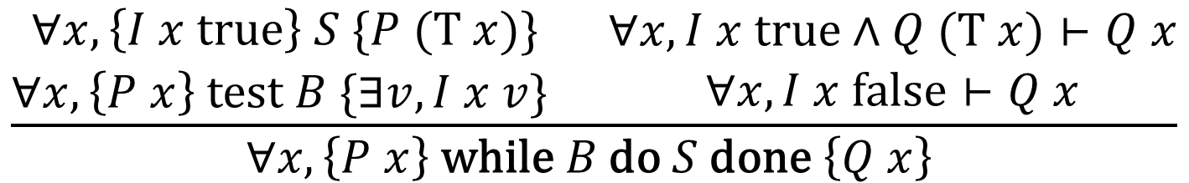
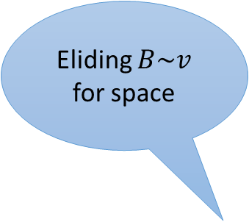
Digression: Hoare Rule for While
$$\frac{\left\{P∧B\right\} S \{P\} }{\left\{P\right\} \text{while} B \text{do} S \text{done} \left\{ ¬B∧P \right\} }$$
Eliding $B\sim v$ for space
“transition function”
$$\frac{\begin{matrix}\begin{matrix}∀x,\left\{I x true\right\} S \{P (T x)\} \\ ∀x,\left\{P x\right\} test B \{∃v, I x v\} \end{matrix} & \begin{matrix}∀x, I x true∧Q (T x)⊢Q x \\ ∀x, I x false⊢Q x\end{matrix}\end{matrix}}{∀x, \left\{P x\right\} \text{while} B \text{do} S \text{done} \left\{Q x\right\} }$$

Slide 16
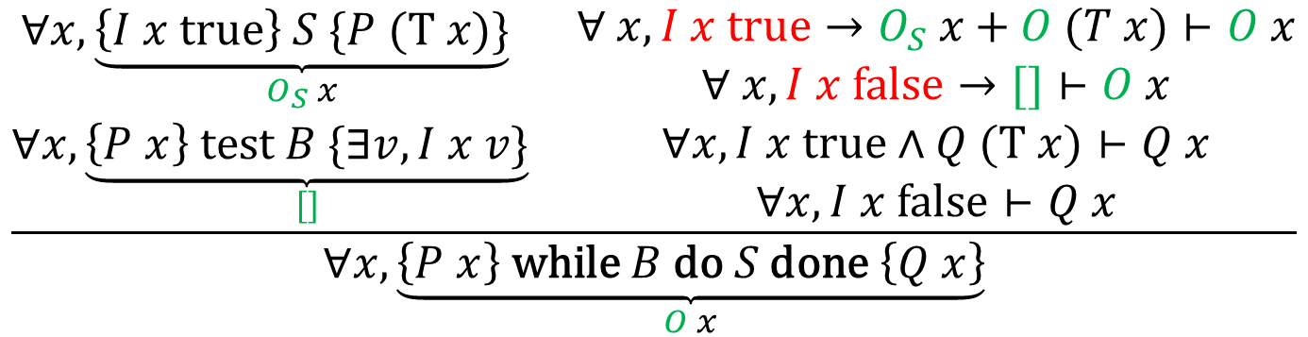
Digression: Hoare Rule for While
$$\frac{\left\{P∧B\right\} S \{P\} }{\left\{P\right\} \text{while} B \text{do} S \text{done} \left\{ ¬B∧P \right\} }$$
Can’t talk about state here
$$\frac{\begin{matrix}\begin{matrix}∀x,\underset{O_{S} x}{\underbrace{\left\{I x true\right\} S \{P (T x)\}}} \\ ∀x,\underset{[]}{\underbrace{\left\{P x\right\} test B \{∃v, I x v\}}}\end{matrix} & \begin{aligned}∀ x, I x true→O_{S} x+O (T x)⊢O x \\ ∀ x, I x false→[]⊢O x \\ ∀x, I x true∧Q (T x)⊢Q x \\ ∀x, I x false⊢Q x\end{aligned}\end{matrix}}{∀x, \underset{O x}{\underbrace{\left\{P x\right\} \text{while} B \text{do} S \text{done} \left\{Q x\right\}}}}$$

Slide 17
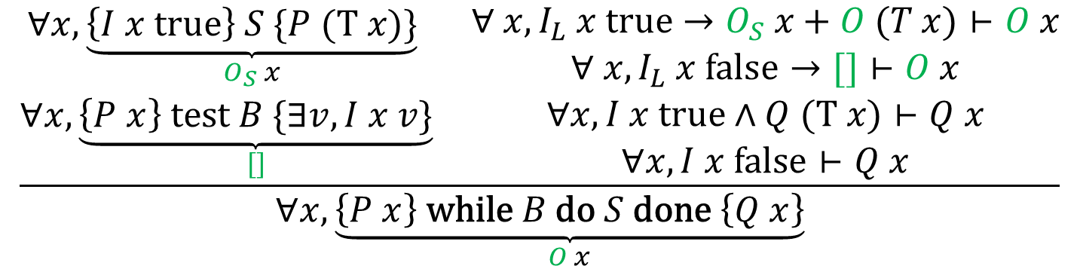
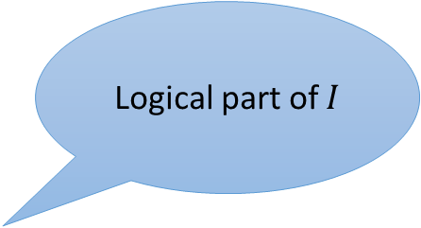
Digression: Hoare Rule for While
$$\frac{\left\{P∧B\right\} S \{P\} }{\left\{P\right\} \text{while} B \text{do} S \text{done} \left\{ ¬B∧P \right\} }$$
Logical part of $I$
$$\frac{\begin{matrix}\begin{matrix}∀x,\underset{O_{S} x}{\underbrace{\left\{I x true\right\} S \{P (T x)\}}} \\ ∀x,\underset{[]}{\underbrace{\left\{P x\right\} test B \{∃v, I x v\}}}\end{matrix} & \begin{aligned}∀ x, I_{L} x true→O_{S} x+O (T x)⊢O x \\ ∀ x, I_{L} x false→[]⊢O x \\ ∀x, I x true∧Q (T x)⊢Q x \\ ∀x, I x false⊢Q x\end{aligned}\end{matrix}}{∀x, \underset{O x}{\underbrace{\left\{P x\right\} \text{while} B \text{do} S \text{done} \left\{Q x\right\}}}}$$

Slide 18
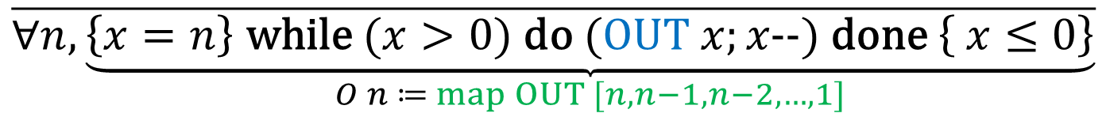


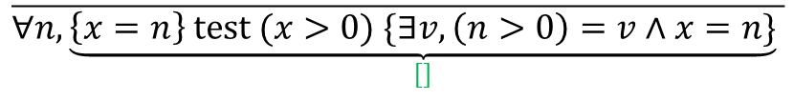
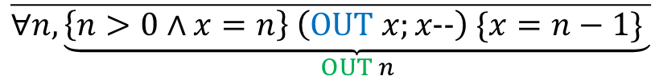

Digression: Hoare Rule for While
Example with output
$$\overline{∀n, \underset{OUT n}{\underbrace{\left\{n>0∧x=n\right\} \left(OUT x;x\text{−−}\right) \{x=n−1\} }}}$$
$$\overline{∀n,n>0→OUT n+O (n−1)⊢O n}$$
$$\overline{∀n,n≤0→[]⊢O n}$$
On-the-fly demo at the end, time and interest permitting
$$\overline{∀n,\underset{[]}{\underbrace{\left\{x=n\right\} test (x>0) \{∃v, \left(n>0\right)=v∧x=n\}}} }$$
$$\overline{∀n,n>0∧x=n∧x≤0⊢x≤0}$$
$$\overline{∀n,n≤0∧x=n⊢x≤0}$$
$$\overline{∀n,\underset{O n ≔ map OUT [n,n−1,n−2,…,1]}{\underbrace{\left\{x=n\right\} \text{while} (x>0) \text{do} (OUT x;x\text{−−}) \text{done} \left\{ x≤0\right\}}}}$$
$$\frac{\begin{matrix}\begin{matrix}∀x,\underset{O_{S} x}{\underbrace{\left\{I x true\right\} S \{P (T x)\}}} \\ ∀x,\underset{[]}{\underbrace{\left\{P x\right\} test B \{∃v, I x v\}}}\end{matrix} & \begin{aligned}∀ x, I_{L} x true→O_{S} x+O (T x)⊢O x \\ ∀ x, I_{L} x false→[]⊢O x \\ ∀x, I x true∧Q (T x)⊢Q x \\ ∀x, I x false⊢Q x\end{aligned}\end{matrix}}{∀x, \underset{O x}{\underbrace{\left\{P x\right\} \text{while} B \text{do} S \text{done} \left\{Q x\right\}}}}$$

Slide 19
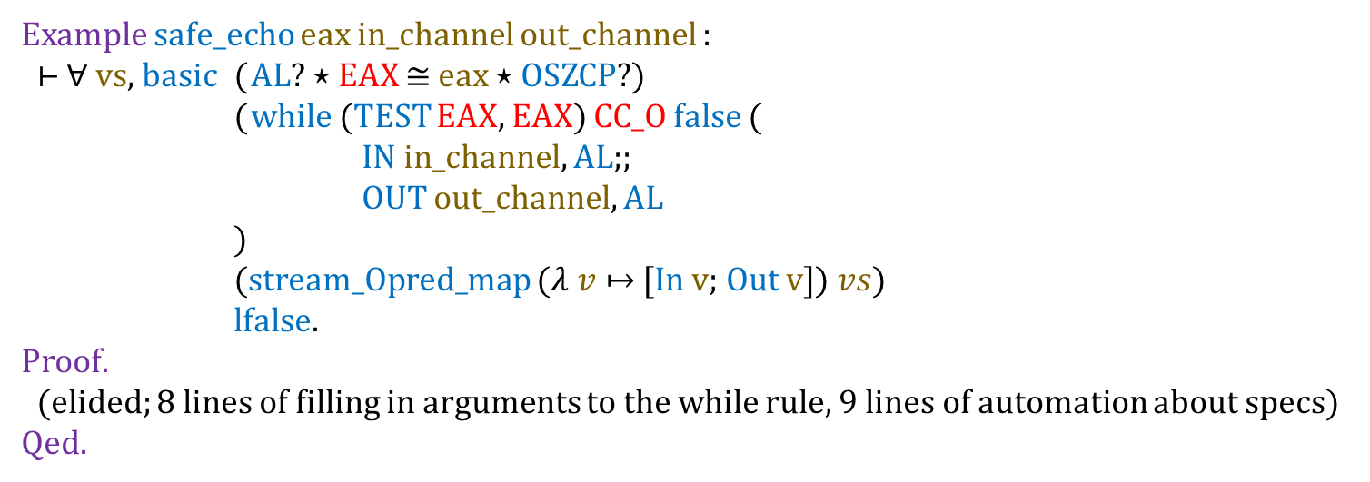
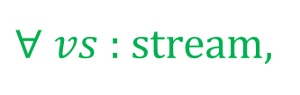
Verified I/O Programs: Echo
$∀$ $vs$ : stream,
{true} {true}
while true do (v ← input; out v) done
map ($v↦$ In $v$; Out $v$) $vs$
Example safe_echo eax in_channel out_channel :
⊢ ∀ vs, basic ( AL? ⋆ EAX $≅$ eax ⋆ OSZCP?)
( while (TEST EAX, EAX) CC_O false (
IN in_channel, AL;;
OUT out_channel, AL
)
(stream_Opred_map ($λ v↦$ [In v; Out v]) $vs$)
lfalse.
Proof.
(elided; 8 lines of filling in arguments to the while rule, 9 lines of automation about specs)
Qed.

Slide 20
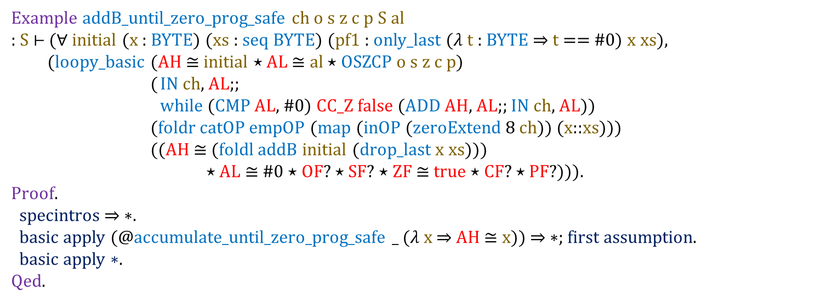
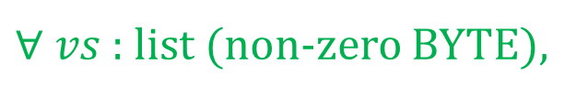
Verified I/O Programs: Accumulator
$∀$ $vs$ : list (non-zero BYTE),
{acc=x}
{acc = fold accumulate x vs}
while ((v ← input) $≠$ 0) do (acc = accumulate acc v) done
map ($v↦$ In $v$) $vs$
Example addB_until_zero_prog_safe ch o s z c p S al
: S $⊢$ ($∀$ initial (x : BYTE) (xs : seq BYTE) (pf1 : only_last ($λ$ t : BYTE ⇒ t == #0) x xs),
(loopy_basic (AH ≅ initial ⋆ AL $≅$ al ⋆ OSZCP o s z c p)
( IN ch, AL;;
while (CMP AL, #0) CC_Z false (ADD AH, AL;; IN ch, AL))
(foldr catOP empOP (map (inOP (zeroExtend 8 ch)) (x::xs)))
((AH ≅ (foldl addB initial (drop_last x xs)))
⋆ AL ≅ #0 ⋆ OF? ⋆ SF? ⋆ ZF ≅ true ⋆ CF? ⋆ PF?))).
Proof.
specintros ⇒ ∗.
basic apply (@accumulate_until_zero_prog_safe _ (𝜆 x ⇒ AH ≅ x)) ⇒ ∗; first assumption.
basic apply ∗.
Qed.

Slide 21
Verified I/O Programs: Next Steps
readline (via accumulator template)
prime number printer
text adventure?
use memory-mapped I/O rather than IN and OUT

Slide 22
Automation

Slide 23

Instruction Automation: Ideal
Define the instruction in the model
State the high-level (e.g., Hoare) rule
Push-button verification
Maybe even omit 2, if the inference is good enough.
Image from https://flic.kr/p/3KYpfJ, “State of Mind”, tshein

Slide 24
Instruction Automation: Reality
Define the instruction in the model
Definition evalBinOp {n} op : BITS n → BITS n → ST (BITS n) :=
match op with
| OP_XOR ⇒ evalLogicalOp xorB
…
end.
Definition evalLogicalOp {n} (f : BITS n → BITS n → BITS n) arg1 arg2 :=
let result := f arg1 arg2 in
do! updateFlagInProcState CF false;
do! updateFlagInProcState OF false;
do! updateZPS result;
retn result.

Slide 25
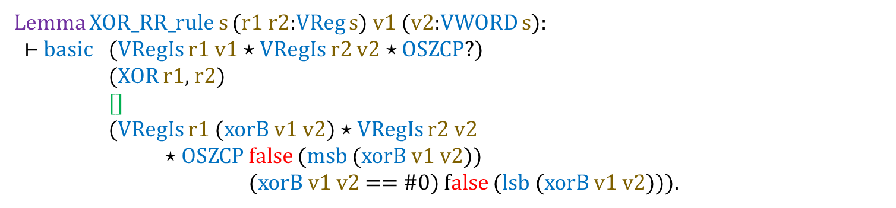
Instruction Automation: Reality
State the high-level (e.g., Hoare) rule
Lemma XOR_RR_rule s (r1 r2:VReg s) v1 (v2:VWORD s):
$⊢$ basic (VRegIs r1 v1 ⋆ VRegIs r2 v2 ⋆ OSZCP?)
(XOR r1, r2)
[]
(VRegIs r1 (xorB v1 v2) ⋆ VRegIs r2 v2
⋆ OSZCP false (msb (xorB v1 v2))
(xorB v1 v2 == #0) false (lsb (xorB v1 v2))).

Slide 26
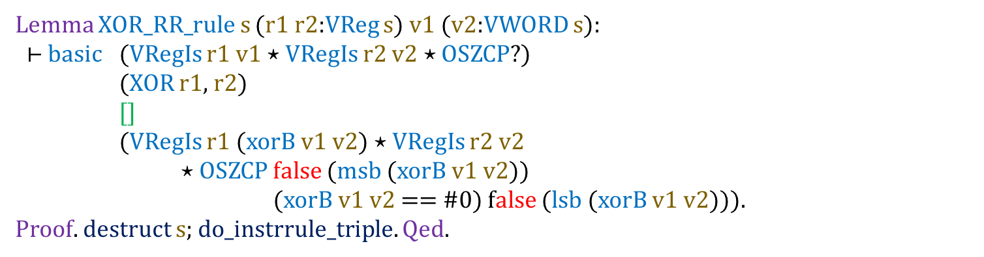
Instruction Automation: Reality
Push-button verification
Lemma XOR_RR_rule s (r1 r2:VReg s) v1 (v2:VWORD s):
$⊢$ basic (VRegIs r1 v1 ⋆ VRegIs r2 v2 ⋆ OSZCP?)
(XOR r1, r2)
[]
(VRegIs r1 (xorB v1 v2) ⋆ VRegIs r2 v2
⋆ OSZCP false (msb (xorB v1 v2))
(xorB v1 v2 == #0) false (lsb (xorB v1 v2))).
Proof. destruct s; do_instrrule_triple. Qed.

Slide 27
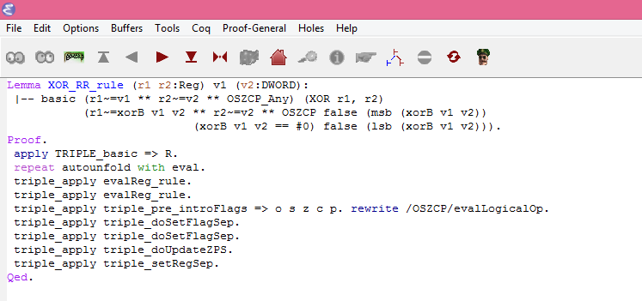
Instruction Automation: Old Reality
Push-button verification

Slide 28
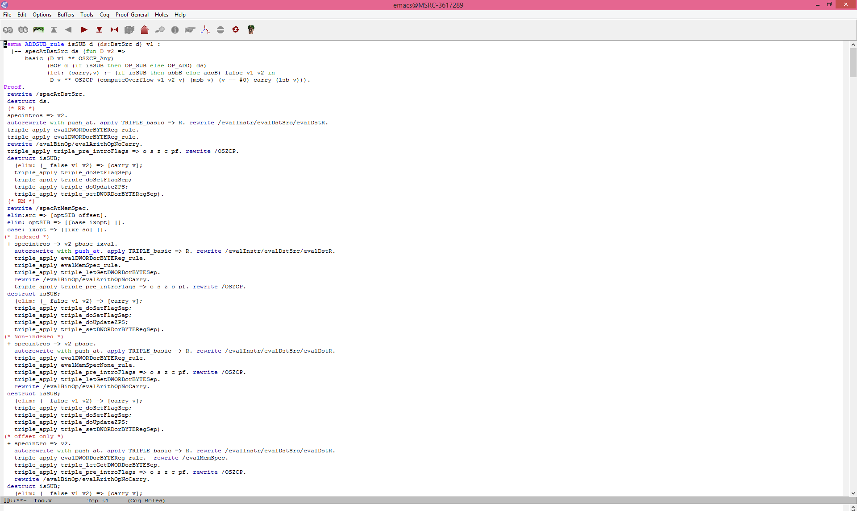
Instruction Automation: Old Reality

Slide 29
Instruction Automation: Mechanics
Lookup
Application
Heuristics
Lemma XOR_RR_rule s (r1 r2:VReg s) v1 (v2:VWORD s):
$⊢$ basic (VRegIs r1 v1 ⋆ VRegIs r2 v2 ⋆ OSZCP?)
(XOR r1, r2)
[]
(VRegIs r1 (xorB v1 v2) ⋆ VRegIs r2 v2
⋆ OSZCP false (msb (xorB v1 v2))
(xorB v1 v2 == #0) false (lsb (xorB v1 v2))).
Proof. destruct s; do_instrrule_triple. Qed.

Slide 30
Instruction Automation: Mechanics
Automated timing scripts helped ensure that the automation didn’t slow things down unreasonably.
Example diff
After | File Name | Before || Change
------------------------------------------------------------
17m33.61s | Total | 18m51.54s || -1m17.92s
------------------------------------------------------------
0m35.85s | examples/mulc | 0m42.18s || -0m06.32s
0m33.42s | examples/specexamples | 0m27.19s || +0m06.23s
0m24.29s | x86/lifeimp | 0m30.41s || -0m06.12s
0m17.60s | x86/inlinealloc | 0m21.79s || -0m04.18s
0m27.75s | x86/imp | 0m31.41s || -0m03.66s
0m17.56s | x86/instrrules/mov | 0m20.79s || -0m03.23s
0m15.76s | x86/call | 0m19.29s || -0m03.52s
0m51.82s | x86/instrrules/addsub | 0m54.54s || -0m02.71s
0m33.68s | x86/instrrules/cmp | 0m35.90s || -0m02.21s
0m27.69s | x86/cfuncspec | 0m29.79s || -0m02.09s
0m25.84s | x86/screenproof | 0m28.47s || -0m02.62s
0m19.90s | x86/instrcodec | 0m22.39s || -0m02.49s
0m26.98s | triple/set | 0m28.91s || -0m01.92s

Slide 31
Program Automation: Ideal
Write a program
State the spec
Sprinkle annotations
Push-button verification
Maybe even omit 3, if the inference is good enough.
Image from https://flic.kr/p/3KYpfJ, “State of Mind”, tshein

Slide 32
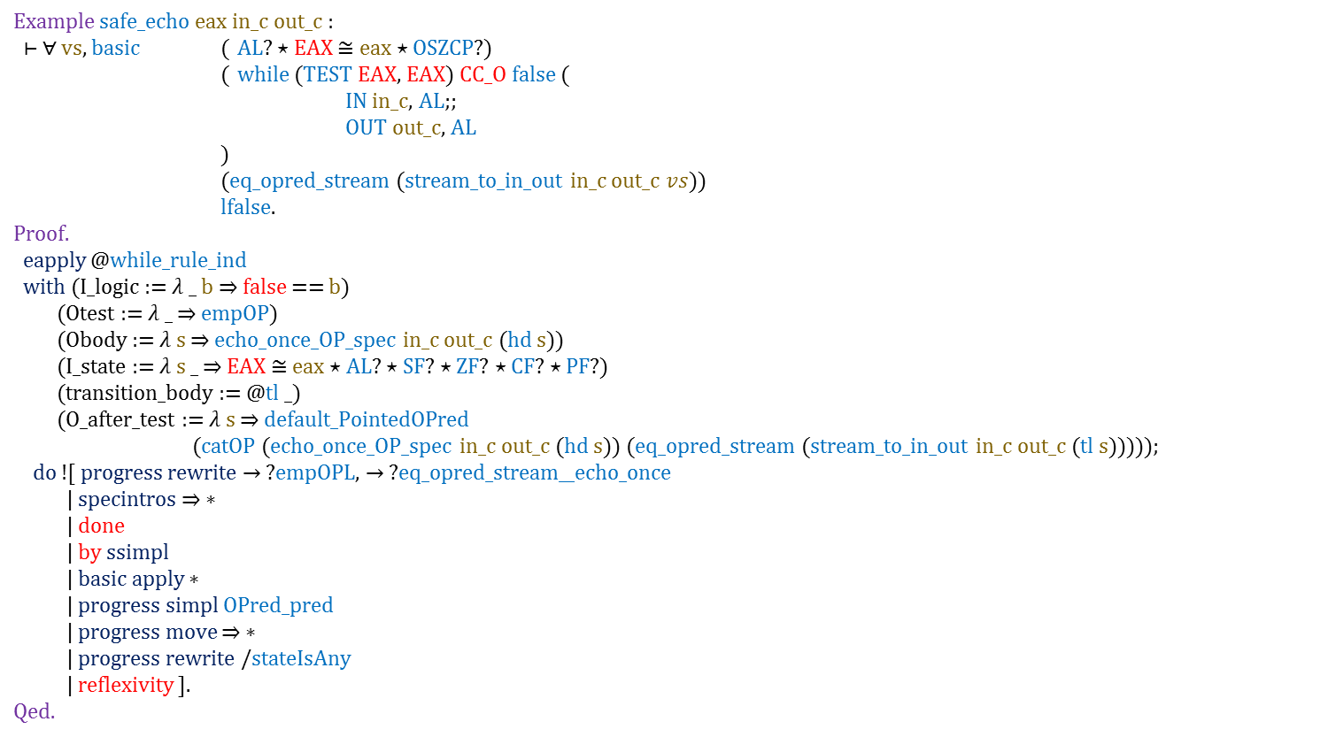
Program Automation:
Reality
specapply ∗ takes care of essentially all of the unstructured code reasoning
Example safe_echo eax in_c out_c :
⊢ ∀ vs, basic ( AL? ⋆ EAX $≅$ eax ⋆ OSZCP?)
( while (TEST EAX, EAX) CC_O false (
IN in_c, AL;;
OUT out_c, AL
)
(eq_opred_stream (stream_to_in_out in_c out_c $vs$))
lfalse.
Proof.
eapply @while_rule_ind
with (I_logic := 𝜆 _ b ⇒ false == b)
(Otest := 𝜆 _ ⇒ empOP)
(Obody := 𝜆 s ⇒ echo_once_OP_spec in_c out_c (hd s))
(I_state := 𝜆 s _ ⇒ EAX $≅$ eax ⋆ AL? ⋆ SF? ⋆ ZF? ⋆ CF? ⋆ PF?)
(transition_body := @tl _)
(O_after_test := 𝜆 s ⇒ default_PointedOPred
(catOP (echo_once_OP_spec in_c out_c (hd s)) (eq_opred_stream (stream_to_in_out in_c out_c (tl s)))));
do ![ progress rewrite → ?empOPL, → ?eq_opred_stream__echo_once
| specintros ⇒ ∗
| done
| by ssimpl
| basic apply ∗
| progress simpl OPred_pred
| progress move ⇒ ∗
| progress rewrite /stateIsAny
| reflexivity ].
Qed.
basic apply ∗ takes care of all of the code reasoning here

Slide 33
Program Automation: Mechanics
Lookup (via typeclasses)
Application (via helper lemmas)
Heuristics (for side conditions)

Slide 34
Open Issues

Slide 35

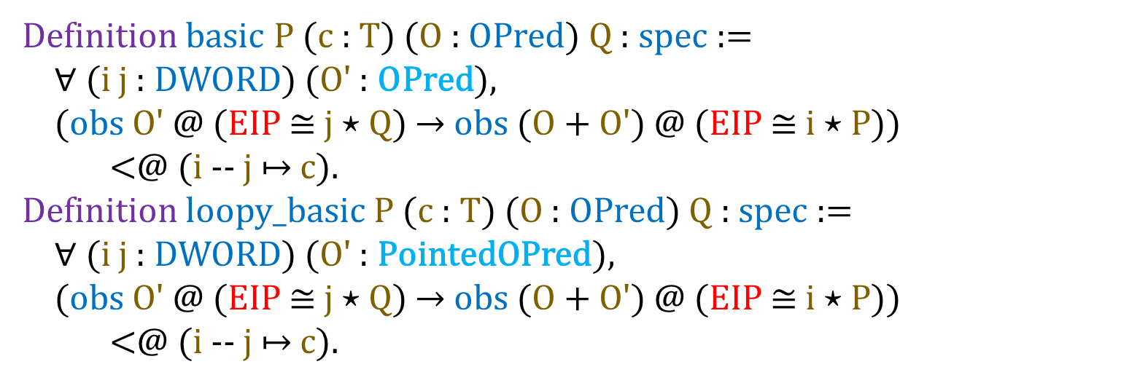
Open Issues: Pointy Predicates
Definition basic P (c : T) (O : OPred) Q : spec :=
$∀$ (i j : DWORD) (O' : OPred),
(obs O' @ (EIP $≅$ j $⋆$ Q) $→$ obs (O + O') @ (EIP $≅$ i $⋆$ P))
<@ (i -- j $↦$ c).
Definition loopy_basic P (c : T) (O : OPred) Q : spec :=
$∀$ (i j : DWORD) (O' : PointedOPred),
(obs O' @ (EIP $≅$ j $⋆$ Q) $→$ obs (O + O') @ (EIP $≅$ i $⋆$ P))
<@ (i -- j $↦$ c).
Image from https://flic.kr/p/ab1bwS, “Spiky balls” Tom Magliery

Slide 36
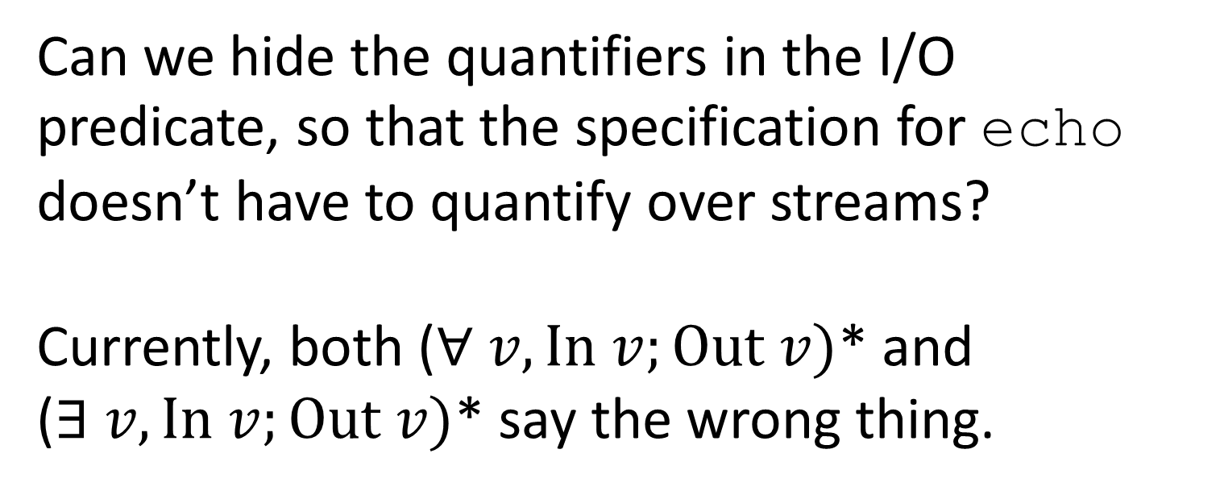
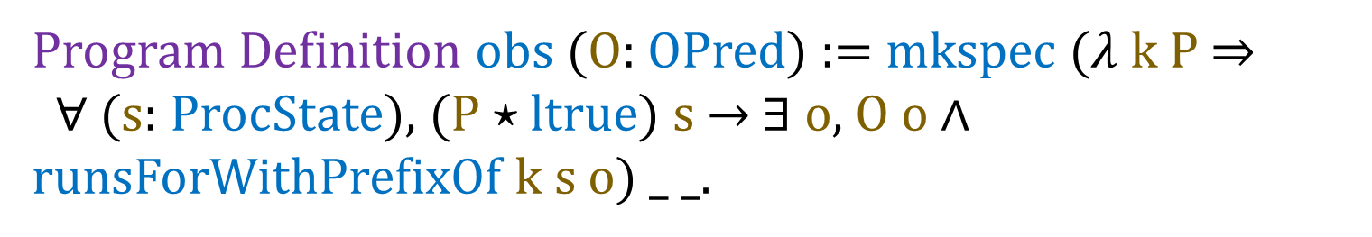
Open Issues: Quantifier Location
Program Definition obs (O: OPred) := mkspec ($λ$ k P $⇒$
$∀$ (s: ProcState), (P $⋆$ ltrue) s $→$ $∃$ o, O o $∧$ runsForWithPrefixOf k s o) _ _.
Can we hide the quantifiers in the I/O predicate, so that the specification for echo doesn’t have to quantify over streams?
Currently, both ($∀ v, In v;Out v)$* and ($∃ v, In v;Out v)$* say the wrong thing.

Slide 37
Take Home Messages
We can verify the I/O behavior of simple assembly programs.
Putting effort into Coq automation results in tactics which are:
comparable in speed to manual proofs
capable of push-button verification in well-specified domains

Slide 38
Acknowledgements
Thanks to:
Andrew Kennedy, my host here at MSR, and Nick Benton, who is also on this project.
Georges Gonthier, for help with Coq and SSReflect
Jonas Jensen, Jesper Bengtson, Gregory Malecha, and Edward Z. Yang for discussions about various aspects of I/O specifications, among other things.

Slide 39
Thanks! Questions? Requests for verification demo?

