Slide 1

Efficient and Verified Finite-Field Operations
Andres Erbsen, Jade Philipoom, Jason Gross, Robert Sloan, Adam Chlipala
RWC 2019
github.com/mit-plv/fiat-crypto
Notes:
Good morning RWC, and thank you for choosing my talk over an additional 25 minutes of sleep.
I am Andres Erbsen, and I am presenting the work that my colleagues and I have been doing at MIT.
This project explored a new workflow for implementing finite field arithmetic with very high assurance of correctness.
All code is open source, and the repository linked in the slides also contains pointers to more detailed write-ups.
But first, let’s take a look at the state of practice today.

Slide 2
Example of Tricky Tedium: P256 mul
// smallfelem_mul sets |out| = |small1| * |small2|
// On entry: small1[i] < 2^64 and small2[i] < 2^64
// On exit: out[i] < 7 * 2^64 < 2^67.
static void smallfelem_mul(longfelem out, const smallfelem small1,const smallfelem small2){
limb a;
uint64_t high, low;
a = ((uint128_t)small1[0]) * small2[0];
low = a;
high = a >> 64;
out[0] = low;
out[1] = high;
a = ((uint128_t)small1[0]) * small2[1];
low = a;
high = a >> 64;
out[1] += low;
out[2] = high;
a = ((uint128_t)small1[1]) * small2[0];
low = a;
high = a >> 64;
out[1] += low;
out[2] += high;
a = ((uint128_t)small1[0]) * small2[2];
low = a;
high = a >> 64;
out[2] += low;
out[3] = high;
a = ((uint128_t)small1[1]) * small2[1];
low = a;
high = a >> 64;
out[2] += low;
out[3] += high;
a = ((uint128_t)small1[2]) * small2[0];
` low = a;
high = a >> 64;
out[2] += low;
out[3] += high;
a = ((uint128_t)small1[0]) * small2[3];
low = a;
high = a >> 64;
out[3] += low;
out[4] = high;
a = ((uint128_t)small1[1]) * small2[2];
low = a;
high = a >> 64;
out[3] += low;
out[4] += high;
a = ((uint128_t)small1[2]) * small2[1];
low = a;
high = a >> 64;
out[3] += low;
out[4] += high;
a = ((uint128_t)small1[3]) * small2[0];
low = a;
high = a >> 64;
out[3] += low;
out[4] += high;
a = ((uint128_t)small1[1]) * small2[3];
low = a;
high = a >> 64;
out[4] += low;
out[5] = high;
a = ((uint128_t)small1[2]) * small2[2];
low = a;
high = a >> 64;
out[4] += low;
out[5] += high;
a = ((uint128_t)small1[3]) * small2[1];
low = a;
high = a >> 64;
out[4] += low;
out[5] += high;
a = ((uint128_t)small1[2]) * small2[3];
low = a;
high = a >> 64;
out[5] += low;
out[6] = high;
a = ((uint128_t)small1[3]) * small2[2];
low = a;
high = a >> 64;
out[5] += low;
out[6] += high;
a = ((uint128_t)small1[3]) * small2[3];
low = a;
high = a >> 64;
out[6] += low;
out[7] = high;
}
Notes:
This is an excerpt from a good implementation of field element multiplication for the P256 elliptic curve.
–
It is probably too small for many of you to read, but rest assured, you are not missing much insight.
And this is not all of it, the modular reduction is on the next slide.

Slide 3
...and the reduction (64-bit)
static void felem_shrink(
smallfelem out,
const felem in) {
felem tmp;
u64 a, b, mask;
s64 high, low;
static const u64 kPrime3Test = 0x7fffffff00000001ul;
tmp[3] = zero110[3] + in[3] +
((u64)(in[2] >> 64));
tmp[2] = zero110[2] + (u64)in[2];
tmp[0] = zero110[0] + in[0];
tmp[1] = zero110[1] + in[1];
a = tmp[3] >> 64;
tmp[3] = (u64)tmp[3];
tmp[3] -= a;
tmp[3] += ((limb)a) << 32;
b = a;
a = tmp[3] >> 64;
b += a;
tmp[3] = (u64)tmp[3];
tmp[3] -= a;
tmp[3] += ((limb)a) << 32;
tmp[0] += b;
tmp[1] -= (((limb)b) << 32);
high = tmp[3] >> 64;
high = ~(high - 1);
low = tmp[3];
mask = low >> 63;
low &= bottom63bits;
low -= kPrime3Test;
low = ~low;
low >>= 63;
mask = (mask & low) | high;
tmp[0] -= mask & kPrime[0];
tmp[1] -= mask & kPrime[1];
tmp[3] -= mask & kPrime[3];
tmp[1] += ((u64)(tmp[0] >> 64));
tmp[0] = (u64)tmp[0];
tmp[2] += ((u64)(tmp[1] >> 64));
tmp[1] = (u64)tmp[1];
tmp[3] += ((u64)(tmp[2] >> 64));
tmp[2] = (u64)tmp[2];
out[0] = tmp[0];
out[1] = tmp[1];
out[2] = tmp[2];
out[3] = tmp[3];
}
Notes:
I find it useful to separate the complexities in this kind of code into two categories.
–
First, there are low-level optimizations, such as the manually unrolled multiplication loop on the previous slide and the use of bit-shifts for multiplication here.
But more importantly, the algorithm itself that is being implemented is tricky, and correctly applying it to p256 requires careful thought.

Slide 4
Reduction Algorithm for 32-bit CPUs
A = (A₁₅,A₁₄,A₁₃,A₁₂,A₁₁,A₁₀,A₉,A₈,A₇,A₆,A₅,A₄,A₃,A₂,A₁,A₀)
T = (A₇, A₆, A₅, A₄, A₃, A₂, A₁, A₀)
S₁ = (A₁₅, A₁₄, A₁₃, A₁₂, A₁₁, 0, 0, 0)
S₂ = (0, A₁₅, A₁₄, A₁₃, A₁₂, 0, 0, 0)
S₃ = (A₁₅, A₁₄, 0, 0, 0, A₁₀, A₉, A₈)
S₄ = (A₈, A₁₃, A₁₅, A₁₄, A₁₃, A₁₁, A₁₀, A₉)
D₁ = (A₁₀, A₈, 0, 0, 0, A₁₃, A₁₂, A₁₁)
D₂ = (A₁₁, A₉, 0, 0, A₁₅, A₁₄, A₁₃, A₁₂)
D₃ = (A₁₂, 0, A₁₀, A₉, A₈, A₁₅, A₁₄, A₁₃)
D₄ = (A₁₃, 0, A₁₁, A₁₀, A₉, 0, A₁₅, A₁₄)
A mod p256 = T+2S₁+2S₂+S₃+S₄−D₁−D₂−D₃−D_{4 mod p256}
Notes:
Here is a pseudo-code for the same operation on a 32-bit machine, with a lot of low-level detail omitted. It is still tricky. Could you spot a typo, or convince yourself that there isn’t one?
Just to be clear, there is some method to the madness here, and implementation experts (many of whom are in this room right now) know how to work it.

Slide 5

Finite Field Implementations – Status Quo
Operations
Prime #s
HW Arches


Limiting factor: experts are busy and fallible.
Notes:
And because this level of manual specialized implementation is seen as necessary to achieve satisfactory performance, it is done over and over again for each operation, each prime, and each class of target hardware.
Now, in this room we have a good number of experts who actually know how to write this code and do it well. But the time and attention of experts is limited, and there is an unfortunate tradeoff between effort spent auditing existing implementations and writing new ones.
And of course, hunting for typos or arithmetic errors in code such as that on the previous slide is hardly a glamurous job, especially if the conclusion is that there probabbly aren’t any.

Slide 6
A Different Finite-Field Library
Boring from the programmer’s perspective
  from_bytes, +, *, -, …, to_bytes
Computer-checkable proofs of correctness (Coq)
Many fields & CPUs; compile-time specialization
As fast as handwritten C for Curve25519, P256
Used in BoringSSL, Ring, Titan, WireGuard
Notes:
Thus, we decided to do something different, while maintaining the same API.
However, I would like to point out three unusual aspects of our field arithmetic library.
First, all of our code comes with computer-checkable proofs of full functional correctness, that is that for all inputs the output of our code matches that of a naive reference implementation.
Second, the source code for arithmetic implementation is shared between multiple finite fields and hardware architectures. During compilation, the generic implementation gets specialized to specific parameters, for example “curve25519 using 10 limbs and 32-bit multiplication”.
This does not come at the cost of performance – for the most important curves, our generated C code is faster than previous hand-written C code.
Our generated implementations are already included in some popular cryptography libraries: …
5min?

Slide 7
demo of push-button synthesis
Notes:
Now, let’s take a look at the functionality our toolchain provides. For example, the standard implementation of curve25519 using 64-bit multiplication can be summoned as follows.
NAME LIMBS S C BITWIDTH carry_mul
curve25519 5 2\^255 1,19 64 carry_mul
Otoh, poly1305 also needs a finite field implementation. And let’s target a machine that only supports multiplying 32-bit integers just for variery:
poly1305 5 '2^130' 1,5 32 carry_mul
Of course, some primes do not allow for simple unsaturated implementations, so we also have a code generator for Montgomery reduction. For example, P256:
P256 '2^256' '2^224,1;2^192,-1;2^96,-1;1,1' 64

Slide 8
Coq – Interactive Proof Assistant
A functional programming language for definitions
Theorem statements in the same language
Various means of generating proofs
  Scripting (imagine shell, JavaScript)
  Already-proven algorithms (static analysis)
One relatively small checker for all proofs
Notes:
In the implementation of this we rely heavily on the Coq proof assistant. For the purposes of understanding this work, there are really three key parts to coq.
First, coq is a proof assistant for mathematics. It has a built-in language for mathematical definitions. This language is purely functional, so if you know Haskell or safe rust, it is kind-of like that. Theorem statements are written in the same language, code in other languages can be analyzed, for example, by writing an interpreter for that language.
Coq has a strong separation between generation and checking of proofs. There is one algorithm that checks all proofs against their respective theorem statements, and considering only the core Coq features, that trusted base is relatively small.
Proofs can be generated in various ways. There is a built-in scripting language that unites the expressiveness of assembly with the performance and simplicity and javascript.
Furthermore, algorithms implemented and proven correct in coq can be executed to check some property of the code in question, for example, we use this technique to prove that our code does not have undesired integer overflow.

Slide 9
Our Algorithm-Centric Workflow
Specification
mulmod a b :=
a * b mod m
Notes:
Let me tell you about how our library is structured.
First of all, there are specifications for individual finite field operations. Each one is only a couple of lines, defining the finite field operation in terms of integer arithmetic in the Coq standard library. The low-level interface specification also includes bounds preconditions.

Slide 10
Our Algorithm-Centric Workflow
Specification
mulmod a b :=
a * b mod m
Template Implementation
Proof
Let reduce s c p :=
let (lo, hi)
:= split s p in
add lo (mul c hi).
Notes:
Then, there are implementation templates, for example “unsaturated Solinas reduction” or “word-by-word Montgomery reduction”.
Each of these is proven correct once, for all possible compile-time parameters and run-time inputs. For example, 32-bit and 64-bit Curve25519 and the poly1305 example I showed below all use the same code and are certified by the same proof.
Writing a generic implementation is hard work, the high-level code needs to anticipate low-level optimizations. But in our experience is much simpler than writing specific code directly – for example, these implementations do not need to worry about sizes of finite integer types and overflow. I will say more about this soon, but first let’s take a look at how this Coq code is turned into C that a can dropped into a normal library.

Slide 11
Our Algorithm-Centric Workflow
Specification
mulmod a b :=
a * b mod m
Template Implementation
Proof
Let reduce s c p :=
let (lo, hi)
:= split s p in
add lo (mul c hi).
Parameter
Selection
Specialization
Micro-
optimization
cc
Notes:
First, we need to specify the parameters of the implementation template, for example the number of limbs and the modulus. This is the “64” and “19” from the example I showed on the command line.
Some low-level parameters such as the bounds preconditions for each limb are inferred using heuristics and not passed on the CLI I showed.
Then the implementation is specialized to the parameters using partial evaluation. This is similar to very aggressive constant propagatipon, for example lists and loops in the generic code get replaced with operations on individual variables. The simplified code does not need dynamic memory management.
In the end, there are some low-level rewriting and peephole optimizations, and we use a standard C compiler to turn our generated code into machine code.

Slide 12
Template Implementations
Inputs and output: list of limb weights and values
Mathematical integers, no overflow!
mul [(a,x), …] [(b,y), …] = [(a*b, x*y), …]
Lists and weights optimized away
Bitwidths chosen based on ranges
Notes:
Now, let’s take a look at what the generic implementations actually look like so that partial evaluation suffices to turn them into efficient use-case-specific code. They are quite different from run-time-generic bignum libraries. our code has more parameters, and is very inefficient if executed without partial evaluation.
A key design decision to simplify the generic implementations was to carry information about the representation along with the numbers being represented. A field element is not represented as an array of limb values, instead it is a list of pairs: each limb and its value. The value represented in this way can be recovered using a dot product.
The limb weights do not persist to run-time, but the generic implementations rely on them heavily, for example to decide how to shift partial products during modular reduction.
Similarly, the weights influence the fixed-size integers eventually chosen for each variable.

Slide 13
Multiplication: Code & Proof
Definition mul (p q : list (Z*Z)) : list (Z*Z) :=
flat_map (fun ‘(a, x) =>
map (fun ‘(b, y) =>
(a*b, x*y))
q) p.
Lemma eval_map_mul a x p: eval (map (fun ‘(b, y)=>(a*b, x*y)) p)=a*x*eval p.
Proof. induction p; push; nsatz. Qed.
Lemma eval_mul p q : eval (mul p q) = eval p * eval q.
Proof. induction p; cbv [mul]; push; nsatz. Qed.
Notes:
Here is a simple example: schoolbook multiplication.
The implementation and the corresponding proofs, one per loop.
The multiplication definitions takes as input two field elements, each represented as a list of pairs of weight and the value at that weight.
The most indented part of the implementation forms one partial product, which is a pair containing the new weight, and the new run-time value.
The details of the proof are not particularly important, but please do note that they fit on the same slide. Each one proceeds by induction on the list of limbs of one input field element, and the cases are solved as systems of polynomial equations using Gröbner basis computation.

Slide 14
Solinas Reduction: Code & Proof
Lemma reduction_rule a b s c (modulus_nz:s-c<>0) :
(a + s * b) mod (s - c) = (a + c * b) mod (s - c).
Proof. apply Z.add_mod_Proper;[reflexivity|apply reduction_rule',modulus_nz]. Qed.
Definition reduce (s:Z) (c:list (Z*Z)) (p:list (Z*Z)) : list (Z*Z) :=
let ‘(low, high) := split s p in
add low (mul c high).
Lemma eval_reduce s c p (s_nz:s<>0) (modulus_nz:s-eval c<>0) :
eval (reduce s c p) mod (s - eval c) = eval p mod (s - eval c).
Proof. cbv [reduce]; push. rewrite <-reduction_rule, eval_split; trivial. Qed.
Notes:
Now, schoolbook multiplication wasn’t that hard to begin with. Let’s look at prime-shape-specific modular reduction. The key behind the efficiency of this trick is that the modulus can be expressed as the difference of a power of two and a small constant c.
Modular reduction proceeds in three steps.
First, the field element being reduced is split into two halves: all limbs with weight greater than (and divisible by) the power of two just larger than the prime. This power of two is called threshold in the code. For curve25519, threshold is 2^255.
Then, the high half is multiplied by c, the difference of the modulus and the next power of two. For curve25519, c is 19. Note that c can contain multiple limbs, for example, the 448-bit goldilocks prime has a two-limb c.
Again, the proofs fit on the slide, this time no induction is needed because there are no loops.

Slide 15
Solinas Reduction: Code & Proof
Lemma reduction_rule a b s c (modulus_nz:s-c<>0) :
(a + s * b) mod (s - c) = (a + c * b) mod (s - c).
Proof. apply Z.add_mod_Proper;[reflexivity|apply reduction_rule',modulus_nz]. Qed.
Definition reduce (s:Z) (c:list (Z*Z)) (p:list (Z*Z)) : list (Z*Z) :=
let ‘(low, high) := split s p in
add low (mul c high).
Lemma eval_reduce s c p (s_nz:s<>0) (modulus_nz:s-eval c<>0) :
eval (reduce s c p) mod (s - eval c) = eval p mod (s - eval c).
Proof. cbv [reduce]; push. rewrite <-reduction_rule, eval_split; trivial. Qed.
Notes:
Now, schoolbook multiplication wasn’t that hard to begin with. Let’s look at prime-shape-specific modular reduction. The key behind the efficiency of this trick is that the modulus can be expressed as the difference of a power of two and a small constant c.
Modular reduction proceeds in three steps.
First, the field element being reduced is split into two halves: all limbs with weight greater than (and divisible by) the power of two just larger than the prime. This power of two is called threshold in the code. For curve25519, threshold is 2^255.
Then, the high half is multiplied by c, the difference of the modulus and the next power of two. For curve25519, c is 19. Note that c can contain multiple limbs, for example, the 448-bit goldilocks prime has a two-limb c.
Again, the proofs fit on the slide, this time no induction is needed because there are no loops.

Slide 16
Solinas Reduction: Code & Proof
Lemma reduction_rule a b s c (modulus_nz:s-c<>0) :
(a + s * b) mod (s - c) = (a + c * b) mod (s - c).
Proof. apply Z.add_mod_Proper;[reflexivity|apply reduction_rule',modulus_nz]. Qed.
Definition reduce (s:Z) (c:list (Z*Z)) (p:list (Z*Z)) : list (Z*Z) :=
let ‘(low, high) := split s p in
add low (mul c high).
Lemma eval_reduce s c p (s_nz:s<>0) (modulus_nz:s-eval c<>0) :
eval (reduce s c p) mod (s - eval c) = eval p mod (s - eval c).
Proof. cbv [reduce]; push. rewrite <-reduction_rule, eval_split; trivial. Qed.
Notes:
Now, schoolbook multiplication wasn’t that hard to begin with. Let’s look at prime-shape-specific modular reduction. The key behind the efficiency of this trick is that the modulus can be expressed as the difference of a power of two and a small constant c.
Modular reduction proceeds in three steps.
First, the field element being reduced is split into two halves: all limbs with weight greater than (and divisible by) the power of two just larger than the prime. This power of two is called threshold in the code. For curve25519, threshold is 2^255.
Then, the high half is multiplied by c, the difference of the modulus and the next power of two. For curve25519, c is 19. Note that c can contain multiple limbs, for example, the 448-bit goldilocks prime has a two-limb c.
Again, the proofs fit on the slide, this time no induction is needed because there are no loops.

Slide 17
More Implementations
Unsaturated Solinas reduction
Word-by-word Montgomery reduction
Saturated Solinas reduction
Barrett reduction
Notes:
And there is more. I picked what I thought would be the most instructive parts to show in this talk, and these happened to be most closely related to unsaturated solinas reduction. But our library also includes a high-quality implementation of Word-by-word Montgomery reduction and also Saturated solinas reduction and Barrett reduction.

Slide 18
Compilation Step-by-Step
add [x, y, z] [t, 0, v] – concrete length
a = x+t; b = y+0; c = z + v; – unroll loop
a = x+t; b = y; c = z + v; – arith. opt.
Assuming inputs <2²⁶, have – range analysis
uint32_t a=x+t; uint32_t b=y; uint32_t c=z+v;
Continue knowing a<2²⁷, b<2²⁶, c<2²⁷
Possible* using Coq’s built-in partial evaluation!
Notes:
The templates I just described are far removed from common practice in cryptographic implementation.
We as well were surprised that fast code can be derived from them, in fact we first started out with significantly more complicated templates, having confused ourselves into think that these would improve performance.
But hindsight is 20/20, and now it all looks simple enough. Let’s walk through the compilation process step by step.
First, it is important that all input lists lengths are known at compile time. The lists are blast into elements and the loops are undrolled. Then arithmetic simplification can be performed. After the code is in straight-line format, the range of each value can be determined based on the ranges of inputs of the last operation. Finally, the ranges out the output variables are recorded for documentation purposes.
– 14min

Slide 19
Speed of Compilation & Checking
It matters!
Incremental compilation helps (but not in CI)
Coq is largely unoptimized (asymptotics!)
...but allows proven extensions
Write & prove partial evaluator in Coq
Notes:
Now, in theory it is possible to do all this using the selective evaluation facilities built into coq, the same commands that we used to unfold the definitions we were proving stuff about in the proofs of the generic implementations. And our first prototype worked this way, a while back.
However, the unrolled code for large primes may contain several hundreds of lines, and as far as Coq is concerned, that is a lot of lines. So somewhere between p256 and p384 the asymptotic complexity issues in Coq made the direct approach unworkably slow.
However, there is an upside to using Coq here. If we had been using a special-purpose tool, we would have faced an uncomfortable dilemma: either stay with small primes only, or change the trusted code base of the formal verification tool. But Coq can use verified algorithms during proofs, so Jason implemented a certified partial evaluator in Coq.
So even though we completely changed the compilation strategy, the top-level specifications did not change and the entire proof is still checked by Coq.

Slide 20
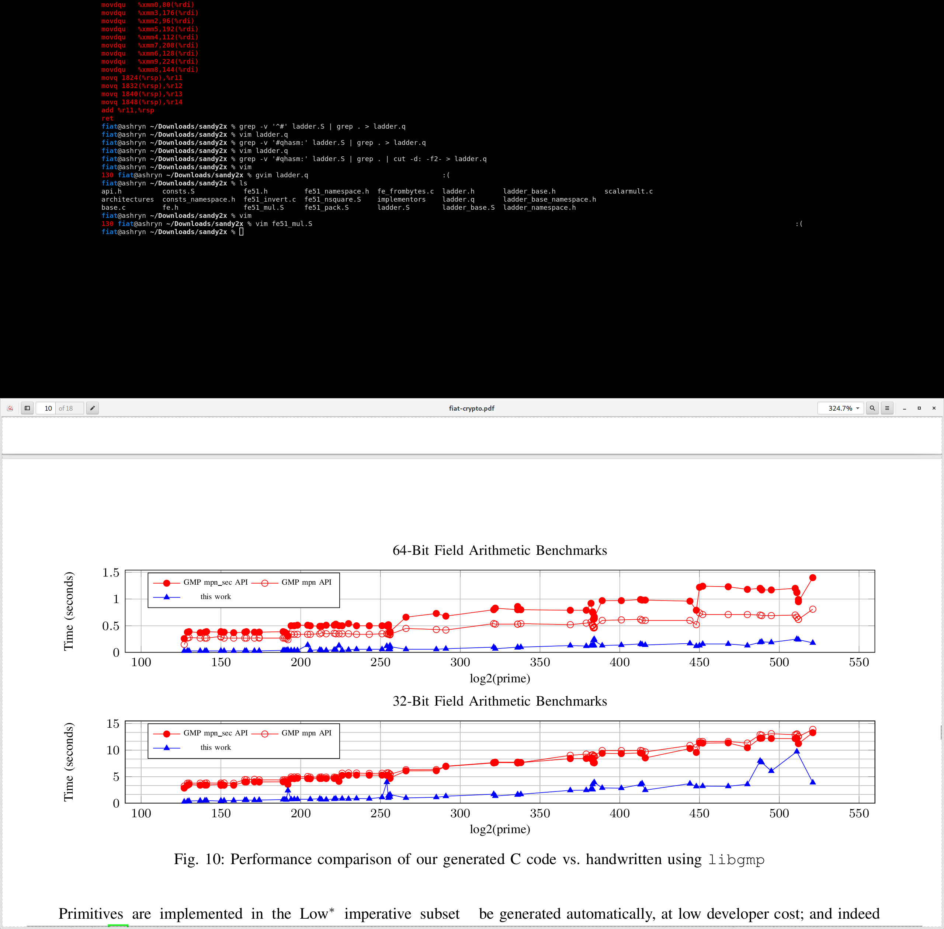
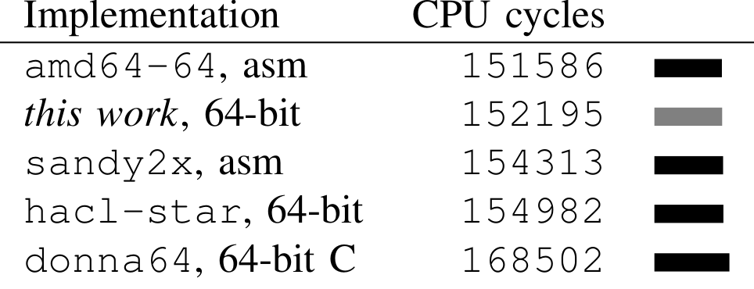
Performance
Curve25519, P256: fastest C code we know of
Faster than GMP on all primes from curves@
Curve25519 on a Broadwell laptop
Notes:
Now, having spent a minute complaining about complaining about compilation performance, let’s come to the good news.
Run-time performance is really really good. For Curve25519 and P256, our generated code outperforms all other C-language implementations we know of.
Furthermore, the performance is good across different primes and 64-bit and 32-bit platforms. The plot on the right shows that our generated code always outperforms GMP, even if GMP is run in non-constant-time mode.
There is faster assembly code, and noticably faster for P256. However, we have studied this difference the advantage of hand-written assembly code comes from low-level optimizations, most importantly register allocation of carry flags.

Slide 21
Integration Considerations for Generated Code
Check in generated code (slow compilation, dependency)
Not really human-readable
  Presentation issues: variable naming, whitespace…
  Only slightly less readable than expert-optimized code
  But it’s proven correct so we don’t care (mostly)
Document caller’s responsibilities!
  No proof prevents incorrect use
  Caller refactoring considered independently beneficial
Notes:
Now, actually integrating generated code in crypto libraries came with some additional challenges.
First, because code generation is slow and self-respecting no crypto library wants to have coq as a build dependency, we copy-pasted the generated code and checked it into git. This of course earned skewed looks from code reviewers.
In particular, the generated code is lacking in three ways: it has unhelpful variable names, no comments, and generally dumb coding style. However, we hear that a lot of expert-written code has the very same features, so we were not judged too hard. And, you know, our code has computer-checkable correctness proofs.
We updated our code generator to print out specialized versions of the preconditions and postconditions of our functions to comfort the programmer using our code.

Slide 22
Low-Level Interfaces Still Delicate
// fe means field element. Here the field is Z/(2^255-19). An element t,
// entries t[0]...t[9], encodes the integer t[0]+2^26 t[1]+2^51 t[2]+2^77
// t[3]+2^102 t[4]+...+2^230 t[9].
// fe limbs are bounded by 1.125*2^26, 1.125*2^25, 1.125*2^26, etc.
// Multiplication and carrying produce fe from fe_loose.
typedef struct fe { uint32_t v[10]; } fe;
// fe_loose limbs are bounded by 3.375*2^26, 3.375*2^25, 3.375*2^26, etc.
// Addition and subtraction produce fe_loose from (fe, fe).
typedef struct fe_loose { uint32_t v[10]; } fe_loose;
Notes:
I actually went further and refactored some boringssl code calling these field arithmetic functions and introduced different types for field elements with different ranges, so code that violates bounds would not typecheck without casts. And we transcribed the proven preconditions into comments.

Slide 23
Expand Proof Scope Instead!
static void x25519_scalar_mult_generic(uint8_t out[32],
const uint8_t scalar[32],
const uint8_t point[32]) {
// The following implementation was transcribed to Coq and proven to
// correspond to unary scalar multiplication in affine coordinates given that
// point is the x coordinate of some point on the curve. The statement was
// quantified over the underlying field, so it applies to Curve25519 itself
// and the quadratic twist of Curve25519. The decoding of the byte array
// representation of scalar was not considered.
// preconditions: 0 <= scalar < 2^255 (not < order), fe_invert(0) = 0
Notes:
Ideally we would prove that the entire cryptographic primitives, for example key agreement or digital signatures implement their specifications. This way the field elements with differently bounded limbs would not show up in the API anymore. And we did some of that: we simply transcribed BoringSSL C code into Coq and proved it correct.

Slide 24
Wishlist
(too boring for academia!)
coq: fix asymptotic complexity bugs
gcc/clang: register allocation for carry flags
fiat-crypto: more algorithms? e.g. secp256k1...
fiat-crypto: verify C code calling field operations
  functional code for Ed25519 already proven...
Notes:
Overall, we are quite happy with the state of this library. But of course there are things that could be improved.
First, we would love if Coq was less slow. We believe that this is not a sky-blue wish, most of the slowdown we have managed to triage is due to accidental asymptotic complexity, not because Coq needs to solve difficult problems.
Seond, it would be great if a free software C compiler implemented register allocation for carry flags. The inter C compiler does some of this, and we think there is no fundamental reason why one couldn’t do even much better.
On our side, there are still implementations that our templates do not cover. I am aware of two of them: NIST ECC in the style of Emilia Käsper and Adam Langley, and libseckp256k1. We think both are doable, but we haven’t cared so far.
And of course, there is more to crypto than field arithmetic, and we actually verified some Coq code for it already, but it would be great to do the same directly on C code.

Slide 25
thanks
github.com/mit-plv/fiat-crypto

