Slide 1
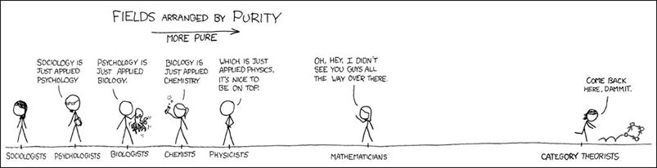
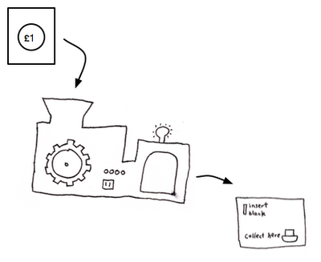



Some of my time
The rest of my time
Cartoon from xkcd, adapted by Alan Huang
Compiler
$$∀i, list\left[i\right]≤list[i+1]$$
Efficient program
Math
Image from “The Three Projections of Doctor Futamura” on A Neighborhood of Infinity

