Slide 1
Guarantees-Driven Mechanistic Interpretability
Formal Proof Size as a Metric for Mechanistic Detail of Understanding
FAR Seminar, Feb 21
Jason Gross
Collaborators: Rajashree Agrawal, Alex Gibson, Chun Hei Yip, Euan Ong, Somsubhro Bagchi, Soufiane Noubir, Thomas Kwa
Funded by ARC Theory
Loosely advised by Paul Christiano, distillation and write-up additionally co-authored with Lawrence Chan
Notes:
Been working on this stuff for six months, first time I’m presenting any of it.
V. interested in feedback & questions throughout (what’s confusing?)
My goal: tutorial of a proofs-based frame on mech interp

Slide 2
This talk in three bullet points
Motivation: If we got AGI tomorrow, what would we need to trust any pipeline we build to scalably automate mechanistic explanation discovery?
Solution: Trustworthiness via math (aka formal proof)
Remaining bottleneck: Unstructured noise

Slide 3
Why mech interp?
AI alignment; might help with:
Catching deception
Mechanistic anomaly detection (MAD)
Adversarial training
Elicit latent knowledge (ELK)
Provide feedback
Actual causal/historical reason, in my case:
Neel Nanda’s modular grokking write up is cool!

Slide 4
What is “mechanistic”?
Intuition: “bottom-up”
“Mechanistic interpretability seeks to reverse engineer neural networks, similar to how one might reverse engineer a compiled binary computer program.” —Chris Olah
“Mechanistic refers to the emphasis on trying to understand the actual mechanisms and algorithms that compose the network” —Neel Nanda
These are actually about faithfulness of mechanism — how closely mechanisms corresponds to the mechanisms the model uses
Quotes from https://transformer-circuits.pub/2022/mech-interp-essay/index.html
https://dynalist.io/d/n2ZWtnoYHrU1s4vnFSAQ519J#z=eL6tFQqNwd4LbYlO1DVIen8K

Slide 5
How do we evaluate “mechanistic”?
Existing methods all focus on faithfulness
Casual Scrubbing
Activation Patching
Path Patching
We have nothing for level of mechanistic detail

Slide 6
Problem 1: Existing metrics are too easy to Goodhart
The brute-force explanation
“I ran the model” i.e., trace the model’s computation on all relevant inputs
100% faithful!
100% bottom-up!
100% useless for many applications!
(also intuitively unsatisfactory)
Very important if we ever want to automate interpretability!
Notes:
This is a problem for automating interpretability, which we’ll want to do to keep pace with capabilities

Slide 7
What’s wrong?
Infeasible to produce
Does not match intuition on “mechanistic”
Common cause:
The explanation is ‘too long’
Notes:
An intuitively ‘mechanistic’ understanding allows us to compact our explanation of the behavior by talking about parts independently.

Slide 8
Problem 2
Existing metrics are limited in what hypotheses they permit
Generally restricted to identifying (sparse) computational subgraphs

Slide 9
Can we get away with minimalism?
Mechanistic detail ∝ 1/(description length of formal proof)
“Mechanistic” = “allows compacting explanation”
Consider theorems that a particular model M achieves a certain level of performance:
𝔼[f(x, M(x))] > b
Goal: minimize proof length (in any formal system) for fixed b; or: maximize b for fixed proof length
Notes:
the expectation of its performance score is bounded below by some b

Slide 10
Can we get away with minimalism?
Mechanistic detail ∝ 1/(description length of formal proof)
What is a proof?
Theorem: 𝔼[f(x, M(x))] > b
Goal: minimize proof length (in any formal system) for fixed b; or: maximize b for fixed proof length
Our proofs consist of two components:
Proof that a particular computation C, when run with any model’s weights, produces a valid bound on that model’s performance
A trace of running C proving that C(M) = b
Notes:
Really we can use any formal system and measure proof-checking time.
In practice, proof length is going to be dominated by the trace of C, which needs to include all the weights of the model written out, at a bare minimum.

Slide 11
Outline of the Technical Part of the Talk
Goal: walkthrough of a toy model to assess this definition of mechanistic detail
Toy algorithmic task
Small transformer architecture
Basic model interpretation
Proof Size vs. Tightness of Bound (table of proofs with four complexities)
Sketch of the proof at each complexity
Noise problem
Conclusions, Limitations, & Future Work
Anchor: Tying mechanistic detail and size of proof

Slide 12
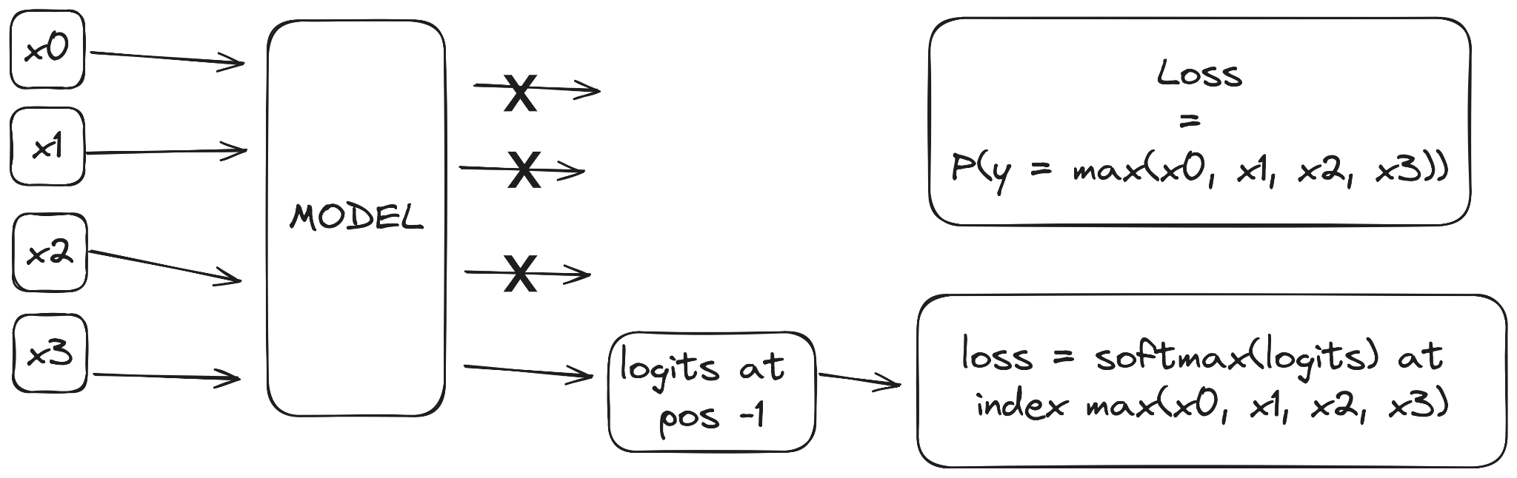
Model Setup: Task
Max-of-K (K=4)
one-hot encoded numbers
Accuracy: argmax(model(xs)[-1]) == max(xs)
Loss: softmax(model(xs)[-1])[max(xs)]
model([40,62,3,0]) == [[_, _, _, [-10, -16, -18, …, 16.8, 32.6, 0.6]]] (position 62 = 64 - 2)

Slide 13
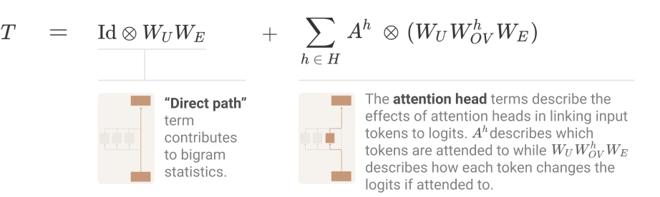
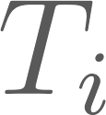
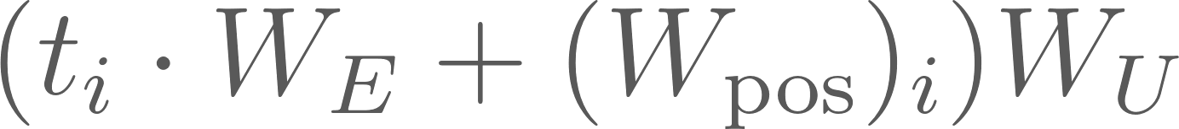

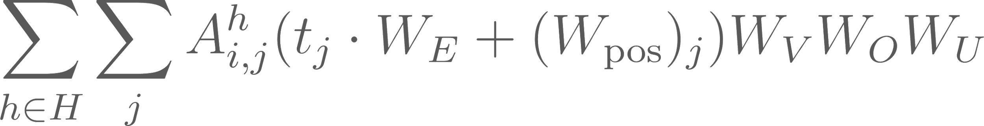
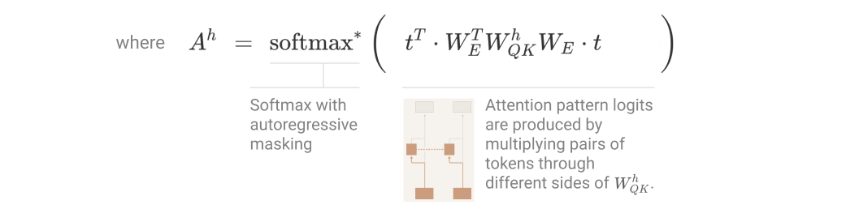
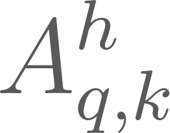
Model Setup
1L, attn-only, no layernorm 1 attn head d_vocab = 64 d_head = d_model = 32 n_ctx = 4
Image from https://transformer-circuits.pub/2021/framework/index.html#onel-path-expansion

Slide 14
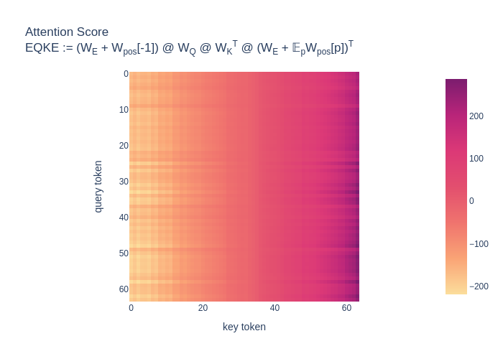
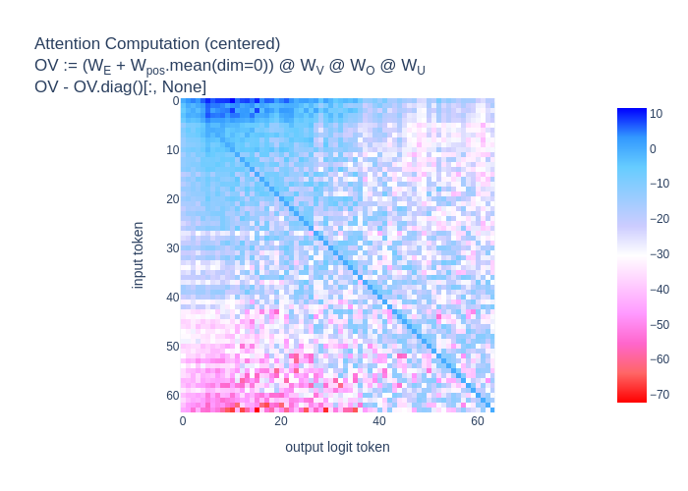
Basic Mech Interp: Attend More to Bigger Tokens & Copy
Attention Score
EQKE := (W_{E} + W_{pos}[-1])W_{Q}W_{K}^{T}(W_{E} + 𝔼_{p}W_{pos}[p])^{T}
Attention Computation (centered)
EVOU := (W_{E} + 𝔼_{p}W_{pos}[p])W_{V}W_{O}W_{U}
EVOU - EVOU.diag()[:, None]

Slide 15
Results: Proof Size vs. Tightness of Bound
Description of Proof | Complexity Cost Budget | Bound
Brute force | Exponential: d_vocab^{n_ctx}n_ctx d_vocab d_model | 99.73%
Convexity of Softmax | Cubic: d_vocab³n_ctx² | 98.4%
Sub-cubic | d_vocab²n_ctx² + d_vocab²d_model | 54.5% – 56.9%
low-rank avg+diff on EU, QK | d_vocab²n_ctx² + d_vocab d_model² + (OV only) d_vocab²d_model | 48.9% – 54.8% (27.8% – 33.2% if via SVD)
Convex Hull on OV (WIP) | d_vocab²n_ctx² + d_vocab d_model² | WIP

Slide 16
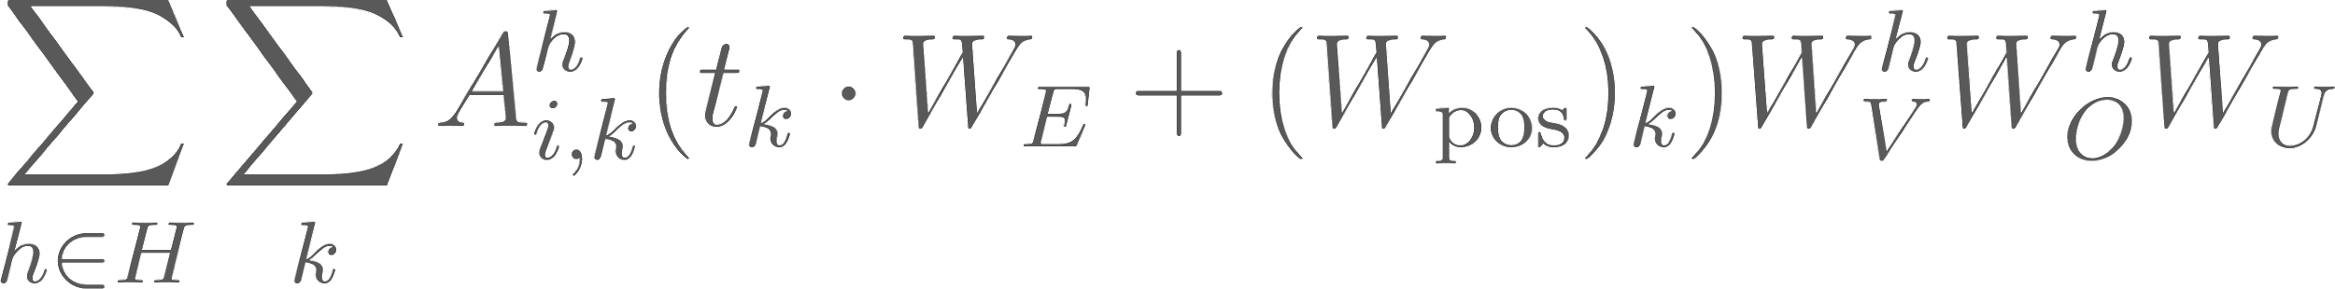
What do & don’t we understand?
Image from https://transformer-circuits.pub/2021/framework/index.html#onel-path-expansion

Slide 17
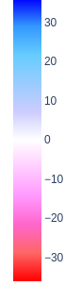
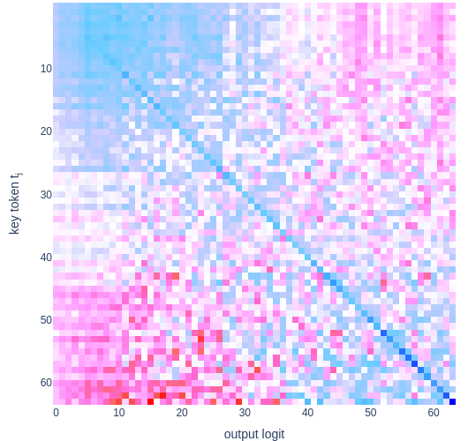
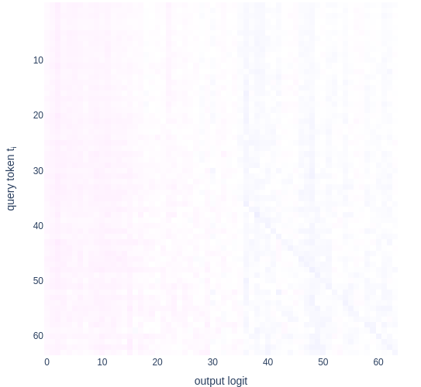
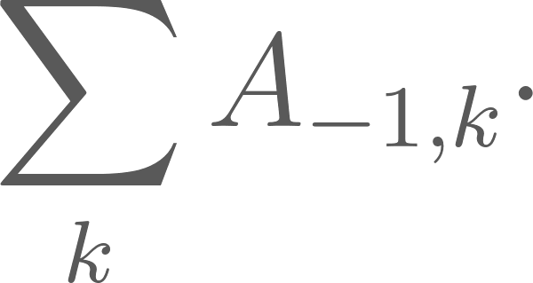
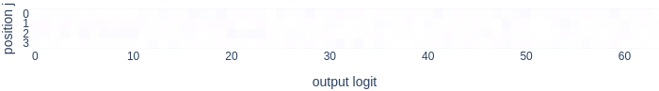
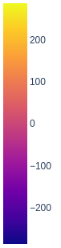
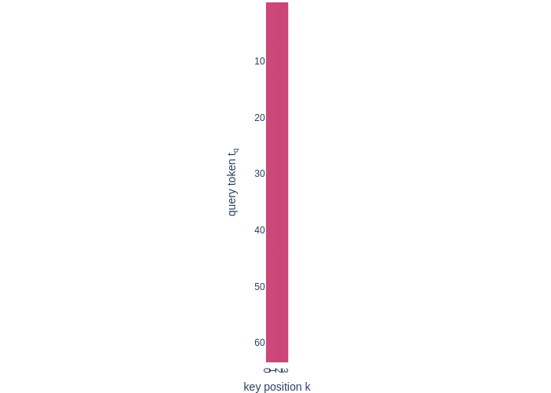
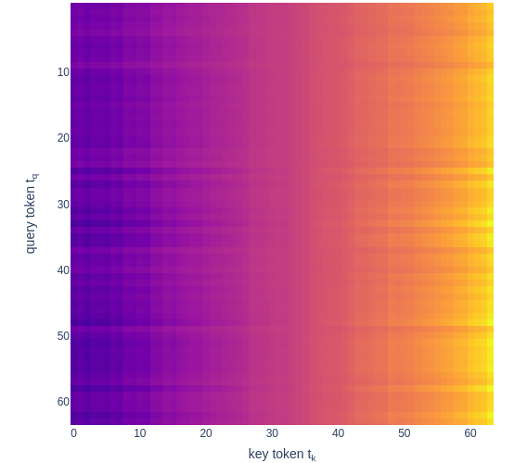
What do & don’t we understand?
(
)
T₋₁ =
+
direct contribution
(
key token contribution
)
key position contribution
A_{-1,k} = softmax*
+
key token contribution
key position contribution

Slide 18
Brute force accuracy: 99.73% (16,777,216 sequences)
𝒪(d_vocab^{n_ctx}n_ctx d_vocab d_model)
(
)
T₋₁ =
+
direct contribution
(
key token contribution
)
key position contribution
A_{-1,k} = softmax*
+
key token contribution
key position contribution

Slide 19
Accuracy with cubic proof: 98.4% (1,048,576 sequences)
𝒪(d_vocab³n_ctx²)
(
)
T₋₁ =
+
direct contribution
(
key token contribution
)
key position contribution
A_{-1,k} = softmax*
+
key token contribution
key position contribution
Notes:
Max token, query token, non-max token, number of copies of non-max token
Convexity of softmax is the driver, we need to know that what matters is only the token being paid attention to

Slide 20
Accuracy with sub-cubic proof: ≈55% (≈ 65,536 sequences)
𝒪(d_vocab²n_ctx² + d_vocab²d_model)
(
)
T₋₁ =
+
direct contribution
(
key token contribution
)
key position contribution
A_{-1,k} = softmax*
+
key token contribution
key position contribution
Notes:
Query paired with max in some places; query paired with non-max in others; max paired with non-max in others; num copies non-max & minimum gap between the max and the non-max

Slide 21
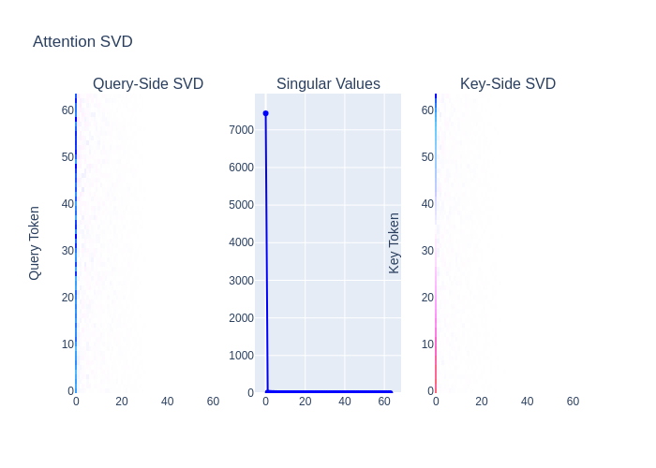
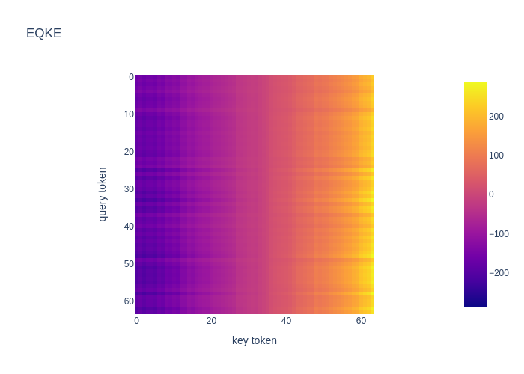
Mechanistic detail in proofs: d_vocab²d_model ⇒ d_vocab d_model²
Attention Score
EQKE := (W_{E} + W_{pos}[-1])W_{Q}W_{K}^{T}(W_{E} + 𝔼_{p}W_{pos}[p])^{T}

Slide 22
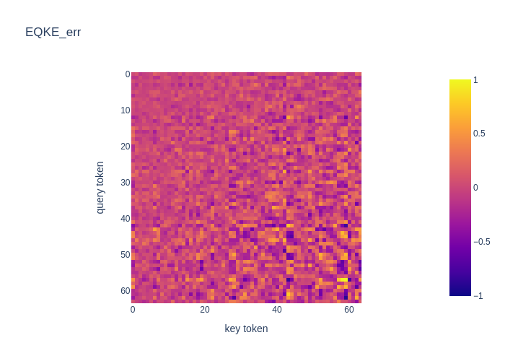
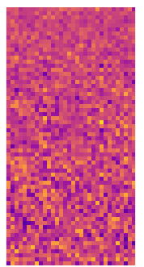
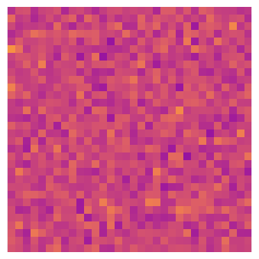
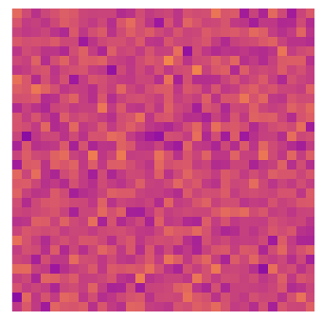
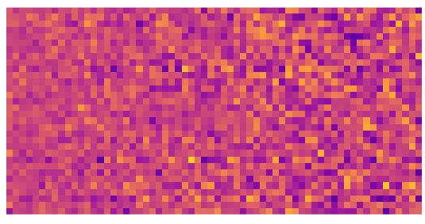
Noise
×
×
×
=
max row diff ≈ 1.85 How???

Slide 23

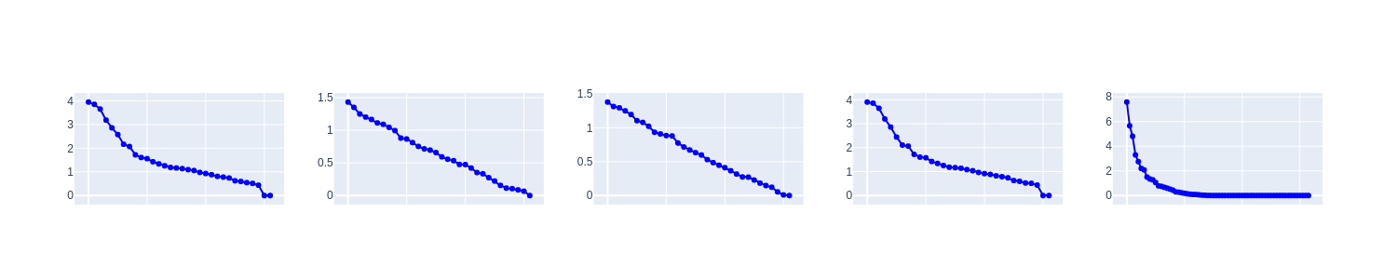
Noise: SVD?
×
×
×
×
×
×
×
×
=
=
×
√2 · σ₁ ≈ 4√2 × √2 · σ₁ ≈ 1.4√2 × √2 · σ₁ ≈ 1.4√2 × √2 · σ₁ ≈ 4√2 ≈ 30√2 ≈ 43 ≥ 10.7
×
×
×
≈
max row diff ≈ 1.85
2 · max abs value ≈ 2
√2 · σ₁ ≈ 7.6√2 ≈ 10.7
Even lower complexity bound:
Frobenius norm: 10 × 4 × 4 × 10 √2 ≈ 1932 √2 ≈ 2732(!)
(best bound with another ~SVD-complexity method: ≈ 5.67)

Slide 24
Conclusions
Proofs are possible!!!!!
But really hard
Small noise is a problem (no mechanistic understanding)
Most existing work glosses over this
Do we even want an explanation of it?
Proofs can be used as a minimalist “grounding” of mech interp
Confused about X in mech interp ⇒ convert to proof frame
Link between mechanistic understanding and proof length
Shorter proofs require more mechanistic understanding
After improving bound tightness (fixed complexity), we can extract mechanistic detail
Failure to compact proof ⇒ lack mechanistic understanding
Objective, numerical standard for mechanistic detail
Can be tailored to subcomponents

Slide 25
Limitations & Future Work
In progress:
Max of 10
Modular addition (including MLPs)
Sorted list
How to solve noise?
Lagrange multiplier on various parts of the proof
Heuristic arguments
Limitations / Future Work:
2L
Layer norm on > 1L
SAEs
Automation

Slide 26
Thank You!

