Slide 1
Compressing explanations
Compact Proofs of Model Performance via Mechanistic Interpretability
Jason Gross, Rajashree Agrawal, Thomas Kwa, Euan Ong, Chun Hei Yip,
Alex Gibson, Soufiane Noubir, Lawrence Chan
Notes:
We did a really cool project on proofs and mech interp! Come talk to us at the poster about it! Here I’m going to give you the takeaways for non-proofy mech interp projects. You can think of mech interp as taking large models and compressing explanations about them. We want to quantify how much we are able to compress with mechanistic understanding, and we use proof-length as the metric.
Without going into the proof approach much, let me give you the takeaways. Proofs of mech interp. Talk to us later.

Slide 2
Formalizing proof length to quantify compression
≈
Behavioral claim
True behavior of the model
theorem statement
Proof = sound computation of worst-case error
Length of proof = cost of running computation
Notes:
Our approach is to use formal proofs. In mechanistic interpretability, you have a claim about how the model behaves. Of course the model’s empirical behavior may diverge a bit, but if your mech interp is good, it’ll be pretty close. To prove this is to compute the worst-case divergence between claim and true behavior. And the length of the proof is the cost of running this computation.

Slide 3
Quantifying the compute-cost of explanations
Brute Force Proof
True Accuracy
Accuracy
Lower Bound
Trivial Proof
Linear scaling of baseline cost
FLOPs to Verify Proof
Notes:
The baseline approach is to just run model inference to bound accuracy, to do all the matmuls. To get a good accuracy bound for any fixed data distribution, we have linearly scaling cost. At one extreme, we can run inference on 0 data points, and produce the trivial proof that the model has accuracy >= 0%. On the other extreme, we can get the brute force proof by running the entire model on every single datapoint. And we can linearly increase or decrease cost to get any bound in between.

Slide 4
Does understanding improve upon the linear baseline?
True Accuracy
Hypothesis: Understanding of structure can help recover
bound tightness
Accuracy
Lower Bound
FLOPs to Verify Proof

Slide 5
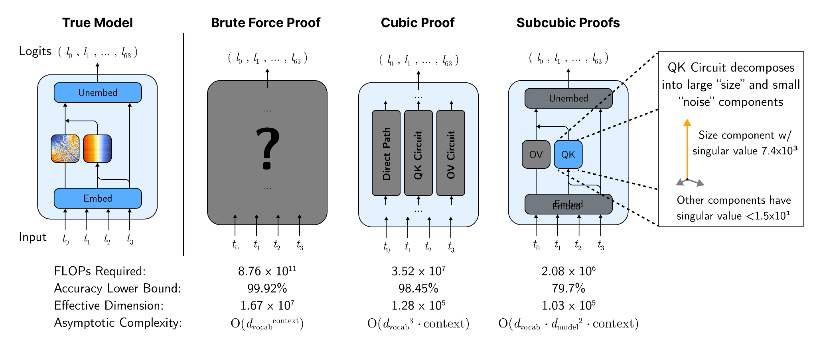
Proofs with varying mechanistic understanding
Notes:
We tested this hypothesis on a toy model, by producing proofs that incorporate varying degrees of mechanistic information about the model.
(Optional: In the brute force proof, we don’t peak into internals at all. The cubic proofs gerrymander the input set and use relationships between paths, the subcubic proofs use information of the actual paths.)

Slide 6
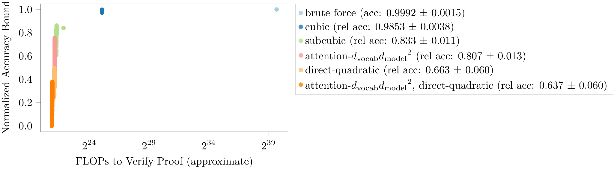
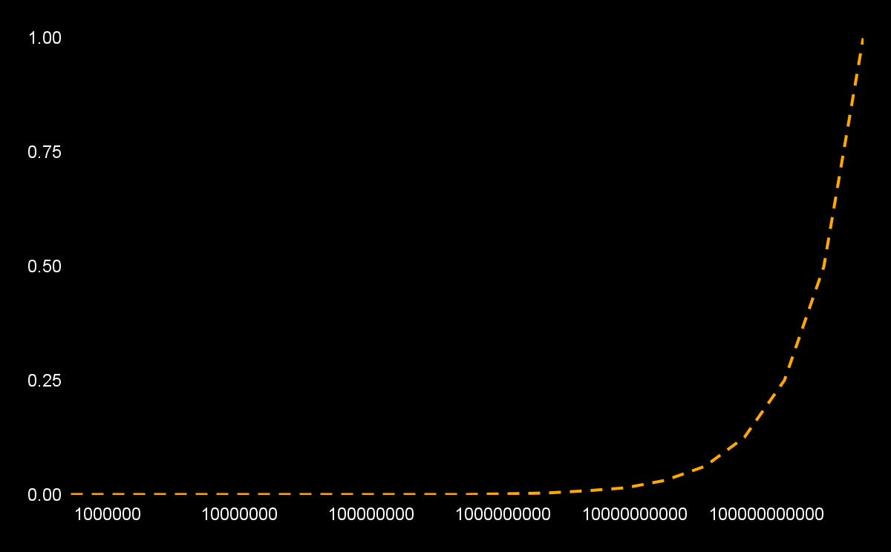
We found an empirical “pareto frontier”
Pareto frontier from incorporating mechanistic understanding
Baseline approach in log scale
Puzzle: Why does more structure not always mean better bound?
Notes:
We find, as hoped for, that more mechanistic understanding allows computing better error bounds cheaply.
However, notice, that going from right to left adds mechanistic understanding but worsens the bound. That is, the proofs with the most mechanistic understanding have bounds that are much better than the linear baseline, but still much worse than longer proofs.
Here’s the puzzle

Slide 7
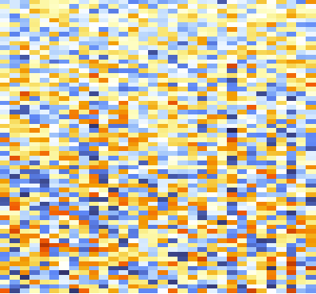
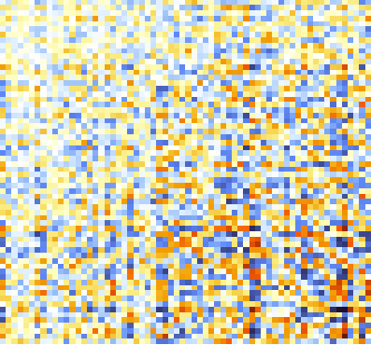
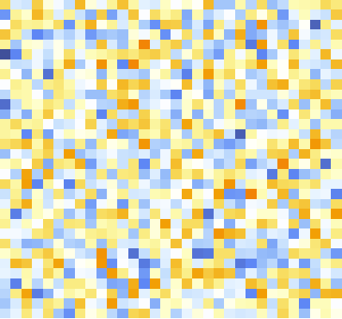
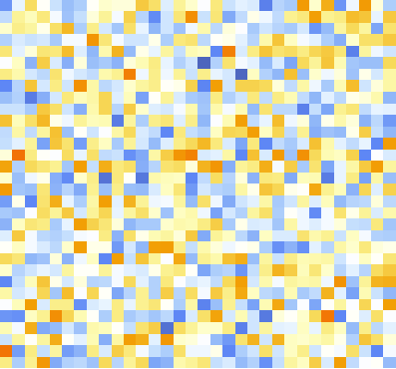
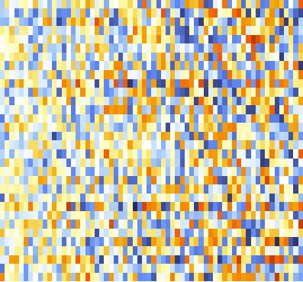
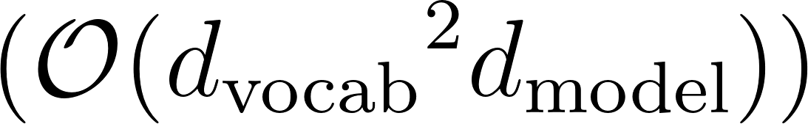
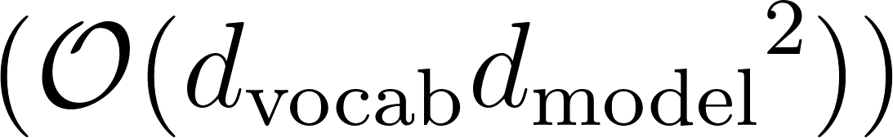
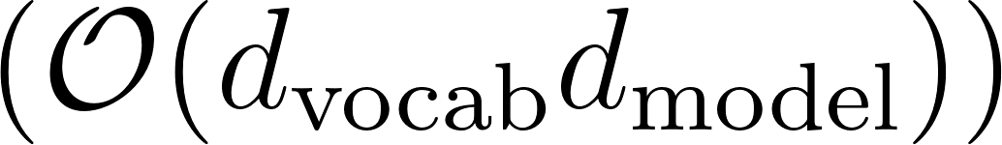
Compounding errors from lack of structure
×
×
×
=
Approximation Strategy | Result | Complexity
(exact) max row diff | ≈ 1.8
2 · (max abs value) | ≈ 2.0
max row diff on subproduct | ≈ 5.7
recursive max row diff | ≈ 97
Notes:
Our concrete metric reveals why mechanistic understanding isn’t sufficient to compute excellent bounds cheaply.
Compression requires structure, and when we have explained all the structure we can find, we are left with apparently incompressible structureless noise and quickly compounding errors.

Slide 8
Wanted: Compression of highly expressive systems
Train Model
Do partial post-hoc analysis
Fine-tune to remove interp errors
Notes:
I’d love to see approaches to mech interp that deal with these compounding error terms in the absence of structure. Maybe we can fine-tune models to suppress the errors, and perhaps even if we only start out with a partial understanding, this fine-tuning will unlock further partial post-hoc interpretation in a virtuous cycle.

Slide 9


Check out our poster!
Scan for paper
Scan for Poster

