Slide 1
Performance Engineering of Proof-Based Software Systems at Scale
Jason Gross
Ph.D. Defense
MIT CSAIL

Slide 2
Outline
Point at the problem, explain why it’s important (standing in the way of verification reaching its promise)
Note, perhaps, that no-one seems to be tackling it or even systematically investigating it --- I have more to say about this, but only have time to hint at this in the defense
Describe what current research progress towards this big problem looks like, using the particular example of the progress I've made towards it (fiat-crypto) with my colleagues during my PhD
Share what I've learnt about how this problem can currently be chipped away at with current techniques
Share what I've learnt about how the larger problem might need very different research that no-one seems to currently be doing

Slide 3
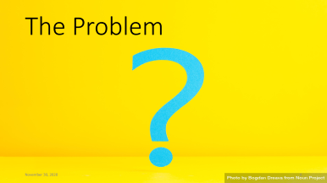
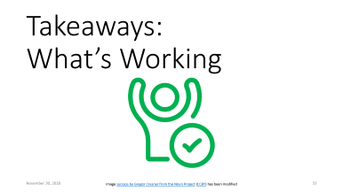
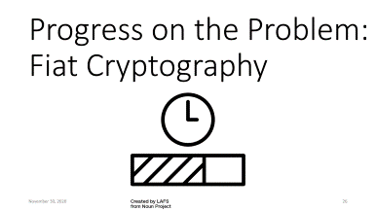
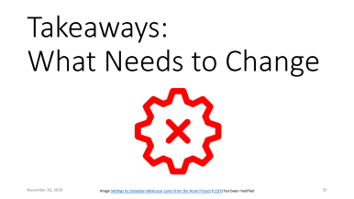
Outline

Slide 4
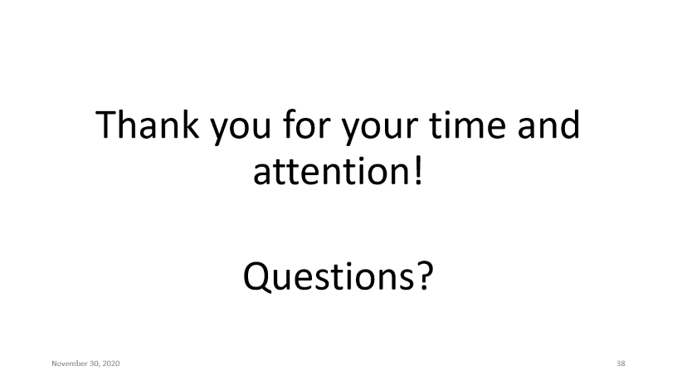
Q & A

Slide 5
Thank you for your time and attention!
Questions?

Slide 6

The Problem

Slide 7



Why Verification?
Software is important
power grid by popcornarts from the Noun Project; X-ray machine by Gan Khoon Lay from the Noun Project
Train by Manaqib S from the Noun Project; Death by Adrien Coquet from the Noun Project; Dollar falling by Davo Sime from the Noun Project

Slide 8

Why Verification?
Software is important
Bugs are bad
power grid by popcornarts from the Noun Project; X-ray machine by Gan Khoon Lay from the Noun Project
Train by Manaqib S from the Noun Project; Death by Adrien Coquet from the Noun Project; Dollar falling by Davo Sime from the Noun Project

Slide 9
Why Verification?
Software is important
Bugs are bad
Verification promises a fix
Notes:
(Note that I'm talking about ITPs; human help is important for difficult problems)

Slide 10
The Current State
Impressive existing verification, including:
CompCert (C compiler)
seL4 (microkernel)
CertiKOS (operating system)
Fiat Cryptography (cryptographic primitives)

Slide 11
The Current State: What’s the Scale?
Impressive existing verification, including:
CompCert
seL4
CertiKOS
Fiat Cryptography
5880
8700
6500
603
Lines of Code Being Verified

Slide 12
The Current State: What’s the Scale?
Impressive existing verification, including:
CompCert
seL4
CertiKOS
Fiat Cryptography
Lines of Code Being Verified

Slide 13
The Current State: What’s the Scale?
Impressive existing verification, including:
CompCert
seL4
CertiKOS
Fiat Cryptography
4200
10600
6642
2585
Lines of Code Being Verified
Lines of Specification

Slide 14
The Current State: What’s the Scale?
Impressive existing verification, including:
CompCert
seL4
CertiKOS
Fiat Cryptography
Lines of Code Being Verified
Lines of Specification

Slide 15
The Current State: What’s the Scale?
Impressive existing verification, including:
CompCert
seL4
CertiKOS
Fiat Cryptography
31,920
1,081,521
90,000
91,611
Lines of Code Being Verified
Lines of Specification
Lines of Proof

Slide 16
The Current State: What’s the Scale?
Impressive existing verification, including:
CompCert
seL4
CertiKOS
Fiat Cryptography
1,081,521
90,000
91,611
Lines of Code Being Verified
Lines of Specification
Lines of Proof

Slide 17
The Current State: What’s the Scale?
Impressive existing verification, including:
CompCert
seL4
CertiKOS
Fiat Cryptography
1,081,521
90,000
91,611
Lines of Code Being Verified
Lines of Specification
Lines of Proof

Slide 18
The Current State: What’s the Scale?
Impressive existing verification, including:
CompCert
seL4
CertiKOS
Fiat Cryptography
Lines of Code Being Verified
Lines of Specification
Lines of Proof

Slide 19
The Current State: What’s the Scale?
Impressive existing verification, including:
CompCert
seL4
CertiKOS
Fiat Cryptography
5880
8700
6500
603
Lines of Code Being Verified

Slide 20
The Current State: What’s the Scale?
Impressive existing verification, including:
CompCert
seL4
CertiKOS
Fiat Cryptography
HERE
5880
8700
6500
603

Slide 21
The Current State: What’s the Scale?
Impressive existing verification, including:
CompCert
seL4
CertiKOS
Fiat Cryptography

Slide 22
The Current State: What’s the Scale?
Impressive existing verification, including:
CompCert
seL4
CertiKOS
Fiat Cryptography
5880
8700
6500
603

Slide 23
The Current State: What’s the Scale?
Impressive existing verification, including:
CompCert (C compiler)
seL4 (microkernel)
CertiKOS (operating system)
Fiat Cryptography (cryptographic primitives)

Slide 24
The Current State
CompCert, seL4, CertiKOS (point out Fiat-Crypto as the new project I enabled)
scale of these projects vs scale of industry
Notes:
tes

Slide 25
The Problem: The Gap
There's a gap between what academia and industry
The bigger problem is asymptotic performance; I'll come back to this in a moment
Currently we academics carve off a small chunk of the gap and spend a lot of time verifying it
I'll be talking about the small chunk that I helpped carve off
TODO: maybe reorganize this next bit?
More broadly, though I don't see us closing this gap with the research we're currently doing; let me share a bit of what I mean by this, before coming back to why I think we need a more systematic study at the end of the defense.
Slide with allocation of PhD time
The performance challenges scale super-linearly with the size and complexity of the programs being verified.
The problem is asymptotic performance.
Notes:
tes

Slide 26
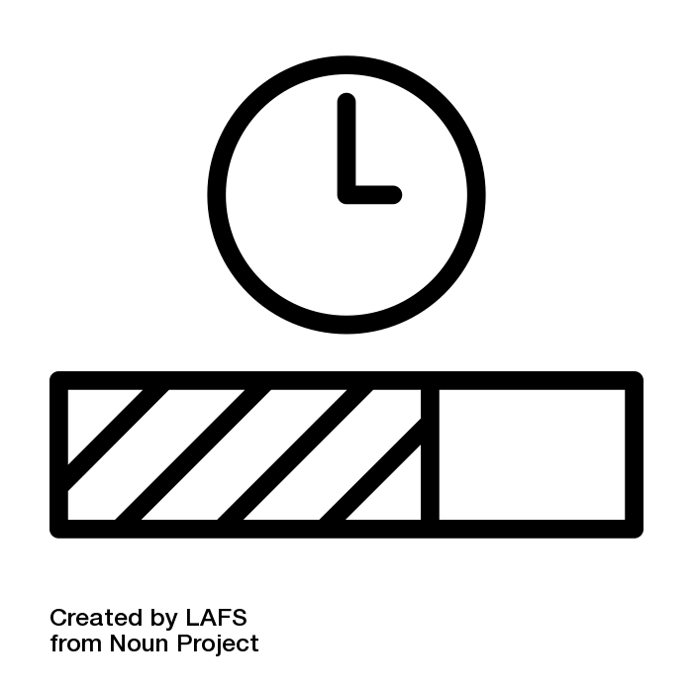
Progress on the Problem: Fiat Cryptography

Slide 27
Fiat Cryptography: The Goal
Low-level cryptographic primitives
Desiderata:
the code we verify must be fast and constant time
Justification: server load, security
it should not take too much effort to add & prove a new algorithm, prime, architecture, etc
Justification: scalability of human effort, edit-compile-debug loops are important here
is should not take too much time for Coq to run the verification (asymptotics are important here)
Justification: Needs to be checkable in time for industry deadlines, in time to be usable
Our output artifact is actually pretty cool, and can automatically generate basically verified code on the command line, in seconds (not hours or days or weeks), for given just the prime, the bitwidth, and the name of the high-level algorithm

Slide 28
Fiat Cryptography: Methodology
Carve up the low-level code into neatly-separated conceptually distinct units that are small enough to not hit asymptotic issues during interactive verification
My colleagues did most of this, though I helpped them see how factoring and abstraction impact performance of verification effort
TODO: describe abstraction in terms of excessive unfolding, either here or elsewhere
The remaining chunk is partial evaluation
Describe it
Note that it's too big to handle interactively with reasonable performance (include perf plots of rewrite)
The underlying reason for this chunk being hard is that all of the abstraction barriers that we introduced to carve the problem up into managable chunks are broken here, so that we get fast low-level code out (this is a general pattern around performant code)
A large chunk of my PhD work was making this possible in a way that scales

Slide 29
Partial Evaluation and Rewriting

Slide 30
Partial Evaluation and Rewriting: Requirements
Requirements:β-reduction (eliminating function call overhead)
ιδ-reduction + rewrites (inlining defintions to eliminate function call overhead, also arithmetic simplification)
Note that without this we get quartic asymptotics of the # lines of code rather than merely quadratic, so it's not really acceptable to save for a later stage
Code sharing preservation (to avoid exponential blowup in code size)
Obvious Requirements:Verified (and not extending the TCB)
Performant (should not introduce extra super-linear factors --- note that we don't quite manage this one, but we do a lot better than the interactive solutions)

Slide 31
Partial Evaluation and Rewriting: Implementation
Reflective so as to not extend the TCB and to perform fast enough
Side benefit: we can extract it to OCaml to run as a nifty command-line utility
NbE (for β) + let-lifting (code-sharing) + rewriting (ιδ+rewrite)
Note that we use some tricks for speeding up rewriting such as pattern-matching compilation, on-the-fly emitting identifier codes so that we can use Coq's/OCaml's pattern matching compiler, pre-evaluating the rewriter itself
TODO: Spend some slides talking about these

Slide 32
Partial Evaluation and Rewriting: Evaluation
It works!
It's performant!
It seems like it would also solve one of the two performance issues that killed the parser-synthesizer I worked on for my masters.

Slide 33
Takeaways: What’s Working
Image success by Gregor Cresnar from the Noun Project (CCBY) has been modified

Slide 34
Takeaways
Asymptotic scaling of interactive proof assistant response is a real problem!
Current method---of working around it by breaking the problem into small enough chunks and solving remaining chunks with specialized reflective solutions---does seem to work.
I'm not optimistic about being able to break things down enough to handle them all interactively; even in very abstract math (category theory), I ran into issues where the way mathematicians did it was not sufficient. Furthermore basically all code that needs to be fast, and a great deal of systems code, inlines definitions in a way that causes performance issues.
And reflective automation requires enormous investment of effort for each new problem.
Because reflection is not a proof engine made of small pieces that can each be said to make progress towards proving a goal, it's not easy to mix-and-match.
I needed let-lifting; prior work had already done NbE and reflective rewriting, but fusing them with let-lifting in a performant way seems to have required re-engineering them almost from scratch.

Slide 35
Takeaways: What Needs to Change
Image Settings by Sebastian Belalcazar Lareo from the Noun Project (CCBY) has been modified

Slide 36
Takeaways: What Needs to Change
Does it have to be this way?
No! (I hope)
No one seems to be studying why proof engines are asymptotically slow!
It's not just accident; there are good reasons that obvious solutions have the wrong asymptotics, and there's so much going on that it's not even clear yet what the specification of "adequate performance" is.
I think solving this problem---getting the basics right, asymptotically---will drastically accelerate the scale of what we as a field can handle, and bring verification closer to it's promise and potential.

Slide 37
Q & A

Slide 38
Thank you for your time and attention!
Questions?

