Slide 1
Global Azure BootCamp
Burlington MA
April 22, 2017
#globalazure

Slide 2
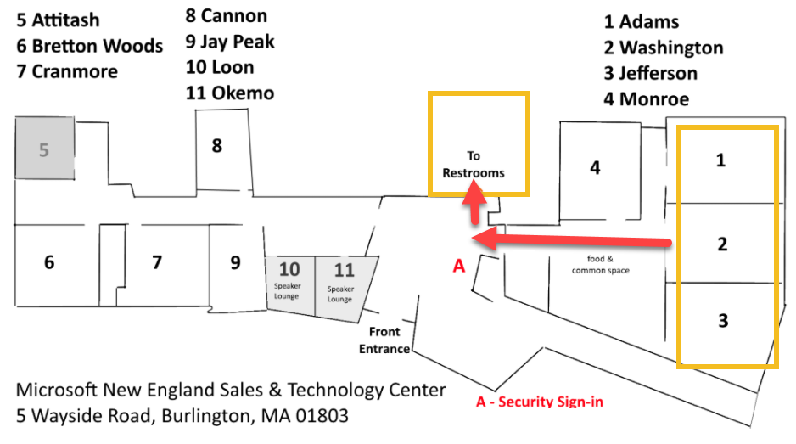
Facilities

Slide 3
Thanks to our Local Sponsors
Microsoft Developer Experience (DX)
Alert Logic
North Boston Azure User Group

Slide 4
Big Thanks to our Speakers
Jason Haley - Compute
Jim O’Neil - Storage
Jorge Cotillo - DevOps
Bryan Cafferky - Managing Azure with PowerShell
Bob Familiar – IoT Device Managament using IoT Hub
Marija Strazdas – Shared Security Responsibility in the Azure Cloud

Slide 5
Today’s Objective
Provide sessions (6 presentations and 3 hands on labs) that will give a good foundation of Azure knowledge to participants that do not currently consider themselves experienced users of the Azure Platform

Slide 6
agenda
9:30 – 10:45 Compute
Hands on Lab
11:00 12:15 Storage
Hands on Lab
12:15 – 12:45 Lunch
12:45 – 1:30 DevOps
1:45 – 3:00 PowerShell
Hands on Lab
3:00 – 3:15 Snack Break
3:15 – 4:00 IoT
4:15 – 5:00 Security
5:00 Raffle

