Slide 1
Azure Web Apps 2019
Global Azure Bootcamp – April 2019
Jason Haley
jason@jasonhaley.com

Slide 2
Goal of this talk:
Highlight newer features of Web Apps
Introduce features coming soon
Hands on Lab: Securing a web application
Storage
Key Vault
SQL DB

Slide 3
Newer Features

Slide 4
az webapp up
Create and deploy code to a web app
Supports:
Nodejs
Python
.NET Core
ASP.NET
Static HTML
Notes:
In a folder structure at least 2 deep off of c:
dotnet new mvc
az webapp up –n jhaleybcc1 –l eastus –sku S1

Slide 5
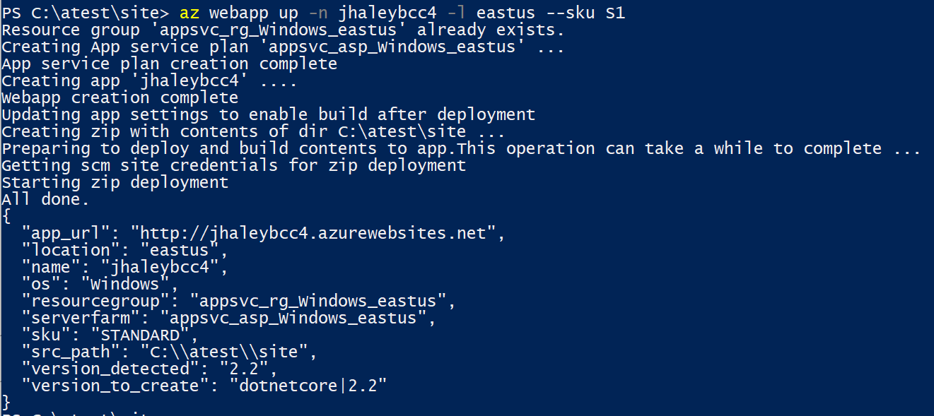

Slide 6


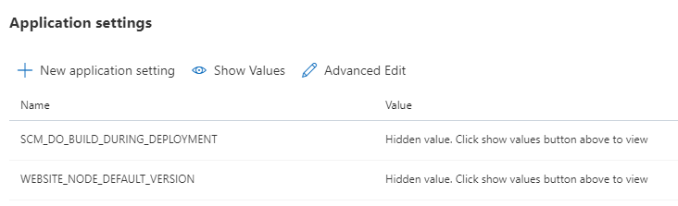
Changes on App Settings blade
Now called Configurations
Now has tabs
FTP configuration added
HTTP/2 Support
Hidden by default
Advanced Edit
Notes:
HTTP/2 support in April 2018
https://blogs.msdn.microsoft.com/appserviceteam/2018/04/13/announcing-http2-support-in-azure-app-service/
FTP changes in May 2018
https://blogs.msdn.microsoft.com/appserviceteam/2018/05/08/web-apps-making-changes-to-ftp-deployments/

Slide 7

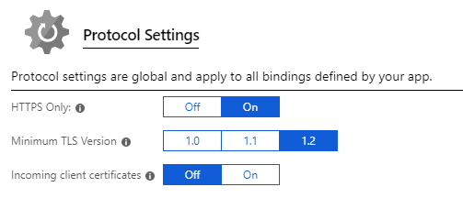

Custom domains and SSL Settings blades
HTTPS Only
Custom domains blade
SSL Settings blade
Minimum TLS Version
Manage .pfx certificates
Manage .cer certificates
Notes:
August 2018 announcement
https://blogs.msdn.microsoft.com/appserviceteam/2018/08/23/devtalk-app-service-ssl-settings-revamp/

Slide 8
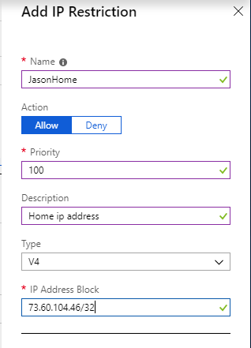
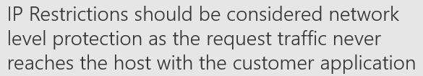
New feature on Networking blade
IP Restrictions
Allows you to create a white list
Enforced at the Front Ends (which are upstream from your app)
Support for IP 4 and IP 6
- What is new in Azure App Service Networking – Ignite 2018

Slide 9
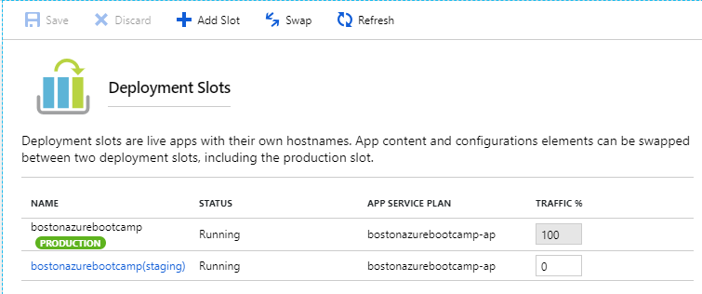
New Deployment slots blade
Improved UX
Allows Testing in production feature
Notes:
Deployment
https://blogs.msdn.microsoft.com/appserviceteam/2018/06/04/app-service-deployment-center-preview/

Slide 10
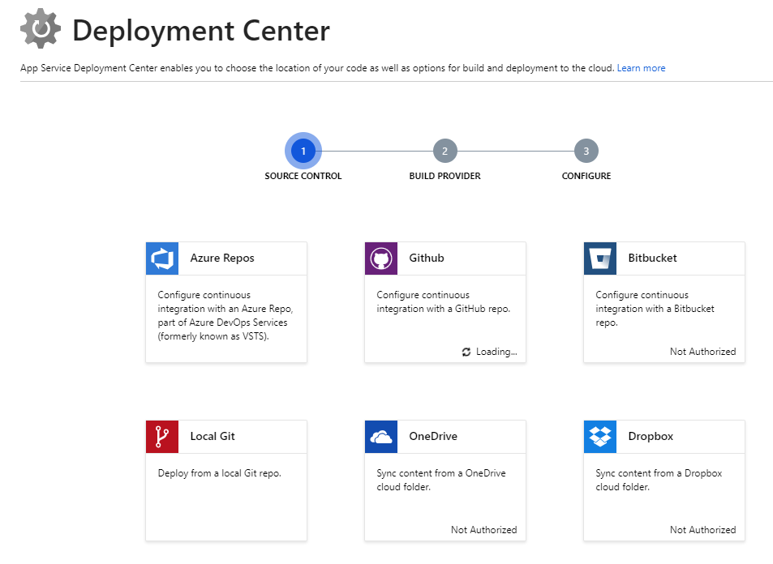
New Deployment Center blade
Improved UX
Search and filter repositories
Revamped log files

Slide 11
Managed Identity
Identity blade in Web Apps
Allow Azure Resources to authenticate to other resources without storing credentials
Available with:
Azure Key Vault
Azure SQL DB
Azure Storage
Others (ARM, Azure Data Lake, Event Hubs, Service Bus)
System Assigned
Connects lifecycle of identity with the web app
User Assigned
Stand alone resources and have their own lifecycle
*Note: Deployments Slots have different Identities
Notes:
Key Vault and Managed Service Identities
https://odetocode.com/blogs/scott/archive/2018/06/13/key-vault-and-managed-service-identities.aspx

Slide 12
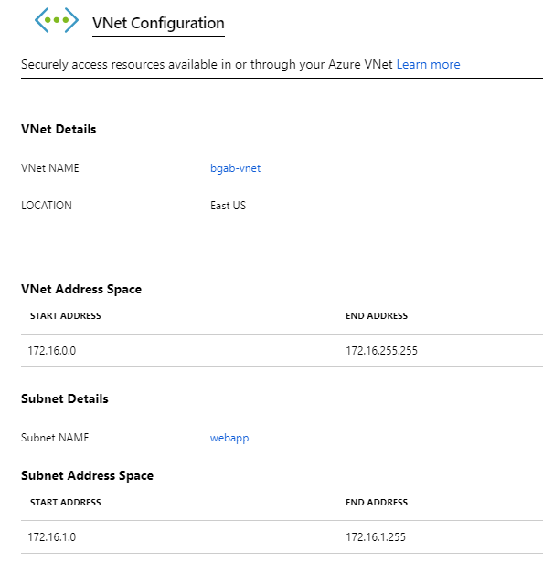
New Vnet Integration (Preview)
Does not use Point to Site VPN
Multi home style integration
Backend of your app in your Vnet
Requires unused subnet with 32 addresses
Needs one address for each App Plan instance
Only available on new App Service scale units
App and VNet must be in same region

Slide 13
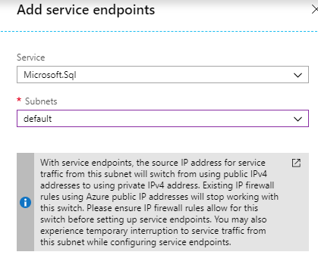
Virtual Network Service Endpoints
Extend your VNet to Azure services
Available with
Azure Storage
Azure SQL DB
Azure Key Vault
Others (SQL Data Warehouse, PostgreSQL, MySQL, Cosmos DB, Service Bus, Event Hubs)

Slide 14
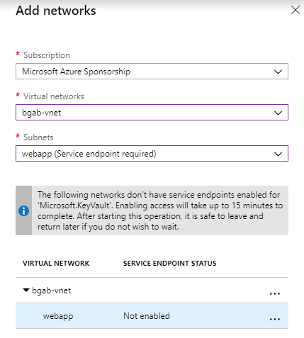
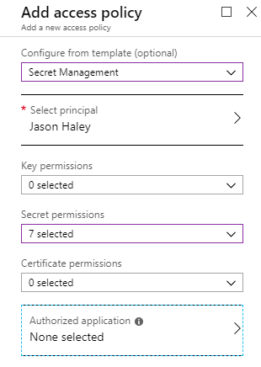
Azure Key Vault
Secret, key and certificate management solution
Firewalls and virtual networks
Connect AKV to subnet
IP Firewall
Access policies
Manage identity permissions
Users
Managed Identities

Slide 15
Securing Web Apps
https://www.github.com/jasonhaley/SecuringWebApps

Slide 16
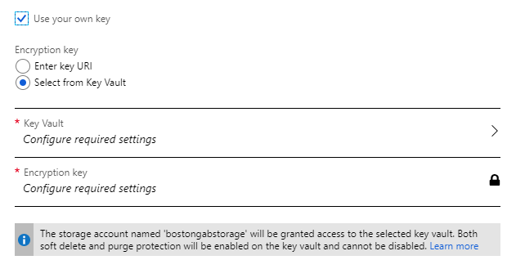
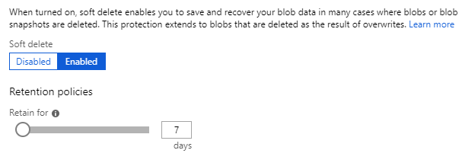
Azure Storage
Encrypted at rest
Bring your own key (New)
Soft delete (New)
Access control
Users
Managed Identities
Firewalls and virtual networks
Connect AKV to subnet
IP Firewall

Slide 17
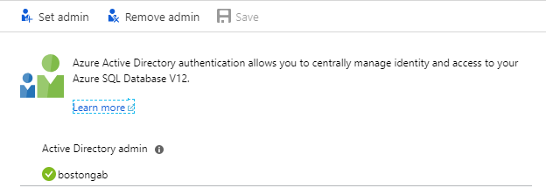
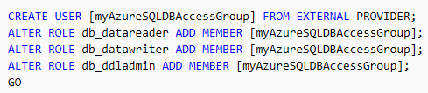
Secure SQL DB from Web App with Managed Identity
Add managed identity to AAD group
Grant SQL DB access to managed identity
Change connection string
Grant minimal privileges to managed identity in SQL DB (Not admin like shown in image)
Notes:
Tutorial: Secure Azure SQL Database connection from App Service using a managed identity
https://docs.microsoft.com/en-us/azure/app-service/app-service-web-tutorial-connect-msi
CREATE USER [XXX] FROM EXTERNAL PROVIDER;
ALTER ROLE db_datareader ADD MEMBER [XXX];
ALTER ROLE db_datawriter ADD MEMBER [XXX];
ALTER ROLE db_ddladmin ADD MEMBER [XXX];

Slide 18
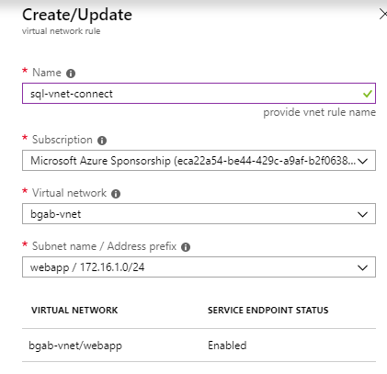
Virtual Network Rule
Configures SQL DB to accept communication from a subnet
Works with Service Endpoints

Slide 19
Connect SQL DB to a VNet
Add Network Rule
Add AAD Group Managed Identity is in to SQL Server

Slide 20
Resources
Samples:
https://github.com/juunas11/Joonasw.ManagedIdentityDemos
What is new in Azure App Service networking
https://bit.ly/2FTre8Y
In the security trenches of Azure SQL Database and Azure SQL Data Warehouse
https://bit.ly/2S7wdIX
Tutorial: Secure Azure SQL Database connection from App Service using a managed identity
https://bit.ly/2RkdJAh
Learn how to protect your data in Azure Storage with new features and capabilities
https://bit.ly/2WjP96m
Manage keys, secrets, and certificates for secure apps and data with Azure Key Vault
https://bit.ly/2HEfZCU

