Slide 1

ensemble method——adaboost，and its apllications
.
Ensemble method:
Adaboost and its aplication
Ryan Jason Doris

Slide 2
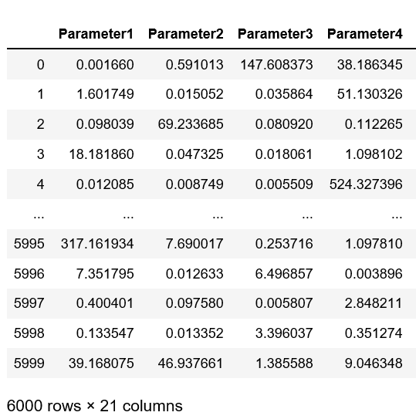
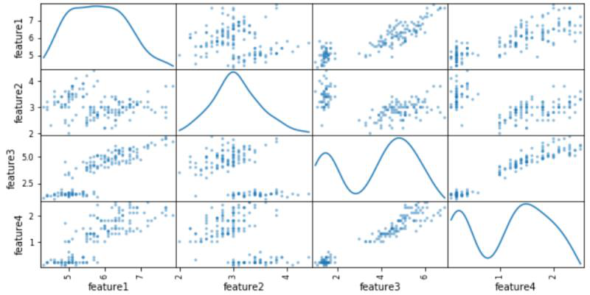
Introduction
workpieces
iris

Slide 3
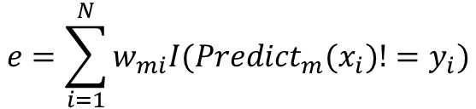

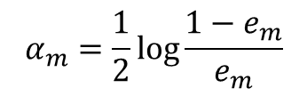
Algorithm Implementation
INITIATE
FIT
CALCULATE
MEASUREMENT
Set stop iteration conditions
Initiate sample weight
Declare new classifier
Train the classifier， based on the sample weight.
weak classifier error
alpha（weight of weak classifier）
new sample weight
Calculate the error of the strong classifier
$$e=\sum_{i=1}^{N}{w_{mi}I({Predict}_{m}(x_{i})!=y_{i})}$$
$$w_{m+1,i}=\frac{w_{m,i}e^{αI({Predict}_{m}(x_{i})!=y_{i})}}{\sum_{i=1}^{N}{w_{m,i}e^{αI({Predict}_{m}(x_{i})!=y_{i})}}}$$
$$α_{m}=\frac{1}{2}\log{\frac{1−e_{m}}{e_{m}}}$$

Slide 4
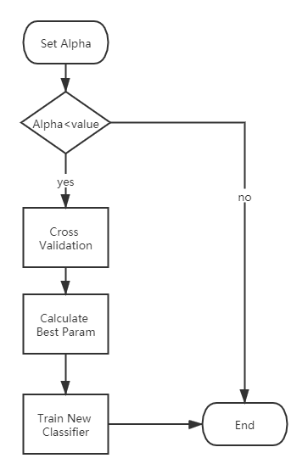
LITTLE IMPROVEMENT
Dynamically modify the weak classifier

Slide 5
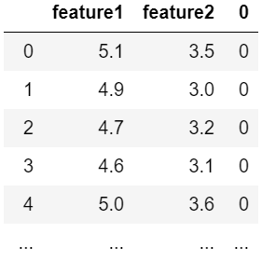
Adaboost Visualization—— Draw Decision Boundary
1
2
3
4
1.cutting down the original data to two categories, change the problem into a binary classification and remain only two predictors
2.The base estimator : logistic regression with parameter C equals to 0.005
3.Using contourf function from matplotlib to draw the boundary.
4.visualization

Slide 6
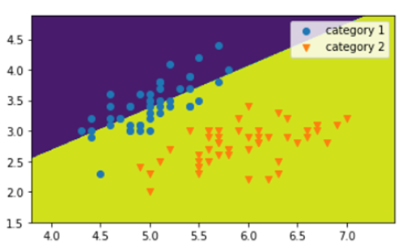
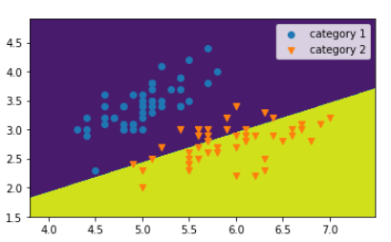
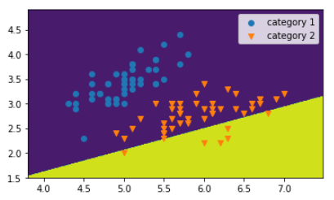
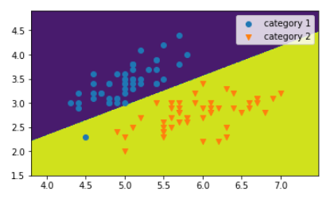
iteration 1 to iteration 12
iteration 13
iteration 14
iteration 15 to iteration 30

Slide 7
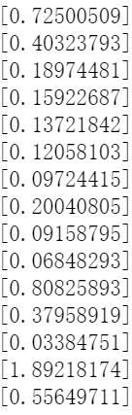


Final results in binary classification and adaboost visualization
Weights of first 15 estimators:
Accuracy rate of first 15 estimators:
Final accuracy
rate
Comparison between sklearn adaboost and our adaboost
Sklearn adaboost
Our adaboost

Slide 8
Workpieces Quality Classification Using Adaboost
difficulties:1.only decision tree
2.overfitting(test accuracy rate:0.67)
leads to：further modification of adaboost

Slide 9
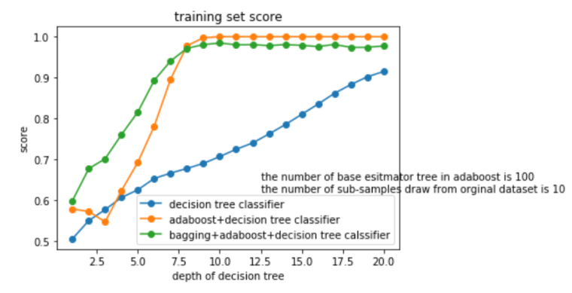
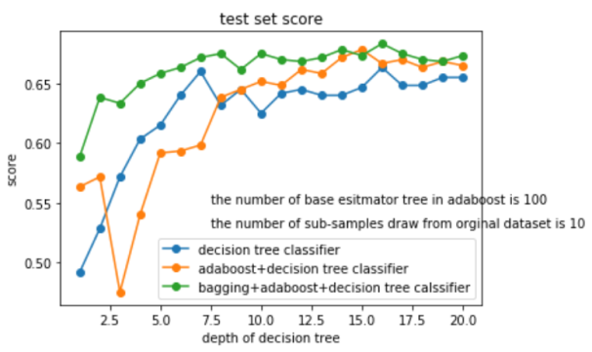
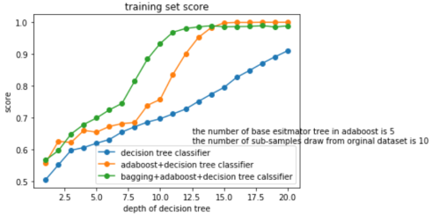
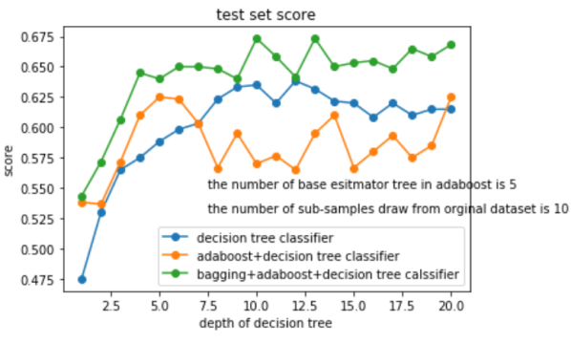

Slide 10
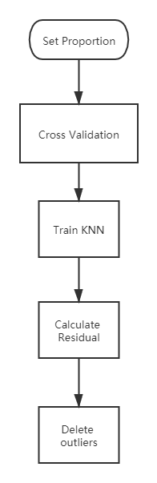
ANOTHER IMPROVEMENT
Use KNN model to take outliers
Use Principal Component Analysis

Slide 11
CONCLUSIONS
adaboost method
1
2
coding ability
3
4
improving algorithm
overfitting reason

