Slide 1
V-BReE A Variance-thresholded Blinded Refinement Ensemble for Multi-Agent LLM Reasoning
University of Guelph - Data 6400 Humanity’s Last Proctors
Jason Ives · Jeremy Greenwood · Milad Ebrahimi Abyazandi · Sherwin Darryl D’Souza

Slide 2

Motivation & Problem Statement
Motivation: Prior work shows multi-agent collaboration can improve LLM reasoning accuracy (test-time scaling).
Tension: Other studies find collaboration can trigger social conformity / sycophancy, sometimes hurting performance.
Problem: Fully open sharing of rationales can cause agents to converge for “social” reasons, creating confident wrong consensus.
Our idea: Restricted collaboration, restrict what agents can see from each other to reduce social influence.
Research question: can Restricted collaboration outperform fully open collaboration?
Notes:
Multi-agent collaboration is a popular test-time scaling approach: multiple LLM agents propose answers, critique each other, and move toward a consensus. Many studies show this improves accuracy.
However, collaboration isn’t always beneficial. When agents see each other’s rationales or strong opinions, they can conform instead of reasoning independently. This can create social conformity and sycophancy, and sometimes even reduce performance by producing a confident consensus that’s still wrong.
So the problem is reliability under information sharing: fully open collaboration may amplify social influence failures that aren’t captured by accuracy alone.
Our idea is to introduce a blinded collaboration framework that restricts what agents share, aiming to keep diversity and independence while still benefiting from collaboration.
Our core question is: Can restricted collaboration match or even outperform fully open collaboration?

Slide 3

Related work
Multi Agent Collaboration improves Reasoning:
RECONCILE: Round-Table Conference Improves Reasoning via Consensus among Diverse LLMs (Chen et al., 2024)
ICE: Iterative Consensus Ensemble (Omar et al., 2025)
Social Influence & Conformity Risks
Talk Isn’t Always Cheap: On the Social Effects of Multi-Agent LLM Interaction (Author et al., 2025)
Do As We Do: Understanding Sycophancy in Language Models (Author et al., 2024)
Notes:
The literature related to our study can be divided into two strands. First, some studies show that multi-agent collaboration helps models converge in a way that improves reasoning accuracy. Second, other studies show that collaboration can induce social conformity and sycophancy, where models converge by “peer pressure” rather than evidence.
On the positive side, methods like RECONCILE and ICE (at a high level) allow agents to see other agents’ answers and reasoning, then discuss or iteratively refine their own responses. These works report higher scores compared to single-agent, inference-time baselines.
On the risk side, studies like “Talk Isn’t Always Cheap” show that collaboration can backfire: during discussion rounds, models sometimes switch from a correct answer to an incorrect one, consistent with conformity or sycophancy effects.
Motivated by this tension, we propose a new test-time scaling framework and ask: If we restrict what agents share during collaboration, can we outperform fully open collaboration?

Slide 4
Dataset: MMLU-Pro (TIGER-AI Lab)
Public benchmark with 12,000+ MCQs.
Covers 14 domains (Law, Physics, Chemistry, Math, etc.)
Each question has a curated gold answer.
10 answer options per question (vs 4 in MMLU) → much lower random-guess accuracy
Designed to evaluate LLM reasoning, not just knowledge recall.
robust to prompt variation and guessing.
Used in ICE - enables direct performance comparison.
Notes:
Why MMLU-Pro is a Good Fit
Requires multi-step reasoning, not surface pattern matching
Large + diverse → allows domain-level analysis
MCQ format → clean accuracy measurement
Common benchmark in multi-agent LLM research
Aligns with our goal: → testing blinded vs open collaboration under realistic reasoning tasks
MMLU-Pro because it’s a harder and more reasoning-focused benchmark. It expands each question to 10 options instead of 4, which lowers random guessing and better tests whether collaboration improves reasoning.

Slide 5
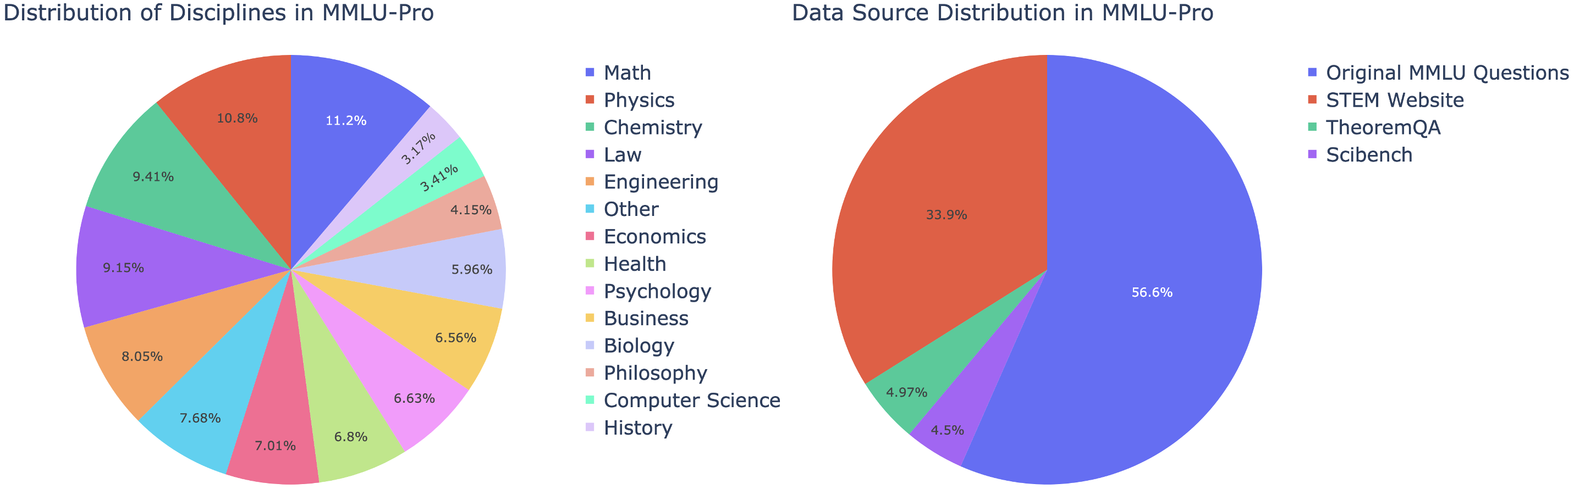
Dataset: MMLU-Pro (TIGER-AI Lab)
Notes:
Why MMLU-Pro is a Good Fit
Requires multi-step reasoning, not surface pattern matching
Large + diverse → allows domain-level analysis
MCQ format → clean accuracy measurement
Common benchmark in multi-agent LLM research
Aligns with our goal: → testing blinded vs open collaboration under realistic reasoning tasks

Slide 6
Task: MCQ Reasoning
Models must:
Interpret the question
Reason about options.
Select one final answer.
We directly compare:
Single models
Open collaboration (ICE-style)
V-BReE (blinded collaboration)
Primary metric: MCQ accuracy

Slide 7
Human Review: Logic Errors & Improvements
Accuracy alone doesn’t show why models fail.
We manually inspect a subset of responses to analyze: a) Reasoning quality across collaboration rounds b) Error patterns (hallucination, overconfidence, conformity) c) Whether blinding reduces confident wrong consensus
Notes:
Helps us understand:
How V-BReE changes reasoning
Where it helps or fails
What to improve next

Slide 8

Human Review: Quantitative Methods
“Per-token basis” testing options:
Verbose output, counting every word, generating a cost-per-word, and dividing score by average cost-per-answer
Limit token count to ~500 for each ensemble answer, limit single-model answer to $ensemble token count × 3 (mean rounds to consensus)$

Slide 9
System Architecture: Blinded Refinement
Premise: 3 models (A, B, and C) solve a problem iteratively through rounds.
Anatomy of a round:
(First round only) Model A receives a question and generates an answer.
Model B receives the question and model A’s answer, and generates a score for the answer, and a revised answer.
Model C receives model B’s answer and generates a score & revision
Model A receives model C’s answer and generates a score & revision
Repeat, calculating Central Hub Variance for the last 3 scores each response (not each round).
Notes:
What is Blinded Refinement? It is a method of iterative improvement on a model’s answer. It is blinded because models can only see the current revision handed to them – they are blinded to all other context outside of the question being answered. It is refinement because the task is to revise and refine the answer before handing it off to the next model.

Slide 10
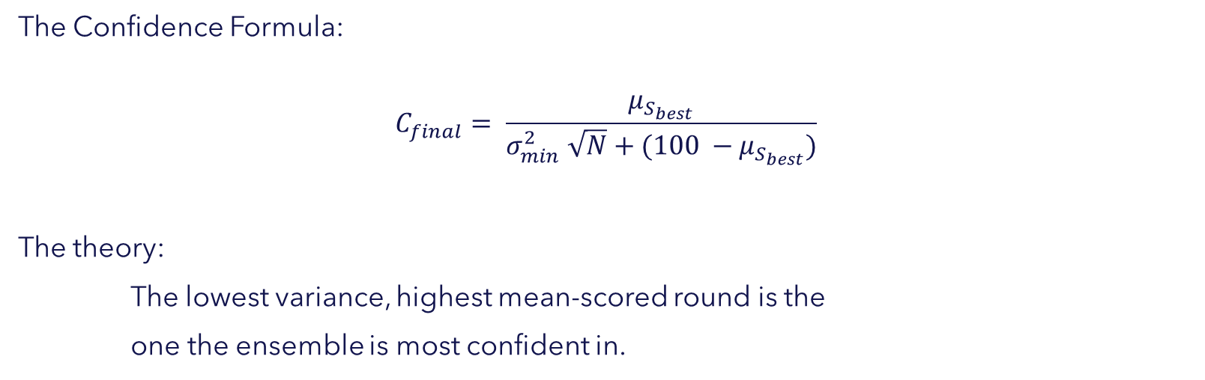
System Architecture: Central Hub Variance
The Confidence Formula:
$$C_{final}= \frac{μ_{S_{best}}}{σ_{min}^{2} \sqrt{N}+(100 −μ_{S_{best}})}$$
The theory:
The lowest variance, highest mean-scored round is the
one the ensemble is most confident in.
Notes:
C-final: final “confidence score” (do not mistake this as having anything to do with confidence intervals, or confidence as a statistical concept).
μ-S-best: mean score of the best variance round.
σ²-min: lowest variance round

Slide 11

Putting It Together: The Innovation
Iterative Consensus Ensemble is prone to “context bloat” and sycophancy
Solution: Only pass the refined answer to the next model
Variance threshold increases each full round.
Stop when ${σ^{2}}_{x_{n}, x_{n−1}, x_{n−2}}<Variance Threshold$, return lowest variance round score.
In a simplified human context: “edit your colleague’s work, if you can’t find anything to fix, submit it.”
Notes:
Will need to discuss this.

Slide 12

Evaluation Plan and Expected Outcomes
Metrics
MCQ Accuracy on MMLU-Pro
Accuracy comparisons
ICE documented metrics
Open-source collaborative frameworks; using same models
Single model performance
V-BReE utilized models
New models
Token count efficiency analysis
Comparison with Open-source collaborative framework token counts.
Human-based logic review

Slide 13
Target results
Strong MMLU-PRO accuracy competitive with the documented ICE framework accuracy of 72.1%.
Strong MMLU-PRO accuracy competitive with similar open-source ensemble frameworks.
Consistent accuracy performance above the independent performance of the constituent models.
Token count economy at or below similar ensemble approaches.
Confidence scoring mechanism that can be used to effectively assess the quality and value of the ensemble response.

Slide 14
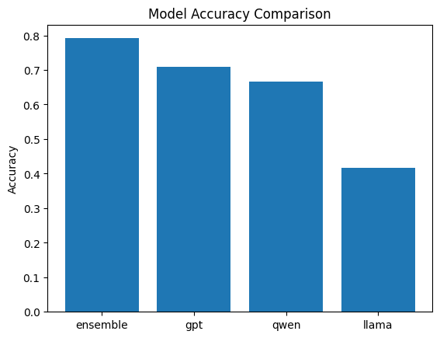
Preliminary test results
Functional testing done with a small sample of 35 questions shows a promising hint of possible accuracy improvements over the constituent models.
Additional rigorous testing will be necessary to determine what, if any, true impact the V-BReE framework has on response accuracy.

Slide 15
Expected Contributions
V-BReE framework programmed in Python, which introduces a novel variance-thresholded refinement technique.
A qualitative method for assessing the response confidence of the ensemble.
A paper documenting the development and testing of the VBReE framework.

Slide 16
Timeline
Key Milestones
V-BReE Python code complete – March 1st
MMLU-PRO accuracy data collection complete – March 2nd
MMLU-PRO accuracy data analysis complete – March 4th
Confidence score tuning complete – March 9th
Human-based logic assessment complete – March 14th

Slide 17
Timeline
Item Number | Date | Incomplete Dependencies | Milestone / Task | Status | Owner | Days From Previous Milestone | Days From Today
1 | 12-Feb | - | Prototype | Completed | - | 0 | -8
2 | 13-Feb | - | Project Proposal | Completed | - | 1 | -7
3 | 22-Feb | - | Midterm Presentation Development Complete | In Progress | Content - All Slides - Milad | 9 | 2
4 | 23-Feb | 3 | Submit Midterm Slides | Planned | Milad | -1 | 3
5 | 24-Feb | 3, 4 | Midterm Presentation | Planned | All | 2 | 4
6 | 27-Feb | - | Open source collaborative frameworks identified | Planned |  | 4 | 7
7 | 27-Feb | - | Model Selection Complete | Planned |  | 0 | 7
8 | 1-Mar | - | V-BReE Python Code Complete | Planned |  | 2 | 9
9 | 2-Mar | 7, 8 | MCQ Accuracy on MMLU-Pro - data collection complete | Planned |  | 1 | 10
10 | 2-Mar | 7, 8, 9 | Accuracy comparison with stand alone models - data collection complete | Planned |  | 0 | 10
11 | 4-Mar | 8, 9 | Confidence score refinement and validation plan developed | Planned |  | 2 | 12
12 | 4-Mar | 8 | Qualitative logic assessment - plan complete | Planned |  | 0 | 12
13 | 4-Mar | 7, 8, 9 | Token count assessment - plan complete | Planned |  | 0 | 12
Notes:
Deliverables in bold
Key milestones highlighted:
Core code complete – March 1
Core accuracy metrics complete – March 2

Slide 18
Timeline - continued
Item Number | Date | Incomplete Dependencies | Milestone / Task | Status | Owner | Days From Previous Milestone | Days From Today
14 | 4-Mar | 7, 8, 9 | MCQ Accuracy on MMLU-Pro - analysis complete | Planned |  | 0 | 12
15 | 4-Mar | 7, 8, 9 | Comparison with ICE documented metrics - analysis complete | Planned |  | 0 | 12
16 | 5-Mar | 6, 7, 8, 9, 10, 11, 12, 13, 14, 15 | Progress Report Development | Planned |  | 1 | 13
17 | 6-Mar | 6, 7, 8, 9, 10, 11, 12, 13, 14, 15, 16 | Progress Report - 5 Pages | Planned |  | 1 | 14
18 | 9-Mar | 8, 9, 11 | Confidence score refinement and validation complete | Planned |  | 3 | 17
19 | 11-Mar | 9, 10, 11 | Accuracy comparison with open source frameworks - data collection complete | Planned |  | 2 | 19
20 | 14-Mar | 7, 8, 9, 13 | Token count assessment - analysis complete | Planned |  | 3 | 22
21 | 14-Mar | 7, 8, 12 | Qualitative logic assessment - analysis complete | Planned |  | 0 | 22
22 | 18-Mar | 6, 7, 8, 9, 10, 11, 12, 13, 14, 15, 16, 17, 18, 19, 20, 21 | Final Presentation Development Complete | Planned |  | 4 | 26
23 | 20-Mar | 6, 7, 8, 9, 10, 11, 12, 13, 14, 15, 16, 17, 18, 19, 20, 21, 22 | Final Presentation | Planned |  | 2 | 28
24 | 9-Apr | 6, 7, 8, 9, 10, 11, 12, 13, 14, 15, 16, 17, 18, 19, 20, 21 | Final Report Development Complete | Planned |  | 20 | 48
25 | 10-Apr | 6, 7, 8, 9, 10, 11, 12, 13, 14, 15, 16, 17, 18, 19, 20, 21, 24 | Final Report Submission - 8 pages | Planned |  | 1 | 49
Notes:
Confidence score tuning complete 9-Mar
Last analysis component complete 14-Mar

Slide 19
Conclusion
Introducing V-BReE – A Variance-thresholded Blinded Refinement Ensemble
Strong accuracy performance
Reduced vulnerability to sycophancy and inter-ensemble “social” pressures
Dynamic exploration of shared response space with optimized result return
Remaining work
Code finalization
MMLU-PRO accuracy testing and analysis
Human logic review
Token count analysis
Confidence metric refinement and validation

