Slide 1
Mitochondrial DNA Basics

Slide 2
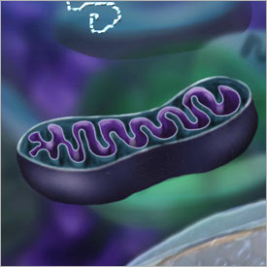
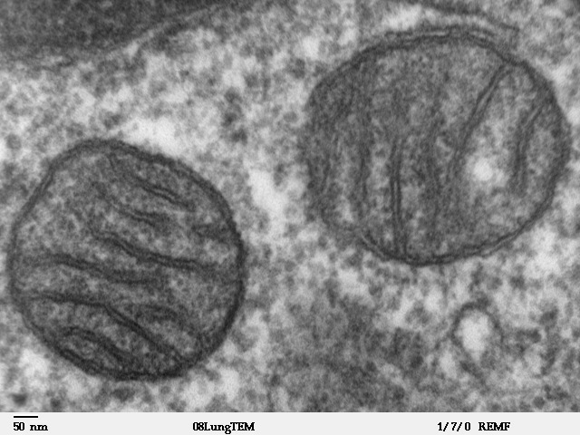
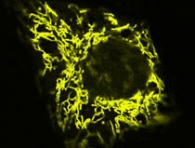
Mitochondria – the powerhouse of the cell

Slide 3
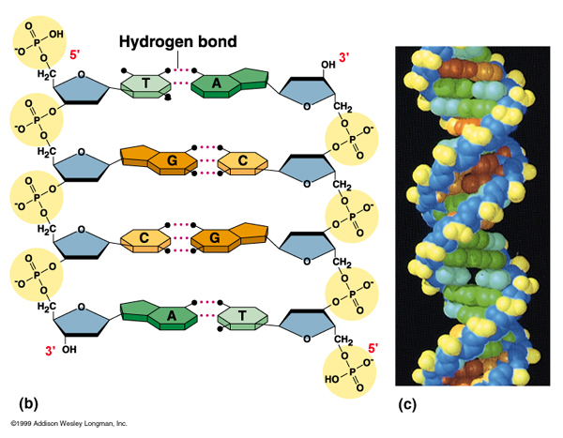
Mitochondrial DNA is DNA

Slide 4
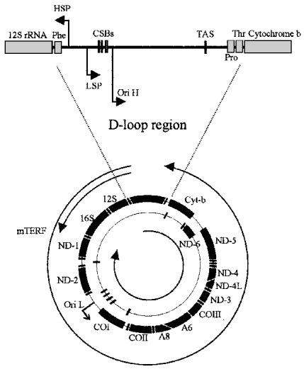
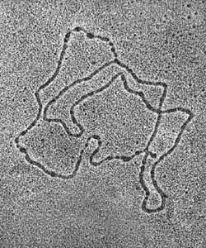
Mitochondrial DNA Structure
Human Mitochondrial DNA
16569 bp

Slide 5
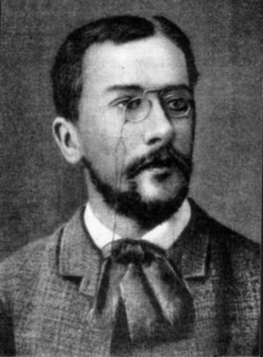
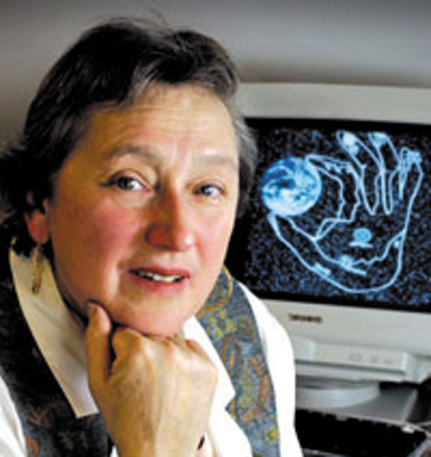
Endosymbiont Theory
Константин Мережковский
Lynn Margulis

Slide 6
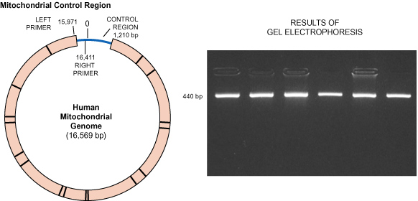
Mitochondrial DNA – replicated by PCR

Slide 7
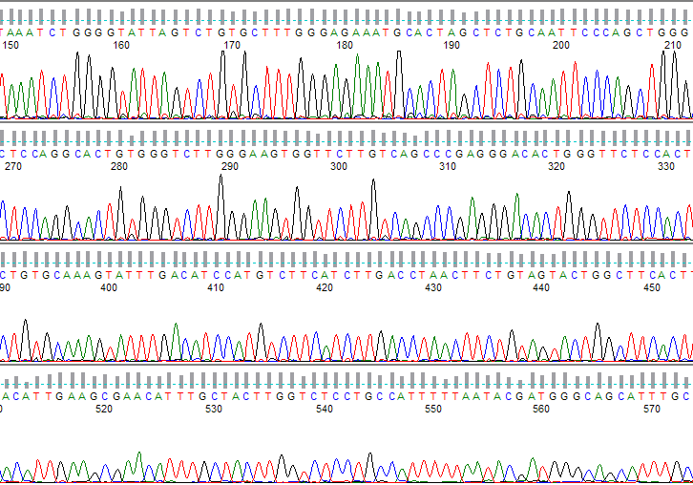
DNA Sequencing

