Slide 1
Mitochondrial DNA Basics

Slide 2
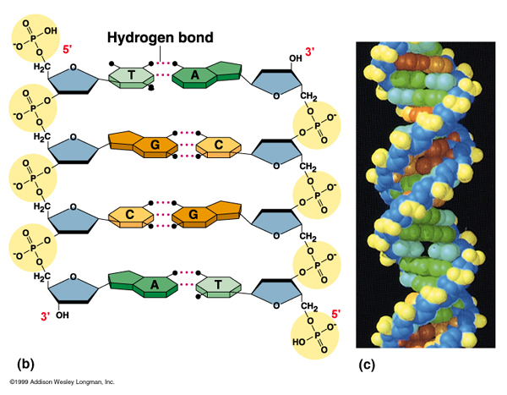
Mitochondrial DNA is DNA

Slide 3
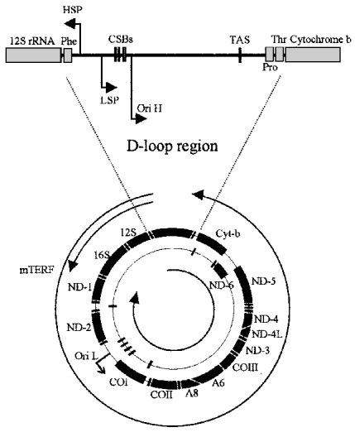
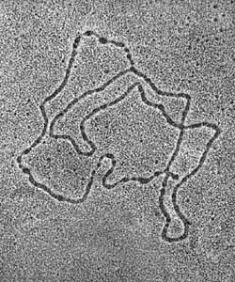
Mitochondrial DNA Structure
Human Mitochondrial DNA
16569 bp

Slide 4
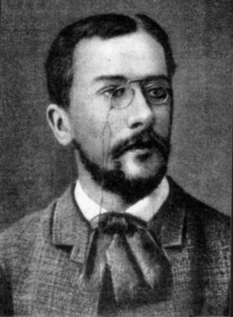
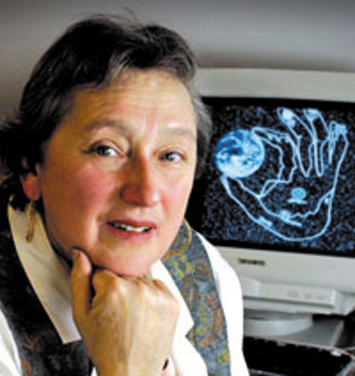
Endosymbiont Theory
Константин Мережковский
Lynn Margulis

Slide 5
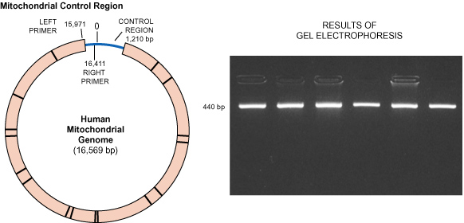
Mitochondrial DNA – replicated by PCR

Slide 6
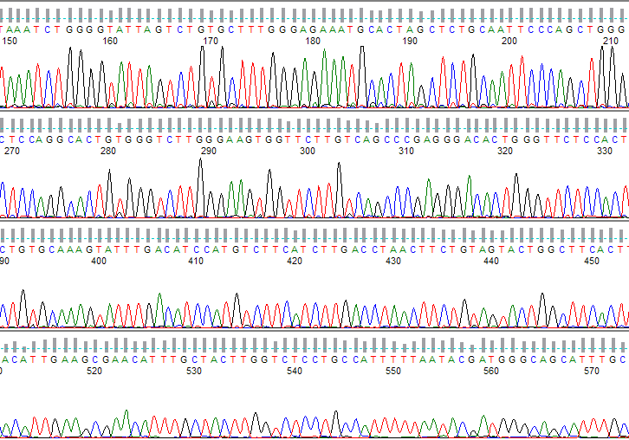
DNA Sequencing

