Slide 1
Human Polymorphisims
PTC Tasting

Slide 2

Variation

Slide 3
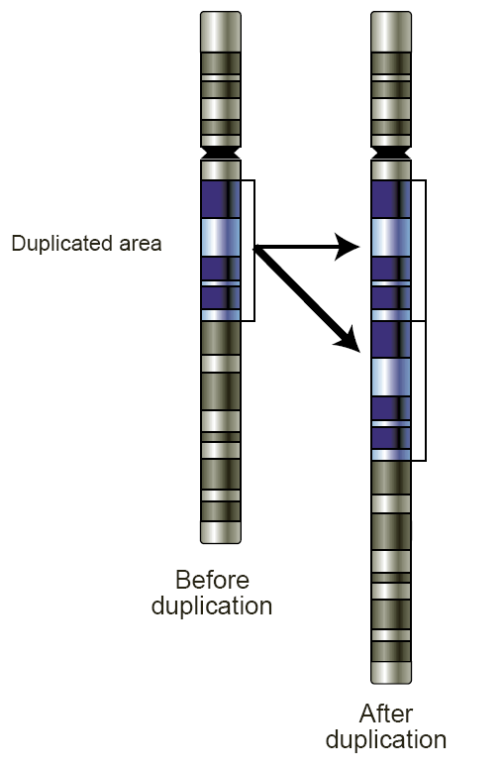
Genetic Variations
Copy Number Variation
- Different number of copies of the same gene
National Human Genome Research Institute - originally from [2] but it has been moved or removed; the entry "gene duplication" is gone from the Talking Glossary of Genetics. The image was brought here from enwiki en:Image:Gene-duplication.png.

Slide 4
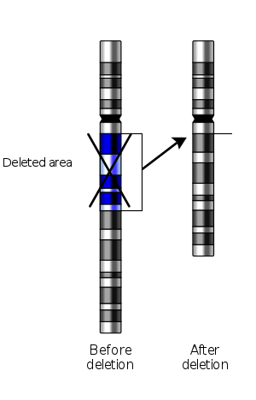
Genetic Variations
Copy Number Variation
- Genes may even get deleted
The original uploader was Mirmillon at French Wikipedia. - Vectorized from File:Deletion.gif National Human Genome Research (USA) Originally from fr.wikipedia; description page is/was here.
Deleción cromosómica.

Slide 5
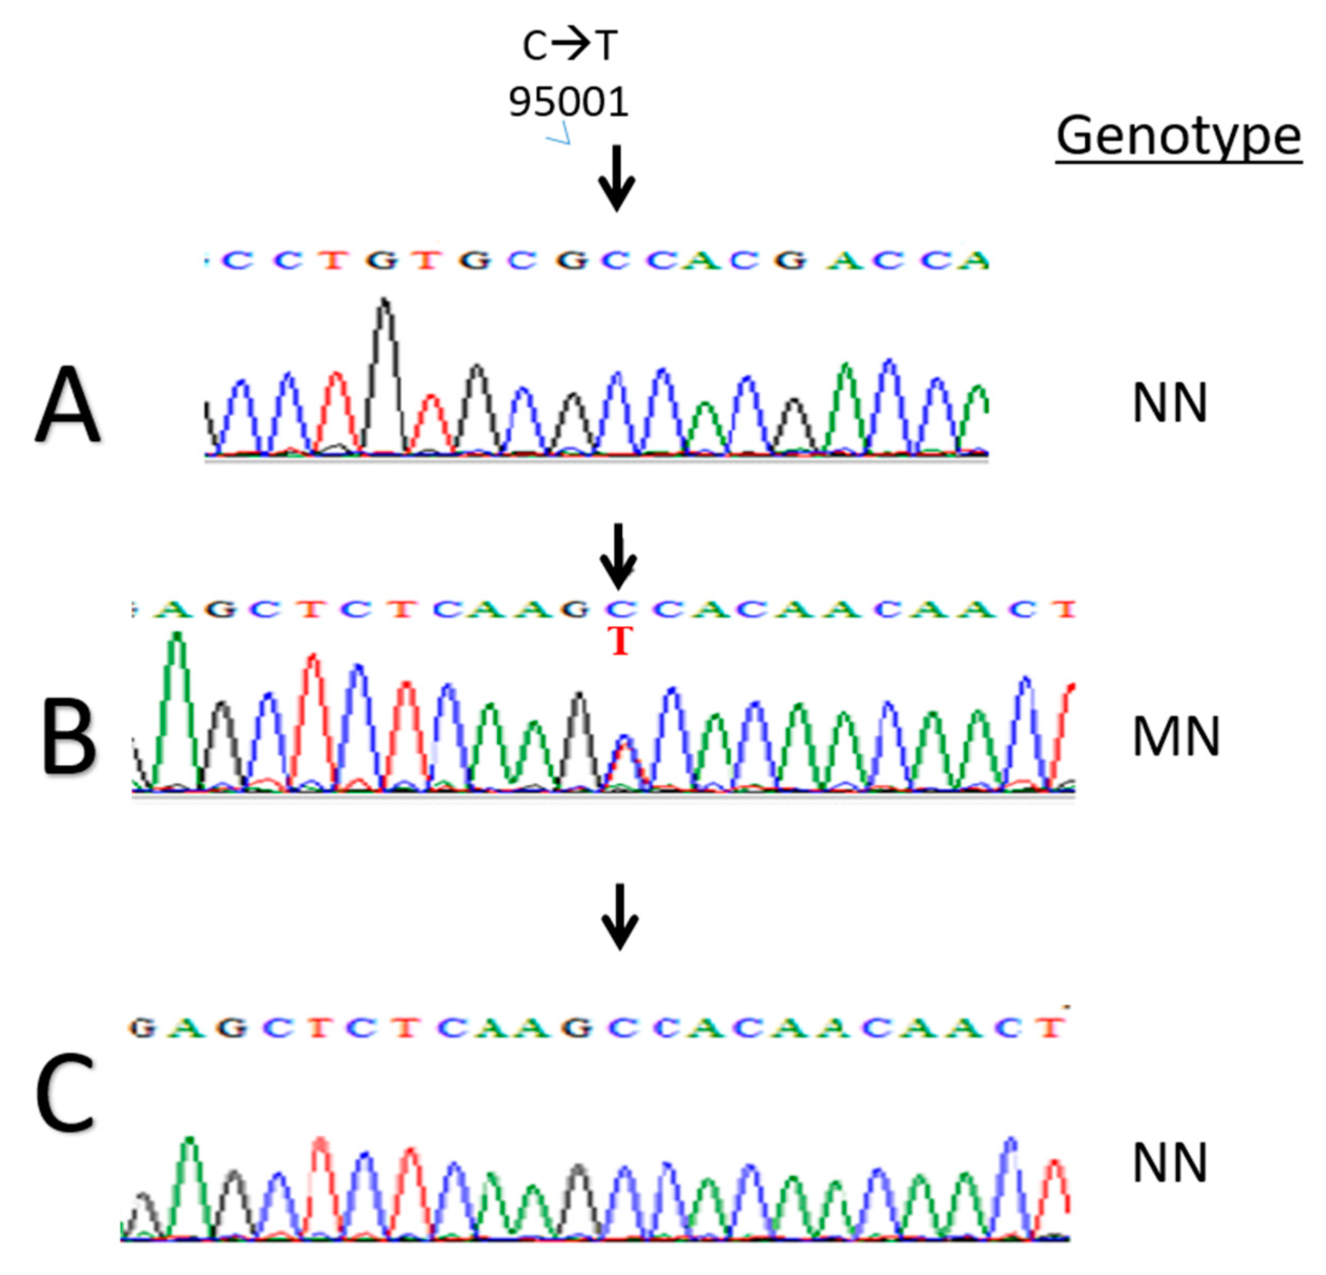
Genetic Variations
Polymorphisim
The gene may come in different varieties (poly- many/morphisim- form)
When a single nucleotide has changed, we often call it a SNP (single nucleotide polymorphisim)
https://www.mdpi.com/2076-2615/9/9/667/htm

Slide 6
Genetic Variations
Polymorphisim
The gene may come in different varieties (poly- many/morphisim- form)
When a single nucleotide has changed, we often call it a SNP (single nucleotide polymorphisim)
https://www.mdpi.com/2076-2615/9/9/667/htm

Slide 7
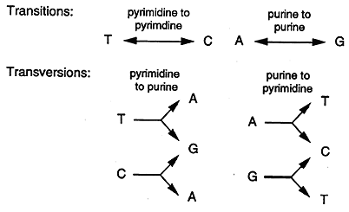
SNP Classifications
Transitions and Transversions
Transition (more common)
- a nucleotide is changed to another nucleotide with a similar chemical structure
Transversion (less common)
- a nucleotide is changed to another nucleotide that does not have the same chemical structure

Slide 8
SNP Classifications
Transitions and Transversions
Cytosine, Thymine – (pyrimidines)
Adenine, Guanine – (purine)

Slide 9
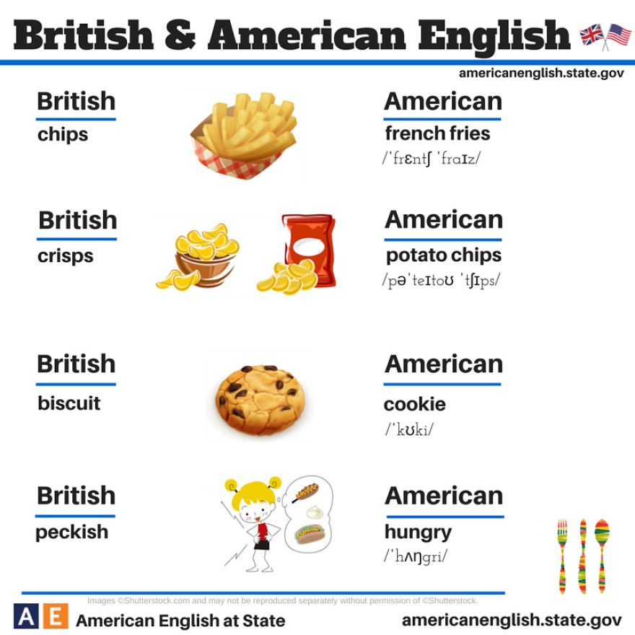


Most variations are subtle (phonological)

Slide 10
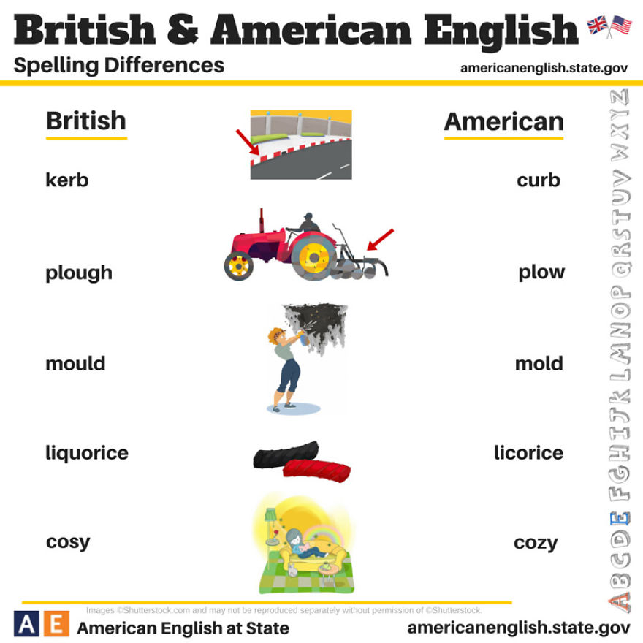
Most variations are subtle (spelling)

Slide 11
PTC Tasting Experiment

Slide 12
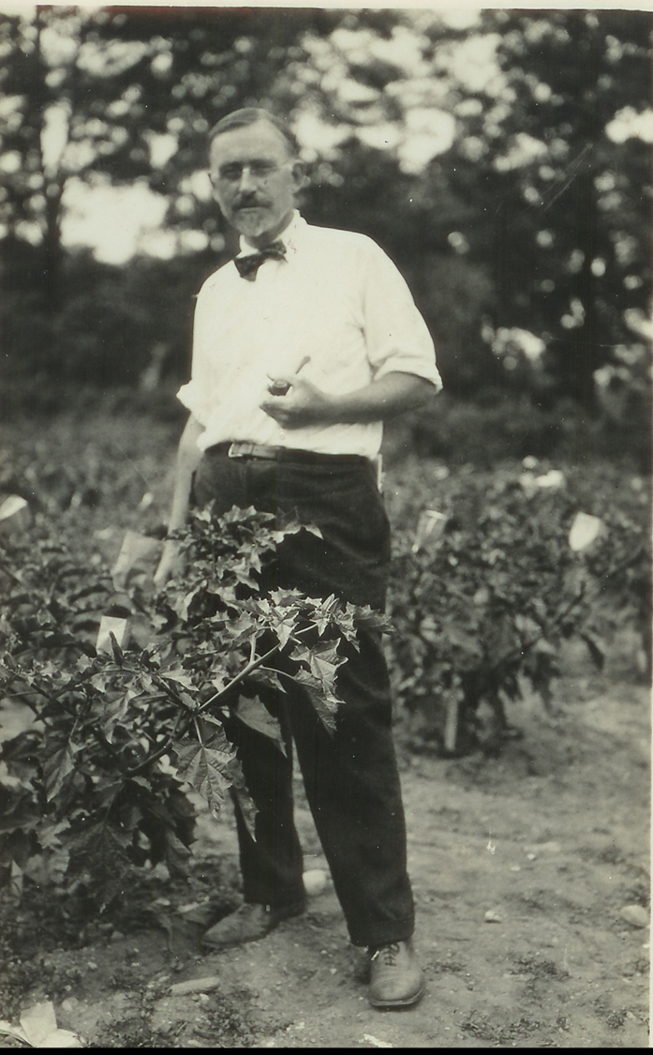
Genetics of PTC Tasting
PTC = phenylthiocarbamide
Prepared by Arthur Fox at Du Pont Company in late 1920s
Lab partner C.R. Noller complained of bitter taste
Fox had no taste
Followed up by Albert Blakeslee at Carnegie Department of Genetics
Published in 1932

Slide 13
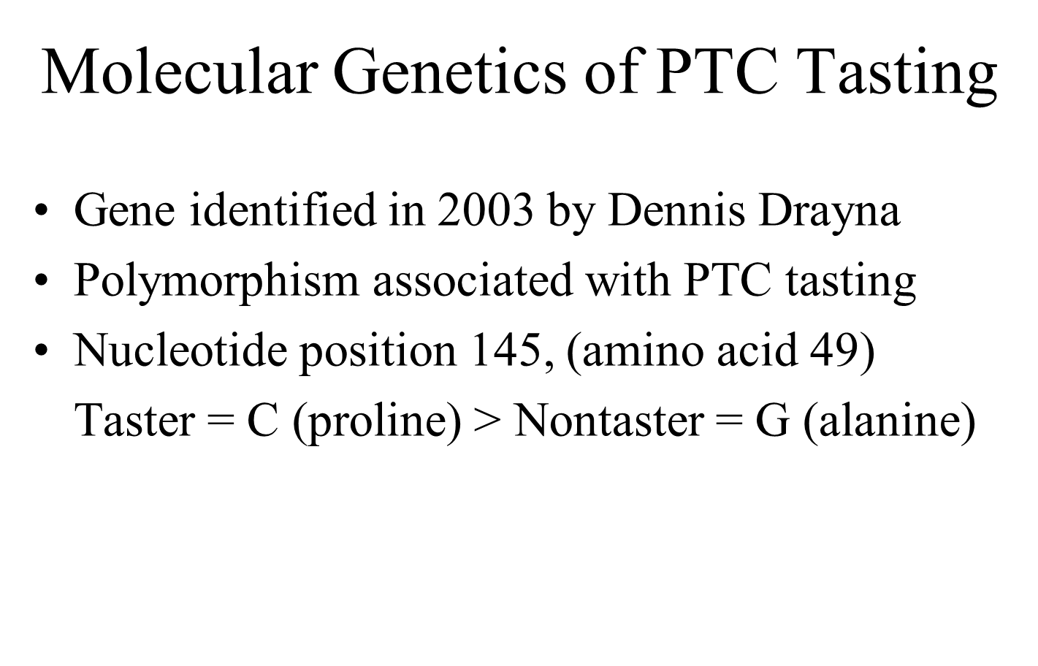

Slide 14
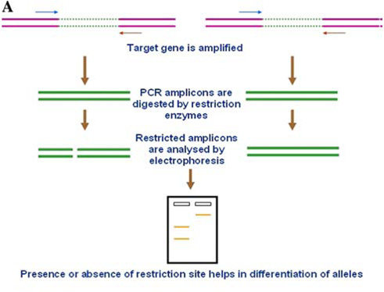
CAPs (Cleaved, Amplified, Polymorphic Sequence)

Slide 15
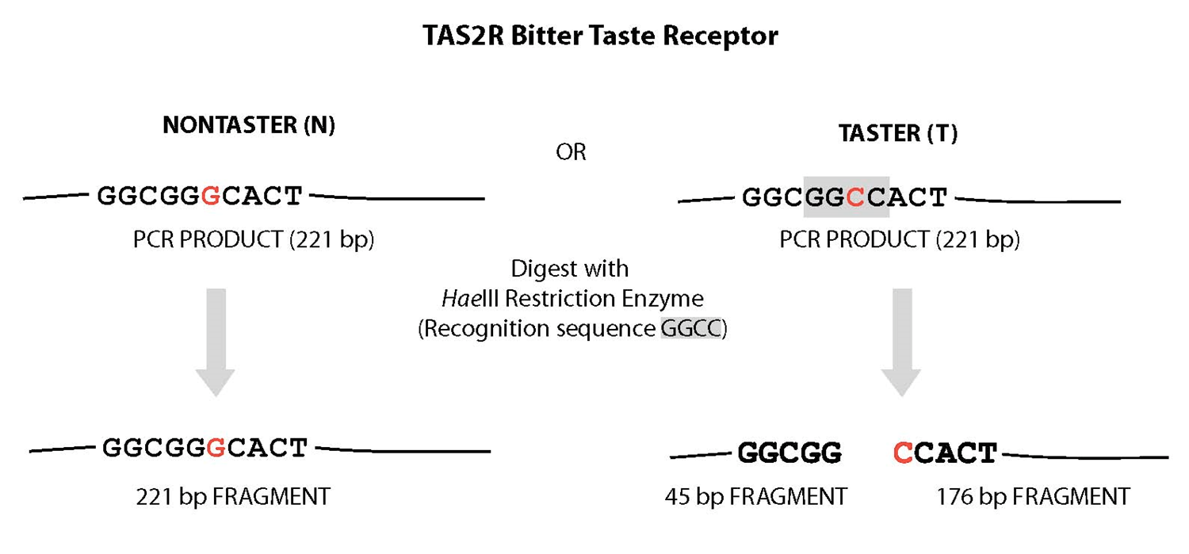

Slide 16
More Complication: PTC Haplotypes
Postition | Taster | Nontaster
145 | C (proline) | G (alanine)
785 | C (alanine) | T (valine)
886 | G (valine) | A (isoleucine)

