Slide 1
Bacterial Transformation II
An experiment in genetic engineering

Slide 2
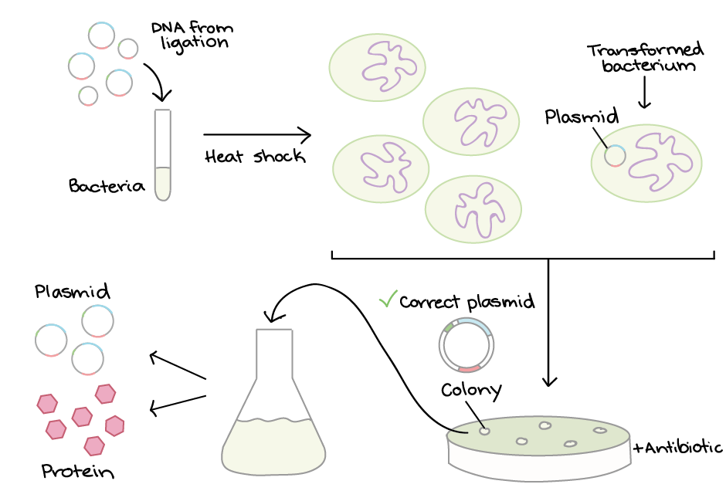
Bacterial Transformation
Image Credit: https://www.khanacademy.org/science/biology/biotech-dna-technology/dna-cloning-tutorial/a/bacterial-transformation-selection

Slide 3
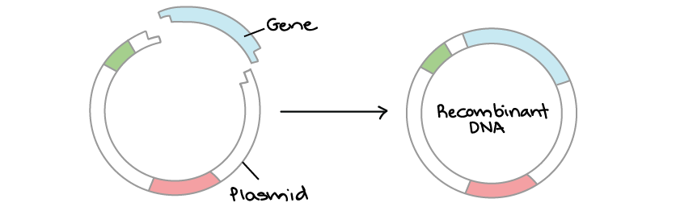
Review – How plasmids are made
Image Credit: https://www.khanacademy.org/science/ap-biology/gene-expression-and-regulation/biotechnology/a/overview-dna-cloning

Slide 4

Review – How plasmids are made
Restriction Enzymes
Image Credit: https://www.khanacademy.org/science/ap-biology/gene-expression-and-regulation/biotechnology/a/overview-dna-cloning

Slide 5
Review – How plasmids are made
Genus, species, strain, number
_____|
Eco R I
GAATTC
|
CTTAAG
(Origins: E. coli RY13)
_____|
Hind III
AAGCTT
|
TTCGAA
(Origins: H. influenzae Rd)

Slide 6
Review – How plasmids are made
EcoRI cuts at GAATTC
TCGATGAATTCTAAGCTTAGTGAATTCTGTGCA
AGCTACTTAAGATTCGAATCACTTAAGACACGT
AATTCTGTGCA
GACACGT
AATTCTAAGCTTAGTG
GATTCGAATCACTTAA
TCGATG
AGCTACTTAA
About R.E.

Slide 7
pGFP plasmid

Slide 8
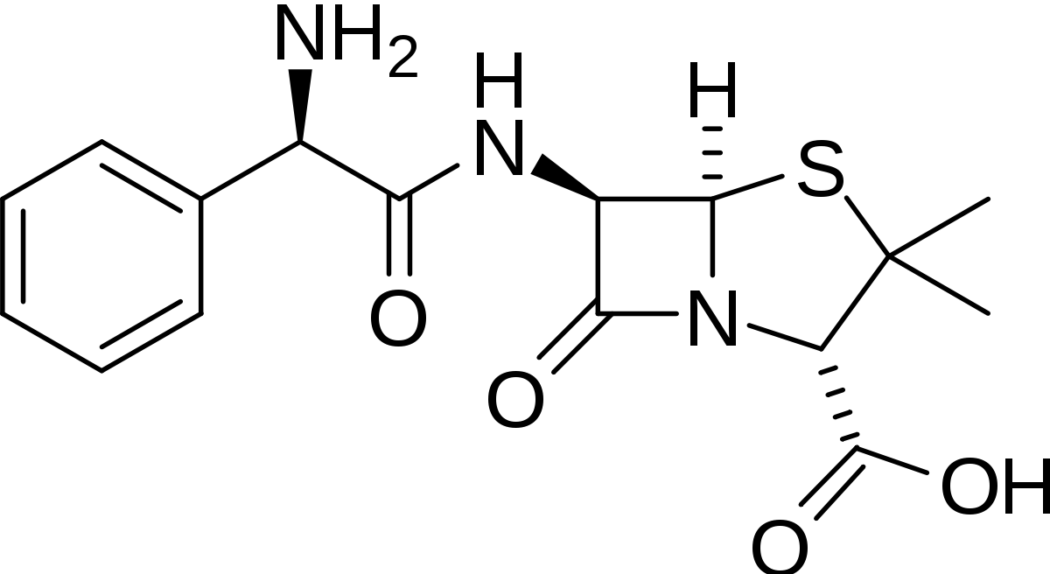
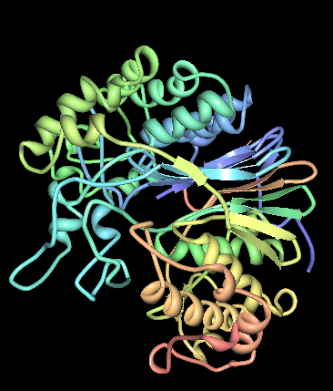
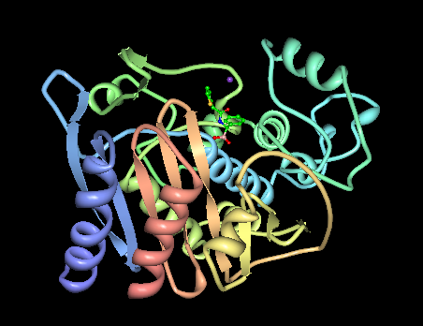
pGFP plasmid
T
Ampicillin
Transpeptidase
β-lactamase bla (TEM-1)

Slide 9
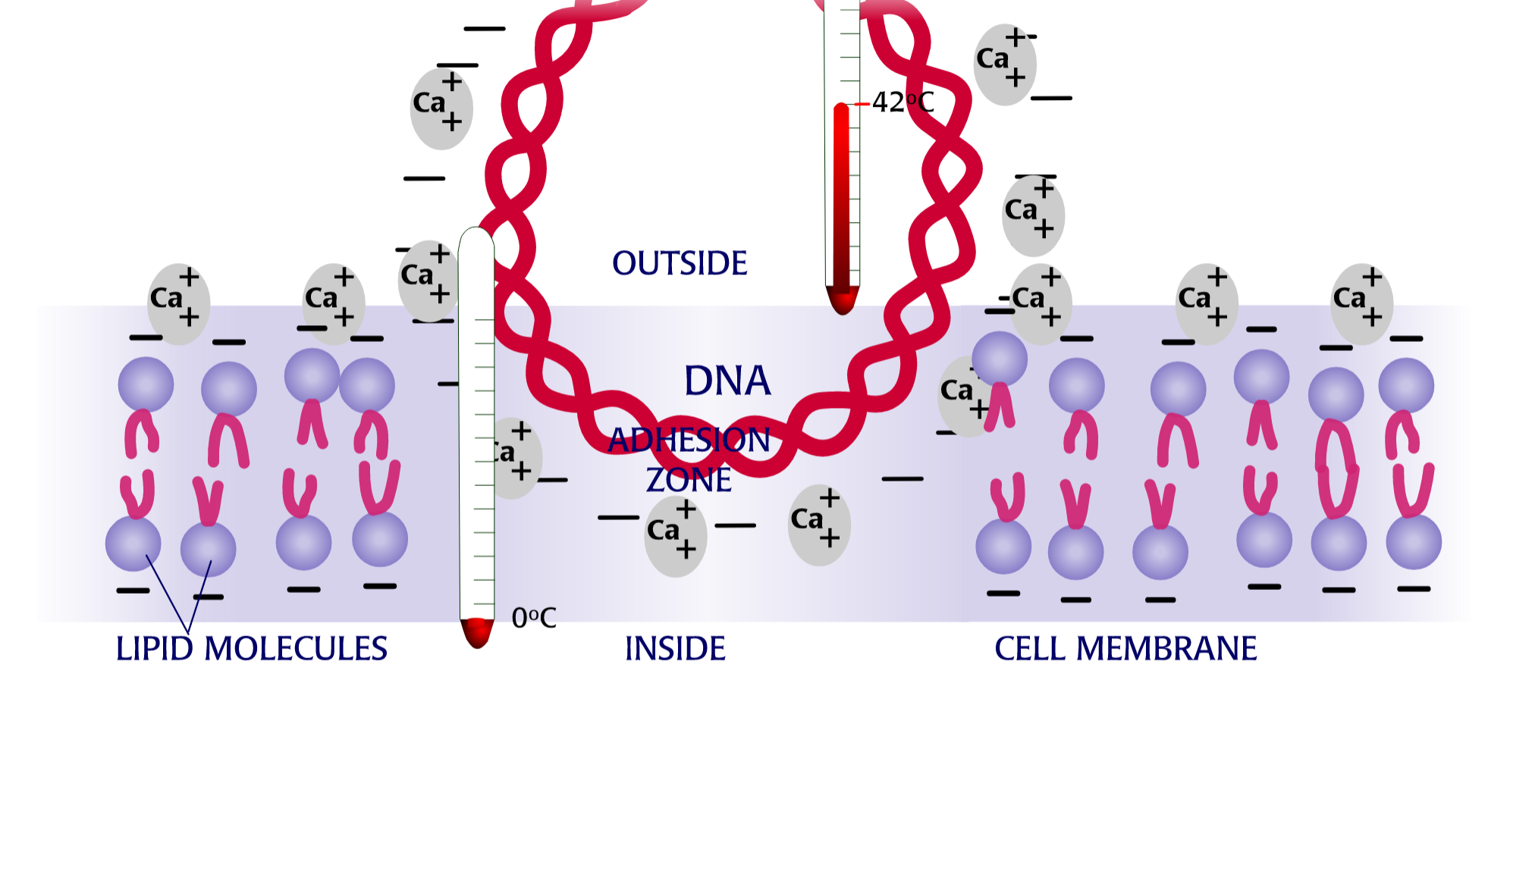
During heat shock – (some) bacteria take up plasmid

Slide 10
Results

Slide 11
Controls
Experiment:
At what temperature does
ice (H₂O) + Chemical “X”
melt?

Slide 12
Controls
Positive control: What does the effect look like if present?

Slide 13
Controls
Positive control: What does the effect look like if present?
Negative control: What does the effect look like if absent?

Slide 14
Controls
Positive control: What does the effect look like if present?
Negative control: What does the effect look like if absent?
Sensitivity control: Across what range of values can I measure the effect?

Slide 15
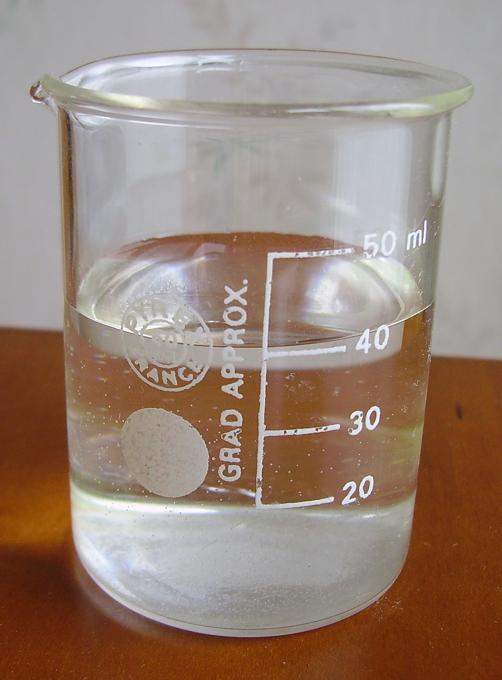
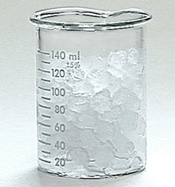
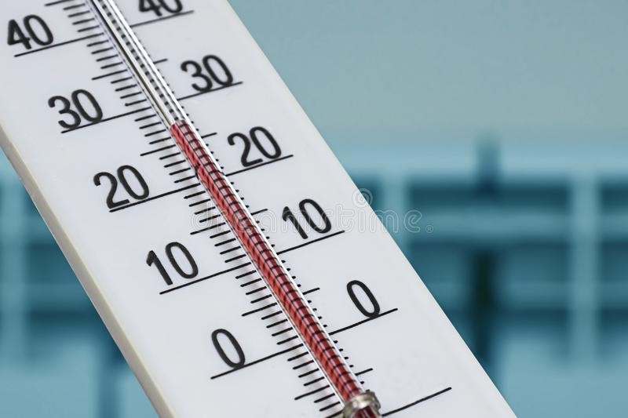
Controls
Positive control
Negative control
Sensitivity control
Photo credits
https://commons.wikimedia.org/wiki/File:Water_in_a_beaker.JPG
http://www.chem.uiuc.edu/webfunchem/temperature/Temp10.htm
https://www.dreamstime.com/photos-images/alcohol-thermometer.html

Slide 16
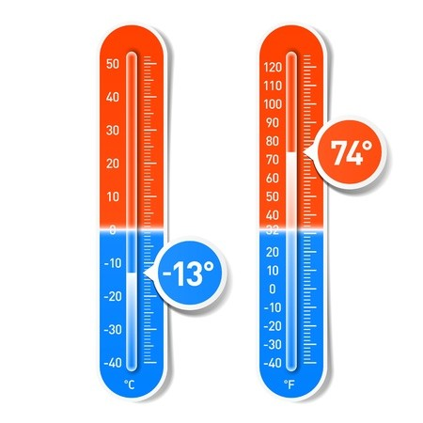
Controls
Positive control
Negative control
Sensitivity control
Photo credits
https://commons.wikimedia.org/wiki/File:Water_in_a_beaker.JPG
http://www.chem.uiuc.edu/webfunchem/temperature/Temp10.htm
https://en.clipdealer.com/vector/media/A:17494508?

Slide 17
Results

Slide 18
Plating Diagram
LB Amp
1
4
(+) Bacteria
( - ) Bacteria
3
2

Slide 19
Plating Diagram
LB Amp
1
4
(+) Bacteria
( - ) Bacteria
3
2

Slide 20
Plating Diagram
LB Amp
1
4
(+) Bacteria
( - ) Bacteria
3
2

Slide 21
Plating Diagram
LB Amp
1
4
(+) Bacteria
( - ) Bacteria
3
2

Slide 22
Plating Diagram
LB Amp
1
4
(+) Bacteria
( - ) Bacteria
3
2

Slide 23
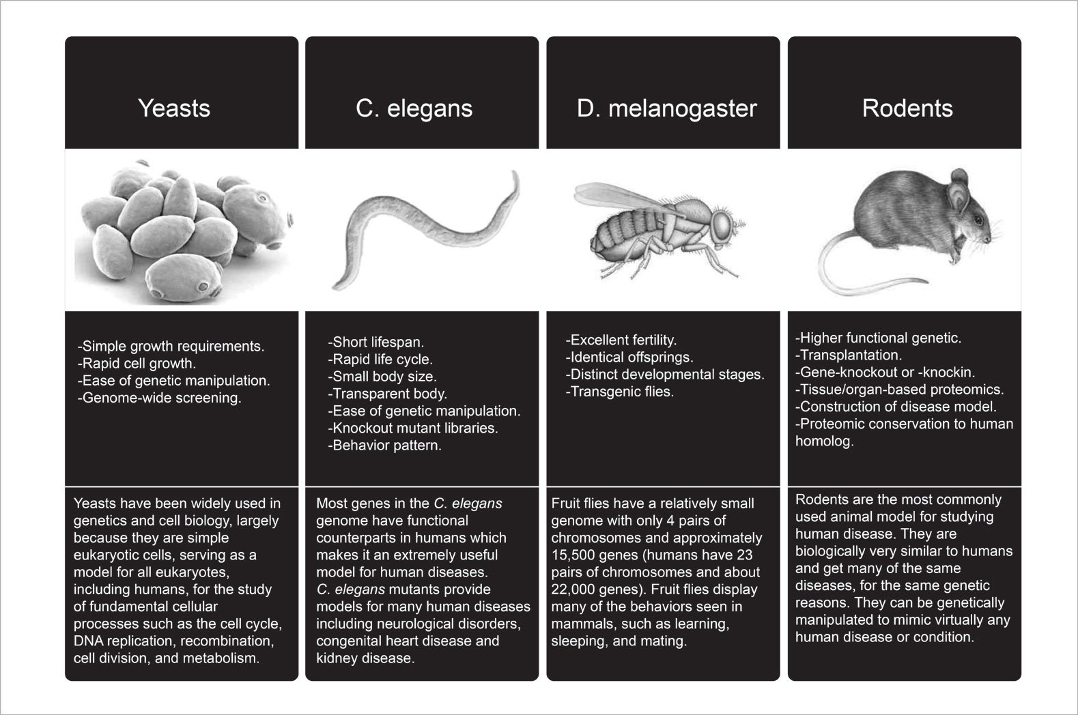
Some MO characteristics and key players
https://blog.atlasantibodies.com/using-antibody-for-human-protein-in-model-organism

Slide 24
Through manipulation and study of model organisms
we work to understand life

Slide 25
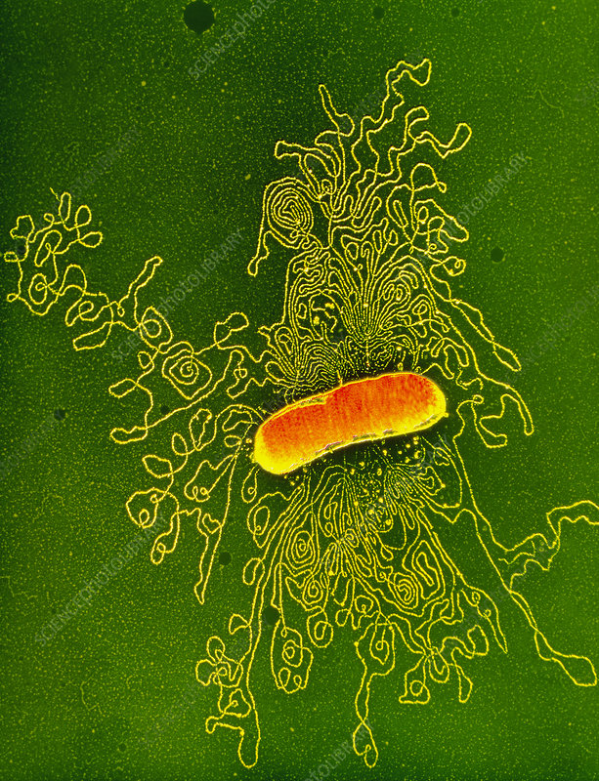
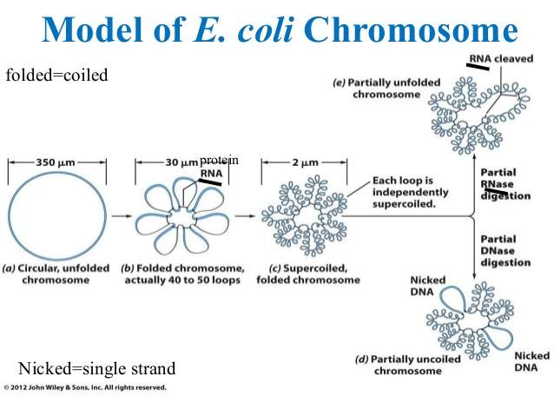
Manipulation at the genetic level
Image Credit
DR GOPAL MURTI / SCIENCE PHOTO LIBRARY

Slide 26
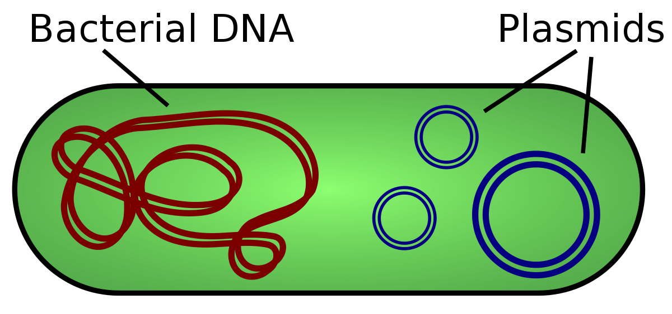
Plasmids – short circular DNAs
Image credit: https://en.wikipedia.org/wiki/Plasmid#/media/File:Plasmid_(english).svg

Slide 27
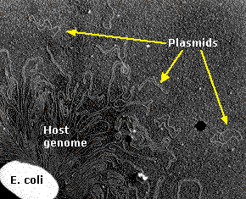
Plasmids – short circular DNAs
Image credit: https://en.wikipedia.org/wiki/Plasmid#/media/File:Plasmid_(english).svg

Slide 28
Plasmid Manipulation
Image Credit: https://www.khanacademy.org/science/ap-biology/gene-expression-and-regulation/biotechnology/a/overview-dna-cloning

Slide 29
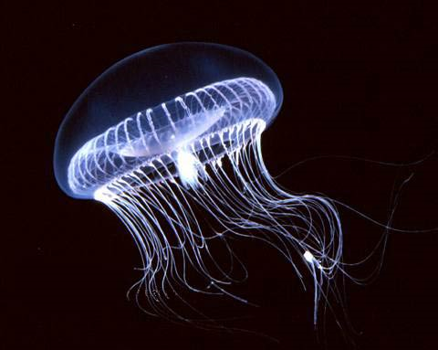
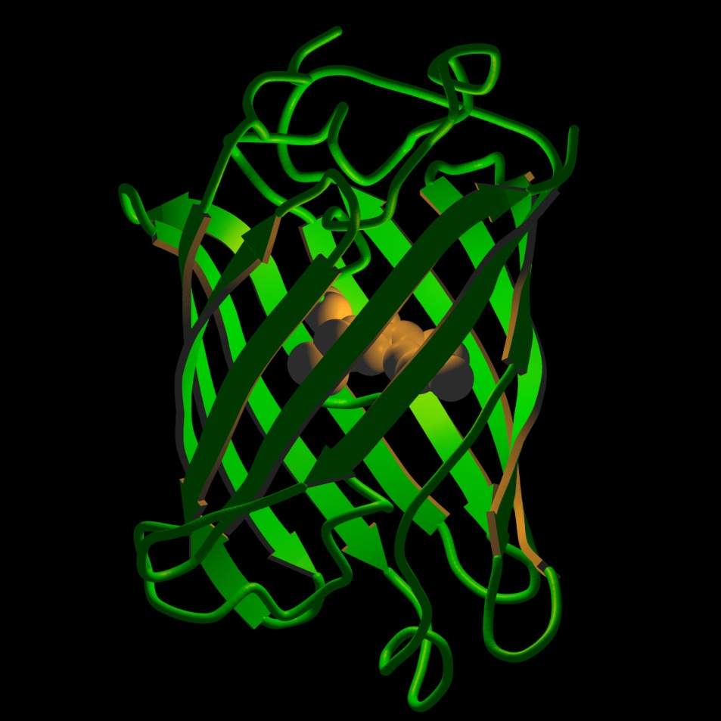
Green Fluorescent Protein
A. Victoria
GFP Protein Structure

