Slide 1
Bacterial Transformation I
An experiment in genetic engineering

Slide 2
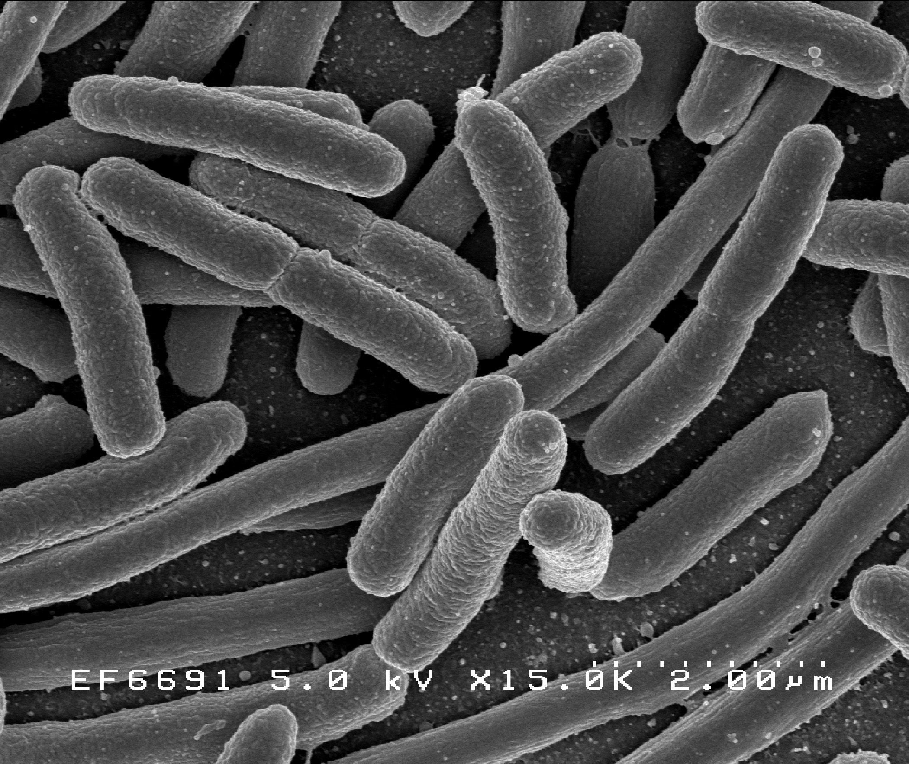
E.coli – a model organism of the molecular biology lab
Image by NIAID

Slide 3
What do you know about E.coli ?

Slide 4
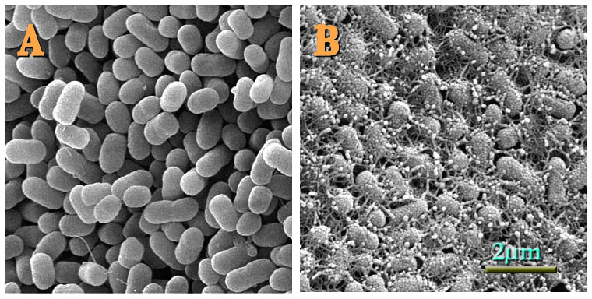
Some strains are harmful, but most are not
Topographical images of colonies of E. coli O157:H7 strains (A) 43895OW (curli non-producing)
and (B) 43895OR (curli producing) grown on agar for 48 h at 28°C.
Image credit: USDA (Pina Fratamico Microbiologist/Lead Scientist)

Slide 5
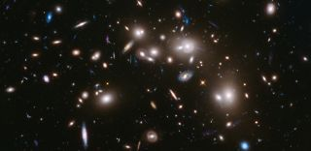
Microorganisms dominate life on earth
Microbes on Earth
9.2 x 10²⁹ – 31.7 x 10²⁹
Nature doi:10.1038/nature.2012.11275
Stars in the Universe
10²⁴
https://www.space.com/26078-how-many-stars-are-there.html

Slide 6
What is a model organism?

Slide 7
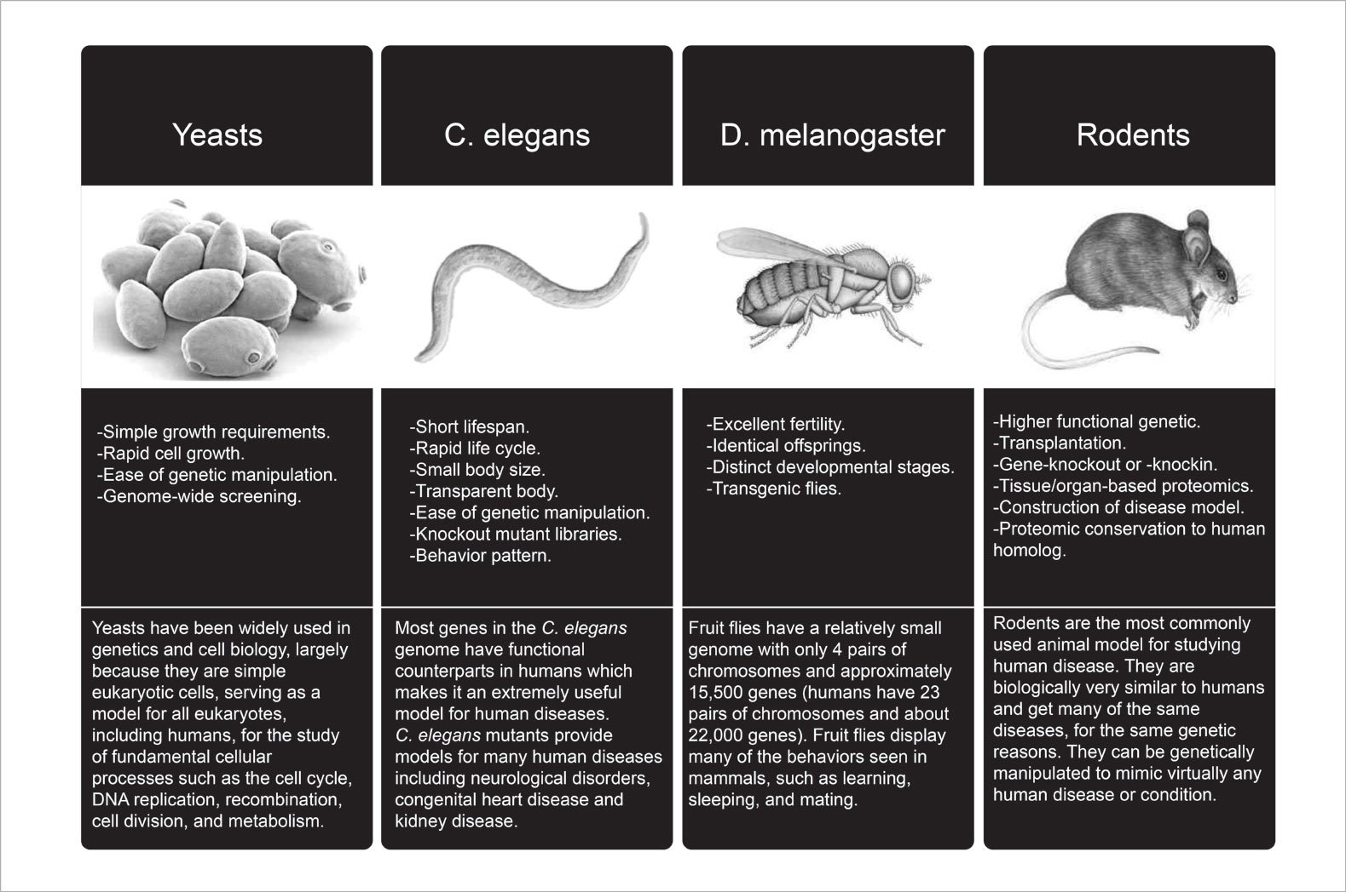
Some MO characteristics and key players
https://blog.atlasantibodies.com/using-antibody-for-human-protein-in-model-organism

Slide 8
Through manipulation and study of model organisms
we work to understand life

Slide 9
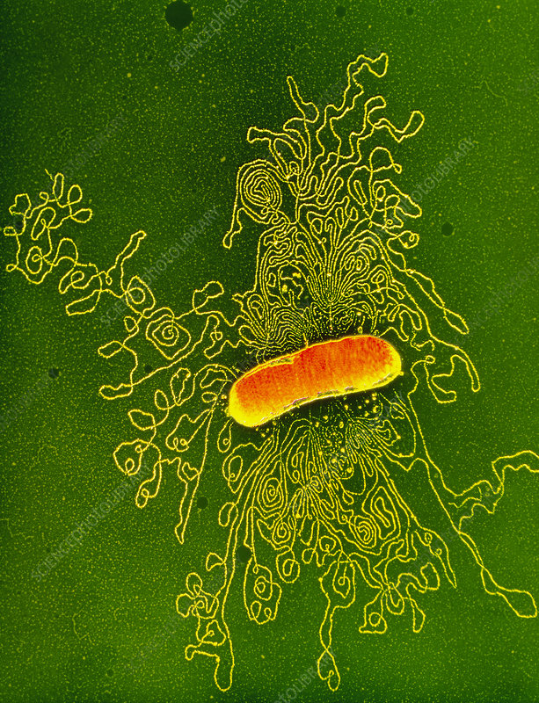
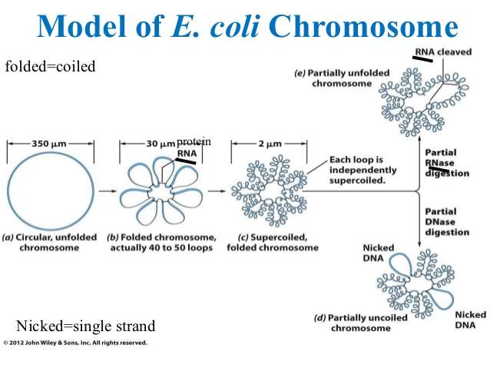
Manipulation at the genetic level
Image Credit
DR GOPAL MURTI / SCIENCE PHOTO LIBRARY

Slide 10
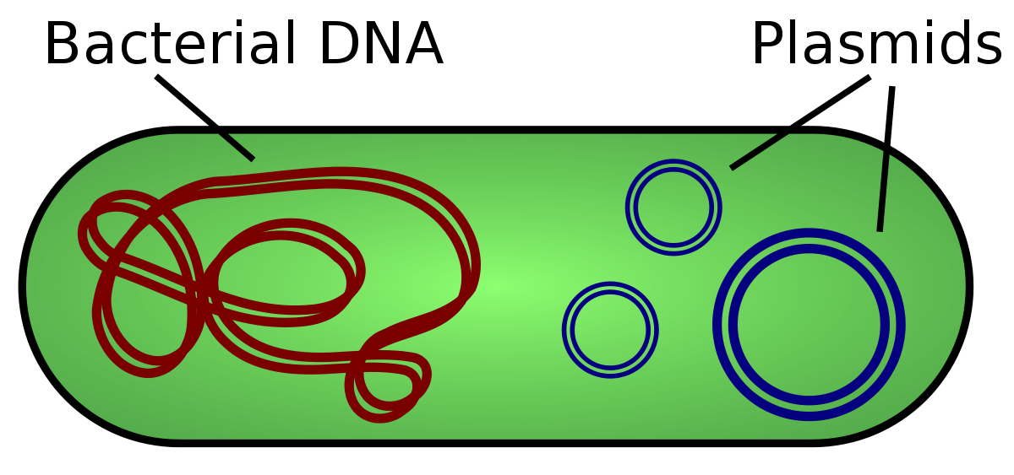
Plasmids – short circular DNAs
Image credit: https://en.wikipedia.org/wiki/Plasmid#/media/File:Plasmid_(english).svg

Slide 11
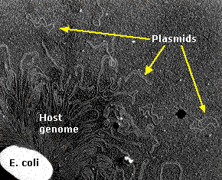
Plasmids – short circular DNAs
Image credit: https://en.wikipedia.org/wiki/Plasmid#/media/File:Plasmid_(english).svg

Slide 12
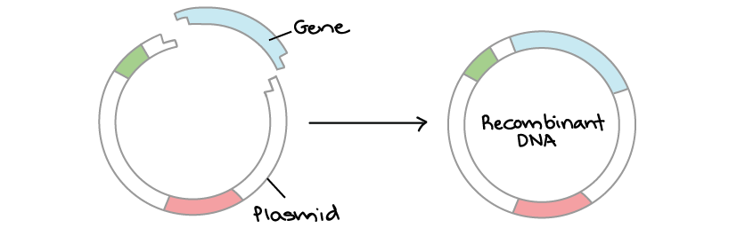
Plasmid Manipulation
Image Credit: https://www.khanacademy.org/science/ap-biology/gene-expression-and-regulation/biotechnology/a/overview-dna-cloning

Slide 13
pGFP plasmid

Slide 14
pGFP plasmid

Slide 15
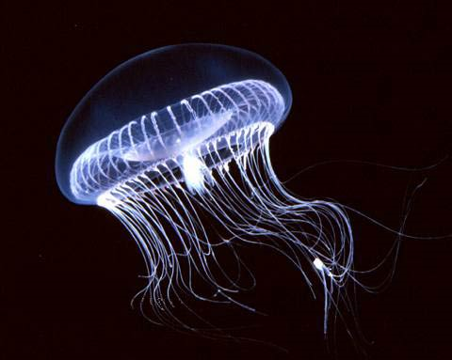
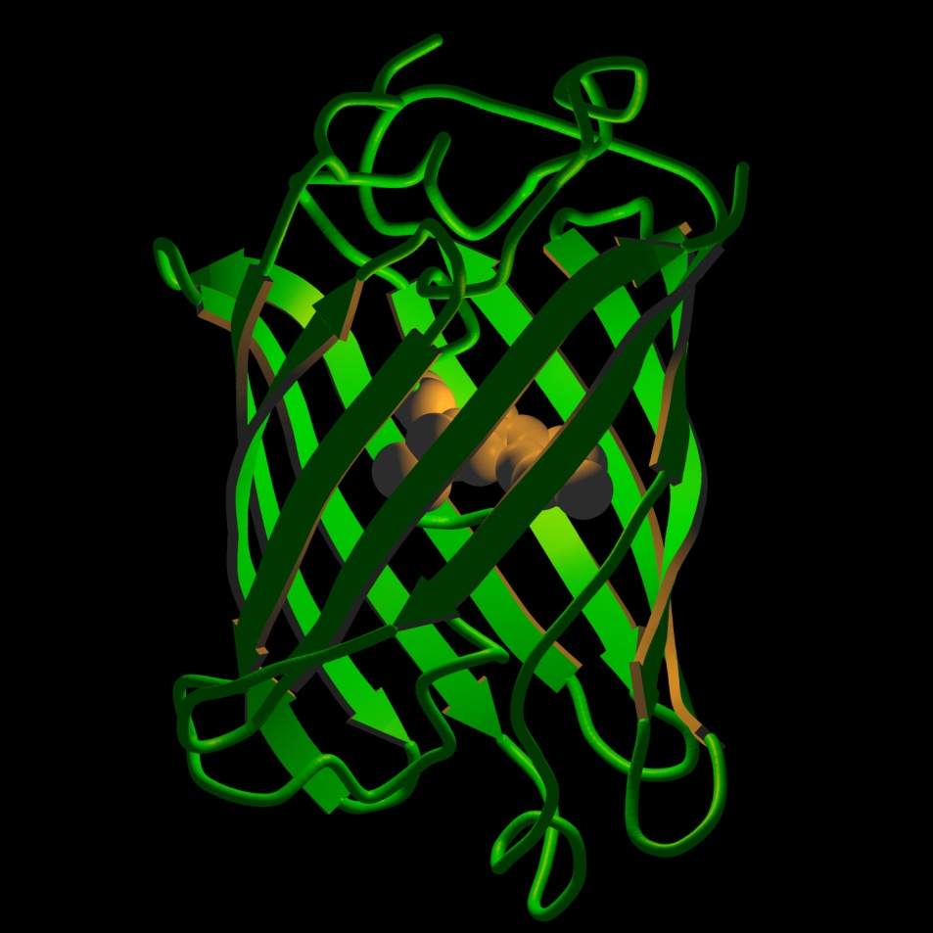
Green Fluorescent Protein
A. Victoria
GFP Protein Structure

Slide 16
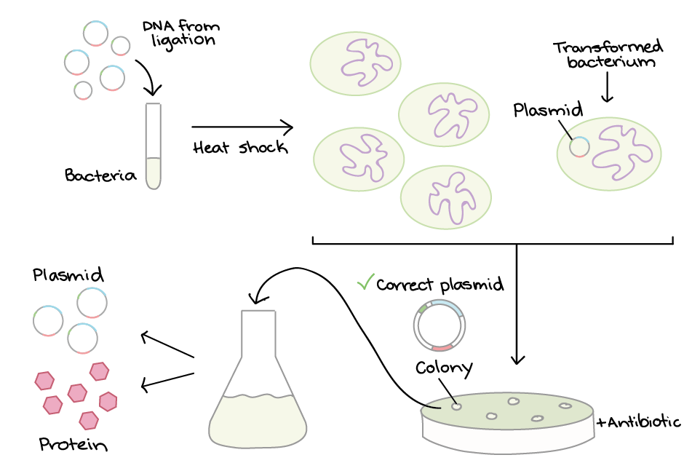
Bacterial Transformation
Image Credit: https://www.khanacademy.org/science/biology/biotech-dna-technology/dna-cloning-tutorial/a/bacterial-transformation-selection

