Slide 1
Bacterial Transformation II
An experiment in genetic engineering

Slide 2
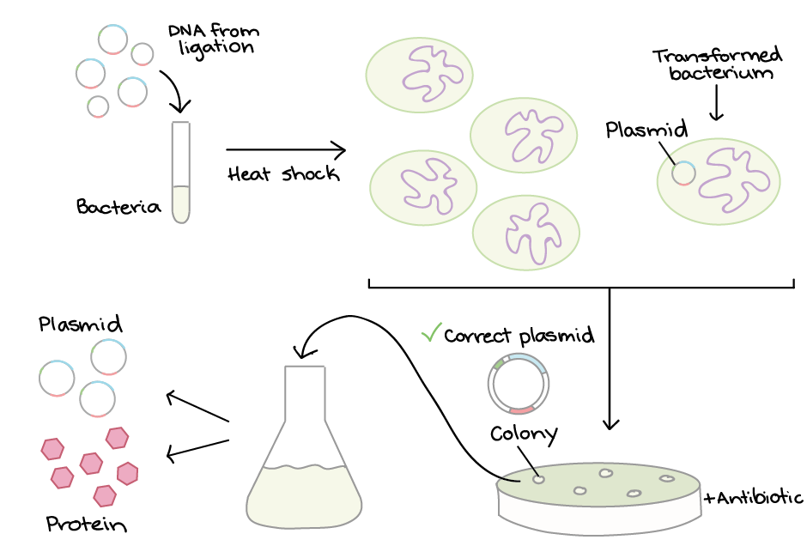
Bacterial Transformation
Image Credit: https://www.khanacademy.org/science/biology/biotech-dna-technology/dna-cloning-tutorial/a/bacterial-transformation-selection

Slide 3
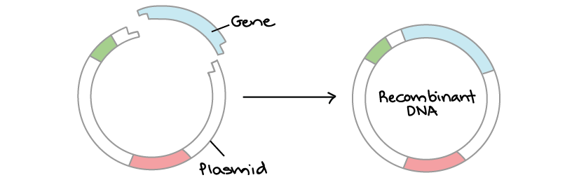
Review – How plasmids are made
Image Credit: https://www.khanacademy.org/science/ap-biology/gene-expression-and-regulation/biotechnology/a/overview-dna-cloning

Slide 4

Review – How plasmids are made
Restriction Enzymes
Image Credit: https://www.khanacademy.org/science/ap-biology/gene-expression-and-regulation/biotechnology/a/overview-dna-cloning

Slide 5
Review – How plasmids are made
Genus, species, strain, number
_____|
Eco R I
GAATTC
|
CTTAAG
(Origins: E. coli RY13)
_____|
Hind III
AAGCTT
|
TTCGAA
(Origins: H. influenzae Rd)

Slide 6
Review – How plasmids are made
EcoRI cuts at GAATTC
TCGATGAATTCTAAGCTTAGTGAATTCTGTGCA
AGCTACTTAAGATTCGAATCACTTAAGACACGT
AATTCTGTGCA
GACACGT
AATTCTAAGCTTAGTG
GATTCGAATCACTTAA
TCGATG
AGCTACTTAA
About R.E.

Slide 7
pGFP plasmid

Slide 8
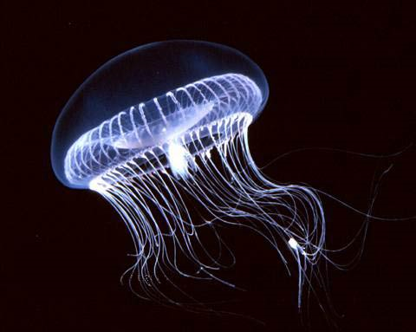
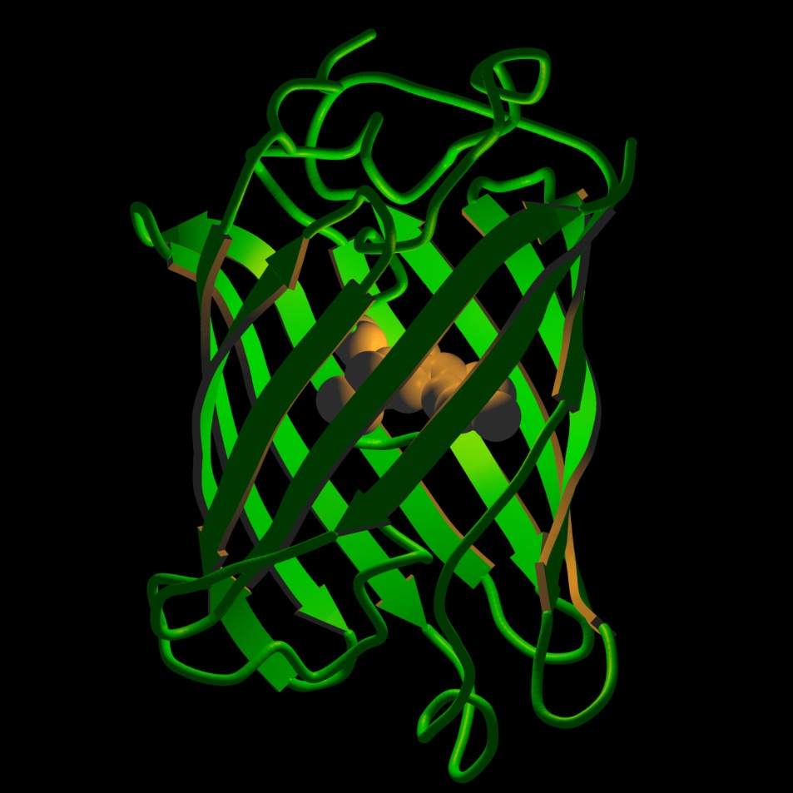
Green Fluorescent Protein
A. Victoria
GFP Protein Structure

Slide 9
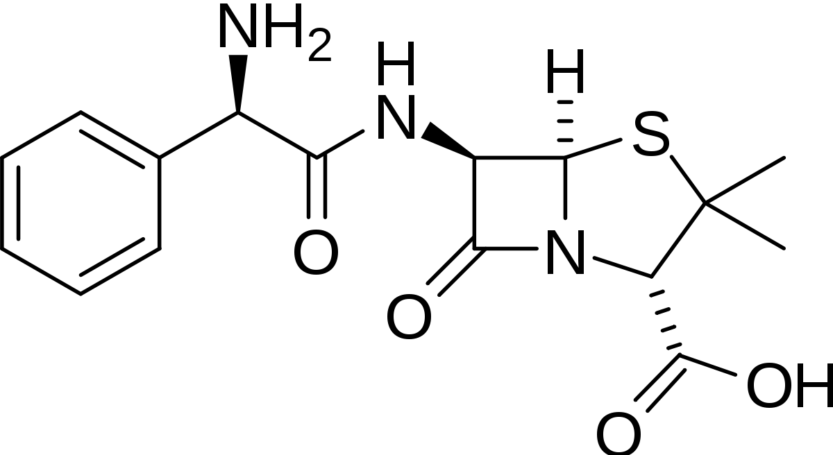
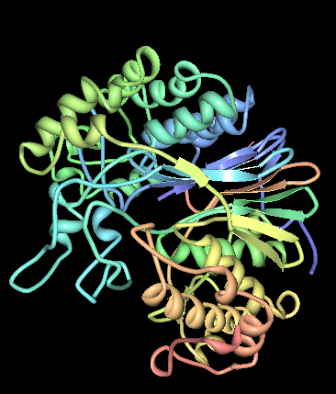
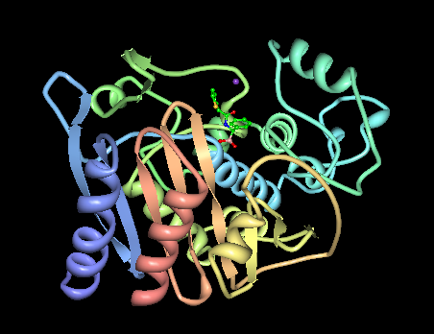
pGFP plasmid
T
Ampicillin
Transpeptidase
β-lactamase bla (TEM-1)

Slide 10
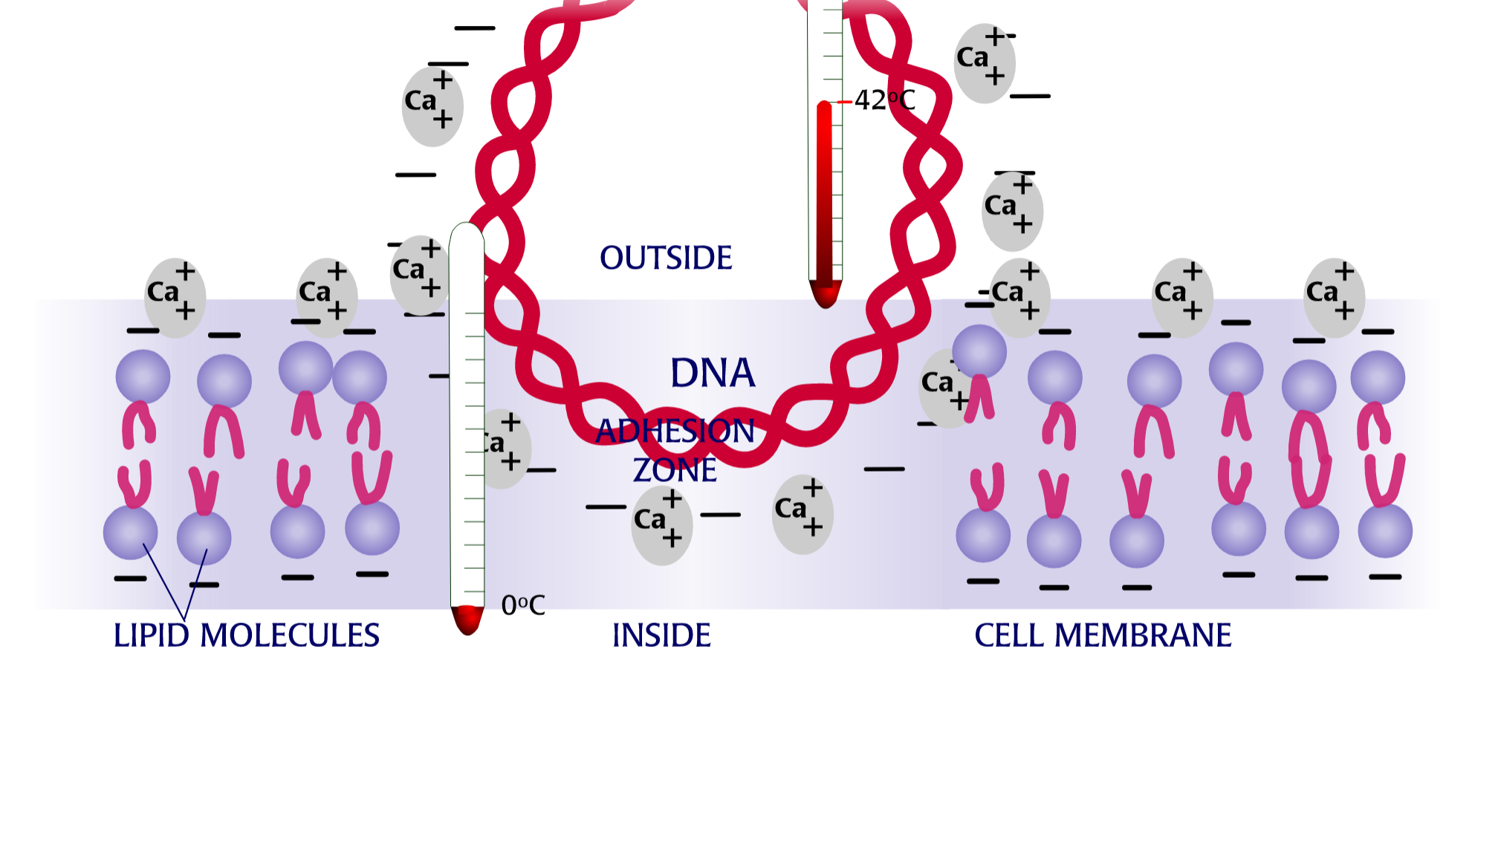
During heat shock – (some) bacteria take up plasmid

Slide 11
Results

Slide 12
Controls
Experiment:
At what temperature does
ice (H₂O) + Chemical “X”
melt?

Slide 13
Controls
Positive control: What does the effect look like if present?

Slide 14
Controls
Positive control: What does the effect look like if present?
Negative control: What does the effect look like if absent?

Slide 15
Controls
Positive control: What does the effect look like if present?
Negative control: What does the effect look like if absent?
Sensitivity control: Across what range of values can I measure the effect?

Slide 16
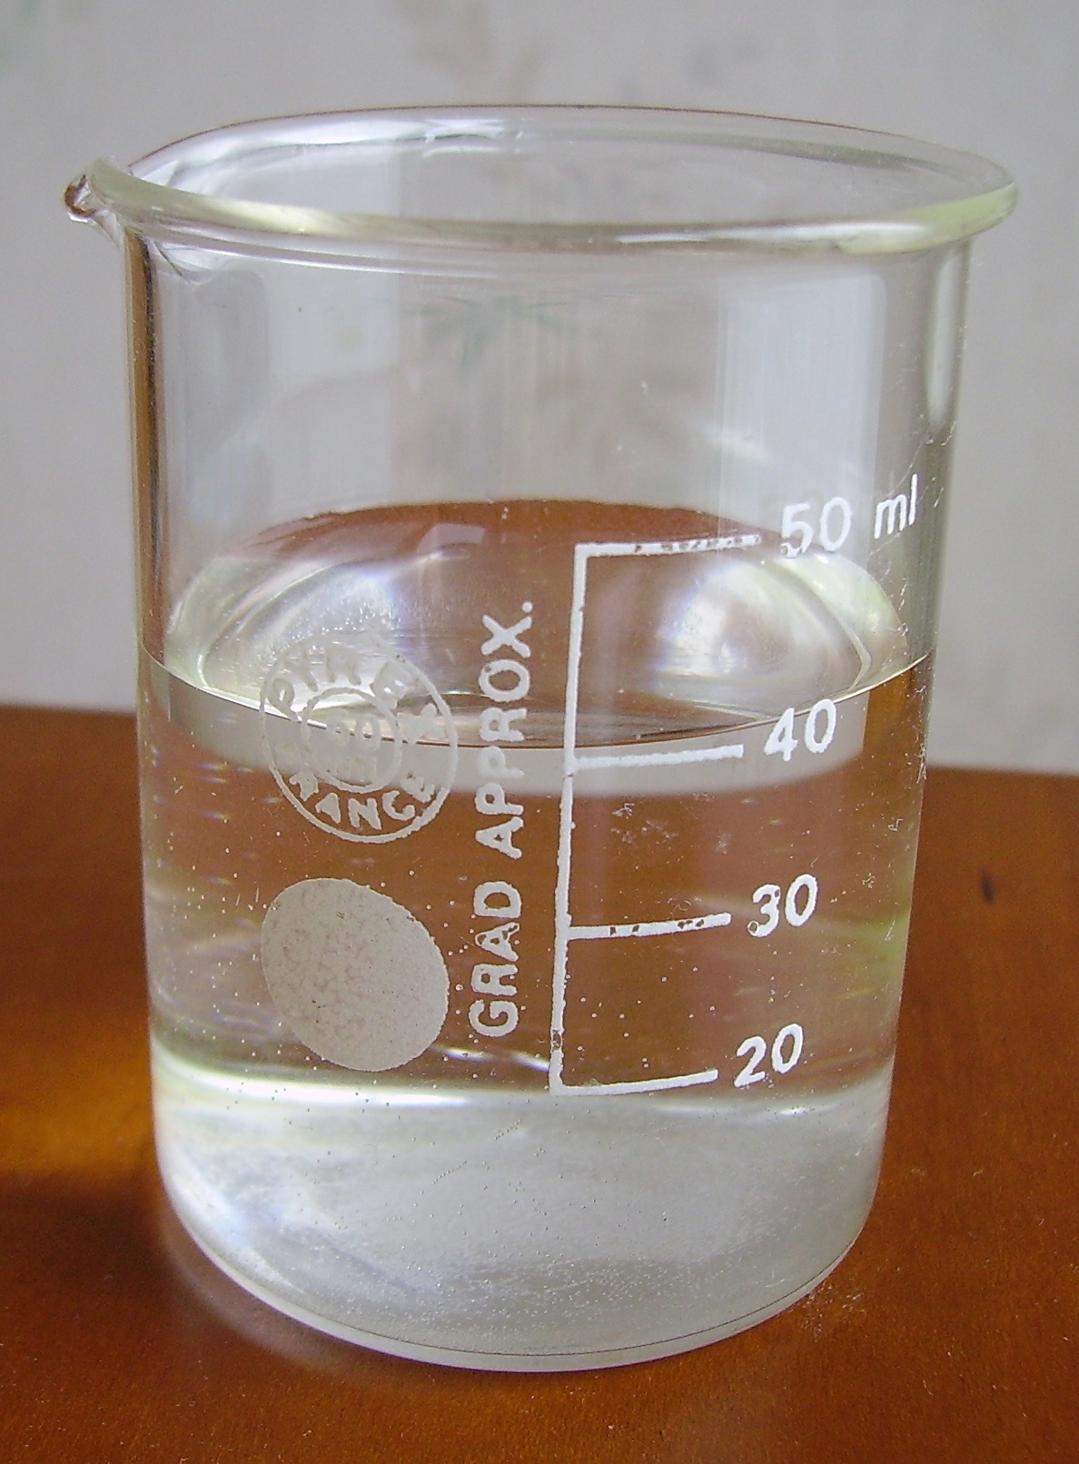
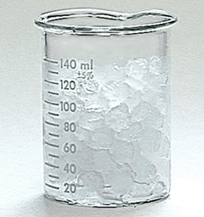
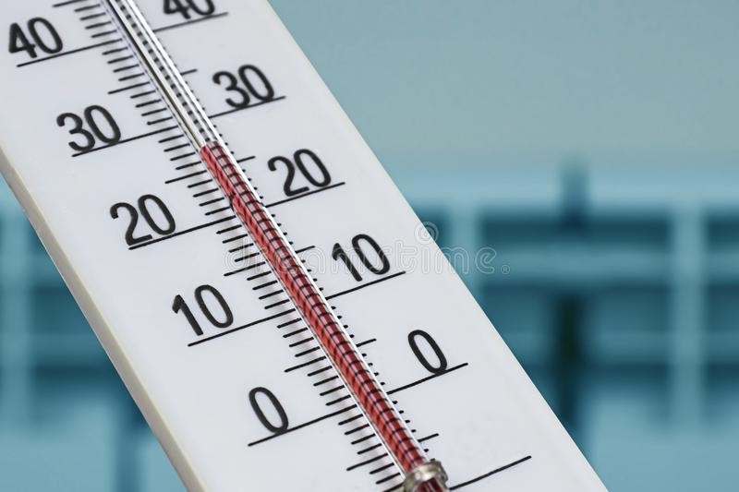
Controls
Positive control
Negative control
Sensitivity control
Photo credits
https://commons.wikimedia.org/wiki/File:Water_in_a_beaker.JPG
http://www.chem.uiuc.edu/webfunchem/temperature/Temp10.htm
https://www.dreamstime.com/photos-images/alcohol-thermometer.html

Slide 17
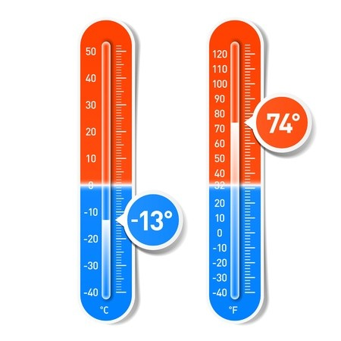
Controls
Positive control
Negative control
Sensitivity control
Photo credits
https://commons.wikimedia.org/wiki/File:Water_in_a_beaker.JPG
http://www.chem.uiuc.edu/webfunchem/temperature/Temp10.htm
https://en.clipdealer.com/vector/media/A:17494508?

Slide 18
Results

Slide 19
Plating Diagram
LB Amp
1
4
(+) Bacteria
( - ) Bacteria
3
2

Slide 20
Plating Diagram
LB Amp
1
4
(+) Bacteria
( - ) Bacteria
3
2

Slide 21
Plating Diagram
LB Amp
1
4
(+) Bacteria
( - ) Bacteria
3
2

Slide 22
Plating Diagram
LB Amp
1
4
(+) Bacteria
( - ) Bacteria
3
2

Slide 23
Plating Diagram
LB Amp
1
4
(+) Bacteria
( - ) Bacteria
3
2

Slide 24
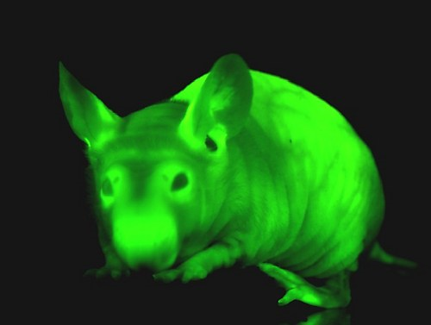
Uses of GFP
ACTCGATCGATCGATGCTACGTCGCGCCGGGCGCTGCATGCTAGCAGCATCGATCAGCAATAGTCGTCGT
ACTAAATTCGTGCTAGCTTTGACGACGACGATGCAAACGTCGTCGTACGTAGCTACGACTAAATTCGTGCT
AGCTTTGACGACGACGATGCAAACGTCGTCGTACGTAGCTACGTAGCATGTGGGATTGACTGACTGACTA
GCAGGGGATCGTAGCTAGCTAGCTAGCAGTAGCTAGCTCGATGCATCGATCGTCAGAGTCGATCGATCGG
AAGCTTTATTAAAATGTCTAAAGGTGAAGAATTATTCACTGGTGTTGTCCCAATTTTGGTTGAATTAGAT
GGTGATGTTAATGGTCACAAATTTTCTGTCTCCGGTGAAGGTGAAGGTGATGCTACTTACGGTAAATTGA
CCTTAAAATTTATTTGTACTACTGGTAAATTGCCAGTTCCATGGCCAACCTTAGTCACTACTTTCGGTTAT
GGTGTTCAATGTTTTGCTAGATACCCAGATCATATGAAACAACATGACTTTTTCAAGTCTGCCATGCCA
GAAGGTTATGTTCAAGAAAGAACTATTTTTTTCAAAGATGACGGTAACTACAAGACCAGAGCTGAAGTCA
AGTTTGAAGGTGATACCTTAGTTAATAGAATCGAATTAAAAGGTATTGATTTTAAAGAAGATGGTAACAT
TTTAGGTCACAAATTGGAATACAACTATAACTCTCACAATGTTTACATCATGGCTGACAAACAAAAGAAT
GGTATCAAAGTTAACTTCAAAATTAGACACAACATTGAAGATGGTTCTGTTCAATTAGCTGACCATTATC
AACAAAATACTCCAATTGGTGATGGTCCAGTCTTGTTACCAGACAACCATTACTTATCCACTCAATCTGC CTTATCCAAAGATCCAAACGAAAAGAGAGACCACATGGTCTTGTTAGAATTTGTTACTGCTGCTGGTATT
ACCCATGGTATGGATGAATTGTACAAATAACTGCAGGACGTACGTACACGTAGCTAGCTCGATCGTACGA
ACTACGATCGATCGATCGATCGACTGCATCGTACAGCACTGACGACTAGCTGCTGCTTGCTGCTGTTTAGC
CGTACGCGTGCGTACGACGTACGTCGTCTTCGCTGTACGTACGTACGATCGAGCTAGCATAATGCATGCG
ACTCGATCGATCGATGCTACGTCGCGCCGGGCGCTGCATGCTAGCAGCATCGATCAGCAATAGTCGTCGT
ACTAAATTCGTGCTAGCTTTGACGACGACGATGCAAACGTCGTCGTACGTAGCTACGTAGCATGTGGGAT
TGACTGACTGACTAGCAGGGGATCGTAGCTAGCTAGCTAGCAGTAGCTAGCTCGATGCATCGATCGTCAG
ACACATCGATCGATCGATCGATCGATCGATCGATTCGATCGATCGATGCTAGCATCGATCGATCGATATGC
CGATCGATCGG
AAGCTTTATTAAAATGTCTAAAGGTGAAGAATTATTCACTGGTGTTGTCCCAATTTTGGTTGAATTAGAT
GGTGATGTTAATGGTCACAAATTTTCTGTCTCCGGTGAAGGTGAAGGTGATGCTACTTACGGTAAATTGA
CCTTAAAATTTATTTGTACTACTGGTAAATTGCCAGTTCCATGGCCAACCTTAGTCACTACTTTCGGTTAT
GGTGTTCAATGTTTTGCTAGATACCCAGATCATATGAAACAACATGACTTTTTCAAGTCTGCCATGCCA
GAAGGTTATGTTCAAGAAAGAACTATTTTTTTCAAAGATGACGGTAACTACAAGACCAGAGCTGAAGTCA
AGTTTGAAGGTGATACCTTAGTTAATAGAATCGAATTAAAAGGTATTGATTTTAAAGAAGATGGTAACAT
TTTAGGTCACAAATTGGAATACAACTATAACTCTCACAATGTTTACATCATGGCTGACAAACAAAAGAAT
GGTATCAAAGTTAACTTCAAAATTAGACACAACATTGAAGATGGTTCTGTTCAATTAGCTGACCATTATC
AACAAAATACTCCAATTGGTGATGGTCCAGTCTTGTTACCAGACAACCATTACTTATCCACTCAATCTGC CTTATCCAAAGATCCAAACGAAAAGAGAGACCACATGGTCTTGTTAGAATTTGTTACTGCTGCTGGTATT
ACCCATGGTATGGATGAATTGTACAAATAACTGCAGGACGTACGTACACGTAGCTA
https://blog.atlasantibodies.com/using-antibody-for-human-protein-in-model-organism

Slide 25
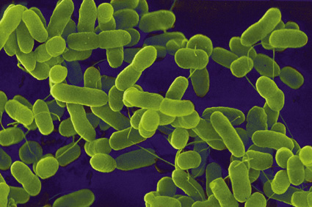

Uses of GFP
CGATCGATCGG
AAGCTTTATTAAAATGTCTAAAGGTGAAGAATTATTCACTGGTGTTGTCCCAATTTTGGTTGAATTAGAT
GGTGATGTTAATGGTCACAAATTTTCTGTCTCCGGTGAAGGTGAAGGTGATGCTACTTACGGTAAATTGA
CCTTAAAATTTATTTGTACTACTGGTAAATTGCCAGTTCCATGGCCAACCTTAGTCACTACTTTCGGTTAT
GGTGTTCAATGTTTTGCTAGATACCCAGATCATATGAAACAACATGACTTTTTCAAGTCTGCCATGCCA
GAAGGTTATGTTCAAGAAAGAACTATTTTTTTCAAAGATGACGGTAACTACAAGACCAGAGCTGAAGTCA
AGTTTGAAGGTGATACCTTAGTTAATAGAATCGAATTAAAAGGTATTGATTTTAAAGAAGATGGTAACAT
TTTAGGTCACAAATTGGAATACAACTATAACTCTCACAATGTTTACATCATGGCTGACAAACAAAAGAAT
GGTATCAAAGTTAACTTCAAAATTAGACACAACATTGAAGATGGTTCTGTTCAATTAGCTGACCATTATC
AACAAAATACTCCAATTGGTGATGGTCCAGTCTTGTTACCAGACAACCATTACTTATCCACTCAATCTGC CTTATCCAAAGATCCAAACGAAAAGAGAGACCACATGGTCTTGTTAGAATTTGTTACTGCTGCTGGTATT
ACCCATGGTATGGATGAATTGTACAAATAACTGCAGGACGTACGTACACGTAGCTA
2. DNA Cloning
https://blog.atlasantibodies.com/using-antibody-for-human-protein-in-model-organism

Slide 26
Uses of GFP
CGATCGATCGG
AAGCTTTATTAAAATGTCTAAAGGTGAAGAATTATTCACTGGTGTTGTCCCAATTTTGGTTGAATTAGAT
GGTGATGTTAATGGTCACAAATTTTCTGTCTCCGGTGAAGGTGAAGGTGATGCTACTTACGGTAAATTGA
CCTTAAAATTTATTTGTACTACTGGTAAATTGCCAGTTCCATGGCCAACCTTAGTCACTACTTTCGGTTAT
GGTGTTCAATGTTTTGCTAGATACCCAGATCATATGAAACAACATGACTTTTTCAAGTCTGCCATGCCA
GAAGGTTATGTTCAAGAAAGAACTATTTTTTTCAAAGATGACGGTAACTACAAGACCAGAGCTGAAGTCA
AGTTTGAAGGTGATACCTTAGTTAATAGAATCGAATTAAAAGGTATTGATTTTAAAGAAGATGGTAACAT
TTTAGGTCACAAATTGGAATACAACTATAACTCTCACAATGTTTACATCATGGCTGACAAACAAAAGAAT
GGTATCAAAGTTAACTTCAAAATTAGACACAACATTGAAGATGGTTCTGTTCAATTAGCTGACCATTATC
AACAAAATACTCCAATTGGTGATGGTCCAGTCTTGTTACCAGACAACCATTACTTATCCACTCAATCTGC CTTATCCAAAGATCCAAACGAAAAGAGAGACCACATGGTCTTGTTAGAATTTGTTACTGCTGCTGGTATT
ACCCATGGTATGGATGAATTGTACAAATAACTGCAGGACGTACGTACACGTAGCTA

Slide 27
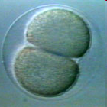
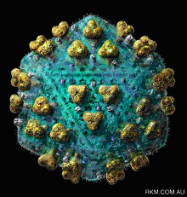
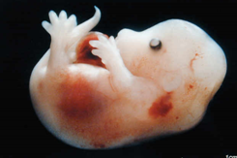
Uses of GFP

Slide 28
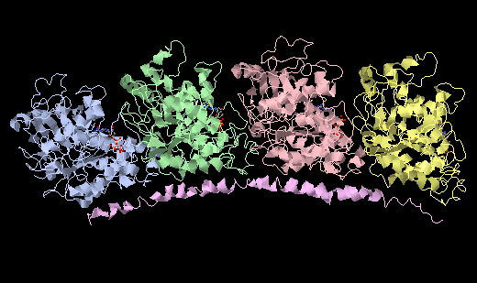
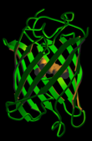
Fusion Protein
TCGAGCCCTACAACTCGGTGCTGTCCACCCACTCCCTGCTGGAGCACACCGATGTCGCCGTGATGCTCGA CAACGAGGCCATCTACGACATTTGCCGCCGCTCCCTGGACATTGAGCGCCCCACCTACACCAACCTGAAC CGCCTGATCGCCCAGGTCATCTCGTCGCTGACCGCCTCGCTTCGCTTTGACGGTGCCCTGAACGTGGATA TCACTGAGTTCCAGACCAACCTGGTGCCCTACCCCCGCATCCACTTCATGCTCAGCTCGTACGCGCCCAT CATCTCGGCCGAGAAGGCGTACCACGAGCAGCTGTCGGTGGCCGAGATCACCAACGCCGCCTTCGAGCCC GCCTCGATGATGGTCAAGTGCGACCCCCGCCACGGCAAGTACATGGCCTGCTGCCTGATGTACCGCGGTG ACGTCGTGCCCAAGGACGTTAACGCGTCCGTGGCCACCATCAAGACCAAGCGCACCATCCAGTTCGTCGA CTGGTGCCCCACCGGCTTCAAGTGCGGTATCAACTACCAGCCCCCCACCGTCGTGCCCGGCGGTGACCTG GCCAAGGTGCAGCGCGCCGTGTGCATGATCTCCAACAGCACTGCTATCGGCGAGATCTTCAGCCGCCTGG ACCACAAGTTCGACCTGATGTACGCCAAGCGTGCCTTCGTGCACTGGTACGTCGGTGAGGGTATGGAGGA GGGTGAGTTCTCCGAGGCCCGCGAGGACCTGGCTGCCCTGGAG
AAGCTTTATTAAAATGTCTAAAGGT
GAAGAATTATTCACTGGTGTTGTCCCAATTTTGGTTGAATTAGATGGTGATGTTAATGGTCACAAATTTTCTG
TCTCCGGTGAAGGTGAAGGTGATGCTACTTACGGTAAATTGACCTTAAAATTTATTTGTACTACTGGTAAATT
GCCAGTTCCATGGCCAACCTTAGTCACTACTTTCGGTTATGGTGTTCAATGTTTTGCTAGATACCCAGATCAT
ATGAAACAACATGACTTTTTCAAGTCTGCCATGCCAGAAGGTTATGTTCAAGAAAGAACTATTTTTTTCAAA
GATGACGGTAACTACAAGACCAGAGCTGAAGTCA AGTTTGAAGGTGATACCTTAGTTAATAGAATCGAATTA
AAAGGTATTGATTTTAAAGAAGATGGTAACAT TTTAGGTCACAAATTGGAATACAACTATAACTCTCACAA
TGTTTACATCATGGCTGACAAACAAAAGAAT GGTATCAAAGTTAACTTCAAAATTAGACACAACATTGAAG
ATGGTTCTGTTCAATTAGCTGACCATTATC AACAAAATACTCCAATTGGTGATGGTCCAGTCTTGTTACCAGA
CAACCATTACTTATCCACTCAATCTGC CTTATCCAAAGATCCAAACGAAAAGAGAGACCACATGGTCTTGTTA
GAATTTGTTACTGCTGCTGGTATT ACCCATGGTATGGATGAATTGTACAAATAACTGCAGGACGTACGTACACG
TAGCTA
α-Tubulin

Slide 29
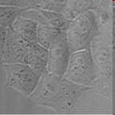
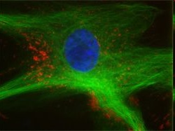
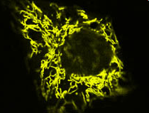
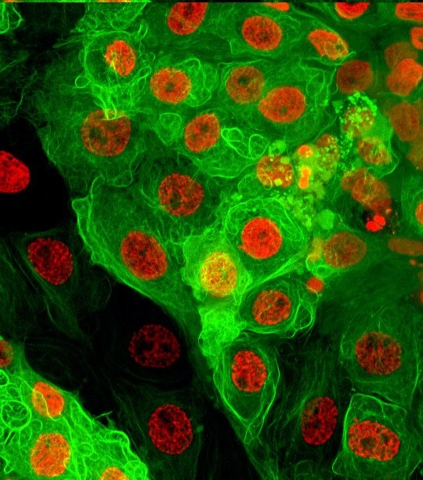
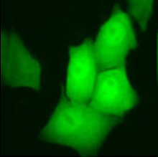
Revealing cell dynamics
Normal view of cells – light microscopy
Cells tagged with fluorescent proteins – fluorescence microscopy

Slide 30
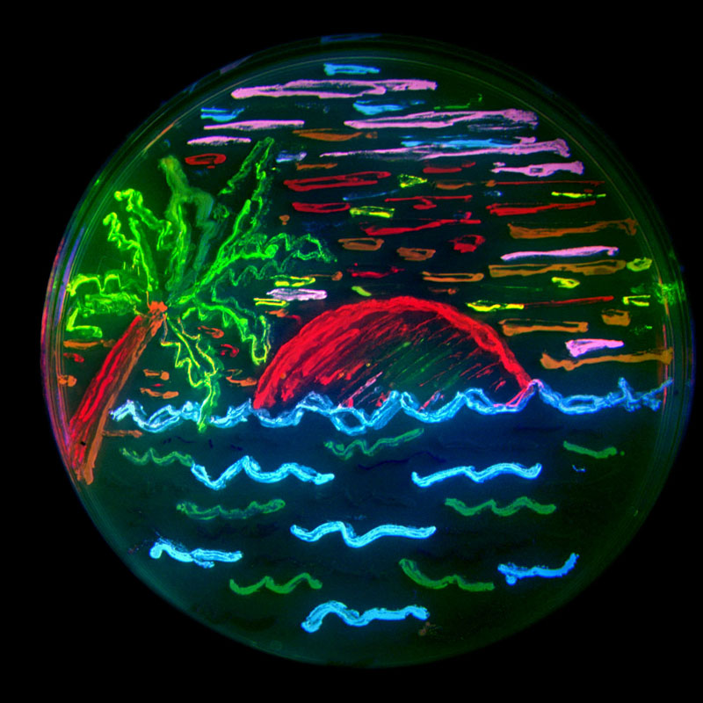
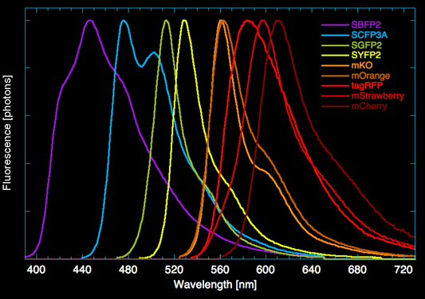
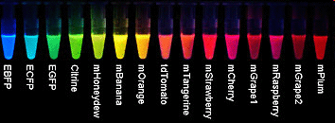
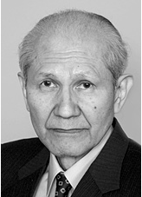
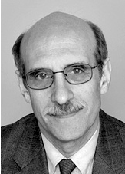
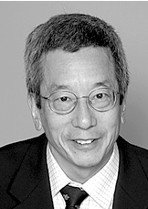

Revealing cell dynamics
Shimomura Chalfie Tsien

Slide 31
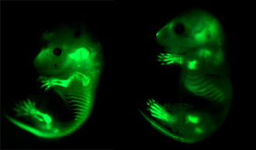
Revealing cell dynamics
Col2-GFP

Slide 32
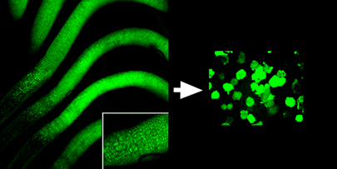
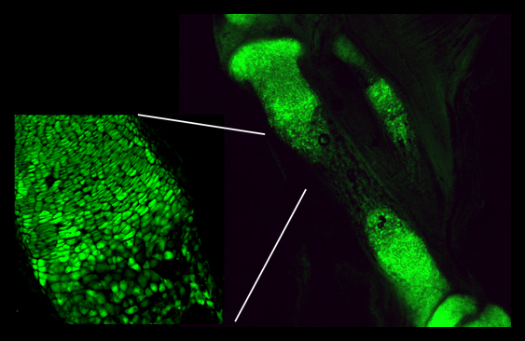
Revealing cell dynamics
As cartilage is converted
to bone, cells go dim
Col2-GFP

Slide 33
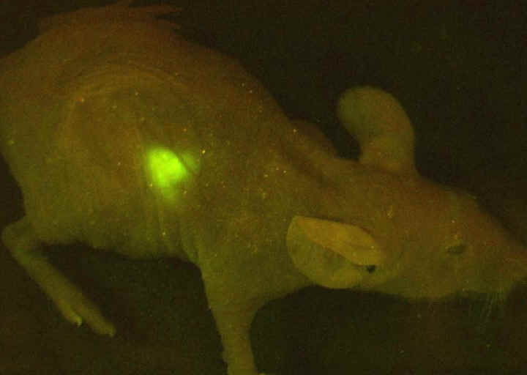
Revealing cell dynamics

