Slide 1
Electrophoresis and Sequencing Basics

Slide 2
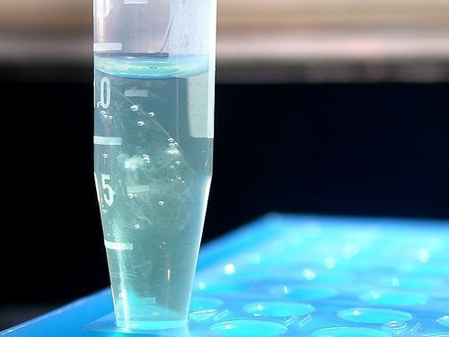
Review: Mitochondrial lab
DNA Extraction from buccal cheek cells

Slide 3
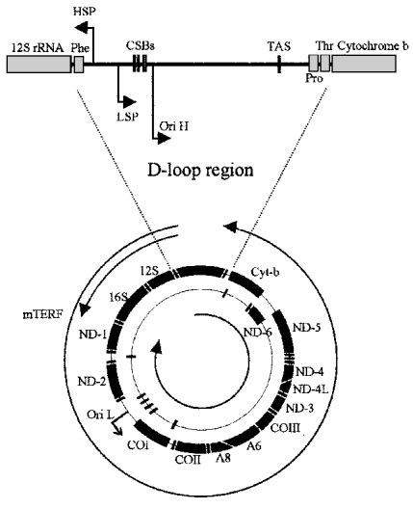
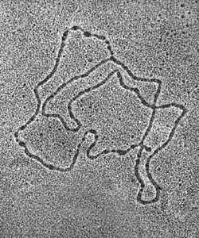
Review: Mitochondrial DNA Structure
Human Mitochondrial DNA
16569 bp

Slide 4
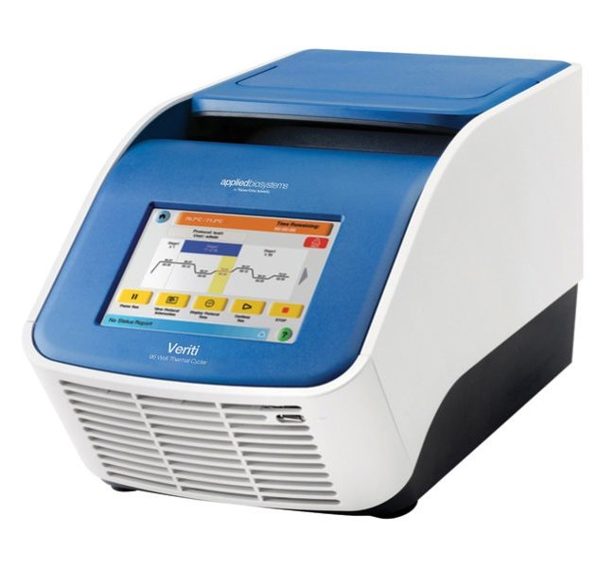
Review: Mitochondrial lab
DNA Amplification by PCR

Slide 5
Review: Mitochondrial lab
Electrophoresis

Slide 6
Ladder 1 2 3 4 Ladder
Ladder 5 6 7 8 Ladder

Slide 7
Electrophoresis – movement by electricity
Allows us to visualize DNA (PCR product)
We can estimate the size (distance a “band” travels)
We can estimate the amount (brightness of the band

Slide 8
Electrophoresis – Components
Gel tank: Holds electrolytic buffer and has electrodes where electricity is applied
Buffer: A salt solution that conducts electricity
Gel: Made of agar; holds the DNA and separates DNA according to size
Loading Dye: Makes it easier to load the PCR sample and keeps the DNA in the gel.
UV Dye: Binds to DNA. Can be in the gel or the loading dye. (We use Syber Green. Ethidium Bromide can also be used)
We can estimate the amount (brightness of the band

Slide 9
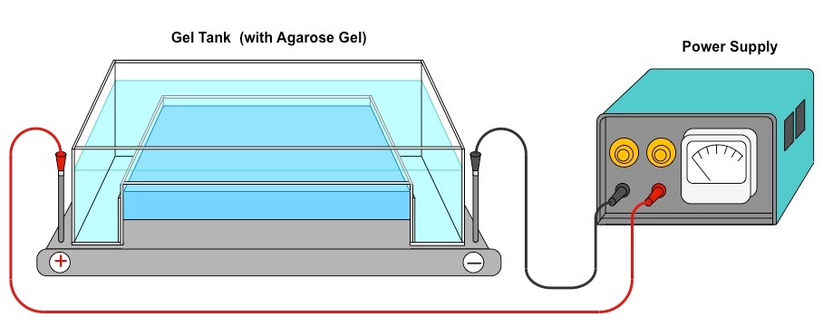
Electrophoresis – Setup
Photo: https://ib.bioninja.com.au/_Media/electrophoresis-dna_med.jpeg

Slide 10
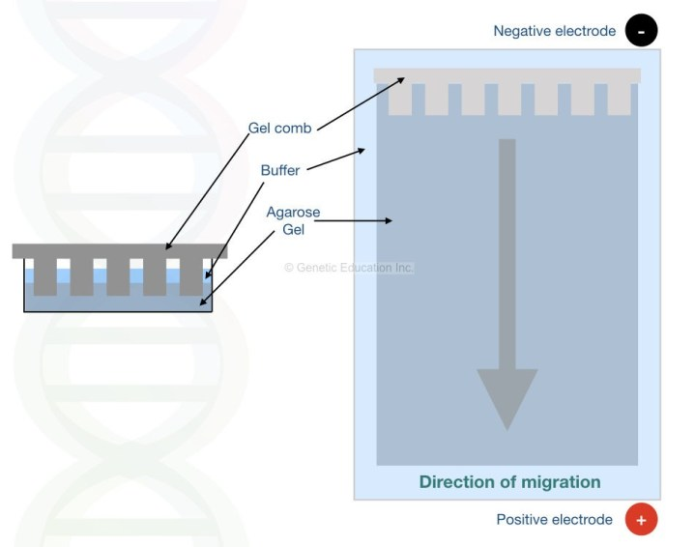
Electrophoresis – Setup
Photo: https://i2.wp.com/geneticeducation.co.in/wp-content/uploads/2018/09/electrophoresis-.001-e1558614261130.jpeg?resize=719%2C566&ssl=1

Slide 18
Electrophoresis – Cut DNA example

Slide 19
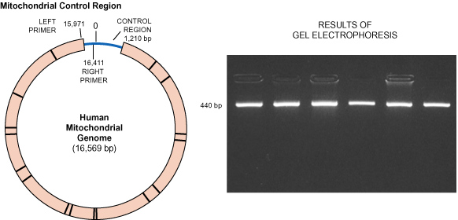
Mitochondrial DNA – replicated by PCR

Slide 20
Ladder 1 2 3 4 Ladder
Ladder 5 6 7 8 Ladder

Slide 21
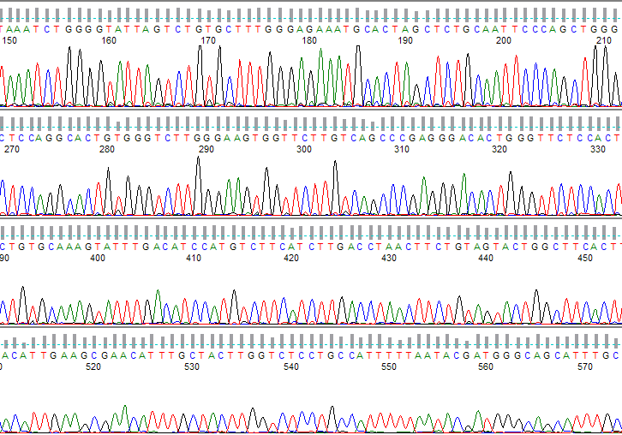
DNA Sequencing

Slide 22
DNA Sequencing
Allows us to determine the nucleotides and their order on a segment of DNA
There are many types of DNA sequencing. For PCR products we use “Sanger” (cycle) sequencing (Fredrick Sanger)
In this method we usually can sequence up to 1000bp of DNA
Many components in common with PCR so be careful not to confuse them!

Slide 23
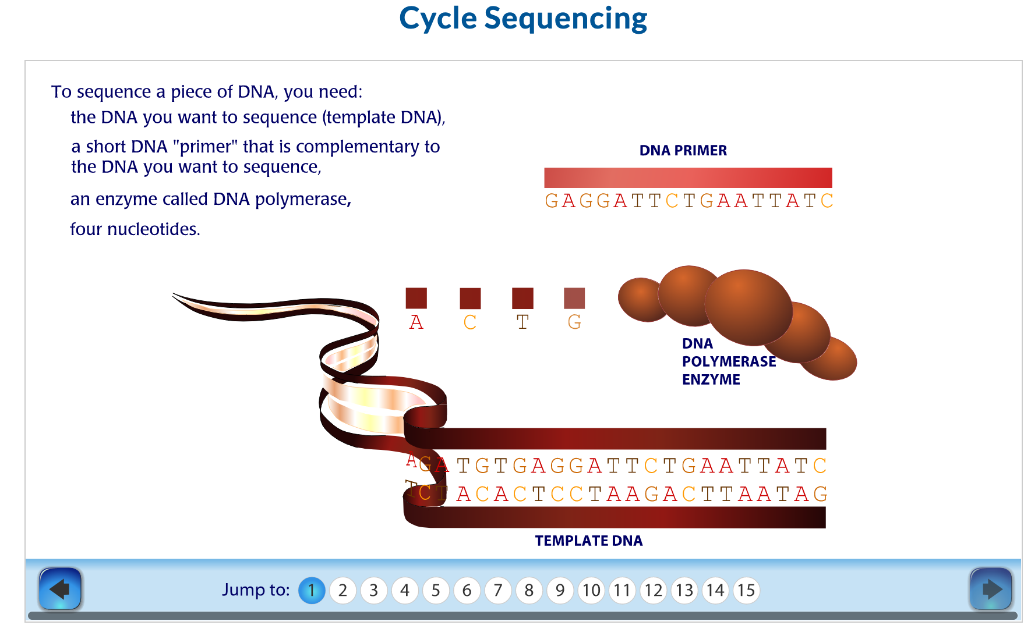
DNA Sequencing

