Slide 1
DNA Barcoding Basics

Slide 2
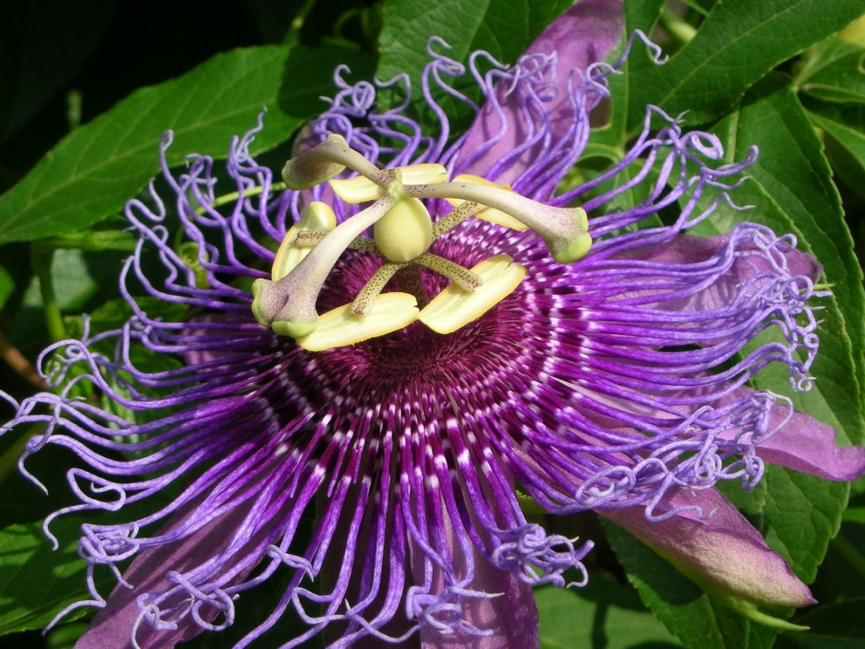

What is DNA barcoding and
why is there a need for it?

Slide 3
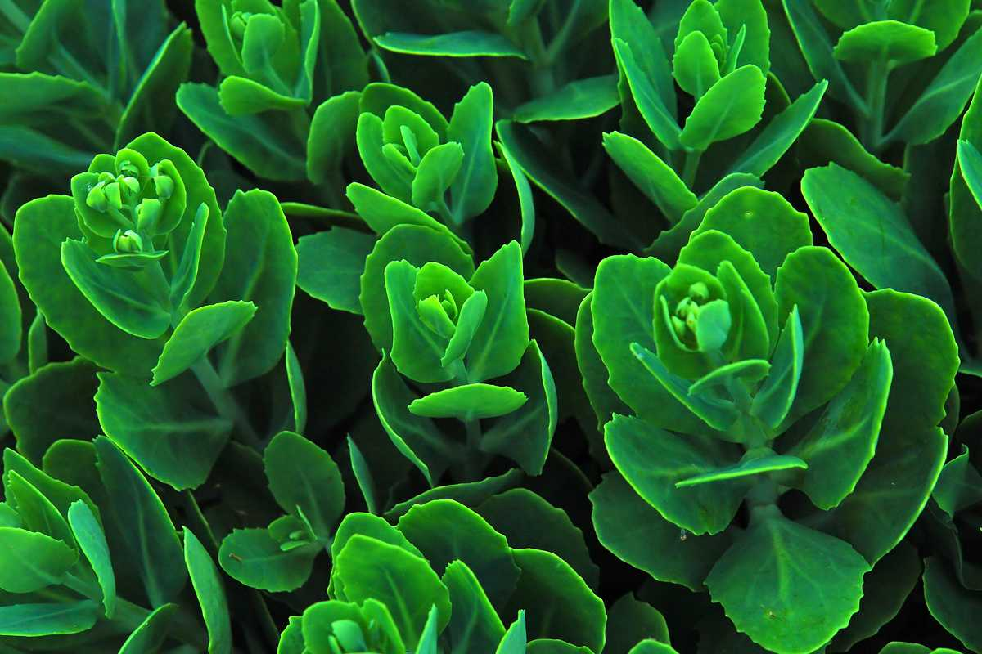



How Barcoding works
Plants are sampled DNA is extracted “Barcode” amplified
ACGAGTCGGTAGCTGCCCTCTGACTGCATCGAATTGCTCCCCTACTACGTGCTATATGCGCTTACGATCGTACGAAGATTTATAGAATGCTGCTACTGCTCCCTTATTCGATAACTAGCTCGATTATAGCTACGATG
Sequenced DNA is compared with plants in a barcode database

Slide 4
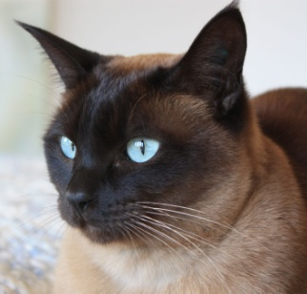
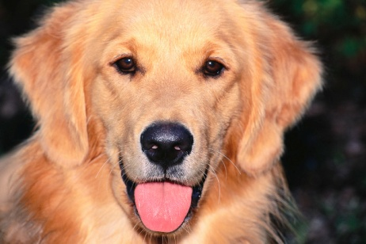
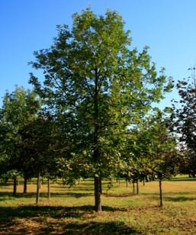
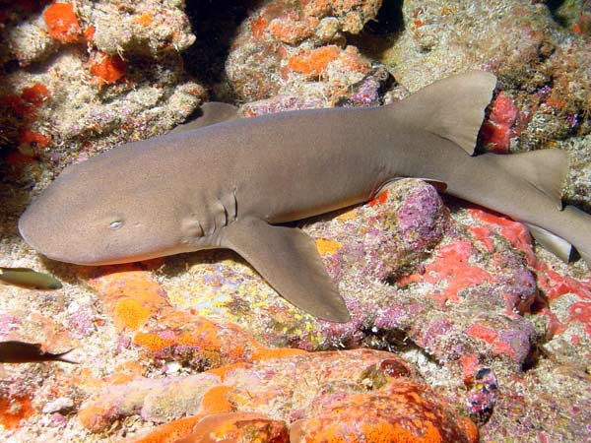
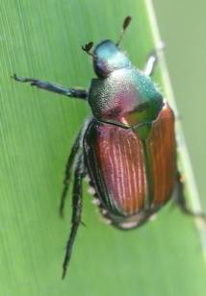
How many species can you name?
How many Animals did you name?
How many mammals?
How many plants?
How many insects?
“Dog”
Canis lupus familiaris
“Shark”
Ginglymostoma cirratum
“Cat”
Felis catus
“Oak Tree”
Quercus alba
“Beetle”
Popillia japonica

Slide 5

Problem 1: No one know how many species there are.

Slide 6
Vertebrates | Species
Mammals | 5,490
Birds | 9,998
Reptiles | 9,084
Amphibians | 6,433
Fishes | 31,300
Total | 62,305
Invertebrates | Species
Insects | 1,000,000
Mollusks | 85,00
Crustaceans | 47,000
Corals | 2,175
Arachnids | 102,248
Total (+others) | 1,305,250
Plants | Species
Angiosperms | 281,821
Gymnosperms | 1,021
Ferns and Allies | 12,000
Mosses | 16,236
Green and Red Algae | 10,134
Total | 321,212
There are currently between 1.5 and 2 million described species
It is estimated that this number may represent as little as half of the true number of species
Perhaps more than 1/3 of all species are threatened (IUCN Red list version 2010.1)

Slide 7
Problem 2: Even though there are millions of species, there is also
a lack of agreement on what a “species” means.

Slide 8

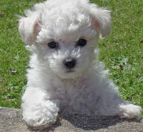
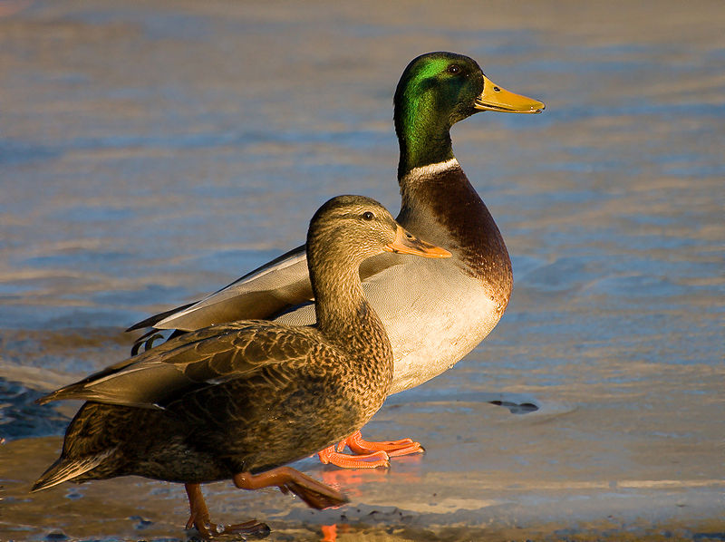
Defining what species are is a
complex task
Dependent on many factors
Interbreeding capabilities
Morphological variation
Ecological context
Genetic similarities
Canis lupus
Canis lupus (familiaris)
Anas platyrhynchos

Slide 9
Problem 3: Current taxonomic methods may be inadequate (or at least too slow) to capture vanishing biodiversity

Slide 10
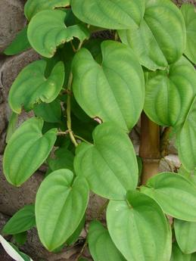
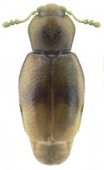
Classical taxonomy is steeped in terminology that can act barrier to understanding
and reduce the number of persons who are qualified to describe biodiversity
Leaves alternate proximally, opposite and ultimately decussate distally, 6–16 × 4–13 cm; petiole ca. as long as blade, winged, base clasping, basal lobes stipulate, growing as extensions of wings, less than
1 mm wide; blade 5–7-veined, ovate, glabrous, base typically sagittate, margins entire, apex acute to acuminate. Staminate inflorescences axillary, 1–2 per axil, paniculate, fasciculate; panicles bearing flowers singly,bracteolate, in a zigzag pattern along rachis, internodes less than 2 mm; rachis to 25 cm, secondary axes 1–3(–6), fasciculate, less than 3 cm, each subtended by deltate-ovate bracteole shorter than 1 mm. Pistillate inflorescences solitary, 4–8(–20)-flowered, 6–35 cm, internodes ca. 1 cm
The body form ranges from hemispherical (e.g., Cleidostethus) to elongate oval (e.g., Clypastraea) to latridiid-like (e.g., Foadia). Corylophids are typically dull brown, but some species have contrasting yellowish-brown patches on the pronotum or elytra. The integument is often densely punctured and may be glabrous or bear short, fine recumbent setae. Most corylophid adults can be diagnosed using the following morphological features: Maxilla with single apical lobe; Mesotrochanter short and strongly oblique; Head usually covered by pronotum; Frontoclypeal suture absent; Antennae elongate with 3-segmented club; Procoxal cavities closed externally; Tarsal formula 4-4-4; Pygidium exposed
Adding to the complexity, if the specimen to be identified is immature in its development
or damaged and incomplete, identification may be impossible.

Slide 11
Leaves alternate proximally, opposite and ultimately decussate distally, 6–16 × 4–13 cm; petiole ca. as long as blade, winged, base clasping, basal lobes stipulate, growing as extensions of wings, less than 1 mm wide; blade 5–7-veined, ovate, glabrous, base typically sagittate, margins entire, apex acute to acuminate. Staminate inflorescences axillary, 1–2 per axil, paniculate, fasciculate; panicles bearing flowers singly,bracteolate, in a zigzag pattern along rachis, internodes less than 2 mm; rachis to 25 cm, secondary axes 1–3(–6), fasciculate, less than 3 cm, each subtended by deltate-ovate bracteole shorter than 1 mm. Pistillate inflorescences solitary, 4–8(–20)-flowered, 6–35 cm, internodes ca. 1 cm
Complex and
Somewhat objective
Simple (A,T,G, or C) and more
Reliably objective
>Dioscorea alata (matK) gene, partial
ATTTAAATTATGTGTCAGATATATTAATACCCCATCCCATCCATCTGGAAATCCTGGTTCAAATACTTCAATGCTGGACTCAAGATGTTTCCTCTT
TGCATTTATTGCGATTCTTTCTCCACGAATATCATAATTCGAAT AGTTTCATTACTCCGAAAAAACCTATTTACGTGATTTCAATTTCAAAAGAAA
ATAAAAGATTTTTTCGAT TCCTATATAATTCTTATGTATTTGAATGTGAATTTGTATTAGTTTTTTTTCATAAGCAATCCTCTTATTT ACGATCAA
GGTCCTCTGGAGTCTTTCTTGAGCGAACACATTTCTATGGAAAAATGGGGCATTTTTTAGTAGTGTGTTGTAATTATTTTCAGAAGACCCAATG
GTTCTTCAAAGATCCTTTTCTGCATTATGTTCGATATC AAGGAAAAGCAATTCTGGTGTCAAAGGGAACTCGTCTTTTGATGAGGAAATGGAGA
TCTTACCTTGTCCATTTTTGGCAATATTATTTTCAATTTTGGTCTCATCCGCATAGGATTCATATAAACCAATTATCAAATTATTCCTTCTGTTTTC
TGGGTTATCTTTCAAATGTACTAATAAATTTTTCCGTGGTAAGGAGTCAAATGTTAGAAAATTCATTTGTAATAGATACTCTTACTAAGAAATT
TGATACCAGAGTTTCAGTTATTGCTCTTATTCG ATCATTGTCTAAAGCGAAATTTTGTACCGTATCCGGGCATCCTATTAGTAAGTCAATATGGA
CAAATTTC TCAGATTTGGATATTATTCATCGATTTGGTTGGATATGTAGAA

Slide 12

Choosing a DNA barcode
There are many criteria that go in to selecting an appropriate region that can serve as a DNA barcode.
Three of them include:
Universality
Robustness
Discrimination
Why are these three criteria important?

Slide 13
Discrimination
Barcoding regions must be different for each species. Ideally you are looking for a single DNA locus which differs in each species.
Oppositional Goals:
Each loci must be different for each species
Although loci must be different, they must be similar enough that
they can be amplified by PCR, aligned and compared

Slide 14
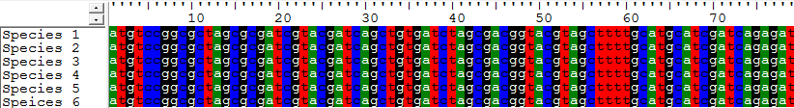
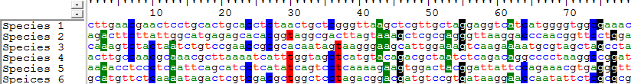
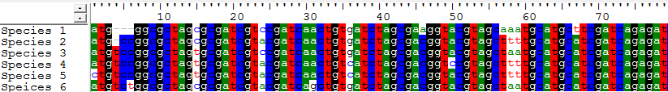
Fail: Sequence is completely conserved, good for PCR, but uninformative as barcode
Fail: Sequence shows no conservation, impossible for PCR, but good as barcode
Win: Sequence shows some (ideally ~70%) conservation, good for PCR, good as barcode

Slide 15
Universality
Since barcoding protocols (typically) amplify a region of DNA by PCR, you need primers that will amplify consistently.
Once you have a candidate locus (loci) that seem discriminatory, do these loci (possibly genes, but possibly non-coding DNA) exist in in virtually all of the species you wish to barcode?
Will you be able to find PCR primers that can amplify across many species, despite mismatches?

Slide 16
Robustness
Since barcoding protocols (typically) amplify a region of DNA by PCR, also need to select a locus that amplifies reliably, and sequences well.
PCR is very sensitive to the chemistry involved (types of enzymes, concentration of reagents, cycling parameters, etc.
The amplified PCR product must also be sequenced. Sanger sequencing is sensitive to highly repetitive DNA.

Slide 17
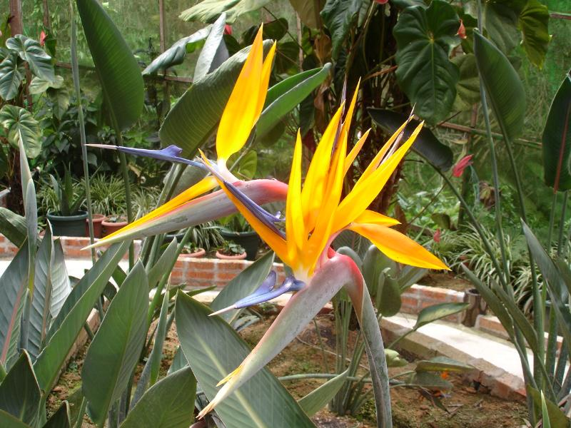
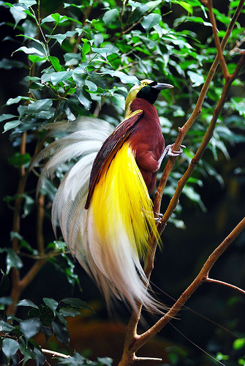
DNA Barcoding
Plants vs. Animals
Finding a DNA locus that possesses all of these
qualities(Discrimination, Universality, Robustness)
was relatively easy in animals.
The animal barcode of choice
Is the mitochondrial gene
cytochrome c oxidase I (COI).

Slide 18

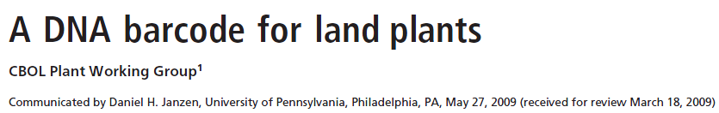
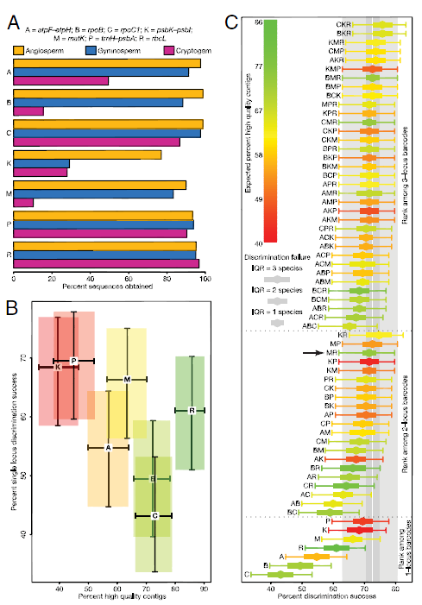
Based on recommendations by a barcoding consortium (Consortium for the Barcode of Life, plant working group) the chloroplast genes rbcL and matK come very close to being ideal candidates for universal plant barcodes.
Like any barcode loci that could be chosen, there will is always a possibility of failure to make a reasonably definitive identification of a particular specimen.

Slide 19
Example Barcoding Experiment

Slide 20
Can we tell the difference between larvae that look (nearly) identical?

Slide 21
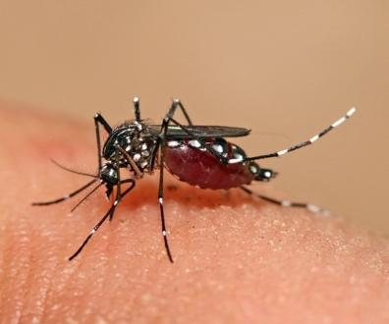
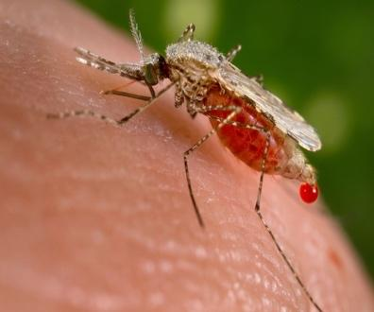
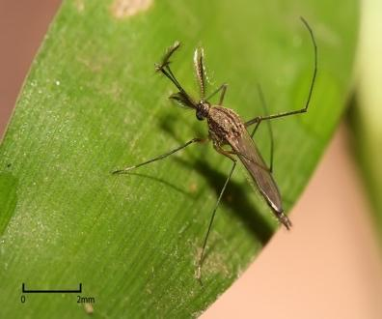
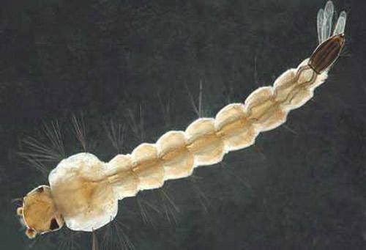
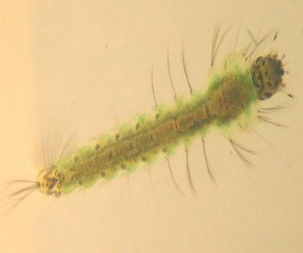
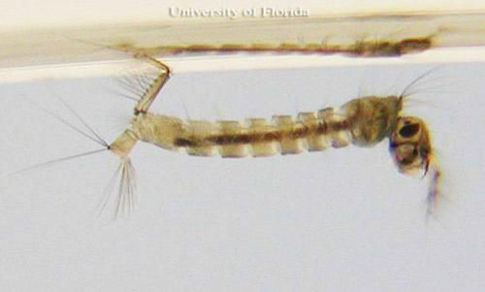
Aedes adult | Anopheles adult | Culex adult
By Muhammad Mahdi Karim - Own work, GFDL 1.2, https://commons.wikimedia.org/w/index.php?curid=11185617 | By Jim Gathany - (PHIL), ID #5814. https://commons.wikimedia.org/w/index.php?curid=799284 | By Muhammad Mahdi Karim - Own work, GFDL 1.2, https://commons.wikimedia.org/w/index.php?curid=7673048
Aedes larva | Anopheles larva | Culex larva
Photograph by Michele M. Cutwa, University of Florida. |  | Photograph by Michelle Cutwa-Francis, University of Florida.

Slide 22
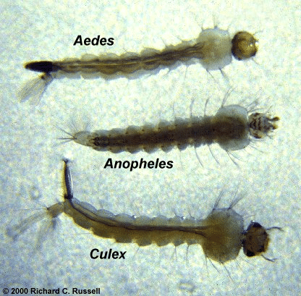

Slide 23
Why does this matter?
Aedes:
Chikungunya
Dengue fever
Lymphatic filariasis
Rift Valley fever
Yellow fever
Zika
Culex:
Japanese encephalitis
Lymphatic filariasis
West Nile fever
Anopheles:
Malaria
Lymphatic filariasis

Slide 24
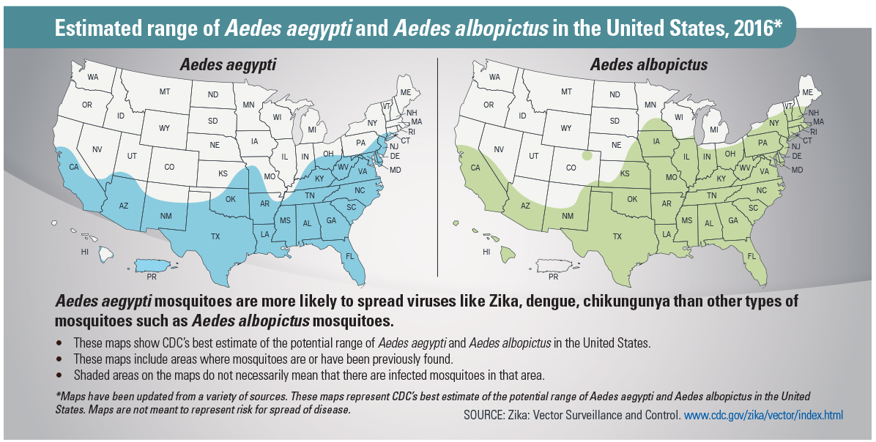
Why does this matter?

