Slide 1
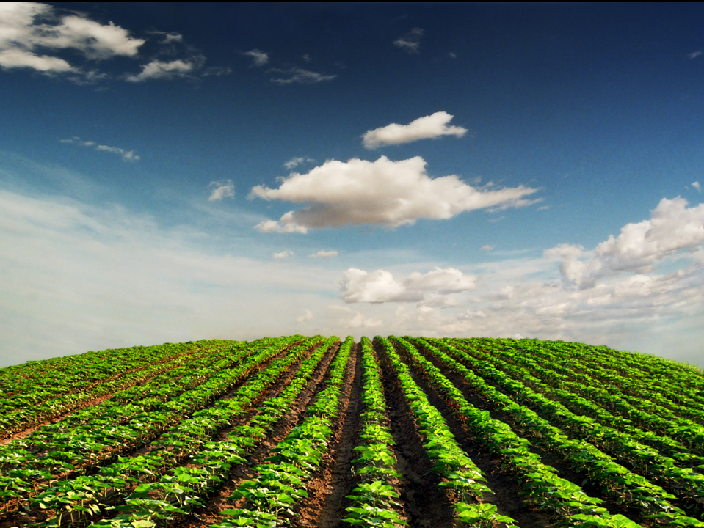
Detecting Genetically
Modified Foods by PCR

Slide 2
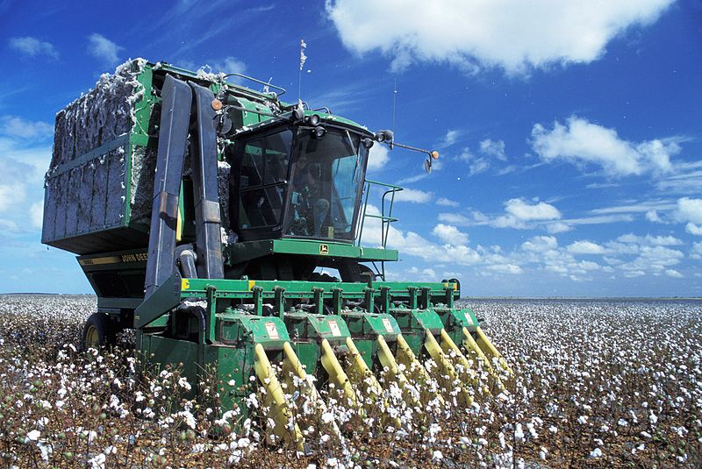
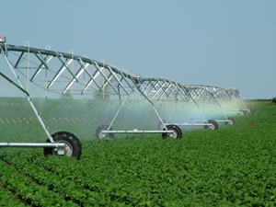
The “Green Revolution”
1950s-1970s
Irrigation
Pesticides
Herbicides
High-yield crop strains
Chemical fertilizers
Mechanized harvesters

Slide 3
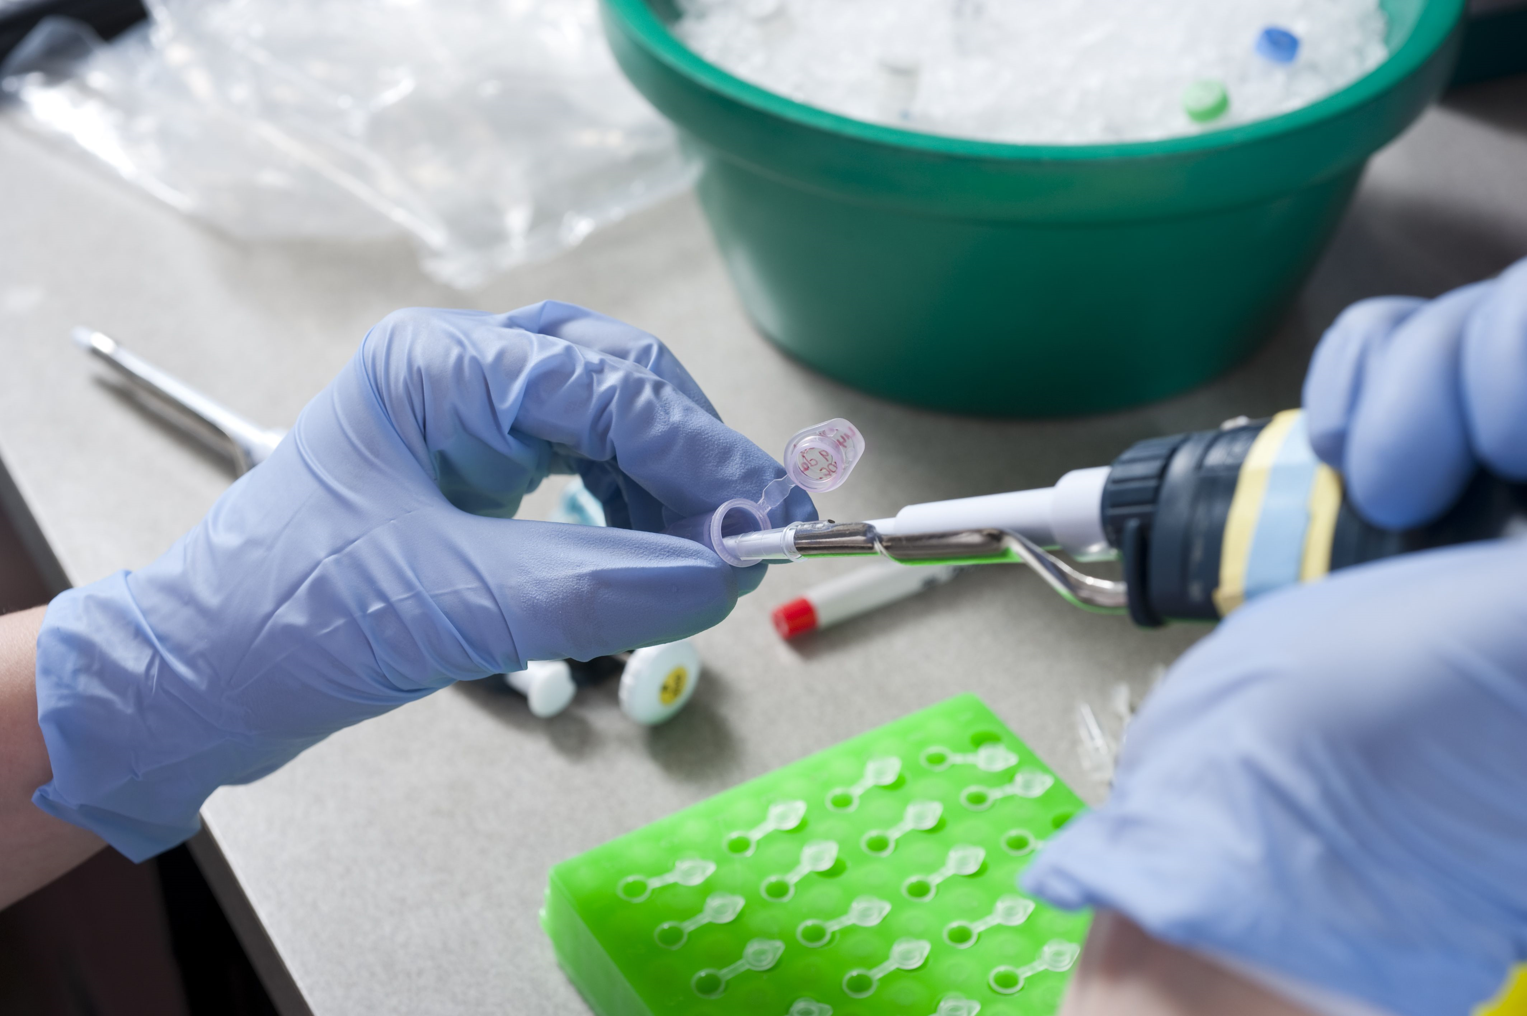
Second “Green Revolution”
Genes for…
Herbicide resistance
Insect resistance
Drought tolerance
Frost tolerance

Slide 4
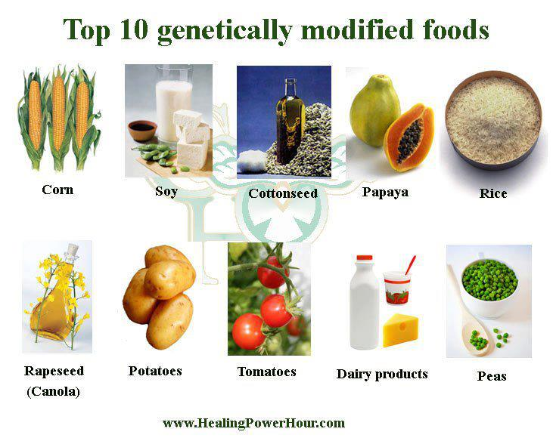
What is a GMO?
Genetically Modified Organism –
Organisms that have had their DNA changed
through methods of genetic engineering
(the change would not occur naturally by mating and/or natural recombination)

Slide 5
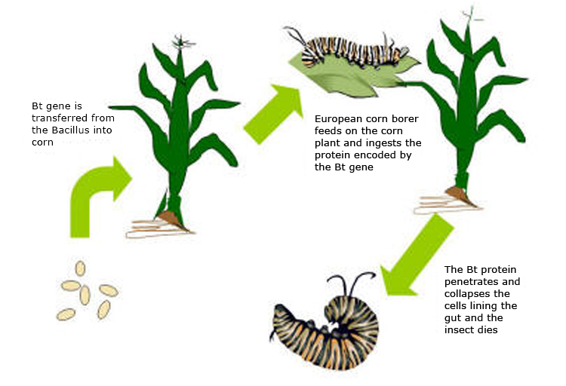
Bt (Bacillus thuringiensis) crops
Reduces application of insecticides & increases crop yields

Slide 6
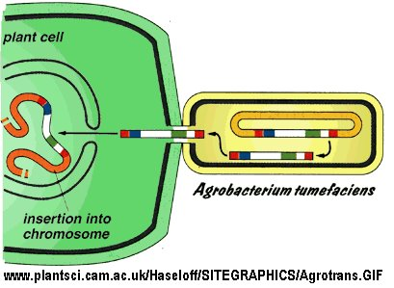
Ht (Herbicide tolerant crops)
Roundup® Ready
Glyphosate resistance gene –
protects against the broad-spectrum herbicide Roundup®
Roundup®-treated fields require less tilling, reducing soil runoff

Slide 7
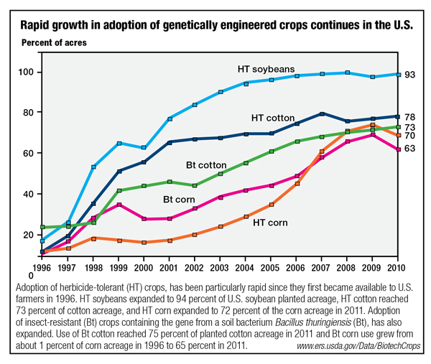
GM Crops in the US

Slide 8
Identification
The percentage of a genetically engineered ingredient that must be present in a food before a label is required:
Australia & New Zealand - 1%
European Union – 0.9%
Japan – 5%
United States – no labeling requirements

Slide 9
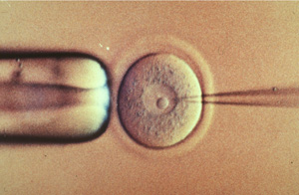
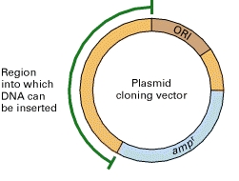
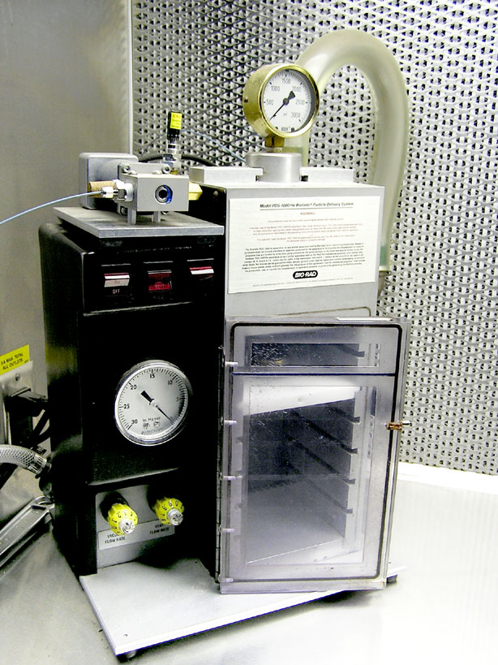
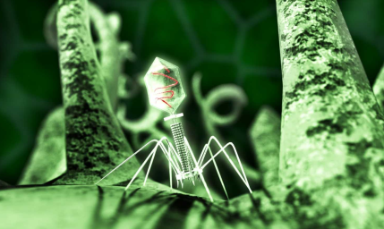
How can DNA be moved from one organism to another?
DNA microinjection
Plasmid
Gene gun
good for mammals
Bacteriophage/Virus
good for plants

Slide 10
How will we know if a plant is genetically modified?
Google “DNALC Kits GMO”
Click on “Protocol”
Click on the “Bioinformatics” tab
Go to “Part 1”

Slide 11
Plasmid
Gene of interest
CaMV 35s promoter:
Very strong promoter causing high levels of gene expression in plants
Being used in almost all GM crops
ori
Antibiotic resistance
CaMV 35s
Insect resistance: Bt crops
Bacillus thuringiensis is a soil bacterium that produces toxins which are poisonous to insects
Herbicide tolerance: Ht crops
Agrobacterium sp. produce proteins that provide resistance to glyphosate herbicides (Roundup® Ready)

Slide 12
Results
Gene of interest
ori
Antibiotic resistance
CaMV 35s
GM foods will contain the 35s promoter
All foods will contain tubulin:
proteins that make up microtubules
(components of the cytoskeleton)

Slide 13
What can it provide?
Issues?
Pest resistance
Herbicide tolerance
Viral resistance
Drought resistance
Increased nutritional value
Improved fruit
Altered ripening
Enriched nutrient content
• Creation of super pests
• Creation of super weeds
Loss of biodiversity
Biotechnology companies control agriculture
Health concerns
Loss of farmable land

