Slide 1

Meet a Scientist!
Camila dos Santos
Cold Spring Harbor Laboratory
December 2020

Slide 2
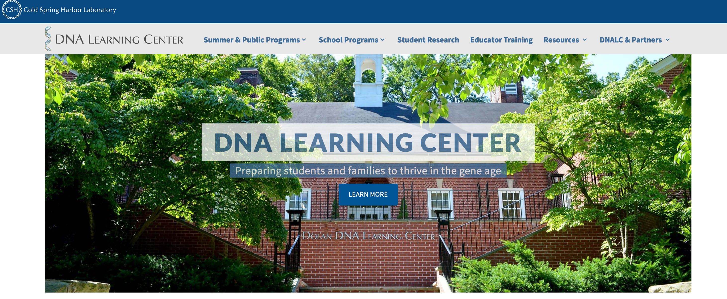




For more “Meet a Scientist” events and field trips visit subscribe and visit
dnalc.cshl.edu

