Slide 1
PCR DNA Basics

Slide 2
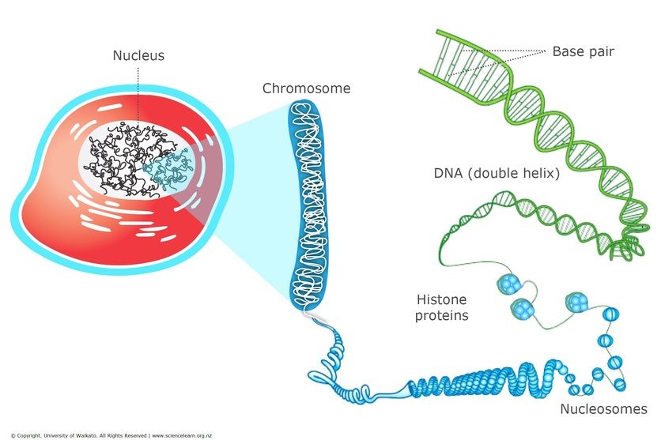
Accessing the cell

Slide 3
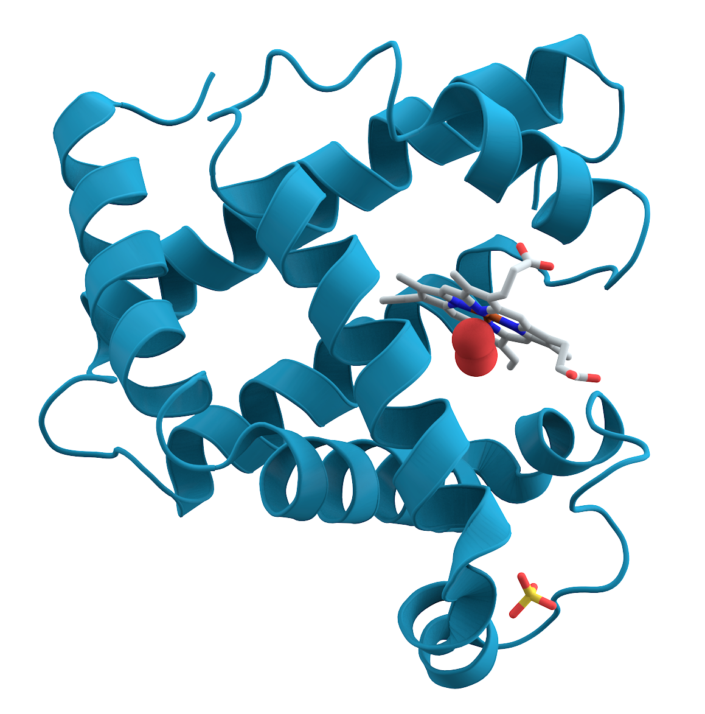
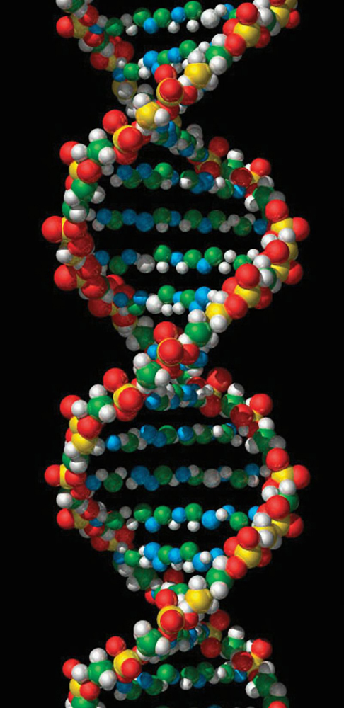
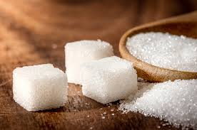
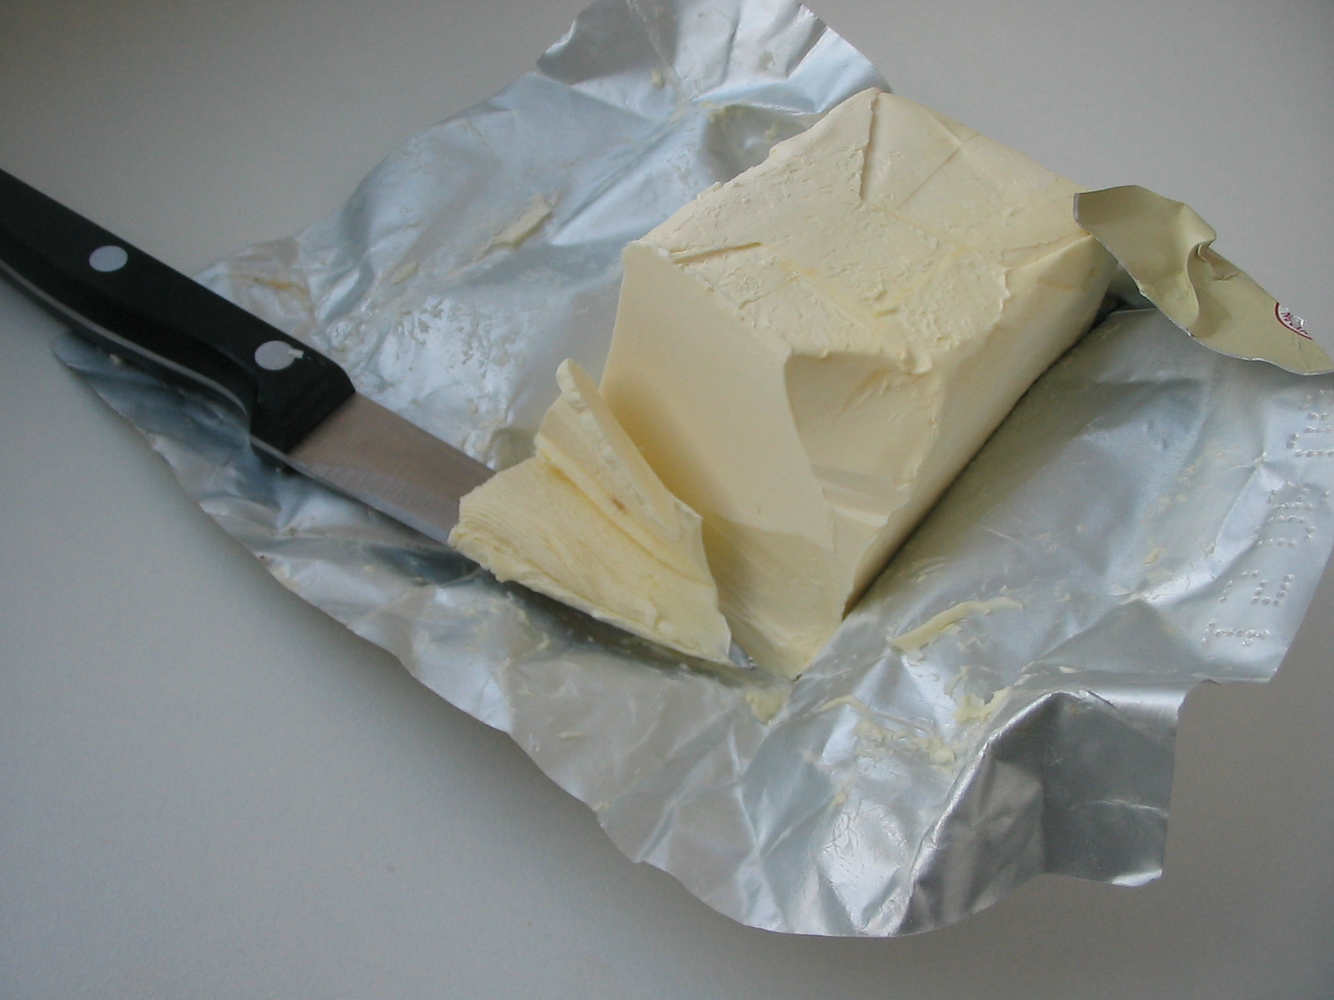
Molecular Components of the Cell
Images:
Sugar: https://theconversation.com/what-the-19th-century-fad-for-anti-slavery-sugar-can-teach-us-about-ethical-christmas-gifts-128968
Protein: https://en.wikipedia.org/wiki/File:Myoglobin.png
Fat: https://en.wikipedia.org/wiki/Fat#/media/File:Margaryn_022.jpg
DNA: https://www.livescience.com/37247-dna.html

Slide 4
Molecular Components of the Cell
Information Carriers
Images:
Sugar: https://theconversation.com/what-the-19th-century-fad-for-anti-slavery-sugar-can-teach-us-about-ethical-christmas-gifts-128968
Protein: https://en.wikipedia.org/wiki/File:Myoglobin.png
Fat: https://en.wikipedia.org/wiki/Fat#/media/File:Margaryn_022.jpg
DNA: https://www.livescience.com/37247-dna.html

Slide 5
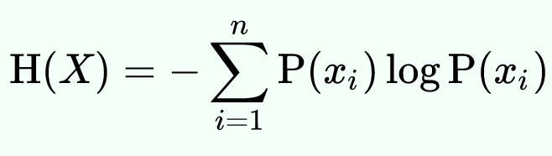
Information (theory)
Shannon’s Entropy Equation
Entropy: How ordered/disordered something is
Images:
https://en.wikipedia.org/wiki/Information

Slide 6
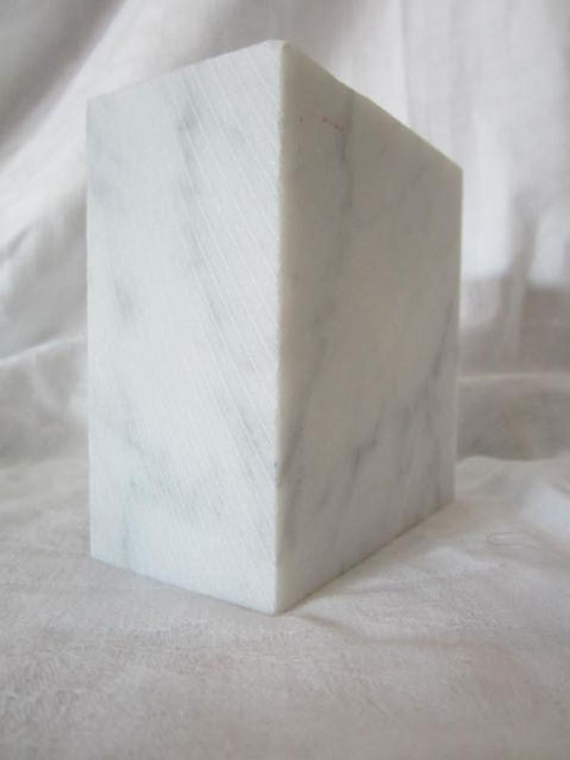
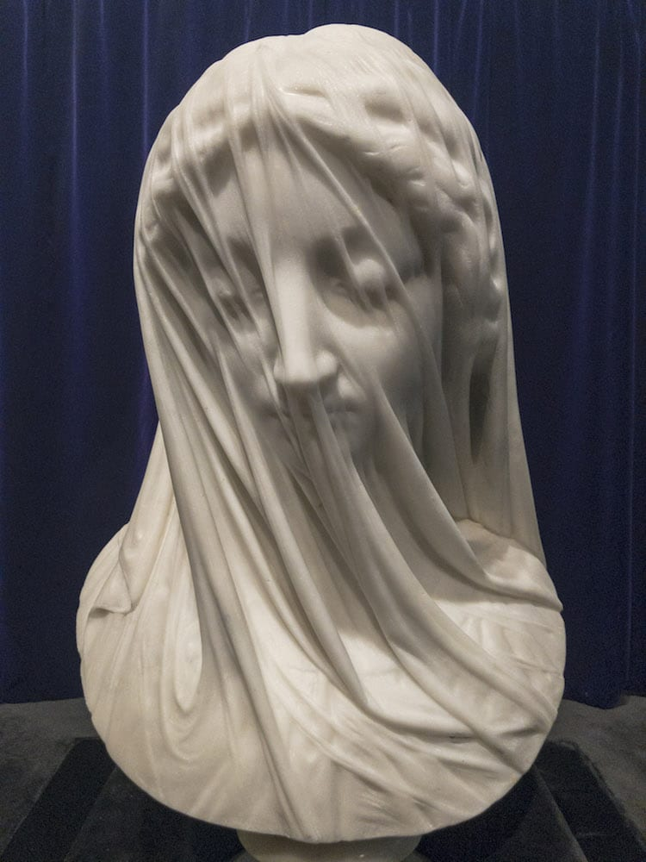
Information (theory)
Images:
https://en.wikipedia.org/wiki/Information

Slide 7
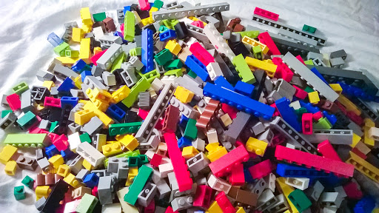
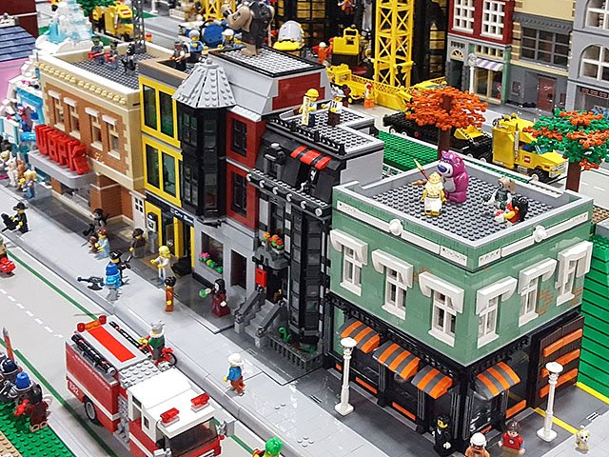
Information (theory)
Images:
http://tomalphin.com/2014/03/from-buckets-to-bins-how-to-sort-a-lot-of-lego.html
https://isthmus.com/news/cover-story/adult-lego-hobbyists-build-bricks/

Slide 8
Information (theory)
Information Carriers

Slide 9
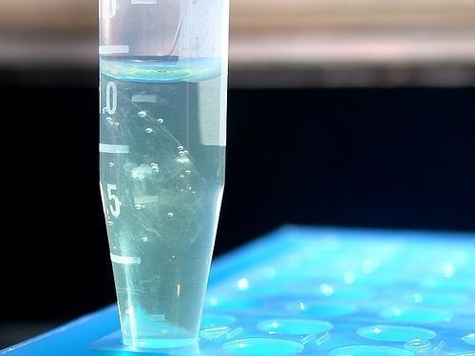
From molecules to sequences
>MT506346.1 Homo sapiens isolate AGENOME-ZPMRG-Z-V1.0 mitochondrion, complete genome GATCACAGGTCTATCACCCTATTAACCACTCACGGGAGCTCTCCATGCATTTGGTATTTTCGTCTGGGGG GTGTGCACGCGATAGCATTGCGAGACGCTGGAGCCGGAGCACCCTATGTCGCAGTATCTGTCTTTGATTC CTGCCTCATCTCATTATTTATCGCACCTACGTTCAATATTACAGGCGAACATACTTACTAAAGTGTGTTA ATTAATTAATGCTTGTAGGACATAATAATAACAATTGAATGTCTGCACAGCCGCTTTCCACACAGACATC ATAACAAAAAATTTCCACCAAACCCCCCCTCCCCCCGCTTCTGGCCACAGCACTTAAACACATCTCTGCC AAACCCCAAAAACAAAGAACCCTAACACCAGCCTAACCAGATTTCAAATTTTATCTTTTGGCGGTATGCA CTTTTAACAGTCACCCCCCAACTAACACATTATTTTCCCCTCCCACTCCCATACTACTAATCTCATCAAC ACAACCCCCGCCCATCCTACCCAGCACACACACACCGCTGCTAACCCCATACCCCGAACCAACCAAACCC CAAAGACACCCCCCACAGTTTATGTAGCTTACCTCCTCAAAGCAATACACTGAAAATGTTTAGACGGGCT CACATCACCCCATAAACAAATAGGTTTGGTCCTAGCCTTTCTATTAGCTCTTAGTAAGATTACACATGCA AGCATCCCCGTTCCAGTGAGTTCACCCTCTAAATCACCACGATCAAAAGGGACAAGCATCAAGCACGCAG CAATGCAGCTCAAAACGCTTAGCCTAGCCACACCCCCACGGGAAACAGCAGTGATTAACCTTTAGCAATA AACGAAAGTTTAACTAAGCTATACTAACCCCAGGGTTGGTCAATTTCGTGCCAGCCACCGCGGTCACACG ATTAACCCAAGTCAATAGAAGCCGGCGTAAAGAGTGTTTTAGATCACCCCCTCCCCAATAAAGCTAAAAC TCACCTGAGTTGTAAAAAACTCCAGTTGACACAAAATAGACTACGAAAGTGGCTTTAACATATCTGAACA CACAATAGCTAAGACCCAAACTGGGATTAGATACCCCACTATGCTTAGCCCTAAACCTCAACAGTTAAAT CAACAAAACTGCTCGCCAGAACACTACGAGCCACAGCTTAAAACTCAAAGGACCTGGCGGTGCTTCATAT
Images:
https://www.sciencelearn.org.nz/resources/2036-dna-extraction

Slide 10
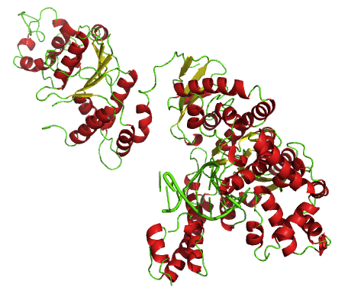
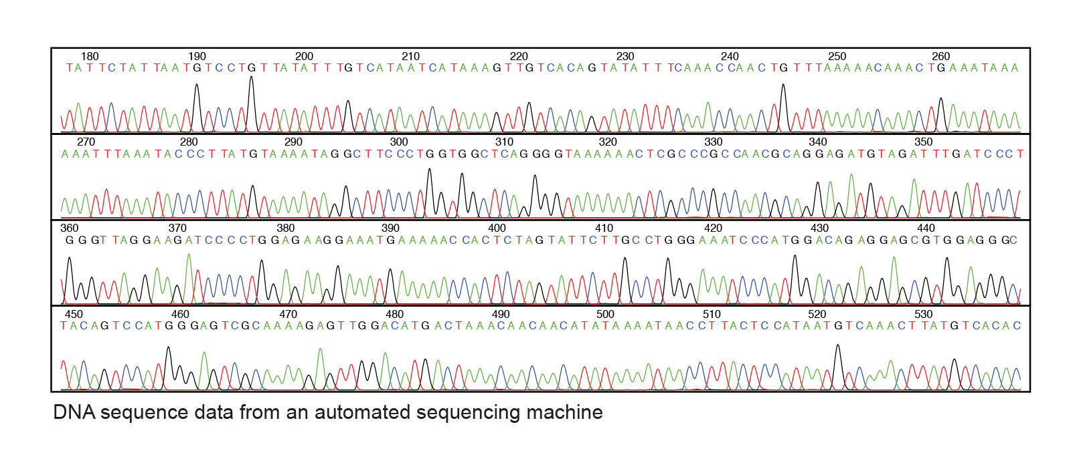
From molecules to sequences
Polymerase Chain Reaction
DNA Sequencing
Images:
https://en.wikipedia.org/wiki/Taq_polymerase#/media/File:Taq.png
https://www.genome.gov/genetics-glossary/DNA-Sequencing

Slide 11
From molecules to sequences
Polymerase Chain Reaction
To get DNA Sequencing to work, we first need many copies of DNA…
(Brighter signal, better photo)
Images:
https://en.wikipedia.org/wiki/Taq_polymerase#/media/File:Taq.png
https://www.genome.gov/genetics-glossary/DNA-Sequencing

Slide 12
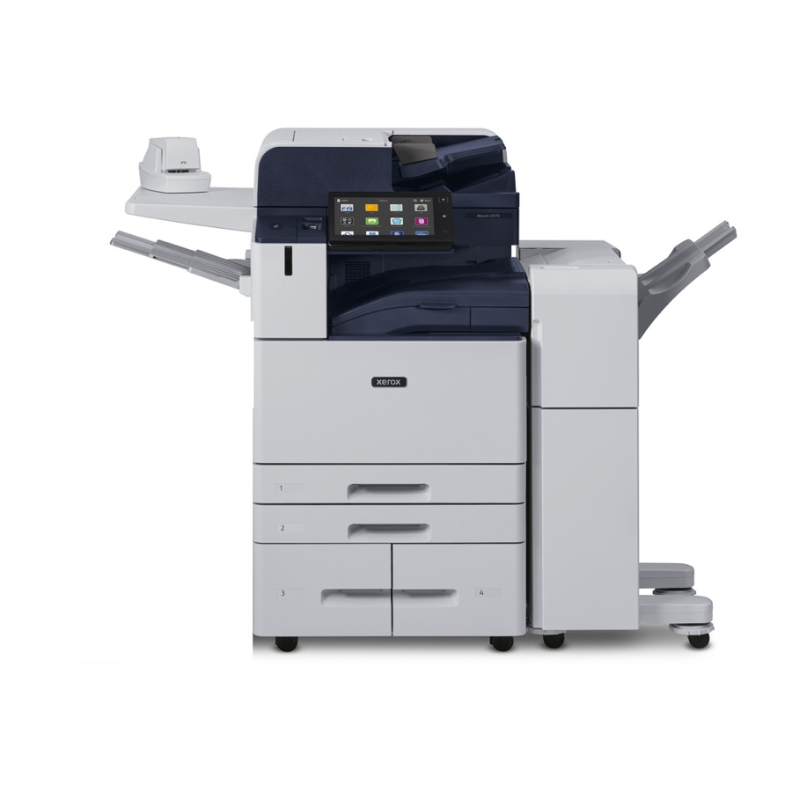
Making a copy
Images:
https://www.faxexpress.com/copiers/Xerox/Xerox_AltaLink_C8135-slash-H2_Copier.html

Slide 13
PCR (molecular) Components
Polymerase (taq)
Template DNA
Primers
Nucleotides (dNTPs)

Slide 14
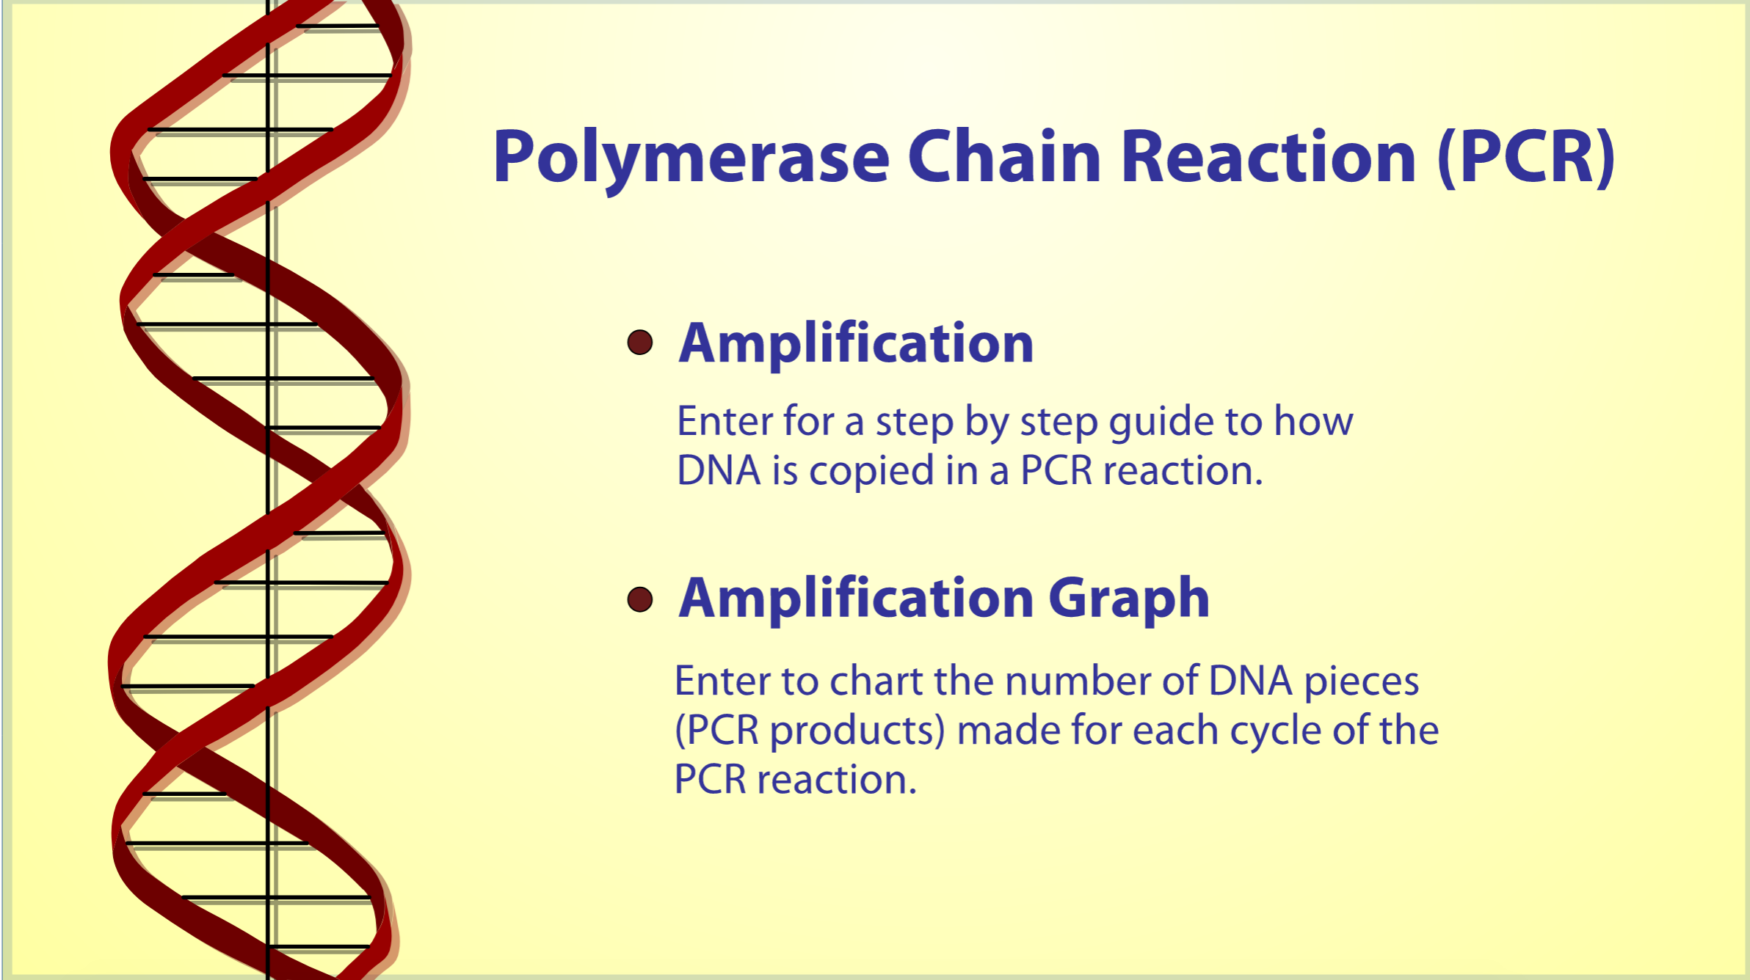
PCR Animation
https://dnalc.cshl.edu/resources/animations/pcr.html

Slide 15
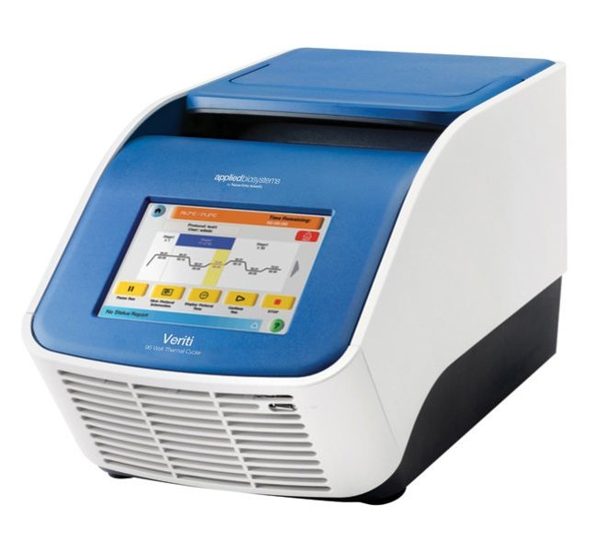
PCR Machine
DNA Amplification by PCR

Slide 16
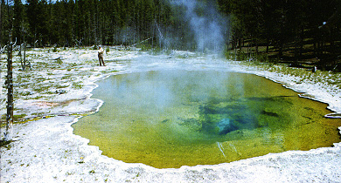
Why Taq Polymerase?
Images:
https://bioinfo.bact.wisc.edu/themicrobialworld/LAHT/b27.html

Slide 17

Why do we need primers? (information)

