Slide 1
CyVerse DNA Subway
Classroom-friendly Bioinformatics

Slide 2

Challenge – bringing students into the fold
Research
Education
Students can work with the same data at the same time and with the same tools as research scientists.
How do scientists share their data and make it publically available?
How do scientists extract maximum value from the datasets they generate?
How can students and educators (who will need to come to grips with data-intensive biology) be brought into the fold?

Slide 3
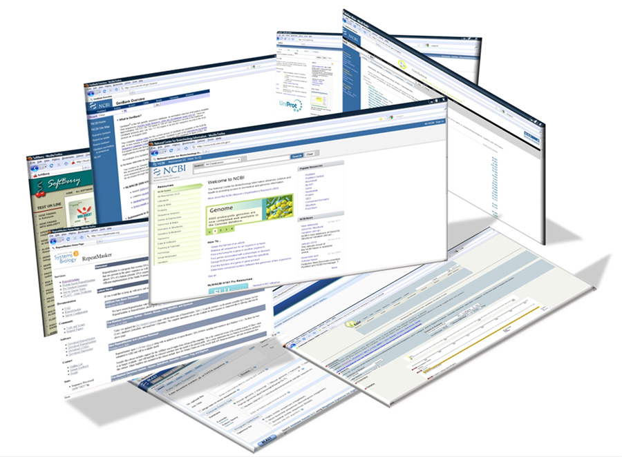
Can you navigate the tools?
What are your challenges in teaching bioinformatics in the classroom?

Slide 4
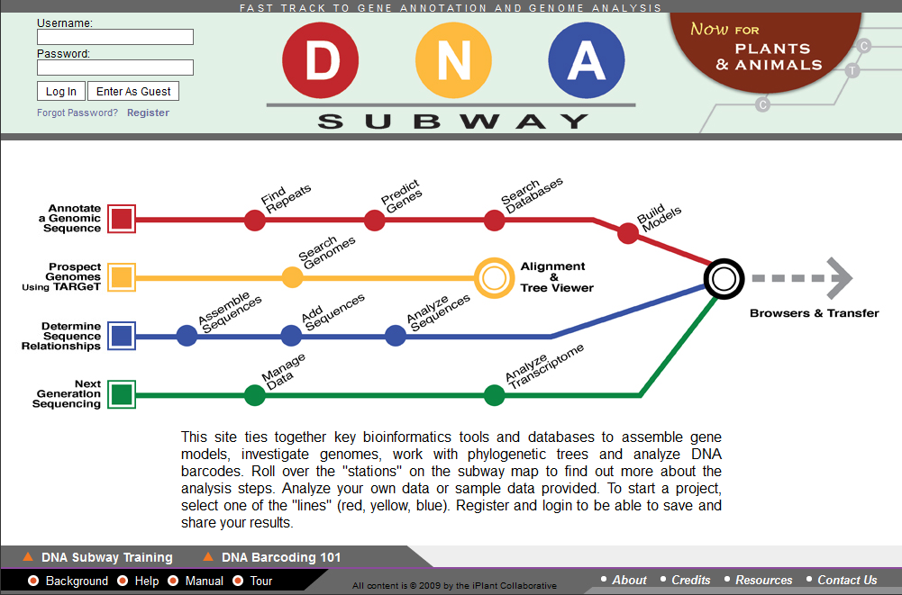
Take the Subway

Slide 5
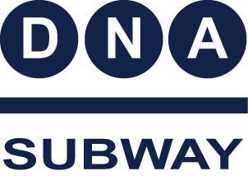
DNA Subway
Classroom friendly bioinformatics
Faculty identified guiding requirements
that shaped the development of CyVerse educational platforms:
Mix lecture and lab – have a wet bench “hook”
Student-scientist partnerships – someone has to care about the data
Co-investigation – projects should potentially lead to publications
Scale – platforms should support projects multiple classrooms can join.

Slide 6
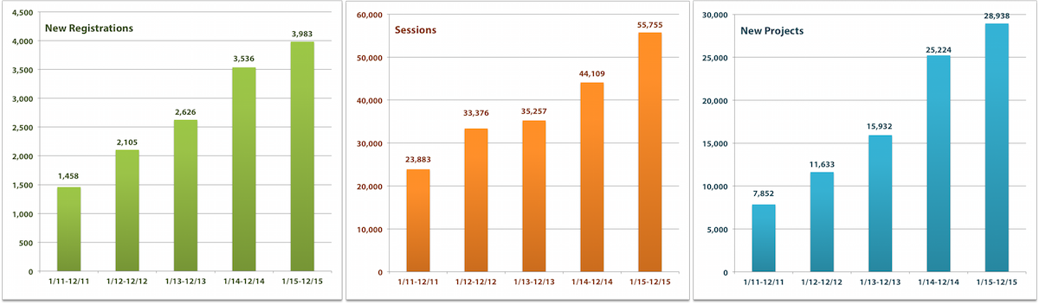
DNA Subway
Classroom friendly bioinformatics
More than 13,000 users
More than 28,000 student projects in 2015

Slide 7
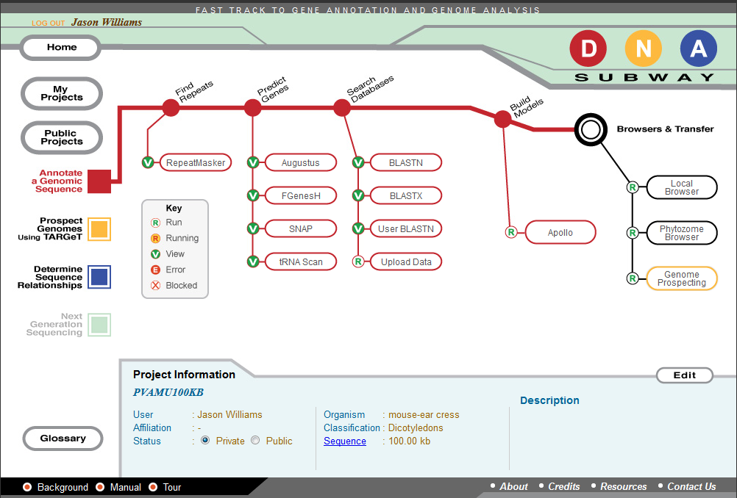
DNA Subway
Red Line: Genome annotation
Red Line
Analyze up to 150 KB of DNA sequence
De novo gene prediction
Construct evidence-based gene models
Visualize genome sequence in browser

Slide 8
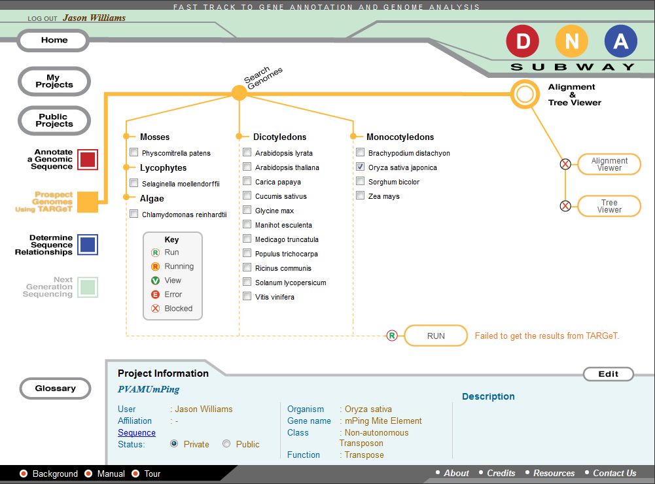
DNA Subway
Yellow Line: Genome prospecting
Yellow Line
Analyze DNA or protein sequence
Search plant genomes using TARGeT
Explore gene duplications, transposons, and non-coding sequences not detectable in conventional BLAST searches

Slide 9
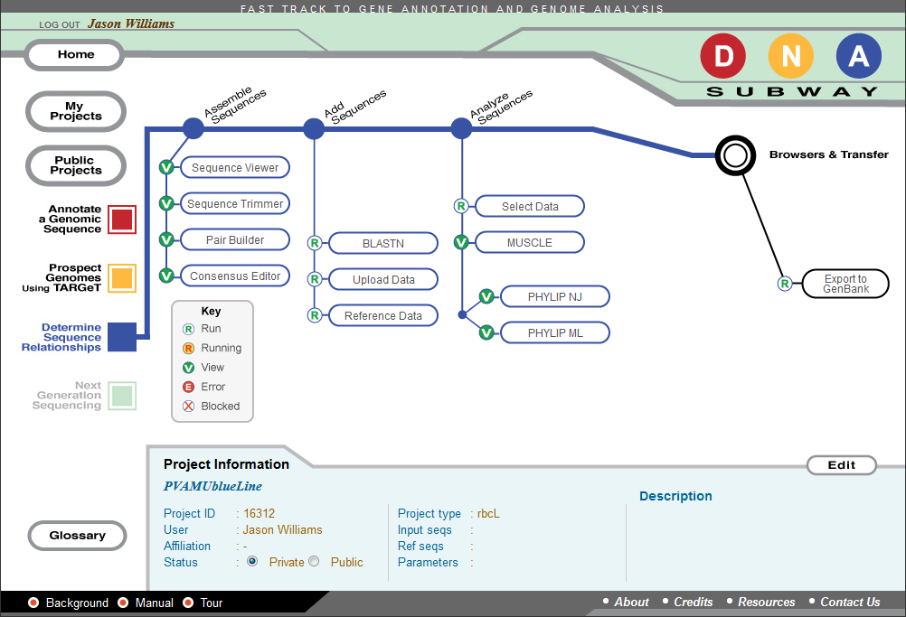
DNA Subway
Blue Line: DNA barcoding, and phylogenetics
Blue Line
Analyze DNA or protein sequence
Search plant genomes using TARGeT
Explore gene duplications, transposons, and non-coding sequences not detectable in conventional BLAST searches

Slide 10
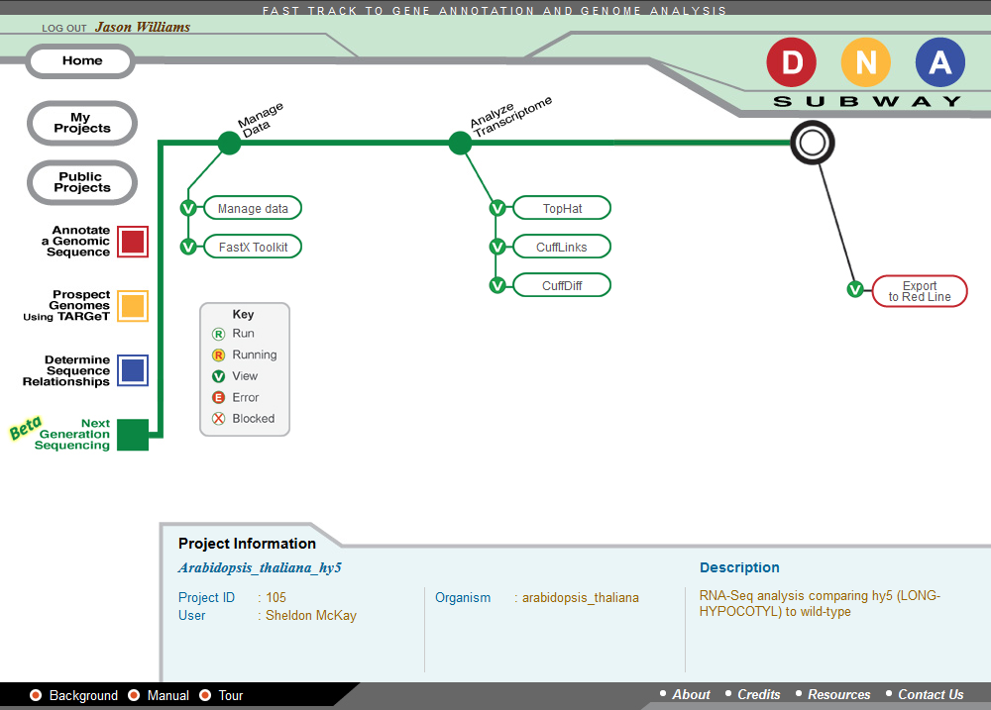
DNA Subway
Green Line: Transcriptome analysis
Green Line
Examine RNA-Seq data for differential
expression
Use High-performance computing to analyze complete datasets
Generate lists of genes and fold-changes; add results to Red Line projects

Slide 11
CyVerse Executive Team

