Slide 1
Lexicon Mining, Language Visualization and Semiotic Squares in Python
Jason S. Kessler*
Puget Sound Python Programming Talk
February 21, 2018
*No, not that Jason Kessler.
@jasonkessler

Slide 2
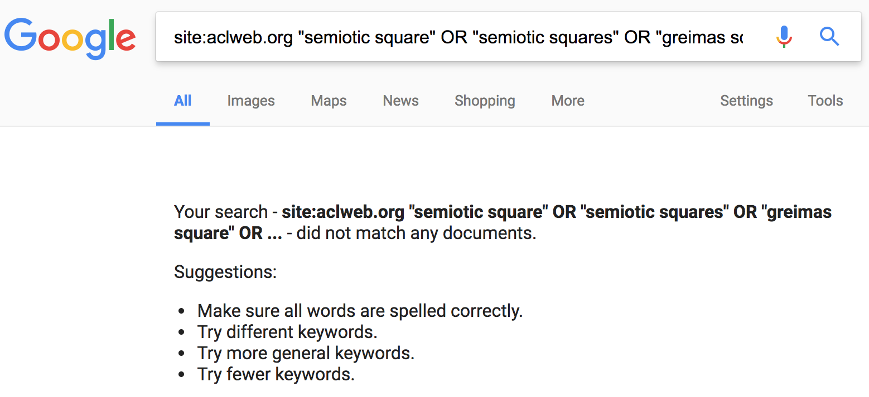
@jasonkessler

Slide 3
By the end of the talk
You’ll know how to programmatically create semiotic squares like this one.
Source: http://www.squadrati.com/2014/03/31/quadrato-semiotico-dei-wine-lovers/
@jasonkessler

Slide 4
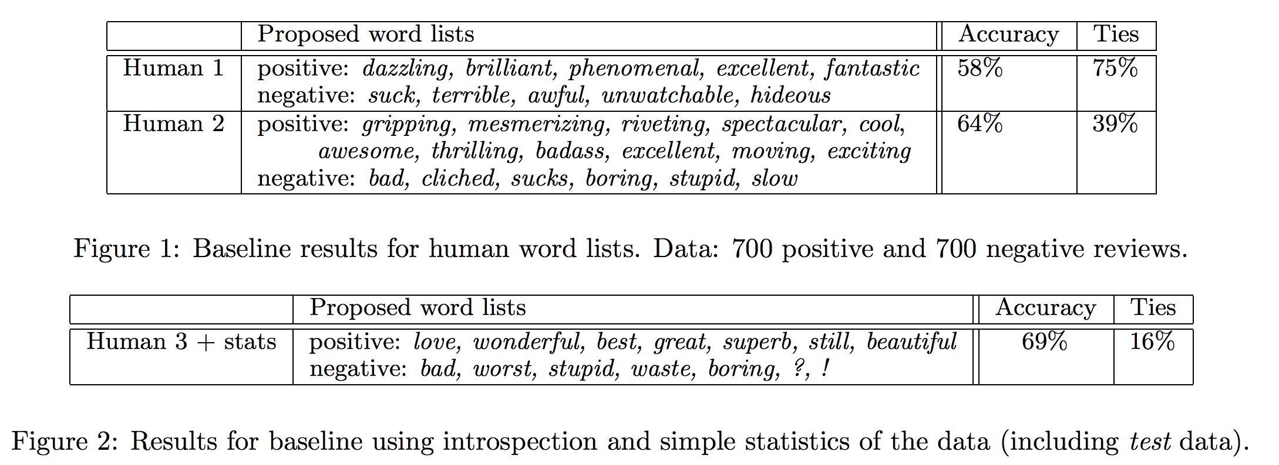
Lexicon speculation
@jasonkessler
Bo Pang, Lillian Lee and Shivakumar Vaithyanathan. Thumbs up? Sentiment classification using machine learning techniques. EMNLP. 2002.

Slide 5
Lexicon mining ≈ lexicon speculation
@jasonkessler
Bo Pang, Lillian Lee and Shivakumar Vaithyanathan. Thumbs up? Sentiment classification using machine learning techniques. EMNLP. 2002.

Slide 6
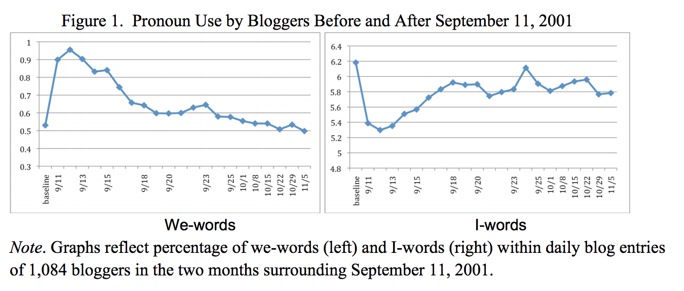
In defense of stop words
@jasonkessler
In times of shared crisis, “we” use increases, while “I” use decreases.
I/we: age, social integration
I: lying, social rank
Cindy K. Chung and James W. Pennebaker. Counting Little Words in Big Data: The Psychology of Communities, Culture, and History. EASP. 2012

Slide 7
Function words and gender
@jasonkessler
Performed on a variety of language categories, including speech.
Other studies have found that function words are the best predictors of gender.
LIWC Dimension Bold: entirely stop words | Effect Size (Cohen’s d) (>0 F, <0 M) MANOVA p<.001
All Pronouns (esp. 3rd person) | 0.36
Present tense verbs (walk, is, be) | 0.18
Feeling (touch, hold, feel) | 0.17
Certainty (always, never) | 0.14
Word count | NS
Numbers | -0.15
Prepositions | -0.17
Words >6 letters | -0.24
Swear words | -0.22
Articles | -0.24
Newman, ML; Groom, CJ; Handelman LD, Pennebaker, JW. Gender Differences in Language Use: An Analysis of 14,000 Text Samples. 2008.

Slide 8
Function word usage is counter-intuitive
@jasonkessler
Pennebaker et al:
Testosterone levels (in two therapeutic settings) predict:
Modest but significant decreases in:
Pronouns referring to others (ex: we, she, they)
Communication verbs (ex: hear, say)
Modest but significant decreases in:
Optimism words (ex: energy, upbeat)
Negative (but statistically insignificant) correlation with subject’s beliefs about testosterone and category usage!
Herring et al:
Subjects tasked with impersonating opposite gender in online game
Discussed stereotypical topics (cars, shopping) but didn’t change stylistic cues
James W. Pennebaker, Carla J. Groom, Daniel Loew, James M. Dabbs. Testosterone as a Social Inhibitor: Two Case Studies of the Effect of Testosterone Treatment on Language. 2004.
Susan C. Herring, Anna Martinson. Assessing Gender Authenticity in Computer-Mediated Language Use: Evidence From an Identity Game. Journal of Language and Social Psychology. 2004.
Notes:
No link to aggression, achievement, sexual behavior, anger, or markers of cognitive complexity.

