Slide 1
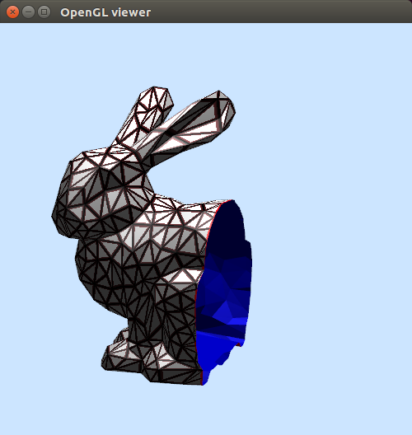
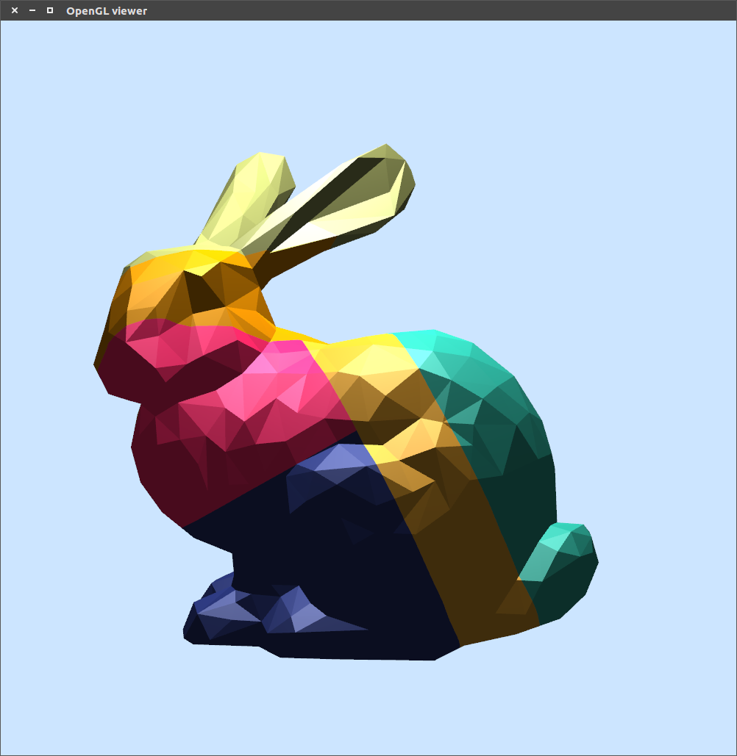
Partitioning Large 3D Models for Use in 3D Printing
Jason Kraft & Uyen Uong

Slide 2
Motivation
Size constraints limit the maximum volume of a printed model
GOAL: develop algorithm to automate subdividing large models into printable subcomponents
Optimize subdivisions based on:
printability (parts must fit inside the working volume of the printer)
assemblability (it must be possible to assemble the parts into a finished model)
efficiency (minimize the number subcomponents)
connector feasibility (each surface connecting to other parts must be large enough for male and female connector protrusions).

Slide 3
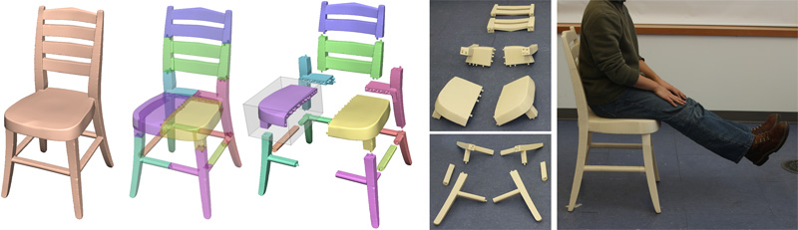
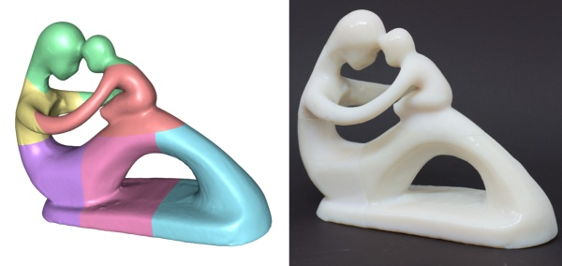
Luo, L., Baran, I., Rusinkiewicz, S., and Matusik, W. 2012. Chopper: Partitioning Models into 3D-Printable Parts. ACM Transactions on Graphics. Vol. 31, No. 6, Article 129.

Slide 4
Main Challenges
Cutting the mesh cleanly
Closing the mesh
Beam Search algorithm for finding the next best cut
Objective functions

Slide 5
Cutting the Mesh
Given a cutting plane, separate the mesh into 2 parts
Need to ensure:
Not adding same vertex twice
Cut triangles oriented the correct way (9 cases)
Makes use of BSP Tree

Slide 6
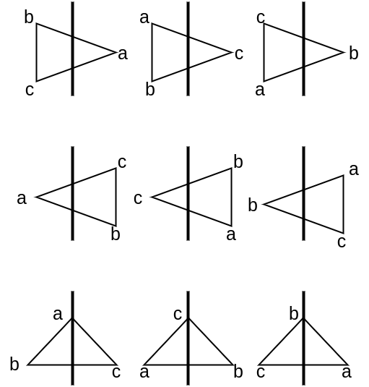
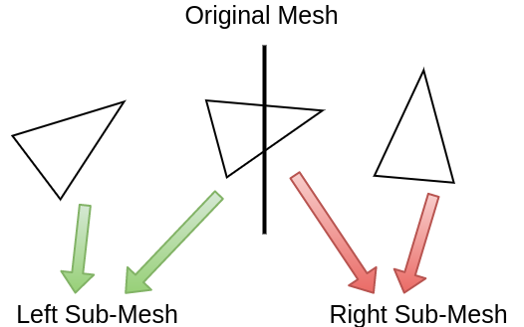
Cutting in a Nutshell

Slide 7
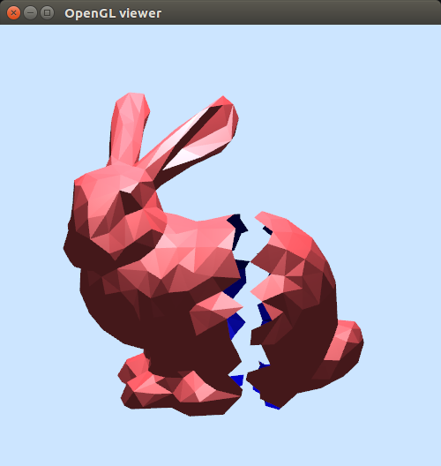
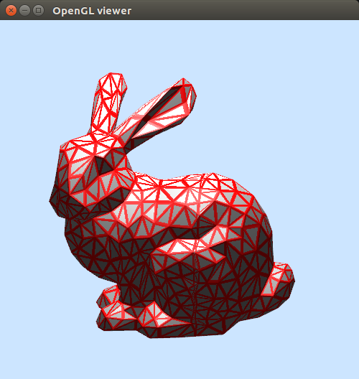
First Try

Slide 8
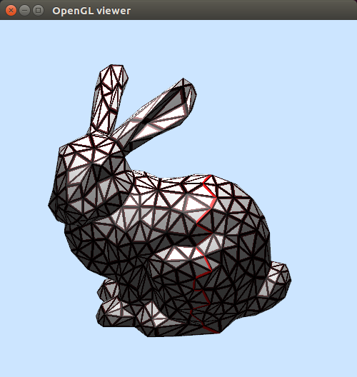
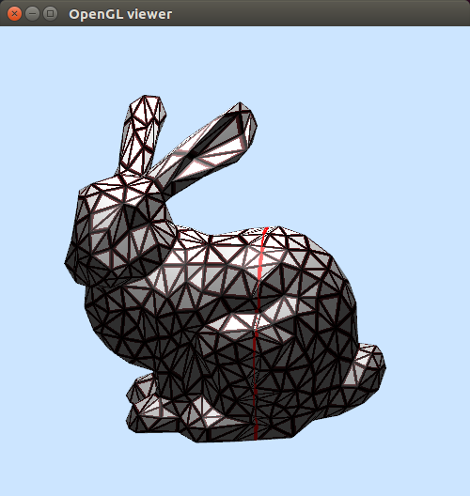
New Approach

Slide 9
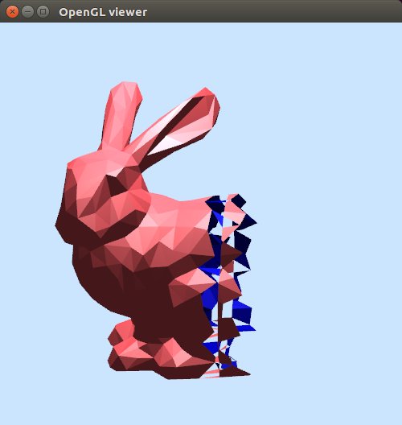
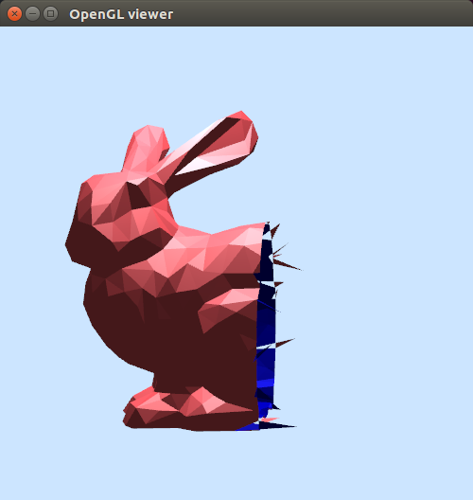
Lots of Tries

Slide 10
Open Mesh

Slide 11
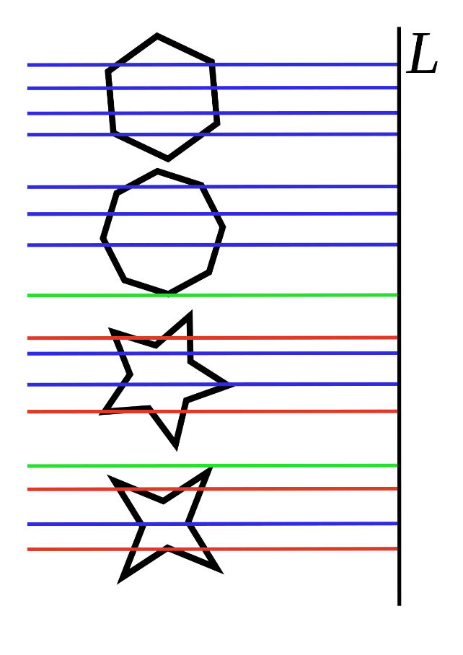
Closing the Mesh - Triangulation
Given an open mesh, need to close it along the cutting plane
1st: Project the points along the boundary onto cutting plane
2nd: Split the polygon into monotone pieces (polygon is monotone with respect to a straight line, L, if all lines perpendicular to L intersect at most twice)
3rd: Triangulate the monotone polygons
But not a priority
Image from https://en.wikipedia.org/wiki/File:M-polygon.svg

Slide 12
Beam Search
In the Chopper paper [Luo, et al. 2012], beam search is used to find the optimal BSP tree that partitions the mesh
Consider all possibilities of cutting the largest part and evaluate them based on the objective functions
Select the b best BSPs to continue with in the next iteration. b = beam width
When all BSPs reach their goal, search ends and the best BSP is chosen

Slide 13
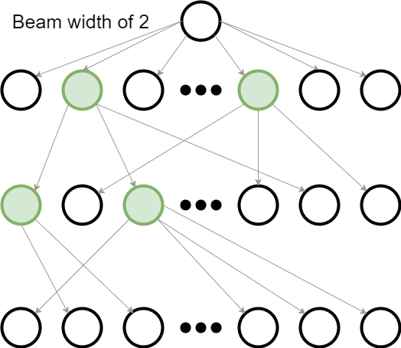
Beam Search contd.

Slide 14
Objective Functions
Optimize the partitions based on printability, assemblability, efficiency, connector feasibility
Score is linear combination of all objectives. Lower scores are better
By using BSP Tree to represent the cuts and terminating when all partitions can fit in the printing volume, printability and assemblability are already satisfied

Slide 15
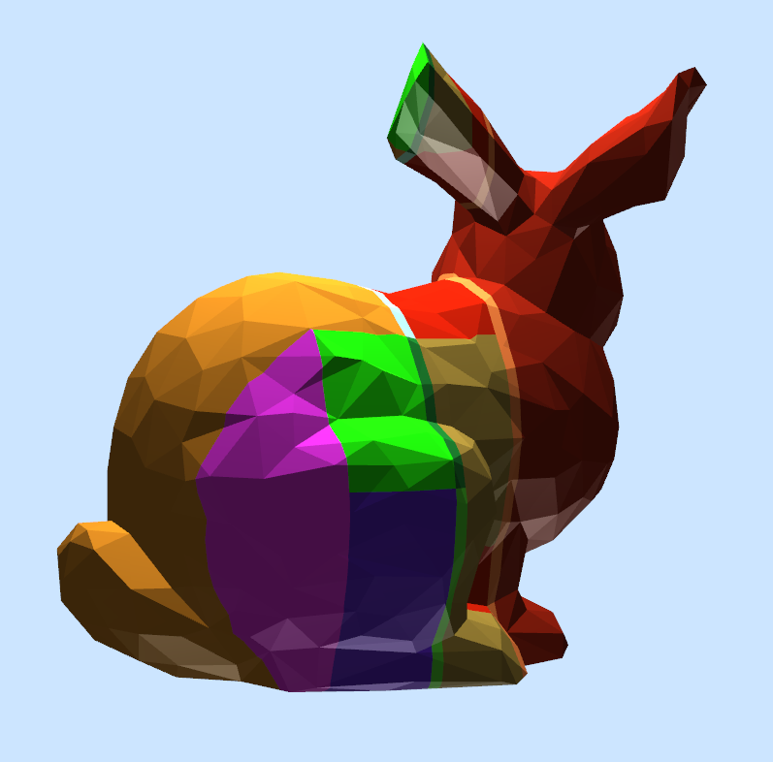
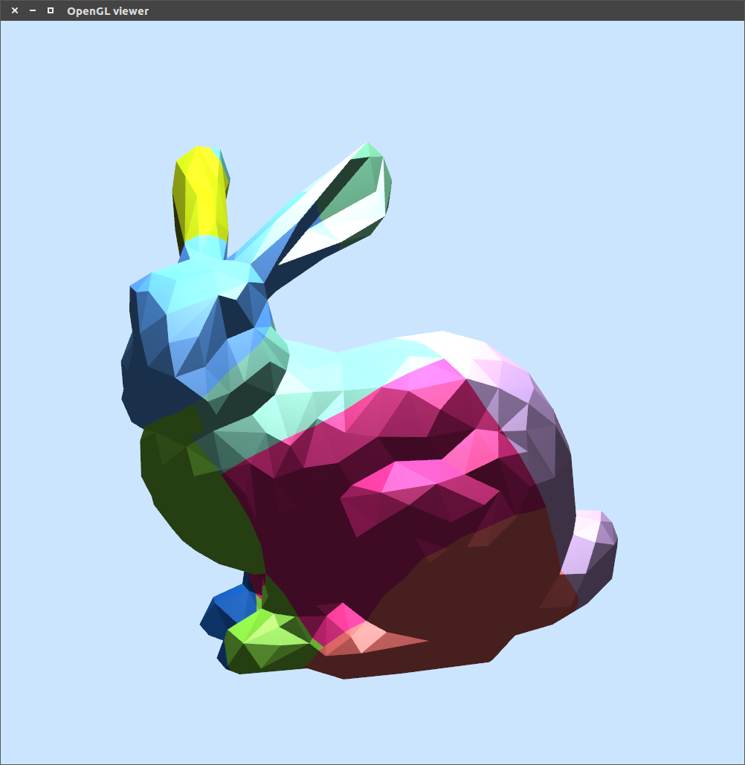
f_{Part}
Minimizes the number of printing volumes needed to tile the partitions
Requires using Oriented Bounding Box (OBB) to compute the tiling
Axis-aligned bounding box sufficient

Slide 16
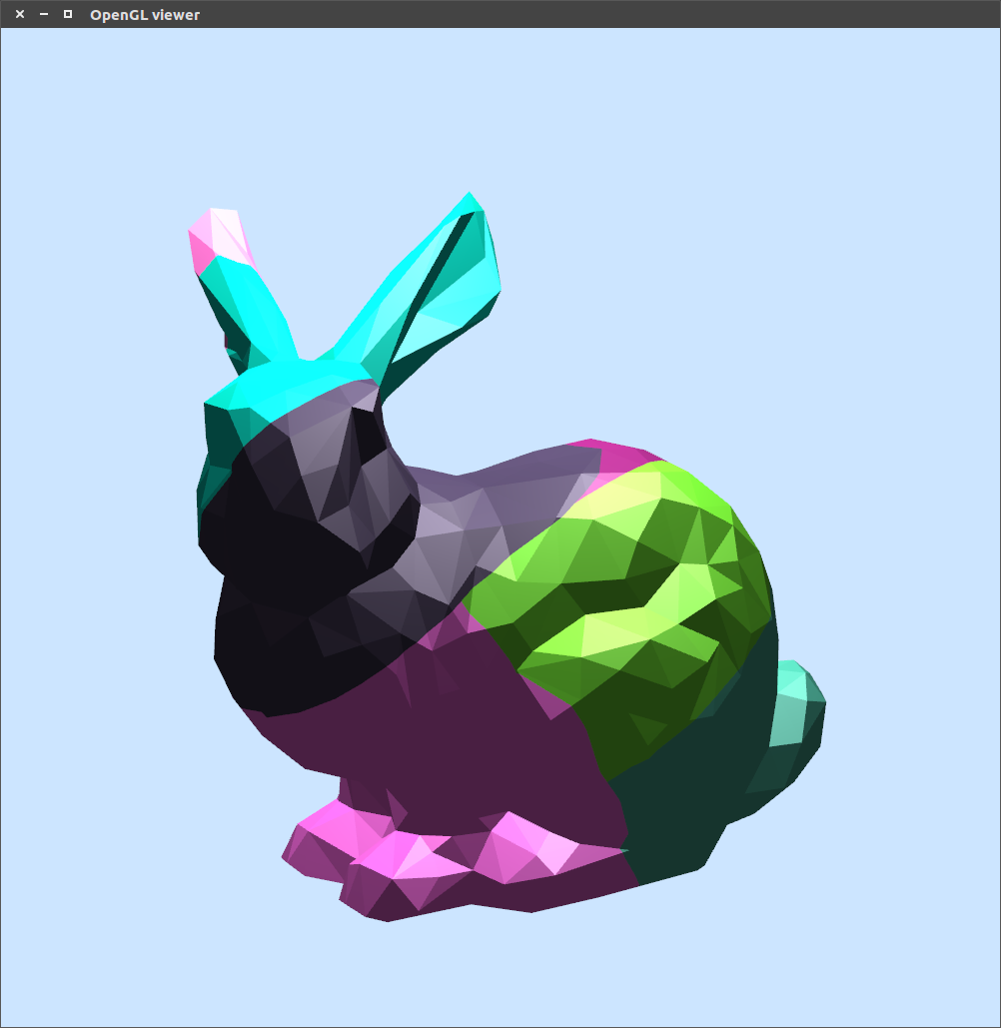
f_{Util}
Maximizes the use of the printing volume
Compares volume of the partition to the volume of the printing volume to ensure using printing volume efficiently

Slide 17
f_{Connector}
Maximizes quality of connector placement
Convex hull is created around the possible connector locations
Compares area of connector to area of the convex hull to ensure that connector can be placed in that cross section

Slide 18
Barber, C., dobkin, D., Huhdanpaa, H. 1995. The Quickhull Algorithm for Convex Hulls. ACM Transactions on Mathematical Software. Vol. 22, No. 4, 469-483.

Slide 19
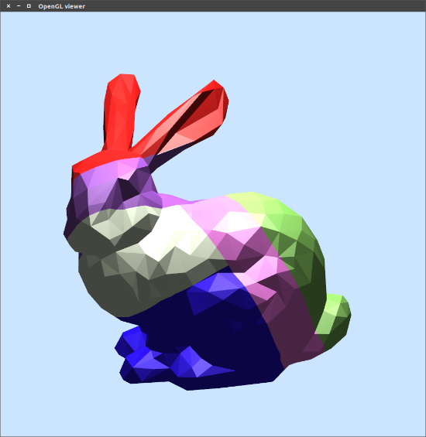
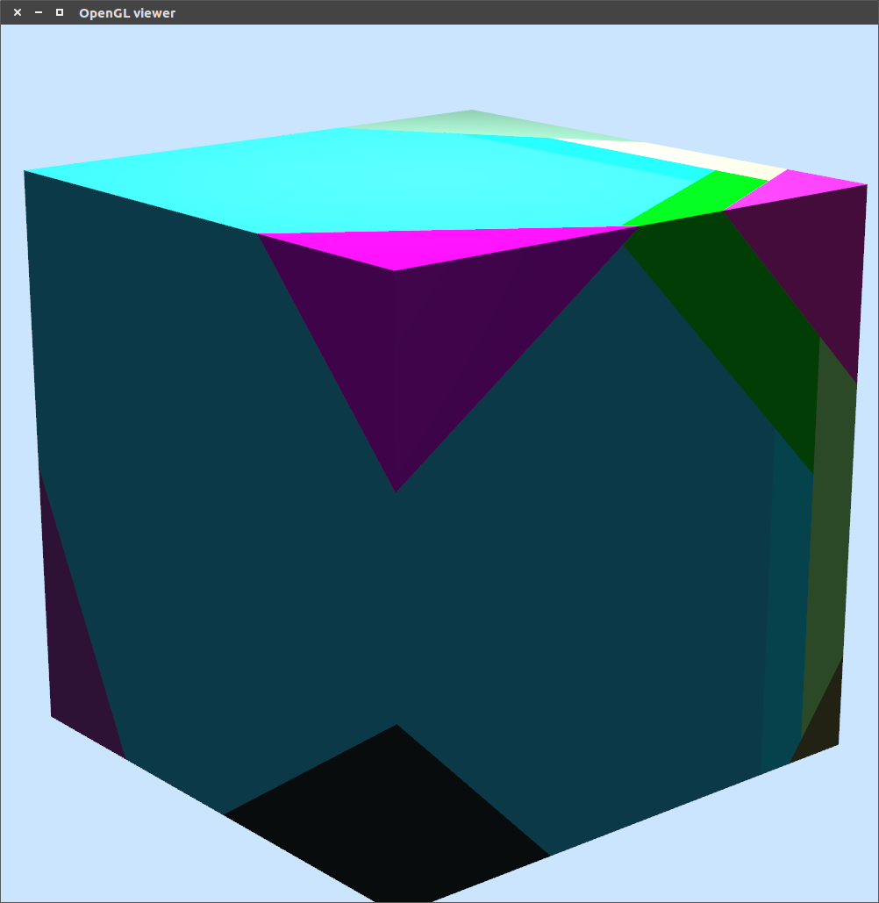
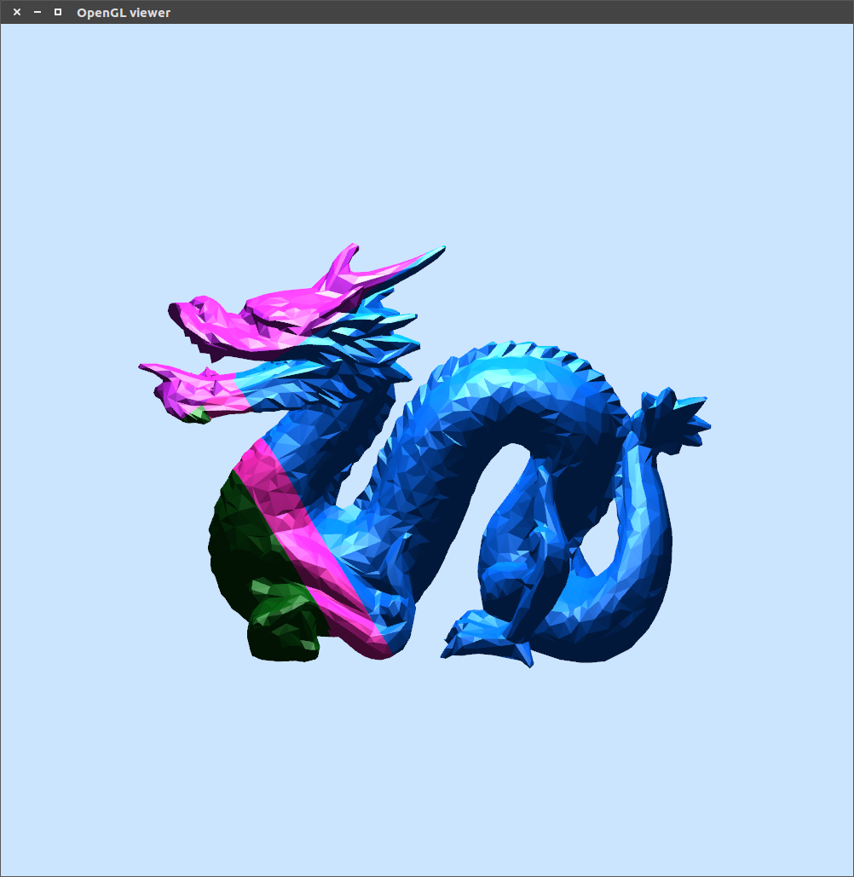
Results
Bunny: 7.16s
Cube: 4.51s (did not converge)
Dragon: 1m 24s (did not converge)

Slide 20
Future Work
Triangulation
f_{Connector}
Optimize/parallelize beam search

Slide 21
Questions?

