Slide 1
Face Detection & Recognition (FDR)
by
Jason Kung ☺ (Member of Google Developers Group Kuala Lumpur)
Disclaimer: All the contents are solely based on my understanding and experiences I have before, you are most welcome to point out any mistakes!

Slide 2

Detection & Recognition, they look similar in fact?
But to me, no!

Slide 3
Differences between Face Detection & Recognition
Face detection focus more on classification, which determine based on categorization problems.
Face recognition focus more on understanding the characteristics of the face, besides than just detecting it.
Which is easier?

Slide 4
Types of FDR Systems
Frontend types (Example: FDR apps using Flask and more)
Backend types (OpenCV, Python, Google Vision API, Tensorflow, Caffe and more)
Embedded types (HuskyLens from Gravity, SiPEED MAiXDuino RISC-V AI IoT Kit, and more)
Real-time systems and frontend systems mostly requires more challenging considerations as factors such as brightness of surroundings, device settings and specifications and so on.

Slide 5
You may buy ……
Raspberry Pi 4B (8GB RAM)
HuskyLens from Gravity
SiPEED MAiXDuino RISC-V AI IoT Kit
Google AIY Vision Kit
Google Coral (Dev Board, USB Accelerator, etc)
UP Squared* AI Vision X Developer Kit
Intel® Movidius™ Neural Compute Stick

Slide 6
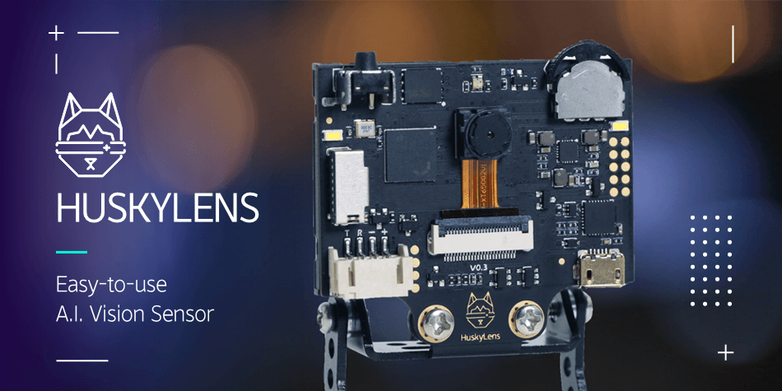
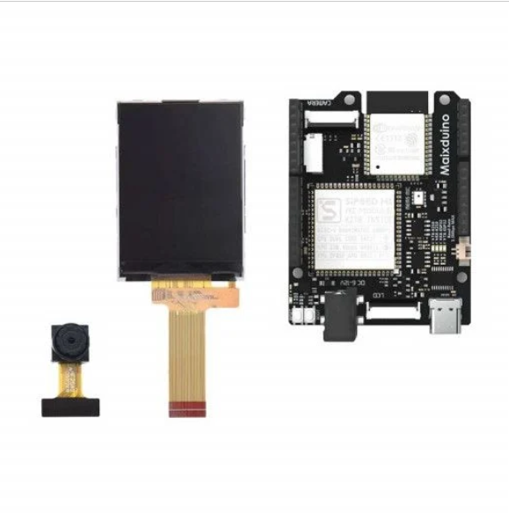
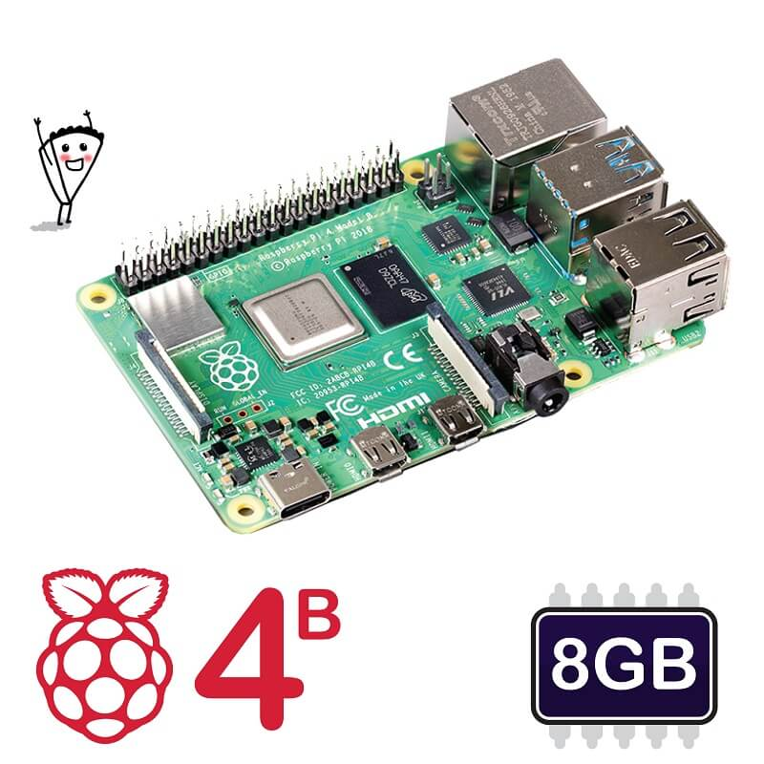
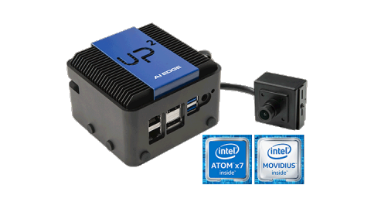
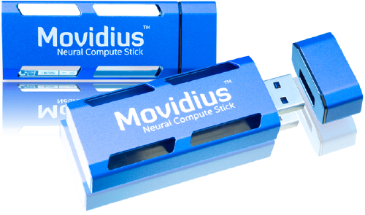
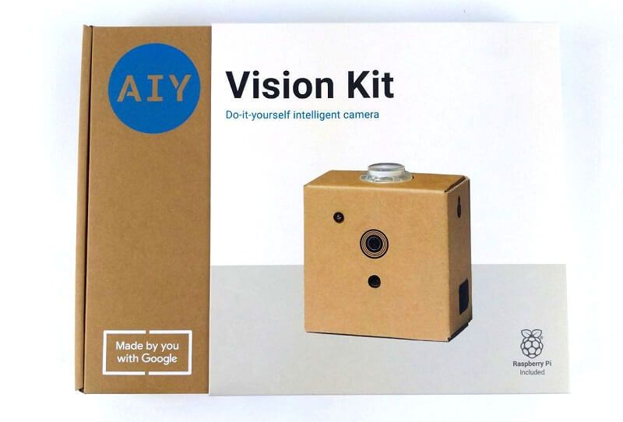
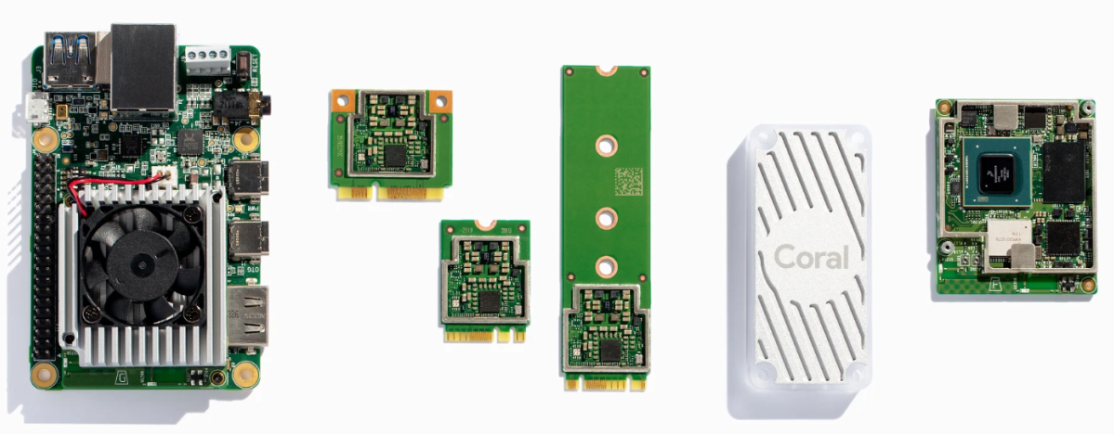

Slide 7
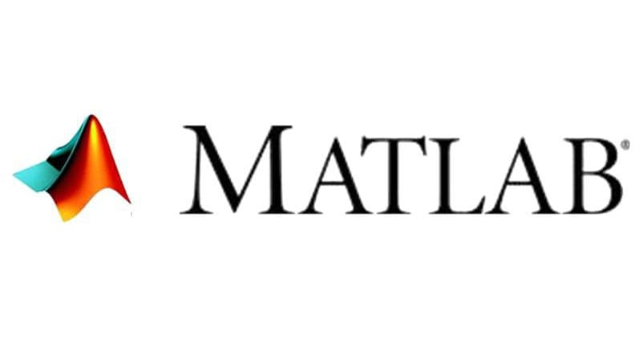

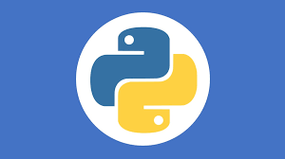

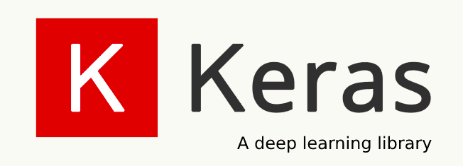
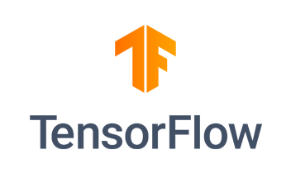
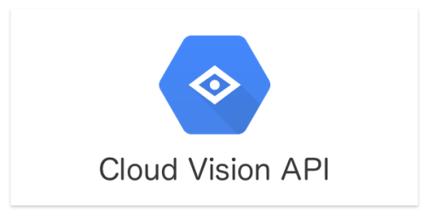

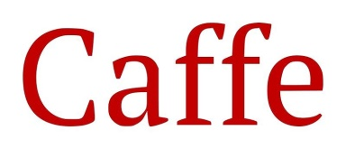
You may use……
Python
OpenCV
FaceNet
Keras
Tensorflow
Caffe
Matlab
Microsoft Azure
Google Cloud Vision API
Javascript
C#
Anaconda
Android Studio
Neural Networks (MTCNN, ABANN, DeepFace etc…… Too much)

Slide 8
How do you evaluate a good FDR System?
Reliability (Low error proning)
Higher evaluation score (Accuracy, speed and so on)
User-friendly (Easy to use and follow)
Features (Supporting firmware)
Cost (How expensive is it to build the system?)

Slide 9
How should I start?
It’s always better for you to start do image processing and understand the effects of the algorithms before implementing to the real-life cases.
Once you are familiar to build a reliable system, then you may build FDR systems across different platforms!

Slide 10
Where I can start practising?
Qwiklabs
Google Codelabs
Coursera
YouTube
Technical events! (Such as Google Developers, Google Meetups, online webinars and forums etc)
Of course, your interest on AI!

Slide 11
What I should take note?
Shifting between different platforms requires different style of writing the code (For example, importing images in Google Colab is !wget(web_address) while others might be image(web_address).
Syncing with cloud resources may be recommended if you are needed to build a database for training.

Slide 12
Steps-by Steps Tutorials
Detect Labels, Faces, and Landmarks in Images with the Cloud Vision API (https://www.qwiklabs.com/focuses/1841?parent=catalog)
Face Detection with the Mobile Vision API (https://codelabs.developers.google.com/codelabs/face-detection/index.html?index=..%2F..index#0)
Face_Detection Simple Tutorial (https://github.com/JasonKung98/Face_Recognition)

Slide 13
The end …… ☺

