Slide 1


生產力工具網站
第7組
梁錦生 01157057
陳光來 01157058

Slide 2
使用之技術
網站架構
網站作品動機
To help people enhance their personal productivity.
1
This website project could help them in task management and let them organize and prioritize their tasks, also let them schedule their events.
Give them an easy-to-use productivity tool website.
2
3
4
5

Slide 3
使用之技術
網站作品動機
網站架構
UI
Take user’s input
(add, mark, delete task/event)
Display the current data from database to website
2
1
Store or remove the task/event on database
3
4
5

Slide 4
使用之技術
網站作品動機
TâcheWave
Home
Today’s To-do List
Upcoming Event
Event Reminder
2
Focus Mode
To-do List
Display all of the events
1
Display all of the to-do lists
Timer
Add/remove event
3
Add/mark/remove task
4
5

Slide 5
網站架構
特色
網站作品動機
使用之技術
Front-end
HTML
CSS
Javascript
Back-end
Node.js
Express.js
Database
MongoDB
3
2
1
4
5

Slide 6
網站架構
網站作品動機
分工
使用之技術
特色
Task management: Add, mark, delete task
Persistence: The data will be stored on database so that the tasks/events won’t gone even if the user refresh or leave the page.
User can set the due dates of the task, and the website will display them sorted by dates.
Event reminder
Focus mode (Pomodoro timer to help the user more focus)
Daily motivation quote
Simple, clean, and user-friendly design
4
3
2
5
1

Slide 7
網站架構
特色
網站作品動機
使用之技術
分工
梁錦生：網站規劃，HTML，Javascript, back-end
陳光來：HTML, 網站設計(CSS)
5
4
3
2
1

Slide 8

Tâche: This word is of French origin and translates to "task" in English. It signifies an assigned piece of work, an activity, or a duty to be accomplished.
Wave: In a broader sense, "wave" could represent a movement or a sequence of oscillations traveling through a medium.
Combining these words, "TâcheWave" could convey the idea of a dynamic approach to managing tasks that involves movement, progression, or a wave-like flow in completing various activities. It could suggest an innovative or organized manner of tackling tasks—perhaps utilizing a wave-like pattern or approach in task management, emphasizing efficiency, continuity, or a structured workflow.

Slide 9
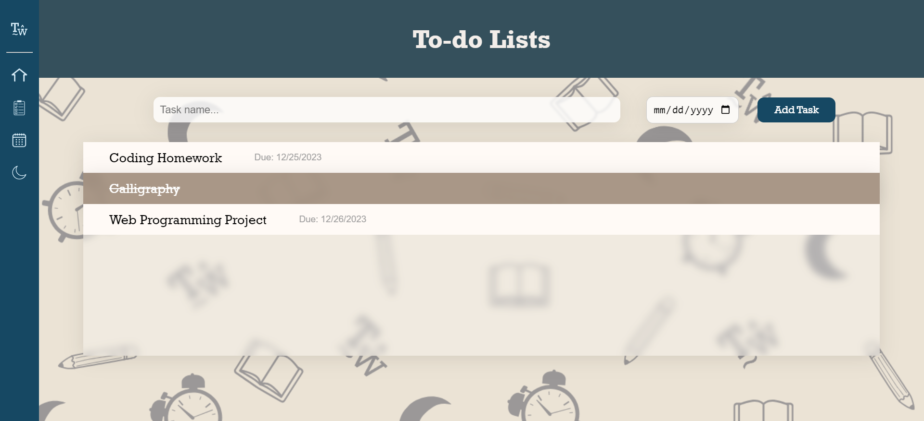
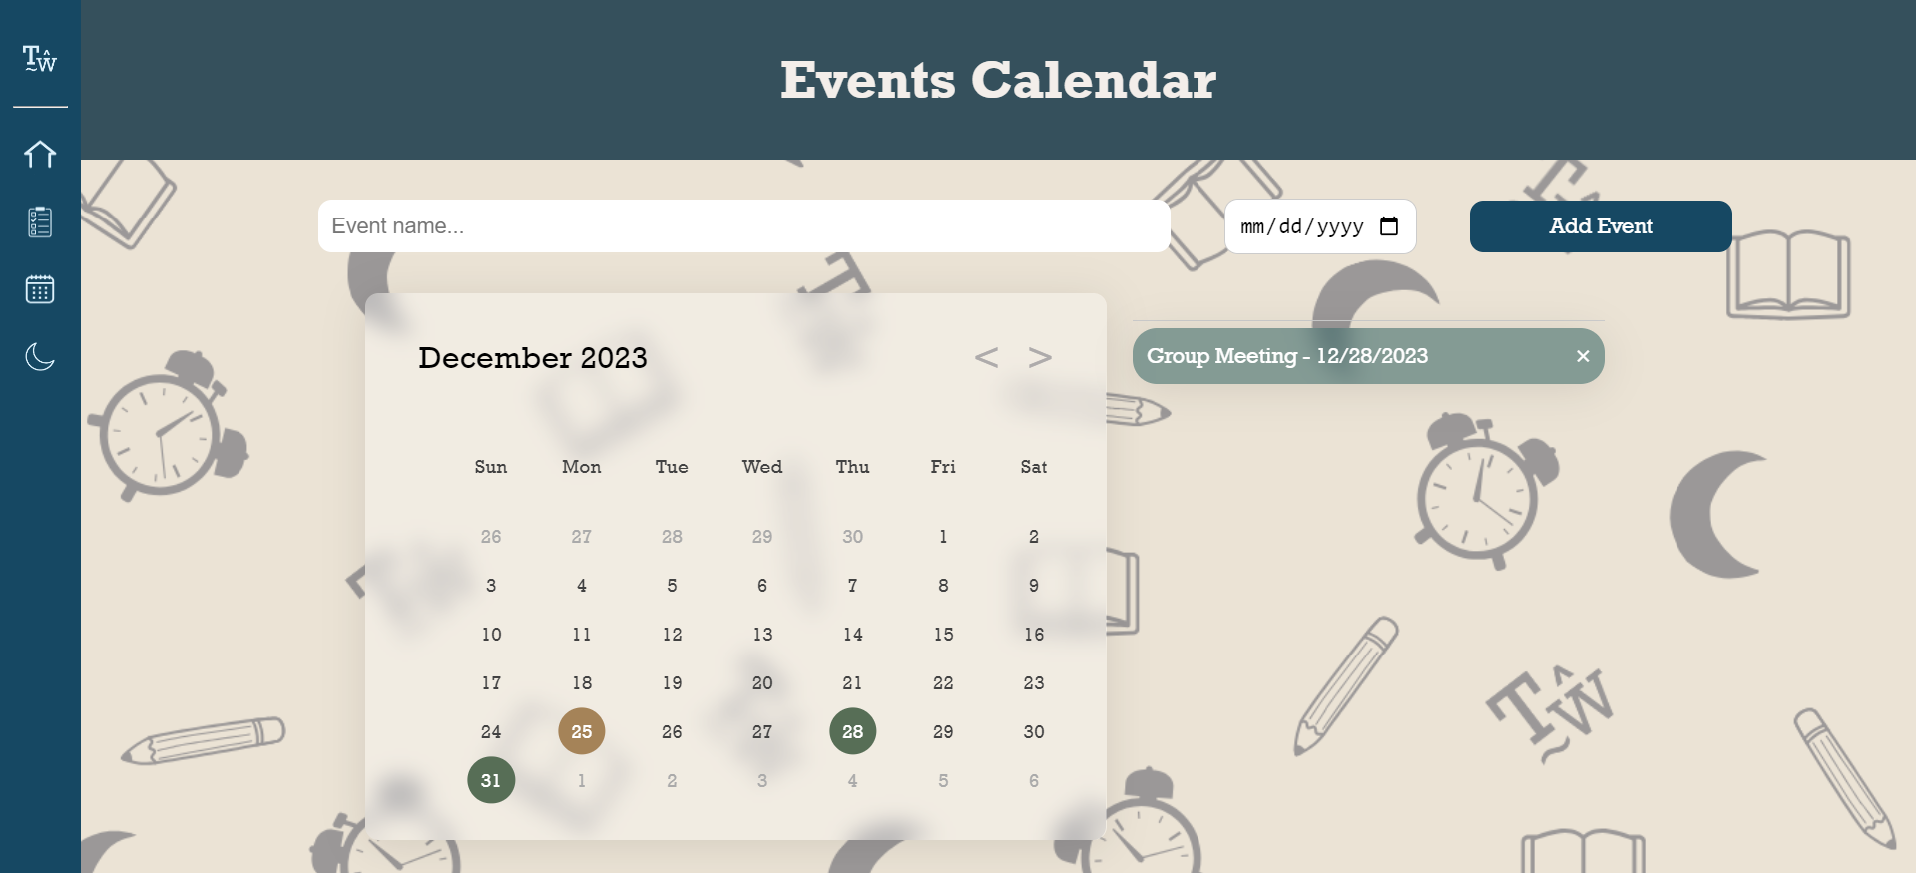
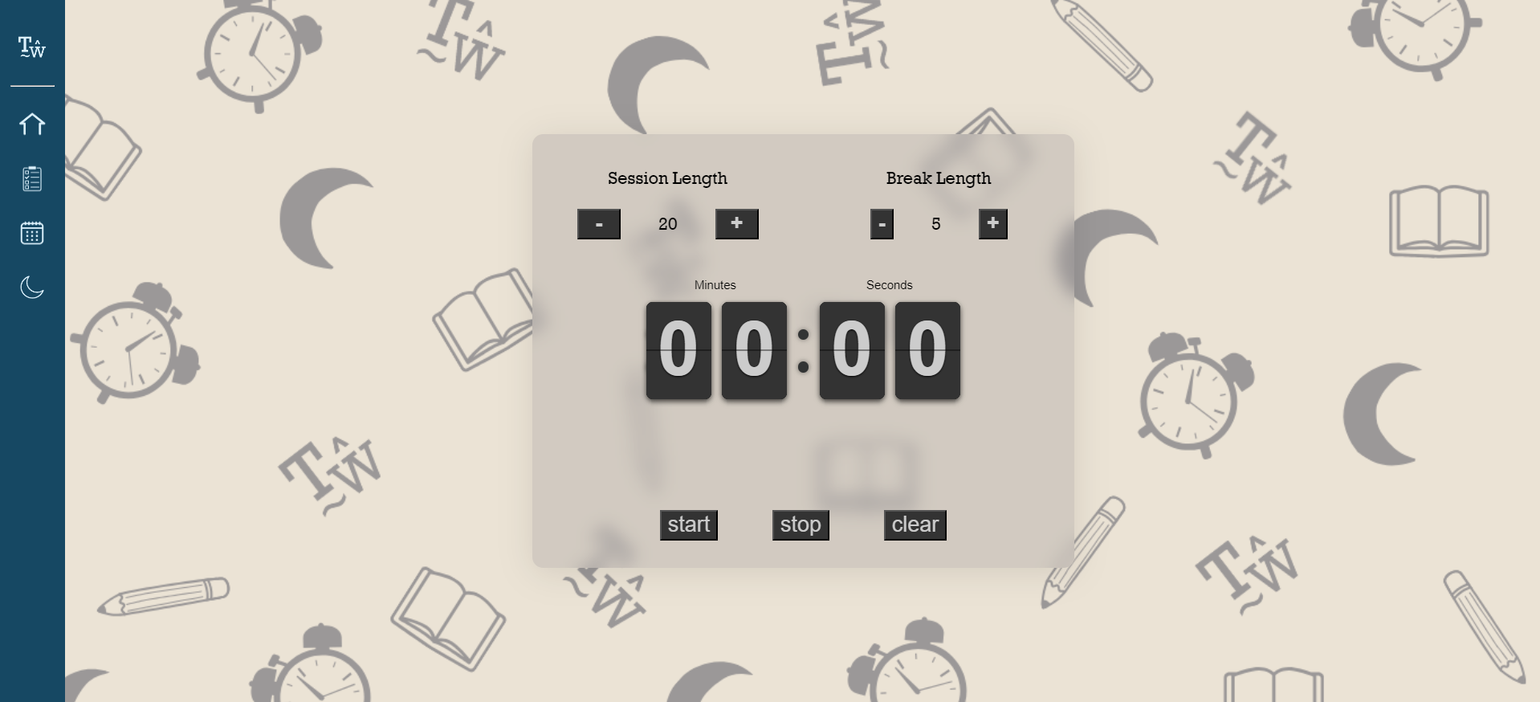

Overview

Slide 10
External Links
FlipClock
https://cdnjs.cloudflare.com/ajax/libs/flipclock/0.7.8/flipclock.css
https://cdnjs.cloudflare.com/ajax/libs/flipclock/0.7.8/flipclock.min.js
jQuery
https://cdnjs.cloudflare.com/ajax/libs/jquery/3.1.0/jquery.min.js

Slide 11
THANK YOU

