Slide 1


“Type-It”
Zach Kubitz, Jason Matuszak, and Joseph Tonecha

Slide 2
Overview
“Type-It” is a take on the popular game “Bop-It” with a couple twists
The game controls include:
“Type-It” where the user enters a given code on a keypad
“Twist-It” where the user twists a potentiometer
“Bop-It” where the user presses a push button

Slide 3
Components
The following parts will be needed for “Twist-It” implementation:
4 Button Keypad
Twist Potentiometer
Arcade Button
Power Switch
New Game Button
Speaker
ATmega328 Microcontroller
Power Indicator LED
9 V Battery Connector
PVC Enclosure
LCD Display
555 Timers

Slide 4
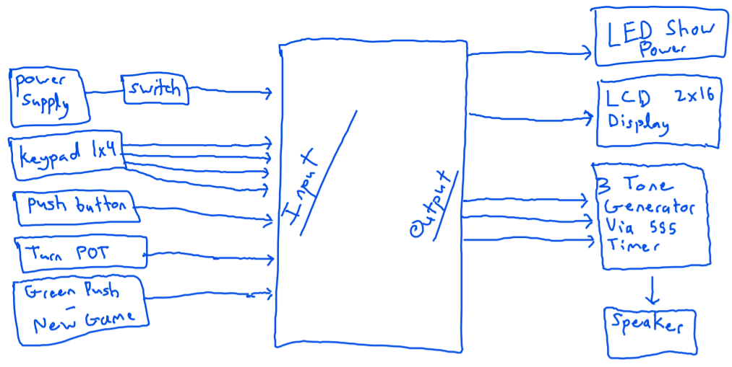
Block Diagram

