Slide 1


“Type-It”
Zach Kubitz, Jason Matuszak, and Joseph Tonecha

Slide 2
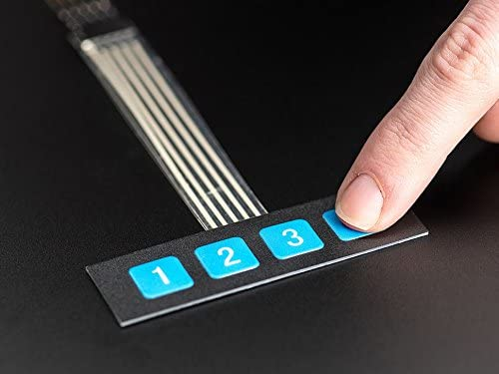
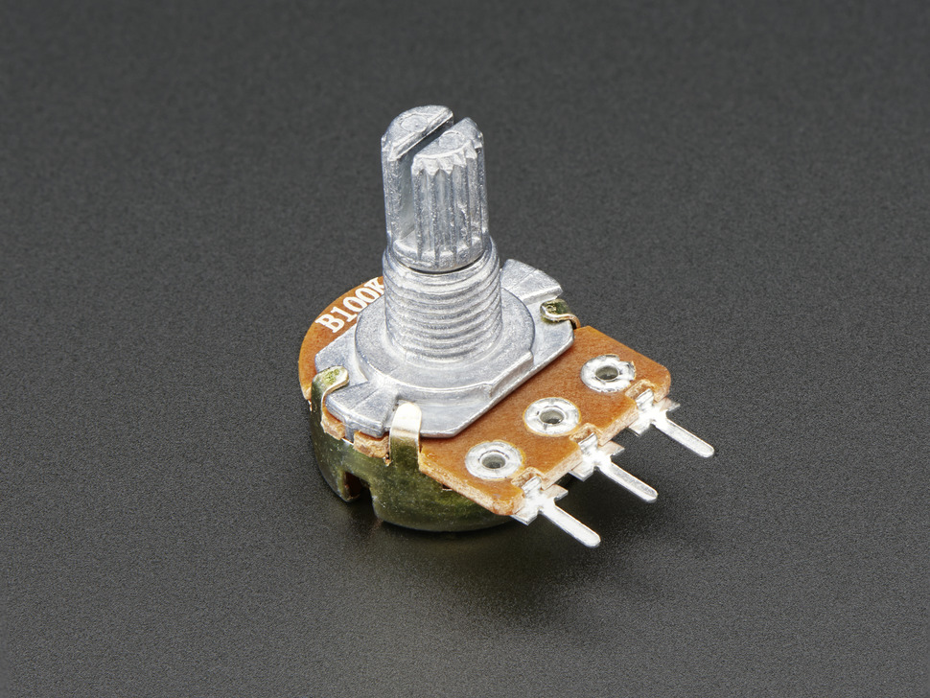
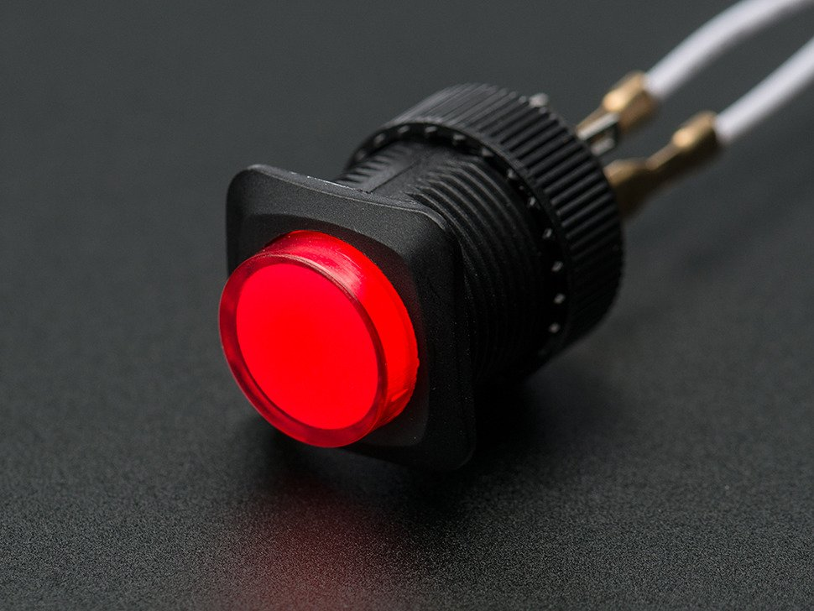
Overview
“Type-It” is a take on the popular game “Bop-It” with a couple twists
The game controls include:
“Type-It” where the user enters a given code on a keypad (3-digit code on a simple 1x4 keypad)
“Twist-It” where the user twists a potentiometer
“Push-It” where the user presses a push button

Slide 3
Components
The following parts will be needed for “Twist-It” implementation:
4 Button Keypad (Type-It)
Twist Potentiometer (Twist-It)
Arcade Button (Push-it)
Power Switch
New Game Button
Speaker
ATmega328 Microcontroller
Power Indicator LED
9 V Battery Connector
PVC Enclosure
LCD Display
555 Timers

Slide 4
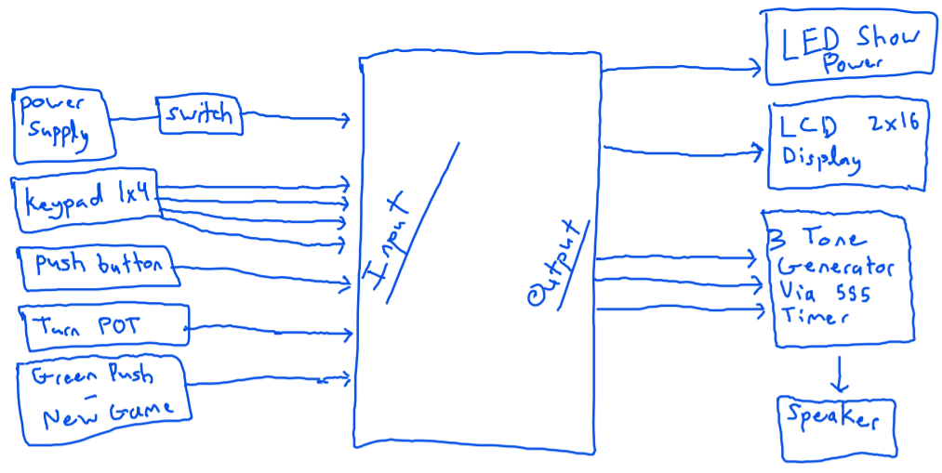
Rough circuit Block Diagram

Slide 5
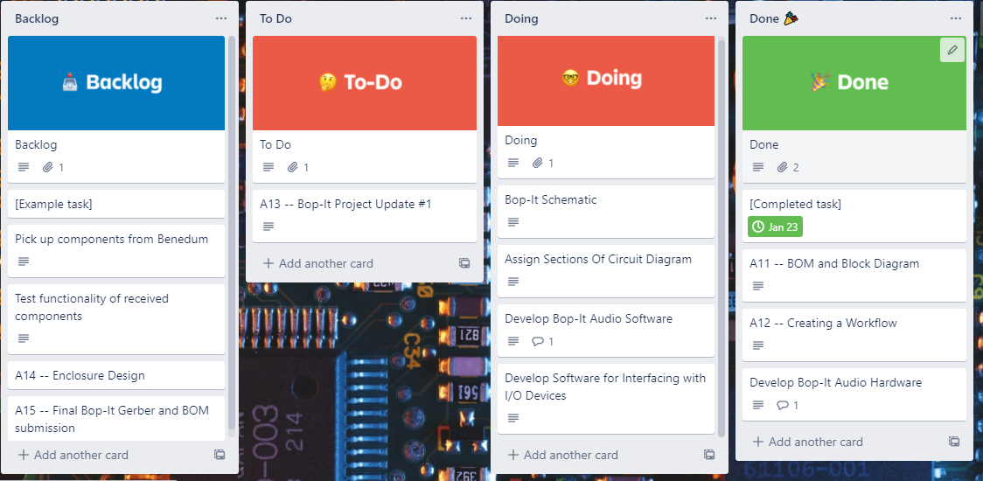
Current Kanban Board Progress

Slide 6
Moving Forward
Jason: Working on circuit diagram implementation in Altium
Zach: Working on software for interfacing with I/O devices
Joe: Working on 555 timer audio software

