Slide 1
Layers Types II
Lecture 5/10

Slide 2
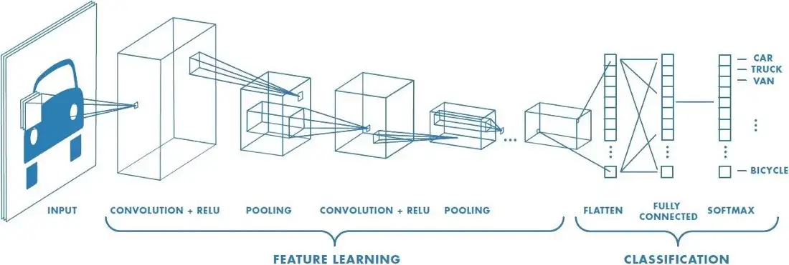
Convolutional layer
Image credit for this section: “A Comprehensive Guide to Convolutional Neural Networks“
https://towardsdatascience.com/a-comprehensive-guide-to-convolutional-neural-networks-the-eli5-way-3bd2b1164a53

Slide 3
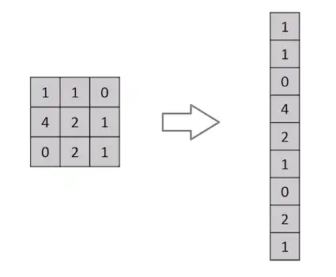
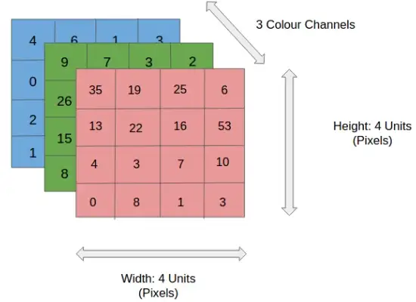
What is wrong with dense layers?

Slide 4
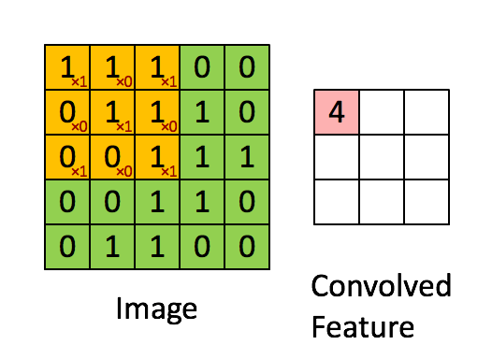
What is a convolution?
1 | 0 | 1
0 | 1 | 0
1 | 0 | 1
“Kernel”

Slide 5
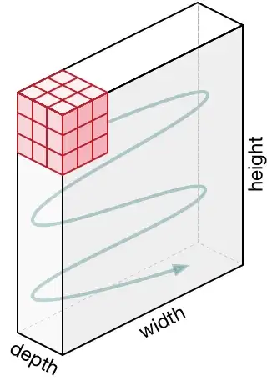
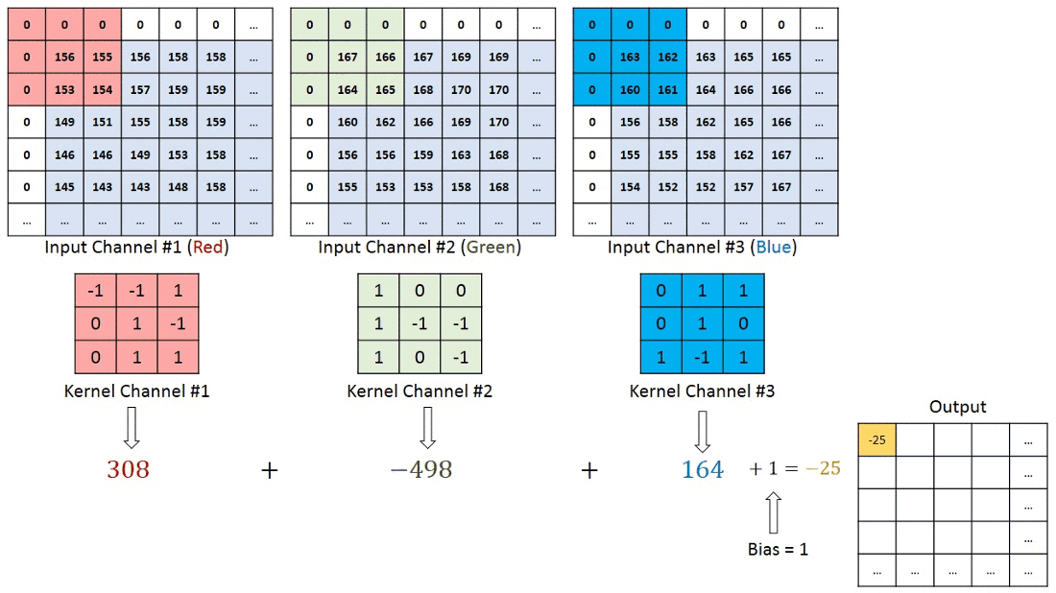
What if image is RGB?
Notes:
When you do a convolution from 3 input channels to 16 output channels, you have 16 filters, each filter has 3 channel-wise kernels (one per input channel).

Slide 6
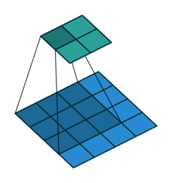
Plain Convolution
Animations credits for this section: https://github.com/vdumoulin/conv_arithmetic/blob/master/README.md
Notes:
Now that we understand the general principle of convolutions, let’s look at addons.
First, we see that the output is smaller than the input (unless the kernel is 1x1); can we try to have an output image that is the same size as the input image?

Slide 7
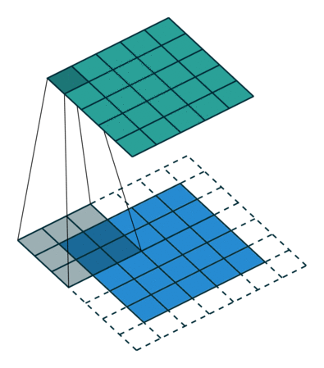
Padding
Padding
Notes:
Yes! By adding some padding. NB: we can add different type of padding: zeros; specific values; torus; reflection; edges…
This also enables us to better capture what is happening near the edges.
NB: this padding technique is not always used, as not much is happening on the edges, and we usually want to reduce the size of images.
Now, the images are usually very big, we would like to reduce their dimension, how can we do that?

Slide 8
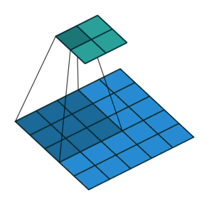
Striding
Striding
Notes:
Striding manages to reduce the dimension
Can we try to produce better kernels?

Slide 9
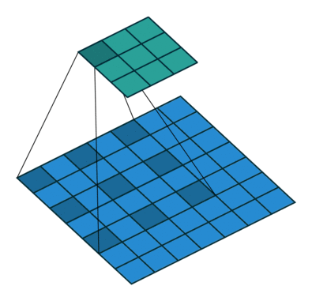
Dilation
1 | 0 | 1
0 | 1 | 0
1 | 0 | 1
Dilation
1 |  | 0 |  | 1
0 |  | 1 |  | 0
1 |  | 0 |  | 1
Notes:
Dilation enables us to have larger kernels without increasing the number of parameters.
NB: this dilation technique is not commonly used.

Slide 10
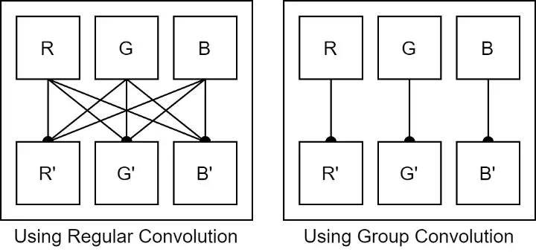
Group convolution
Notes:
Group Convolution enables us to have smaller kernels thus reducing the number of parameters.
NB: this grouping technique is not commonly used, as convolutions have few parameters (compared to dense, for example)

Slide 11

Convolution output formula: plain
Kernel: $ker_{i,j}$ ($k_{1}∗k_{2}$)
Input image: $in_{i,j}$ ($n∗m$)
$$out_{i,j}=\sum_{u=1}^{k_{1}}{\sum_{v=1}^{k_{2}}{\ker_{u,v} ∗{in_{i+u,j+v}}}}$$
$$1≤ i≤n−k_{1}+1$$
$$1≤j≤m−k_{2}+1$$

Slide 12

Convolution output formula: padding
Kernel: $ker_{i,j}$ ($k_{1}∗k_{2}$)
Input image: $in_{i,j}$ ($n∗m$)
Padding: $(p_{1},p_{2})$
$$out_{i,j}=\sum_{u=1}^{k_{1}}{\sum_{v=1}^{k_{2}}{\ker_{u,v} ∗{in_{i+u−p_{1},j+v−p_{2}}}}}$$
$$1≤ i≤n−k_{1}+2p_{1}+1$$
$$1≤j≤m−k_{2}+2p_{2}+1$$

Slide 13

Convolution output formula: striding
Kernel: $ker_{i,j}$ ($k_{1}∗k_{2}$)
Input image: $in_{i,j}$ ($n∗m$)
Padding: $(p_{1},p_{2})$
Striding: $(s_{1},s_{2})$
$$out_{i,j}=\sum_{u=1}^{k_{1}}{\sum_{v=1}^{k_{2}}{\ker_{u,v} ∗{in_{i∗s_{1}+u−p_{1},j∗s_{2}+v−p_{2}}}}}$$
$$1≤ i≤\left\lfloor \frac{n−k_{1}+2p_{1}}{s_{1}}\right\rfloor +1$$
$$1≤j≤\left\lfloor \frac{m−k_{2}+2p_{2}}{s_{2}}\right\rfloor +1$$

Slide 14
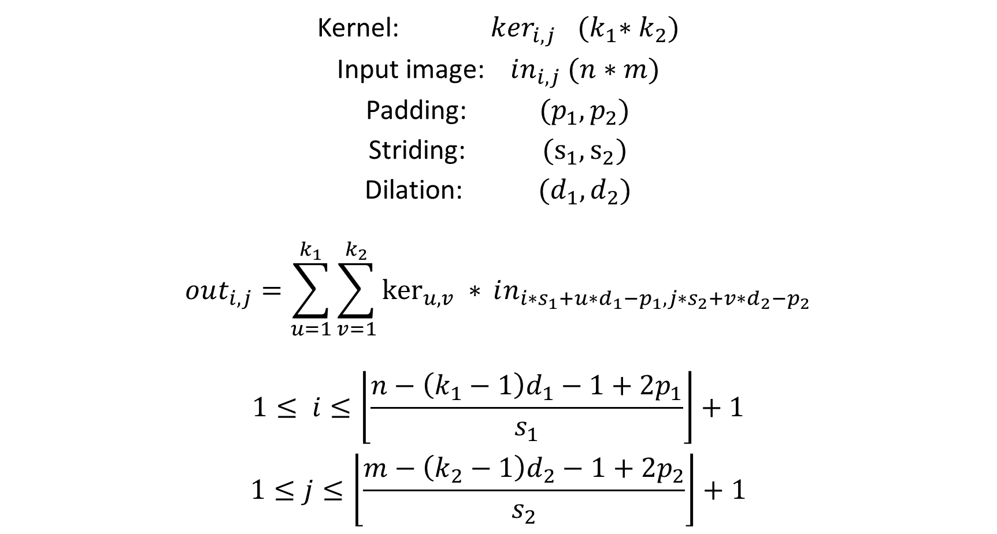
Convolution output formula: dilation
Kernel: $ker_{i,j}$ ${(k}_{1}∗k_{2})$
Input image: $in_{i,j}$ $(n∗m)$
Padding: $(p_{1},p_{2})$
Striding: $(s_{1},s_{2})$
Dilation: $(d_{1},d_{2})$
$$out_{i,j}=\sum_{u=1}^{k_{1}}{\sum_{v=1}^{k_{2}}{\ker_{u,v} ∗{in_{i∗s_{1}+u∗d_{1}−p_{1},j∗s_{2}+v∗d_{2}−p_{2}}}}}$$
$$1≤ i≤\left\lfloor \frac{n−\left(k_{1}−1\right)d_{1}−1+2p_{1}}{s_{1}}\right\rfloor +1$$
$$1≤j≤\left\lfloor \frac{m−\left(k_{2}−1\right)d_{2}−1+2p_{2}}{s_{2}}\right\rfloor +1$$

Slide 15
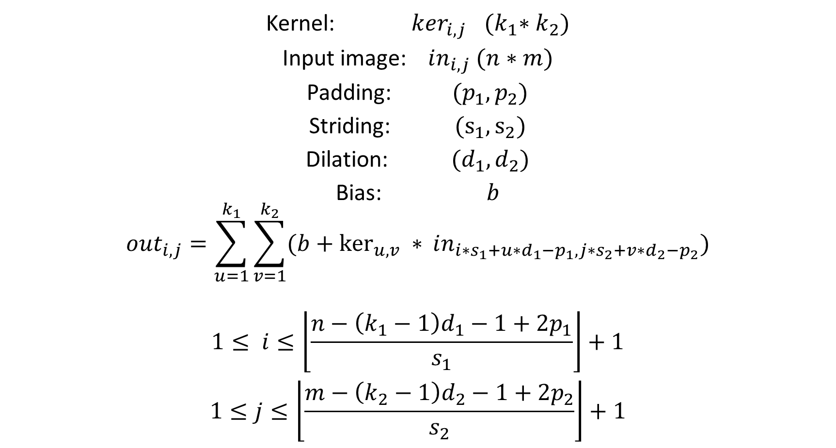
Convolution output formula: bias
Kernel: $ker_{i,j}$ ${(k}_{1}∗k_{2})$
Input image: $in_{i,j}$ $(n∗m)$
Padding: $(p_{1},p_{2})$
Striding: $(s_{1},s_{2})$
Dilation: $(d_{1},d_{2})$
Bias: $b$
$$out_{i,j}=\sum_{u=1}^{k_{1}}{\sum_{v=1}^{k_{2}}{(b+\ker_{u,v} ∗{in_{i∗s_{1}+u∗d_{1}−p_{1},j∗s_{2}+v∗d_{2}−p_{2}}})}}$$
$$1≤ i≤\left\lfloor \frac{n−\left(k_{1}−1\right)d_{1}−1+2p_{1}}{s_{1}}\right\rfloor +1$$
$$1≤j≤\left\lfloor \frac{m−\left(k_{2}−1\right)d_{2}−1+2p_{2}}{s_{2}}\right\rfloor +1$$

Slide 16
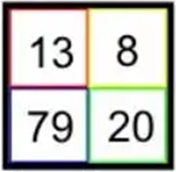
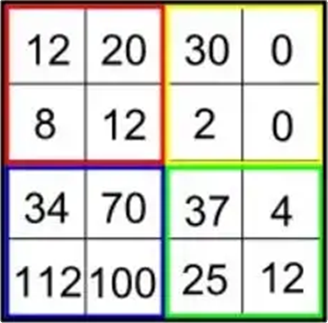
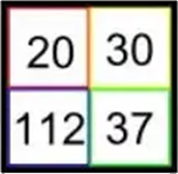
Pooling layer
Average pooling
Max pooling
Notes:
Another technique to reduce the images dimension is to add pooling layers: divide the images to rectangles, and either take the average value, or the maximum.
Note that max pooling is much more popular than the average.
In fact, average pooling is a convolution, with a uniform kernel, while max pooling introduces non-linearity.

Slide 17
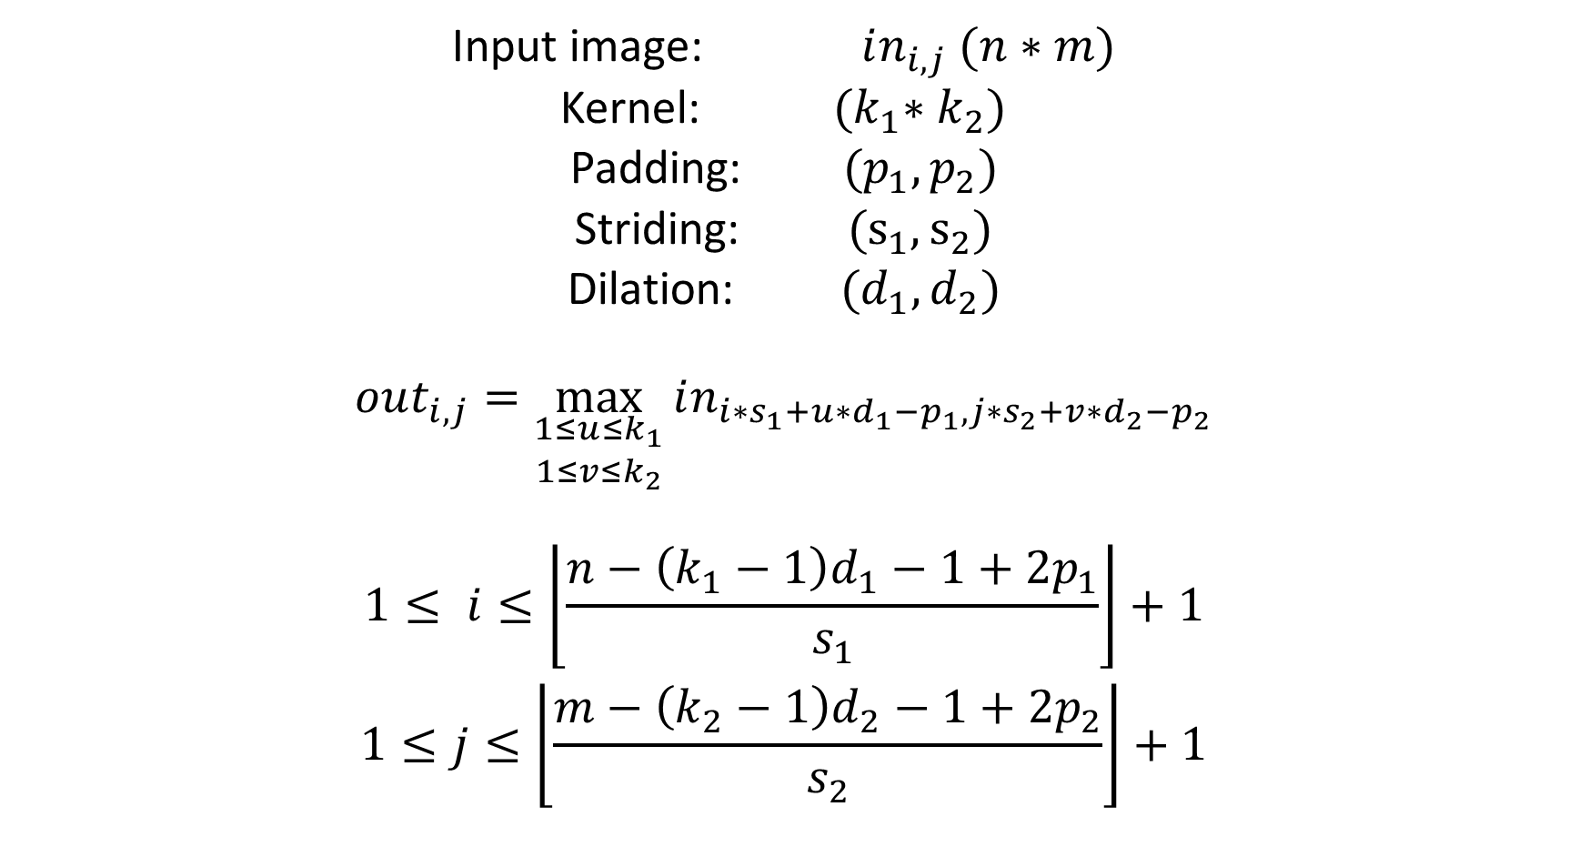
Max pooling output formula
Input image: $in_{i,j}$ $(n∗m)$
Kernel: ${(k}_{1}∗k_{2})$
Padding: $(p_{1},p_{2})$
Striding: $(s_{1},s_{2})$
Dilation: $(d_{1},d_{2})$
$$out_{i,j}=\max_{\begin{aligned}1≤u≤k_{1} \\ 1≤v≤k_{2}\end{aligned}}{in_{i∗s_{1}+u∗d_{1}−p_{1},j∗s_{2}+v∗d_{2}−p_{2}}}$$
$$1≤ i≤\left\lfloor \frac{n−\left(k_{1}−1\right)d_{1}−1+2p_{1}}{s_{1}}\right\rfloor +1$$
$$1≤j≤\left\lfloor \frac{m−\left(k_{2}−1\right)d_{2}−1+2p_{2}}{s_{2}}\right\rfloor +1$$

Slide 18
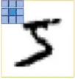

Comparison with dense
Convolution
Dense equivalent

Slide 19
SoftMax Layer
2
0.5
3.2
9.8
1.7
4.2
0.09345794
0.02336449
0.14953271
0.45794393
0.07943925
0.19626168
Normalize
(divide by the norm)

Slide 20
SoftMax Layer
-2
0.5
3.2
9.8
1.7
4.2
-0.11494253
0.02873563
0.18390805
0.56321839
0.09770115
0.24137931
Normalize
(divide by the norm)

Slide 21
SoftMax Layer
-2
0.5
3.2
9.8
1.7
4.2
0.135335283
1.64872127
24.5325302
18033.7449
5.47394739
66.6863310
0.0000746380034
0.0000909277026
0.00135297982
0.994568958
0.000301890604
0.00367778046
Take Exponential
Normalize

Slide 22
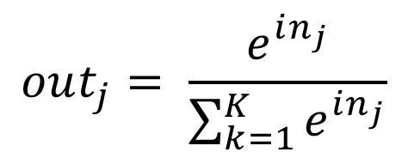
SoftMax Layer
-2
0.5
3.2
9.8
1.7
4.2
0.0000746380034
0.0000909277026
0.00135297982
0.994568958
0.000301890604
0.00367778046
Take SoftMax
(take exponential, then
divide by the norm)
$$out_{j}= \frac{e^{in_{j}}}{\sum_{k=1}^{K}{e^{in_{j}}}}$$

Slide 23

Data

Slide 24
Data Augmentation: Images
Flip horizontal / vertical
Rotate
Rescale
Crop
Dilate/shrink
Add white noise
Add salt/pepper noise
Add white/black boxes
+ anything that you can think of!

Slide 25
Data Augmentation: Audio
Add white noise
Shifting tone
Vary speed
Filter frequencies (drop/add low/high frequencies)

Slide 26
Data Augmentation: Text
Synonym substitute
Random insertion

Slide 27
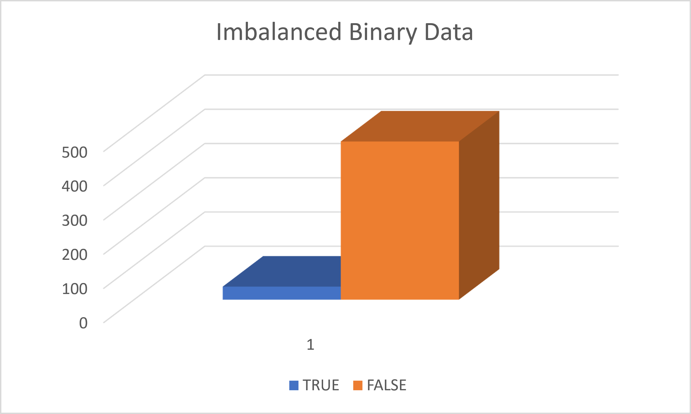
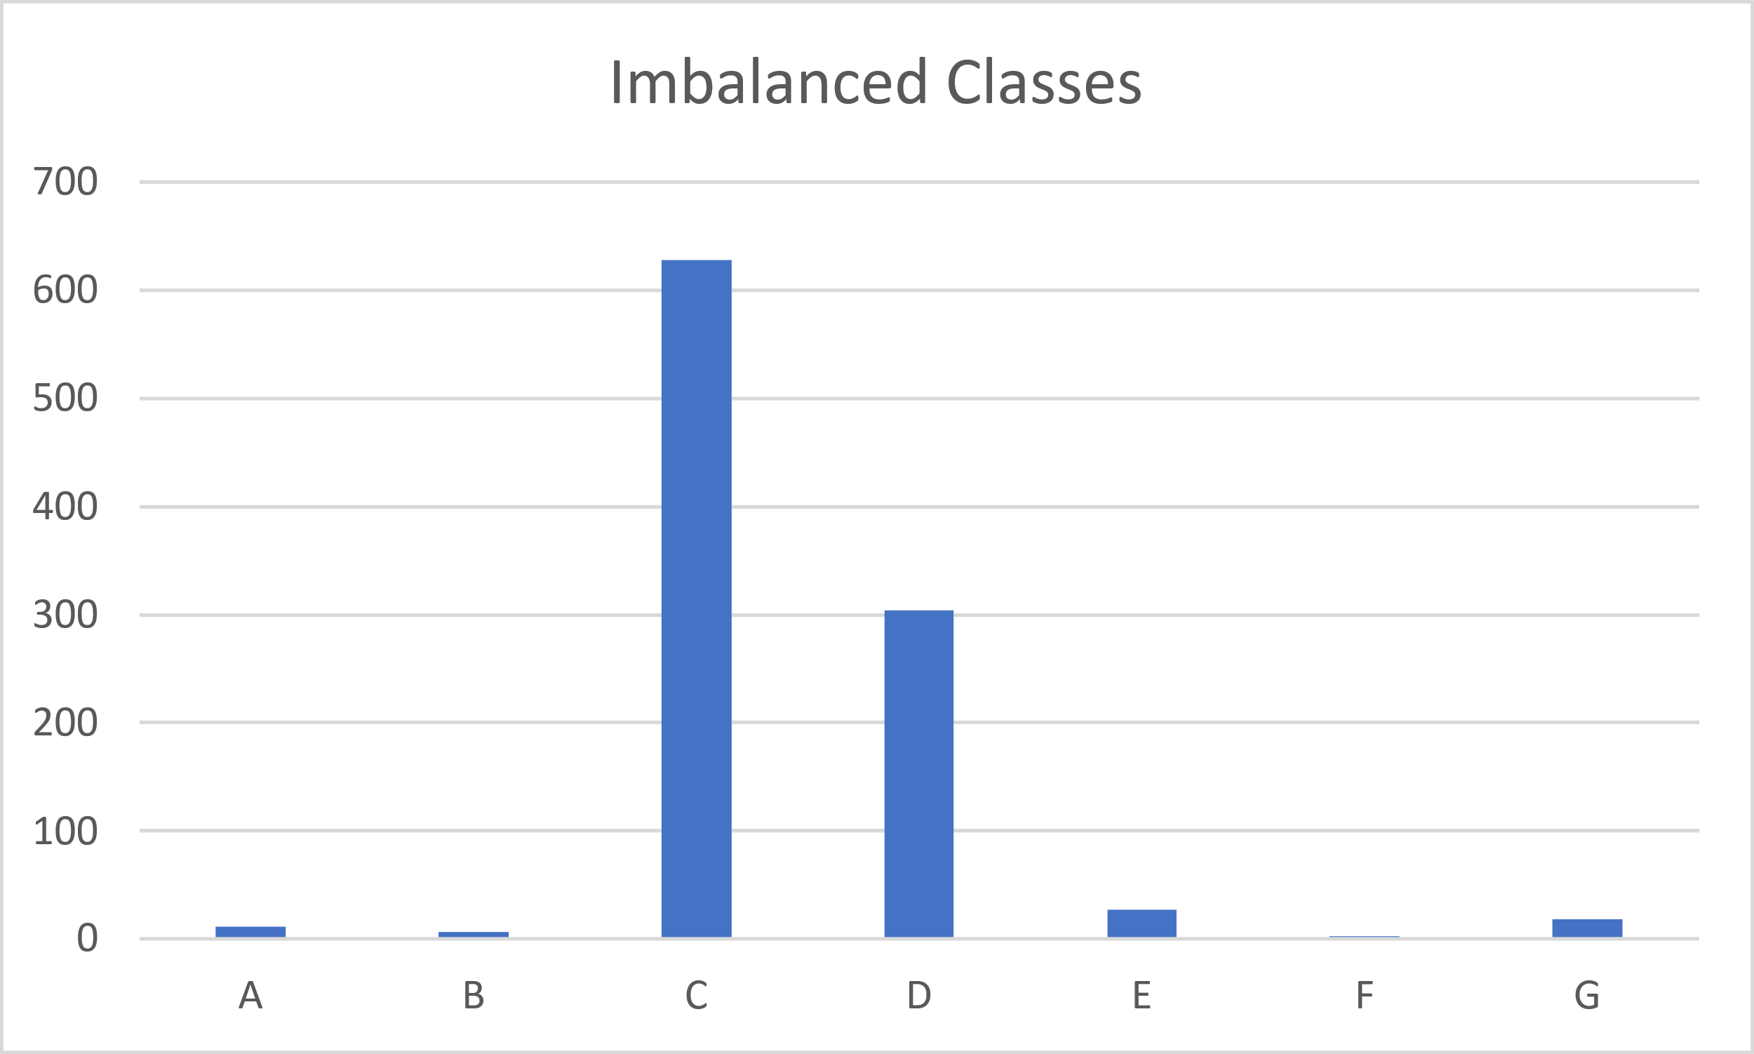
Imbalanced Data: Definition
Binary
Non-Binary

Slide 28
Imbalanced Data: Binary Metrics
Precision: Number of true positive predictions divided by the sum of true positive and false positive predictions.
Recall (or Sensitivity): Number of true positive predictions divided by the sum of true positive predictions and false negative predictions.
F1 Score: Harmonic mean of precision and recall.
ROC (Receiver Operating Characteristic): ROC curve plots the true positive rate (TPR) against the false positive rate (FPR).
AUC-ROC (Area Under the ROC Curve): AUC-ROC summarizes the ROC curve as a single metric by computing the area under the curve.
G-mean: Geometric mean of the recall for the positive class and the recall for the negative class.
Notes:
Harmonic Mean: H = n/(1/x_1 + 1/x_2 + 1/x_3 + … + 1/x_n)

Slide 29
Imbalanced Data: Compensation Techniques
Data-level:
Over sampling / Under sampling
Synthetic data generation
Algorithm-level
Cost-sensitive learning / Class weight adjustment

