Slide 1

高级计算机体系结构
陈文智
浙江大学计算机学院
chenwz@zju.edu.cn

Slide 2
1.1 计算机技术发展综述（1）
1946年: 在二次世界大战期间研制成功的世界上第一台电子计算机ENIAC (Electronic Numerical Intergrator and Calculator)正式对外宣布。
用途：军用；
体积：100英尺长×8.5英尺高×n英尺宽； 组成：18000真空管；
指令数：不足10条，加法，数据传输与转移
60多年来，计算机技术有了惊人的发展
性能：（加法）速度提高了>5个数量级
价格：今天$500的机器相当于80年代中$107的机器，这里同性能计算机的价格比，改善了近5个数量级。

Slide 3
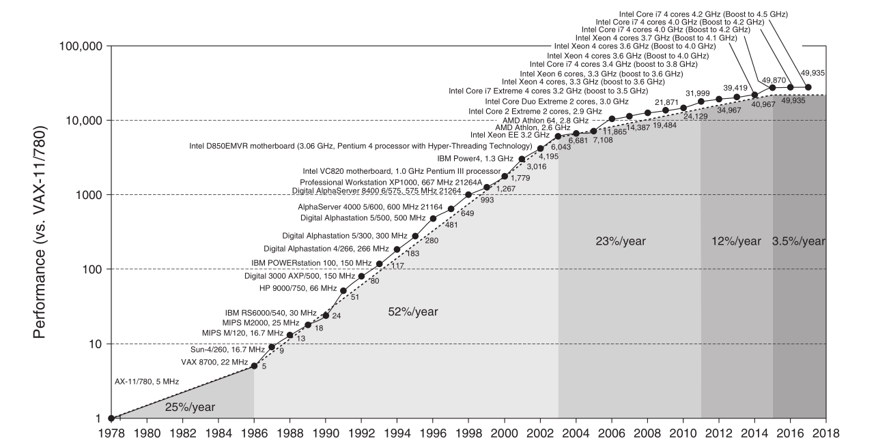
Incredible performance improvement

Slide 4
1.1 计算机技术发展综述（2）
计算机技术快速发展进步的原因之一
技术进步：集成电路技术的进步，还有存储器（包括内外存）和各类外设的进步。
稳定快速发展，即按Moore定律发展，即微处理器性能（按芯片上晶体管数定义）每18个月翻一番，即每年提高58%。
计算机技术快速发展进步的原因之二
计算机设计创新：即计算机体系结构的不断创新。
经历了由简单→复杂→极其复杂→简单→复杂→极其复杂的经历
有时快，有时慢(1977年的VAX/780为１MIPS机器，1985年VAS/785仅为1.5 MIPS，几乎停止不前。
有很多技术，经不起时间考验，已退出历史舞台。

Slide 5
计算机技术发展综述(3)
今天计算机体系结构的研究内容
进一步提高单个微处理器的性能。(光速极限问题)
基于微处理器的多处理器体系结构。
全面提高计算机的系统性能：可用性，可维护性，可缩放性。
新型器件的处理器：如光计算机；新原理的计算机（生物，分子，又提出了DNA计算机)。

Slide 6
计算机体系结构定义
定义：
计算机体系结构包括指令集设计，计算机组成设计与硬件（硬件与逻辑设计）实现。
体系结构不同的例子：
指令集相同，组成不同：
VAX11/780-- SPARC2;
VAX8600--SPARC20;
指令集相同，组成也相同，实现不同： VAX11/780--VAX11/785（IC工艺不同）；
不同型号的Indy(时钟和Cache不同）

Slide 7
1.3 计算机系统结构的分类
一、当前计算机的种类
1989IEEE电气与电子工程师委员会提出的计算机分类：
．个人计算机 Personal Computer (PC)
．工作站 WorkStation (WS)
．小型机 Mini Computer
．中型机 Mainframe
．小巨型机 Minisupercomputer
．巨型机 Supercomputer
*服务器
*桌面计算
*嵌入式系统
*网络并行计算机(Cluster、Grid Computer)
*云计算、智慧地球
界线模糊

Slide 8
二、Flynn分类法
根据指令流和数据流的多倍性对计算机系统结构进行分类，
基本思想：计算机工作过程是指令流的执行和数据流的处理。
指令流：机器执行的指令序列
数据流：由指令流调用的数据序列（包括输入数 据和中间结果）
多倍性：在系统性能的瓶颈部件上处于同一执行 阶段的指令或数据的最大个数。

Slide 9
二、Flynn分类法
单指令流-单数据流（SISD）
传统的顺序计算机，冯·诺依曼架构
单指令流-多数据流（SIMD）
单控制器、多处理单元对多组数据进行处理，超级计算机
多指令流-单数据流（MISD）
多个处理器对同一个数据进行处理，脉动阵列计算机
多指令流-多数据流（MIMD）
多机系统，一般的并行计算机等

Slide 10
1.4 Measuring Suits
Real applications
i.e. C compilers, TeX and Spice.
Modified (or scripted) applications
To enhance portability or to focus on one particular aspect of system performance.
Kernels
Small key pieces (usually small) of real programs. i.e. Livermore Loops and Linpack.
Used to isolate performance of individual features and help explain behavior of real programs.

Slide 11
1.4 Measuring Suits
Toy benchmarks
Small programs (10-100) lines that produce a known result. i.e. QuickSort Sieve of Eratosthenes,Puzzle,
Synthetic benchmarks
synthetic benchmarks try to match the average frequency of operations and operands of a large set of programs. i.e. Whetstone and Dhrystone.
Similar to kernels but are NOT real programs !

Slide 12
1.5 Quantitative Principles
1. Make the Common Case Fast
If a design trade-off is necessary, favor the frequent case (which is often simpler) over the infrequent case.
Perhaps it is the most important and pervasive principle of computer design.
For example, given that overflow in addition is infrequent, favor optimizing the case when no overflow occurs.
Simple is fast! Small is fast!

Slide 13
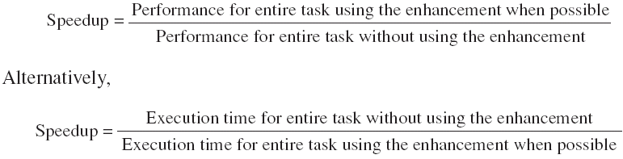
1.5 Quantitative Principles
2. Amdahl’s Law
The performance improvement to be gained from using some faster mode of execution is limited by the fraction of the time the faster mode can be used.
Amdahl's law defines the speedup obtained by using a particular feature:

Slide 14

Fraction _{enhanced} Always <= 1.
The fraction of the computation time in the original machine that can be converted to take advantage of the enhancement
Speedup _{enhanced}
The improvement gained by the enhanced execution mode; that is, how much faster the task would run if the enhanced mode were used for the entire program

Slide 15
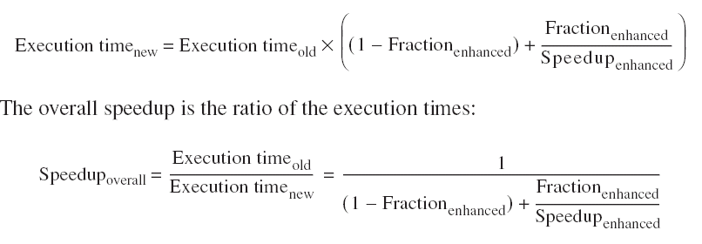

Slide 16

1.5 Quantitative Principles
3. The CPU Performance Equation

Slide 17


CPI

Slide 18
CPU performance is dependent upon three characteristics:
clock cycle (or rate)
clock cycles per instruction
and instruction count.
It is difficult to change one parameter in complete isolation from others
Because the basic technologies involved in changing each characteristic are interdependent:

Slide 19
Clock cycle time—Hardware technology and organization
CPI—Organization and instruction set architecture
Instruction count—Instruction set architecture and compiler technology

Slide 20


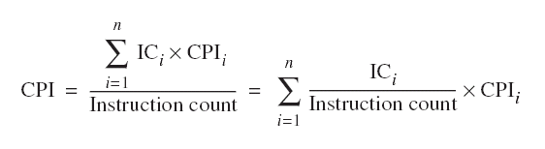

Slide 21
1.5 Quantitative Principles
4. Principle of Locality
Programs tend to reuse data and instructions they have used recently.
a program spends 90% of its execution time in only 10% of the code.
Temporal locality
states that recently accessed items are likely to be accessed in the near future.
Spatial locality
says that items whose addresses are near one another tend to be referenced close together in time.

Slide 22
5. Take Advantage of Parallelism
Taking advantage of parallelism is one of the most important methods for improving performance.

Slide 23
指令级并行技术
陈文智
浙江大学计算机学院
chenwz@zju.edu.cn

Slide 24
本次课内容提要
3.1 流水线技术基础
流水线技术就是指令重叠执行技术，达到加快运算速度的目的
3.2 How Is Pipelining Implemented?
3.3 The Major Hurdle of Pipelining—Pipeline Hazards
由于存在三种流水线竞争：结构竞争、数据竞争、控制竞争，导致流水线性能降低，不能运作在理想的重叠状态，需要插入停顿周期，从而使流水线性能降低。
3.4 Extending the MIPS Pipeline to Handle Multicycle Operations

Slide 25
下次课内容提要
3.5 Instruction-Level Parallelism: Concepts and Challenges
指令之间可重叠执行性称为指令级并行性（Instruction Parallelism-ILP)。因此进一步研究和开发指令之间的并行性，等于拓宽指令重叠执行的可能性，从而能进一步提高流水线的性能。（CPI=1）
3.6 Overcoming Data Hazards with Dynamic Scheduling
针对流水线数据竞争的动态调度
3.7 Reducing Branch Costs with Dynamic Hardware Prediction
针对流水线控制竞争的预测技术
3.8 Hardware-Based Speculation
进一步开发指令级并行性的动态技术
跨控制流的动态调度:数据竞争+控制竞争
3.9 Taking Advantage of More ILP with Multiple Issue
进一步开发指令级并行性(CPI<1)
采用单位时钟发射多条指令

Slide 26
3.1流水线技术基础
本科回顾------- Appendix A.1
3.1.1 What is pipelining?
3.1.2 Why pipelining ?
3.1.3 Ideal Performance for Pipelining

Slide 27
3.1.1 What is pipelining?
Pipelining:
“A technique designed into some computers to increase speed by starting the execution of one instruction before completing the previous one.”
----Modern English-Chinese Dictionary
implementation technique whereby different instructions are overlapped in execution at the same time.
implementation technique to make fast CPUs

Slide 28
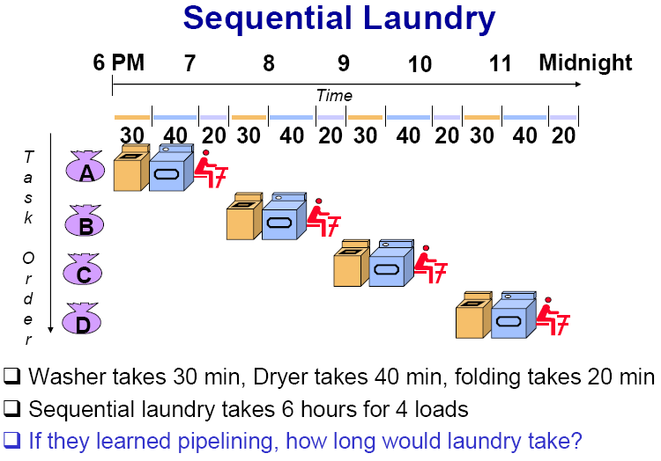
3.1.1 What is pipelining?

Slide 29
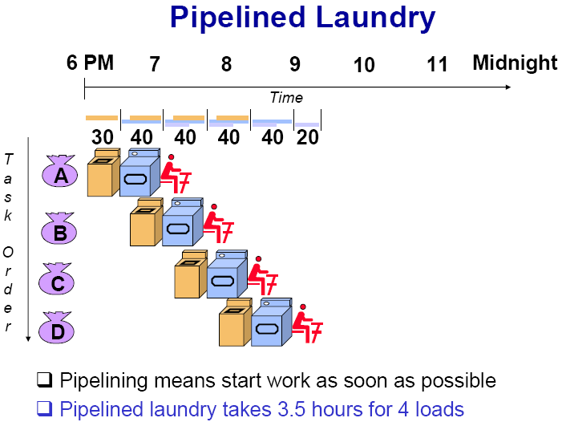
3.1.1 What is pipelining?

Slide 30
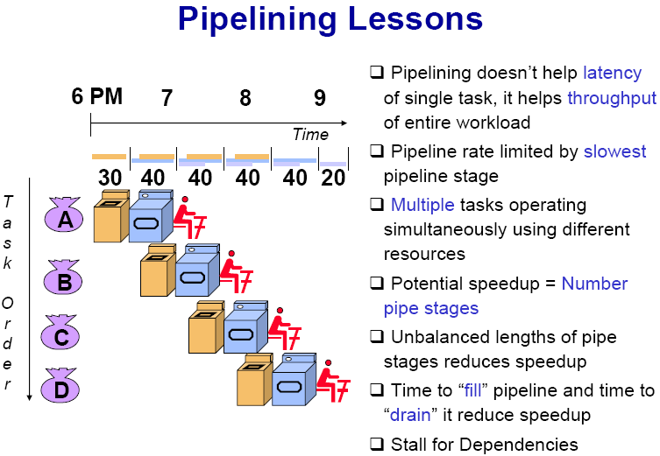
3.1.1 What is pipelining?

Slide 31
3.1.1 What is pipelining?
A pipeline is like an auto assemble line
A pipeline has many stages
Each stage carries out a different part of instruction or operation
The stages, which cooperates at a synchronized clock, are connected to form a pipe
An instruction or operation enters through one end and progresses through the stages and exit through the other end
Pipelining is an implementation technique that exploits parallelism among the instructions in a sequential instruction stream

Slide 32
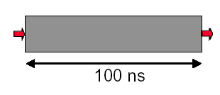
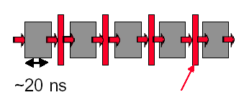
3.1.2 Why pipelining : save time and high utilization factor
Only deal one task each time.
This task takes
“ such a long time”
Latches, called pipeline registers’ break up computation into 5 stages
Deal 5 tasks at the same time.

Slide 33
Why pipelining: How much faster
Can “launch” a new computation every 100ns in this structure
Can finish 10⁷ computations per second
Can launch a new computation every 20ns in pipelined structure
Can finish 5×10⁷ computations per second

Slide 34
Conclusion
The key implementation technique used to Make fast CPU: decrease CPUtime.
Improving of Throughput ( rather than individual execution time)
Improving of efficiency for resources (functional unit)

Slide 35
3.1.3 Ideal Performance for Pipelining
If the stages are perfectly balanced, The time per instruction on the pipelined processor equal to:
Time per instruction on unpipelined machine
Number of pipe stages
So, Ideal speedup equal to
Number of pipe stages.

Slide 36
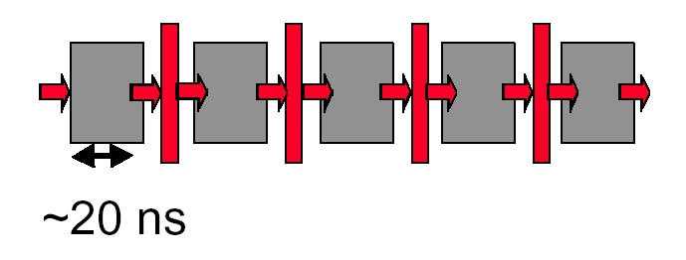
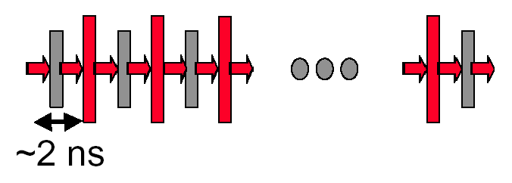
Why not just make a 50-stage pipeline ?
Some computations just won’t divide into any finer (shorter in time) logical implementation.
5 stages OK
50 stages NO. Sorry!

Slide 37
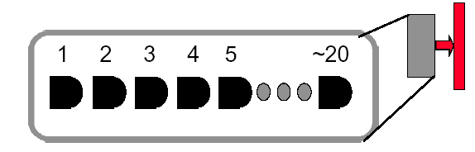
Why not just make a 50-stage pipeline ?
Those latches are NOT free, they take up area, and there is a real delay to go THRU the latch itself.
Machine cycle > latch latency + clock skew
In modern, deep pipeline (10-20 stages), this is a real effect
Typically see logic “depths” in one pipe stage of 10-20 “gates”.
At these speeds, and with this few levels of logic, latch delay is important

Slide 38
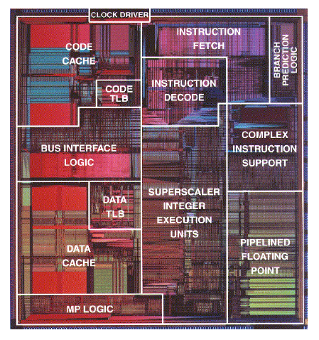
How Many Pipeline Stages?
E.g., Intel
Pentium III, Pentium 4: 20+ stages
More than 20 instructions in flight
High clock frequency (>1GHz)
High IPC
Too many stages:
Lots of complications
Should take care of possible dependencies among in-flight instructions
Control logic is huge

Slide 39
3.2 How Is Pipelining Implemented?
本科回顾------- Appendix A.3
3.2.1 How does instruction Work in the MIPS 5 stage pipeline?
3.2.2 5-stage Version of MIPS Datapath
3.2.3 The MIPS pipelining and some Problems

Slide 40
3.2.1 MIPS 5 stage pipeline (1)
The first two stages of MIPS pipeline
IF (Instruction fetch cycle)
IR←Mem[PC];
NPC ←PC=PC+4;
ID (Instruction decode/register fetch cycle)
A ←Regs[rs];
B ←Regs[rt];
Imm ←sign-extended immediate field of IR;
Note: The first two stages of MIPS pipeline do the same functions for all kinds of instructions.

Slide 41
MIPS 5 stage pipeline (2)
EX (Execution/effective address cycle)
Memory reference:
ALUoutput ←A+Imm
Register-Register ALU instruction:
ALUoutput ←A func B;
Register-Immediate ALU instruction:
ALUoutput ←A op Imm;
Branch:
ALUoutput ←NPC+(Imm <<2 );
Cond ←(A==0)

Slide 42
MIPS 5 stage pipeline (2)
MEM(Memory acces/branch completion cycle)
Memory reference:
LMD ←Mem[ALUoutput] or
Mem[ALUoutput] ←B
Branch:
If (cond) PC ←ALUoutput
WB (Write back cycle)
Register-Register ALU instruction
Regs[rd] ← ALUoutput;
Register-Immediate ALU instruction
Regs[rt] ←ALUoutput;
Load Instruction:
Regs[rt] ←LMD;

Slide 43
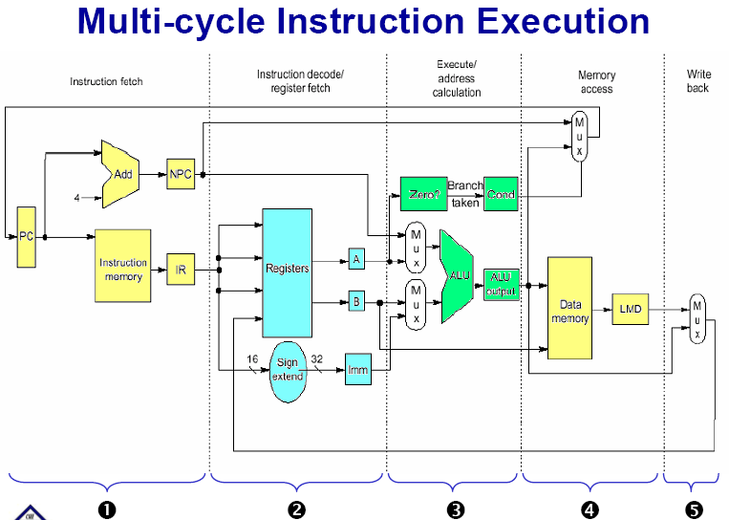
3.2.2 5-stage Version of MIPS Datapath

Slide 44
3.2.3 The MIPS pipelining

Slide 45
Problems that pipelining introduces
一、There is conflict about the memory !
Time (clock cycles)
I
n
s
t
r.
O
r
d
e
r
Ld/St
Mem
Reg
ALU
Mem
Reg
Instr 1
Mem
Reg
ALU
Mem
Reg
Instr 2
Mem
Reg
ALU
Mem
Reg
Instr 3
Mem
Reg
ALU
Mem
Reg

Slide 46
Separate instruction and data memories
use split instruction and data cache
the memory system must deliver 5 times the bandwidth over the unpipelined version.
Time (clock cycles)
I
n
s
t
r.
O
r
d
e
r
Ld/St
IM
Reg
ALU
DM
Reg
Instr 1
IM
Reg
ALU
DM
Reg
Instr 2
IM
Reg
ALU
DM
Reg
Instr 3
IM
Reg
ALU
DM
Reg

Slide 47
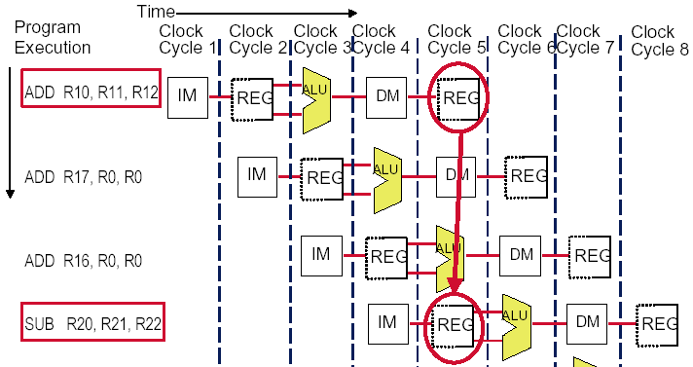
The conflict about the registers !

Slide 48
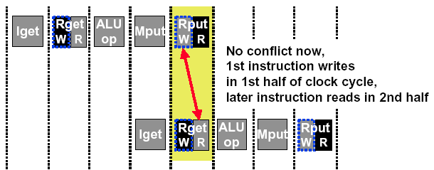
Sometimes we can redesign the resource
Allow WRITE-then-READ in one clock cycle (double pump)
Two reads and one write required per clock.
Need to provide two read port and one write port.

Slide 49
3.3 The Major Hurdle of Pipelining—Pipeline Hazards
本科回顾------- Appendix A.2
3.3.1 Taxonomy of hazard
3.3.2 Structural hazard
3.3.3 Data Hazards
3.3.4 Control Hazards

Slide 50
3.3.1 Taxonomy of hazard
A hazard is a condition that prevents an instruction in the pipe from executing its next scheduled pipe stage
Structural hazards
These are conflicts over hardware resources.
Data hazards
Instruction depends on result of prior computation which is not ready (computed or stored) yet
Control hazards
branch condition and the branch PC are not available in time to fetch an instruction on the next clock

Slide 51

Hazards can always be resolved by Stall
The simplest way to "fix" hazards is to stall the pipeline.
Stall means suspending the pipeline for some instructions by one or more clock cycles.
The stall delays all instructions issued after the instruction that was stalled, while other instructions in the pipeline go on proceeding.
A pipeline stall is also called a pipeline bubble or simply bubble.
No new instructions are fetched during a stall .
But stall harms performance!

Slide 52
3.3.2 Structural hazard
Structural hazards
Occurs when two or more instructions want to use the same hardware resource in the same cycle
Causes bubble (stall) in pipelined machines
Overcome by replicating hardware resources
Multiple accesses to the register file
Multiple accesses to memory
some functional unit is not pipelined.
Not fully pipelined functional units

Slide 53
1. Multi access to the register file
Simply insert a stall , speedup will be decreased.
We have resolved it with “ double bump”

Slide 54
2. Multi access to Single Memory
Time (clock cycles)
I
n
s
t
r.
O
r
d
e
r
Ld/St
Mem
Reg
ALU
Mem
Reg
Instr 1
Mem
Reg
ALU
Mem
Reg
Instr 2
Mem
Reg
ALU
Mem
Reg
Instr 3
Mem
Reg
ALU
Mem
Reg
Insert stall
provide another memory port
split instruction memory and data memory
use instruction buffer

Slide 55
Insert Stall
Time (clock cycles)
I
n
s
t
r.
O
r
d
e
r
Ld/St
Mem
Reg
ALU
Mem
Reg
Instr 1
Mem
Reg
ALU
Mem
Reg
Instr 2
Mem
Reg
ALU
Mem
Reg
Stall
Bubble
Bubble
Bubble
Bubble
Bubble
Instr 3
Mem
Reg
ALU
Mem
Reg

Slide 56
Split instruction and data memory
Time (clock cycles)
I
n
s
t
r.
O
r
d
e
r
Ld/St
IM
Reg
ALU
DM
Reg
Instr 1
IM
Reg
ALU
DM
Reg
Instr 2
IM
Reg
ALU
DM
Reg
Instr 3
IM
Reg
ALU
DM
Reg
Split instruction and data memory / multiple memory port / instruction buffer means:
fetch the instruction and data inference using different hardware resources.

Slide 57
3. Not fully pipelined function unit

Slide 58
4. Why allow machine with structural hazard ?
To reduce cost .
i.e. adding split caches, requires twice the memory bandwidth.
also fully pipelined floating point units costs lots of gates.
It is not worth the cost if the hazard does not occur very often.
To reduce latency of the unit.
Making functional units pipelined adds delay
(pipeline overhead -> registers.)
An unpipelined version may require fewer clocks per operation.
Reducing latency has other performance benefits, as we will see.

Slide 59
3.3.3 Pipelining Data Hazards
Taxonomy of Hazards
Structural hazards
These are conflicts over hardware resources.
Data hazards
Instruction depends on result of prior computation which is not ready (computed or stored) yet
Control hazards
branch condition and the branch PC are not available in time to fetch an instruction on the next clock

Slide 60
1. Data hazard
Data hazards occur when the pipeline changes the order of read/write accesses to operands comparing with that in sequential executing .
Let’s see an Example
DADD R1, R1, R3
DSUB R4, R1, R5
AND R6, R1, R7
OR R8, R1, R9
XOR R10, R1, R11

Slide 61
Data hazard
Basic structure
An instruction in flight wants to use a data value that’s not “done” yet
“Done” means “it’s been computed” and “it’s located where I would normally expect to go look in the pipe hardware to find it”
Basic cause
You are used to assuming a purely sequential model of instruction execution
Instruction N finishes before instruction N+k, for k >= 1
There are dependencies now between “nearby” instructions (“near” in sequential order of fetch from memory)
Consequence
Data hazards -- instructions want data values that are not done yet, or in the right place yet

Slide 62
Coping with data hazards: example

Slide 63
2. Somecases “Double Bump” can do !

Slide 64
3. Proposed solution— STALL
Proposed solution
Don’t let them overlap like this…?
Mechanics
Don’t let the instruction flow through the pipe
In particular, don’t let it WRITE any bits anywhere in the pipe hardware that represents REAL CPU state (e.g., register file, memory)
Let the instruction wait until the hazard resolved.
Name for this operation: PIPELINE STALL

Slide 65
How do we stall ? ——Insert nop by compiler
Bubble
Bubble
Bubble
Bubble
Bubble
Bubble
Bubble
Bubble
Bubble

Slide 66
How do we stall? ——Add hardware Interlock !
Add extra hardware to detect stall situations
Watches the instruction field bits
Looks for “read versus write” conflicts in particular pipe stages
Basically, a bunch of careful “case logic”
Add extra hardware to push bubbles thru pipe
Actually, relatively easy
Can just let the instruction you want to stall GO FORWARD through the pipe…
…but, TURN OFF the bits that allow any results to get written into the machine state
So, the instruction “executes” (it does the work), but doesn’t “save”

Slide 67
Interlock: insert stalls
Bubble
Bubble
Empty slots in the
pipe called bubbles;
means no real
instruction work
getting saved here

Slide 68
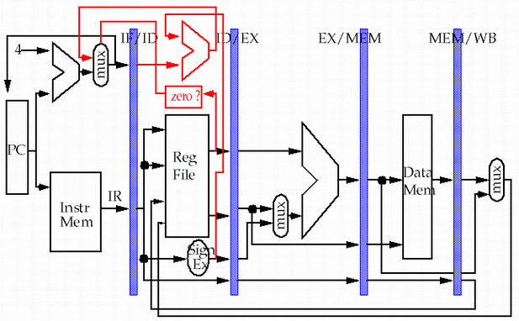
Detect: Data Hazard Logic
Rs =? Rd
Rt =? Rd
between IF/ID and
ID/EX, EX/MEM Stages
Rs
Rt
Rd
Rd
Rd

Slide 69
4. Forwarding
If the result you need does not exist AT ALL yet,
you are out of luck, sorry.
But, what if the result exists, but is not stored back yet?
Instead of stalling until the result is stored back in its “natural” home…
grab the result “on the fly” from “inside” the pipe, and send it to the other instruction (another pipe stage) that wants to use it

Slide 70
Forwarding
Generic name: forwarding ( bypass, short-circuiting)
Instead of waiting to store the result, we forward it immediately (more or less) to the instruction that wants it
Mechanically, we add buses to the datapath to move these values
around, and these buses always “point backwards” in the datapath, from later stages to earlier stages

Slide 71
Forwarding: reduce data hazard stalls
Data may be already computed - just not in the Register File
EX/MEM.ALUoutput → ALU input port
MEM/WB.ALUoutput → ALU input port

Slide 72
Hardware Change for Forwarding
NextPC
ID/EX
EX/MEM
MEM/WR
Registers
mux
ALU
Data
Memory
mux
mux
Immediate
EX/Mem.ALUoutput → ALU input
MEM/WB.ALUoutput → ALU input
MEM/WB.LMD → ALU input

Slide 73
Forwarding path to other input entry
store
load
MEM/WB.LMD → DM input

Slide 74
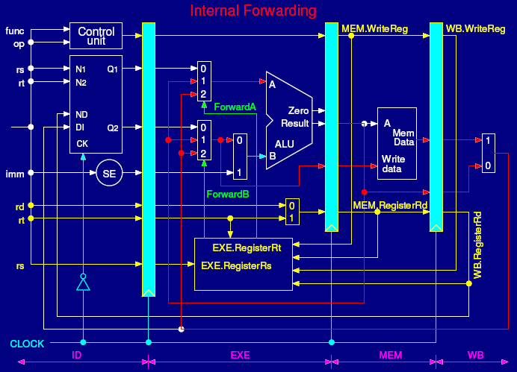

Slide 75
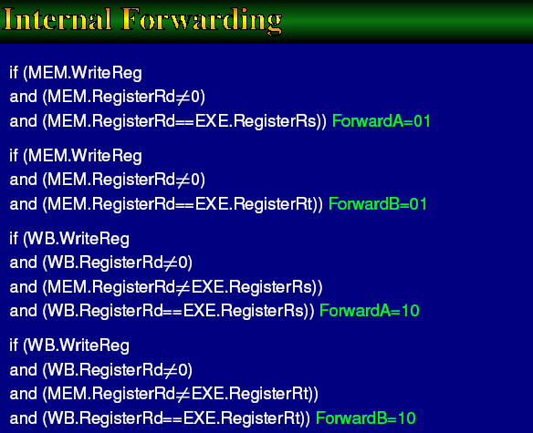

Slide 76
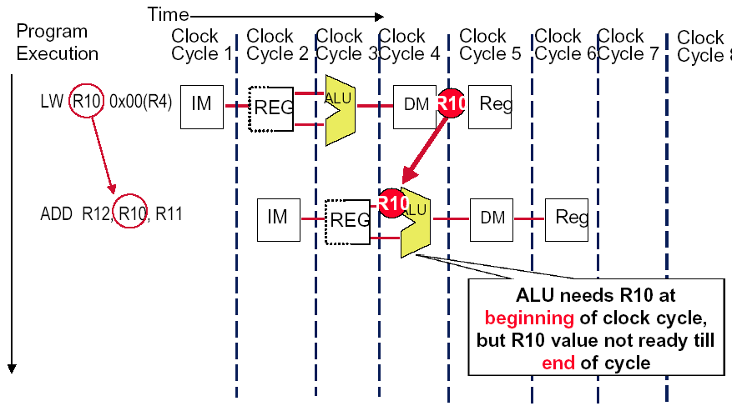
Forwarding isn’t Always available

Slide 77
So we have to insert stall: Load stall
Time (clock cycles)
I
n
s
t
r.
O
r
d
e
r
lw r1, 0(r2)
Ifetch
Reg
ALU
DMem
Reg
Bubble
sub r4,r1,r6
Ifetch
Reg
ALU
DMem
Reg
Bubble
and r6,r1,r7
Ifetch
Reg
ALU
DMem
Reg
or r8,r1,r9
Bubble
Ifetch
Reg
ALU
DMem

Slide 78
5. Instruction reordering ——by compiler to avoid load stall
Try producing fast code for
a = b + c;
d = e – f;
assuming a, b, c, d ,e, and f in memory.
Slow code:
LW Rb,b
LW Rc,c
ADD Ra,Rb,Rc
SW a,Ra
LW Re,e
LW Rf,f
SUB Rd,Re,Rf
SW d,Rd
Fast code:
LW Rb,b
LW Rc,c
LW Re,e
ADD Ra,Rb,Rc
LW Rf,f
SW a,Ra
SUB Rd,Re,Rf
SW d,Rd

Slide 79
3.3.4 Pipelining Control Hazards
Taxonomy of Hazards
Structural hazards
These are conflicts over hardware resources.
Data hazards
Instruction depends on result of prior computation which is not ready (computed or stored) yet
OK, we did these, Double Bump, Forwarding path,
software scheduling, otherwise have to stall
Control hazards
branch condition and the branch PC are not available in time to fetch an instruction on the next clock

Slide 80
3.3.4 Pipelining Control Hazards
Taxonomy of Hazards
Structural hazards
These are conflicts over hardware resources.
Data hazards
Instruction depends on result of prior computation which is not ready (computed or stored) yet
OK, we did these, Double Bump, Forwarding path,
software scheduling, otherwise have to stall
Control hazards
branch condition and the branch PC are not available in time to fetch an instruction on the next clock

Slide 81
The Control hazard
Cause
branch condition and the branch PC are not available in time to fetch an instruction on the next clock
The next PC takes time to compute
For conditional branches, the branch direction takes time to compute.
Control hazards can cause a greater and greater performance loss for MIPS pipeline than do data hazards.

Slide 82
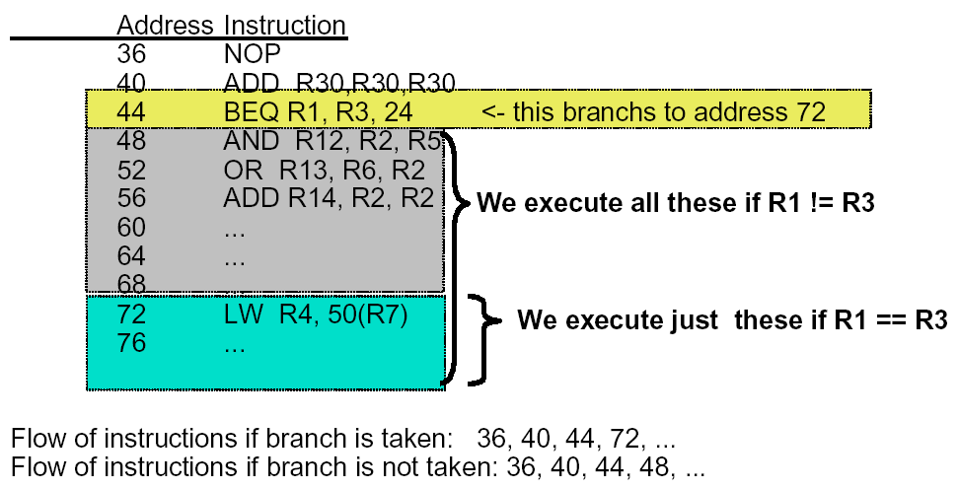
Example: Branches

Slide 83
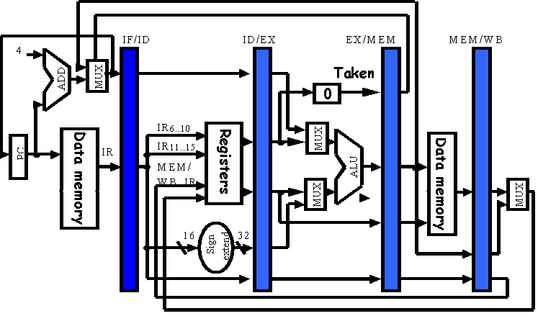
Branches of Basic Pipelined Datapath

Slide 84
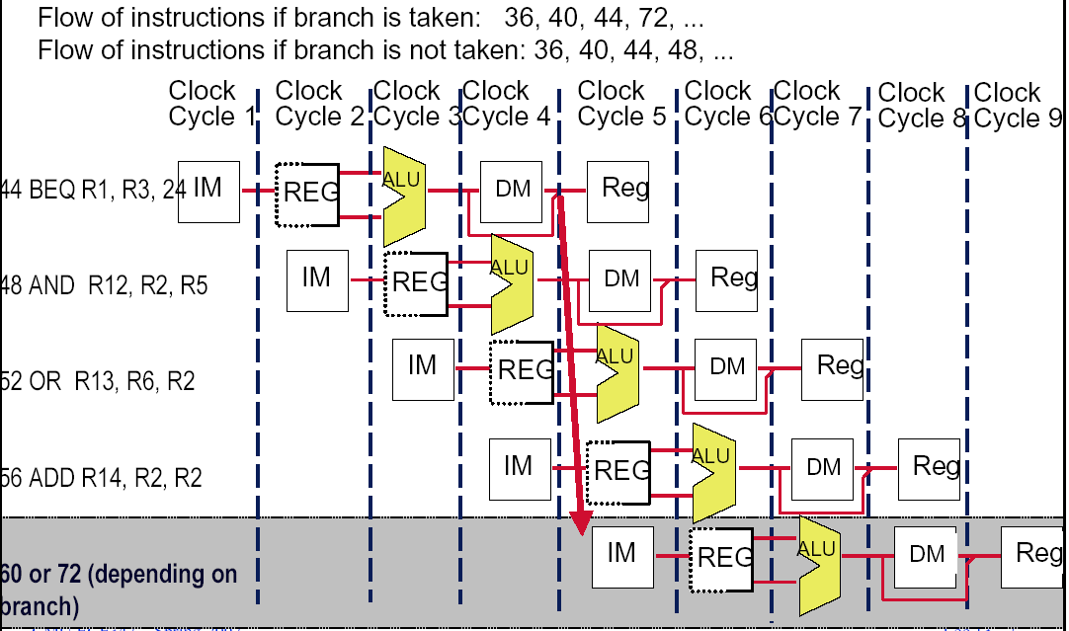
二、The Penalty of Control hazard
b=3

Slide 85
三、Dealing with the control hazard
Four simple solutions
Freeze or flush the pipeline
Penalty is fixed.
Can not be reduced by software.
Predict-not-taken (Predict-untaken)
Treat every branch as not taken
Predict-taken
Treat every branch as taken
Delayed branch
Note:
Fixed hardware
Compile time scheme using knowledge of hardware scheme and of branch behavior

Slide 86
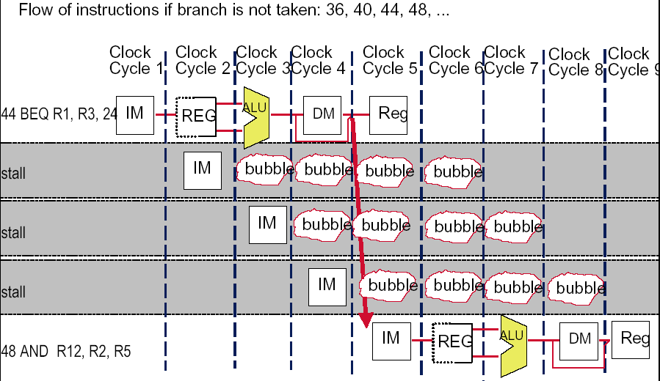
(1)Freeze or flush the pipeline

Slide 87
(2)Predict not-taken
Hardware:
Treat every branch as not taken (or as the formal instruction)
When branch is not taken, the fetched instruction just continues to flow on. No stall at all.
If the branch is taken, then restart the fetch at the branch target, which cause 3 stall.(should turn the fetched instruction into a no-op)
Compiler:
Can improve the performance by coding the most frequent case in the untaken path.

Slide 88
(3)Predict –taken
Most branches(60%) are taken, so we should make the taken branch more faster. Why not try assuming the branch always taken?
Hardware
Treat every branch as taken (evidence: more than 60% branches are taken)
As soon as the branch target address is computed, assume the branch to be taken and begin fetching and executing at the target.
Only useful when the target is known before the branch outcome.
No advantage at all for MIPS 5-stage pipeline.
Compiler
Can improve the performance by coding the most frequent case in the taken path.

Slide 90
Pipeline status for predict-taken
Branch is taken: 1 stall
44 BEQ R1, R3, 24 | IF | ID | EX | MEM | WB
48 AND R12, R2, R5 |  | IF | idle | idle | idle | idle
72 LW R4, 50(R7) |  |  | IF | ID | EX | MEM | WB
76 |  |  |  | IF | ID | EX | MEM
80 |  |  |  |  | IF | ID | EX
Branch is not taken: 3 stall
44 BEQ R1, R3, 24 | IF | ID | EX | MEM | WB
48 AND R12, R2, R5 |  | IF | idle | idle | idle | idle
72 LW R4, 50(R7) |  |  | IF | ID | idle | idle | idle
76 |  |  |  | IF | idle | idle | idle
48 AND R12, R2, R5 |  |  |  |  | IF | ID | EX

Slide 91
Modify MIPS Datapath Move the Branch Computation Forward

Slide 92
Move the Branch Computation more Forward
store
load

Slide 93
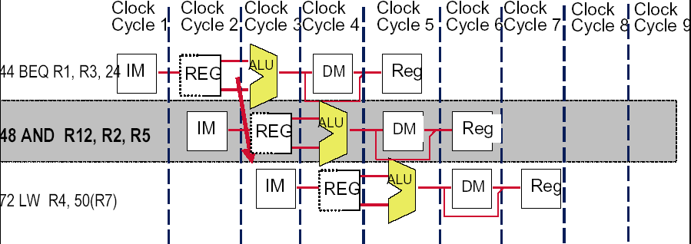
Result: New & Improved MIPS Datapath
Need just 1 extra cycle after the BEQ branch to know right address
On MIPS, its called - the branch delay slot
48 or 72

Slide 94
(4)Delayed branch
Good information
Just 1 cycle to figure out what the right branch address is
So, not 2 or 3 cycles of potential NOP or stall
Strange news
OK, it’s always 1 cycle, and we always have to wait
And on MIPS, this instruction always executes, no matter whether the branch taken or not taken. (hardware scheme)

Slide 95
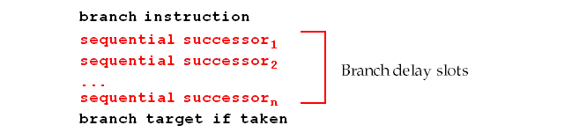
Branch delay slot
Hence the name: branch delay slot
The instruction cycle after the branch is used for address calculation , 1 cycle delay necessary
SO…we regard this as a free instruction cycle, and we just DO IT
Consequence
You (or your compiler) will need to adjust your code to put some useful work in that “slot”, since just putting in a stall is wasteful (compiler scheme)

Slide 96
How to adjust the codes?

Slide 97
Schedualing strategy vs. performance improvement

Slide 98
Constrains of the delayed branch
There are restrictions on the instructions that are scheduled into the delay slots
The compiler's ability to predict accurately whether or not a branch is taken determines how much useful work is actually done.
For scheduling scheme b and c,
It must be O.K. to execute the SUB instruction if the prediction is wrong.
Or the hardware must provide a way of cancelling the instruction.

Slide 99
About delayed branch
Delayed branch are adopted in most RISC processors.
In general, the length of branch delay is more than 1 . However, always just one slot is used due to the compiler complexity.

Slide 100
Summary for control hazard
Control hazards can cause a greater performance loss than do data hazards.
In general, the deeper the pipeline, the worse the branch penalty in clock cycles.
A higher CPI processor can afford to have more expensive branches.
The efficiency of the three schemes greatly depends on the branch prediction.

Slide 101
3.4 Extending the MIPS Pipeline to Handle Multicycle Operations
Alternative resolutions to handle floating-point operations
Complete operation in 1 or 2 clock cycles,
Which means using a slow clock,
or/and using enormous amounts of logic in FP units.
Allow for a longer latency for operations
The EX cycle may be repeated as many times as needed to complete the operation
There may be multiple FP units

Slide 102
THANK YOU

