Slide 1

Cost function
Neural Networks: Learning
Machine Learning

Slide 2







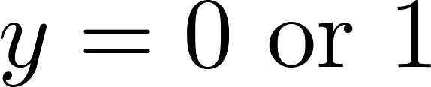
Neural Network (Classification)
total no. of layers in network
no. of units (not counting bias unit) in layer
Layer 1
Layer 2
Layer 3
Layer 4
Binary classification
1 output unit
Multi-class classification (K classes)
K output units
E.g. , , ,
pedestrian car motorcycle truck

Slide 3
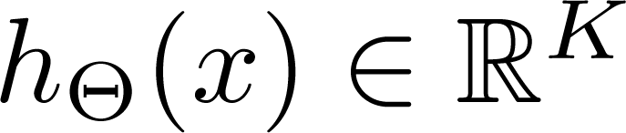
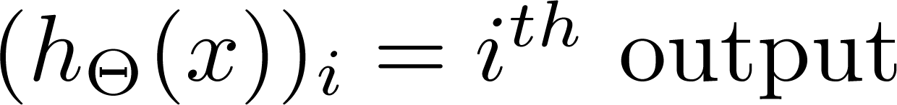
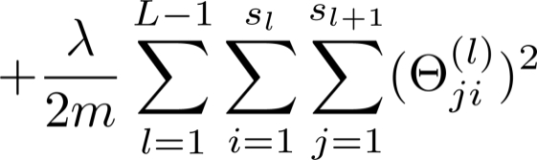
Cost function
Logistic regression:
Neural network:

Slide 4
Backpropagation algorithm
Neural Networks: Learning
Machine Learning

Slide 5
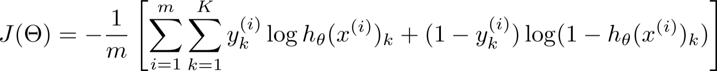
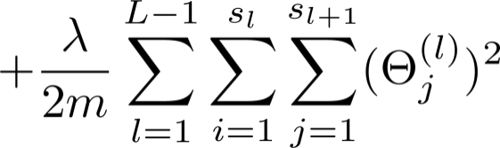
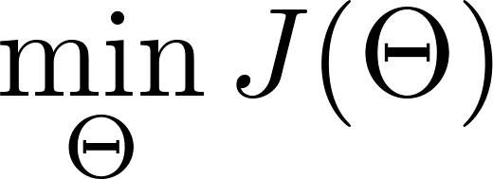
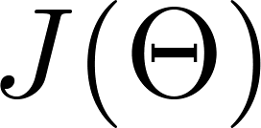
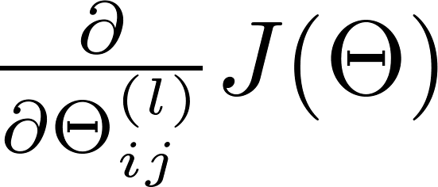
Gradient computation
Need code to compute:

Slide 6


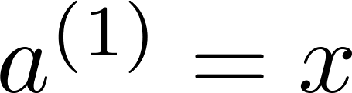
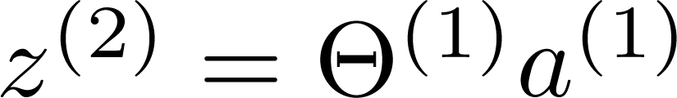
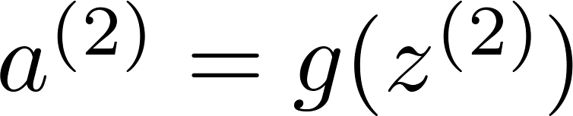
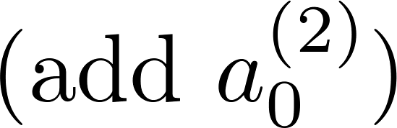
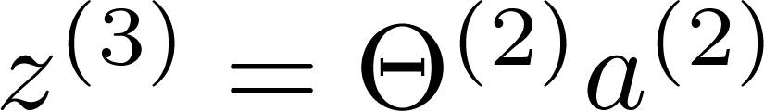
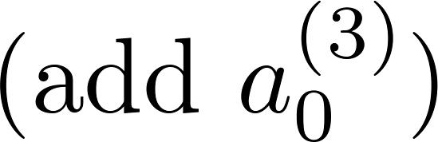
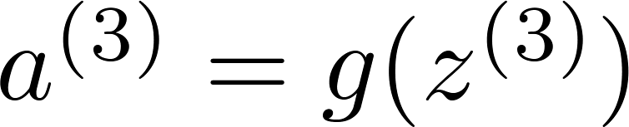
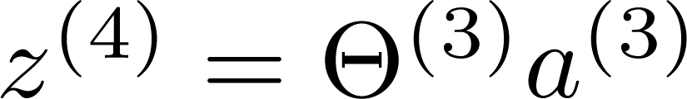
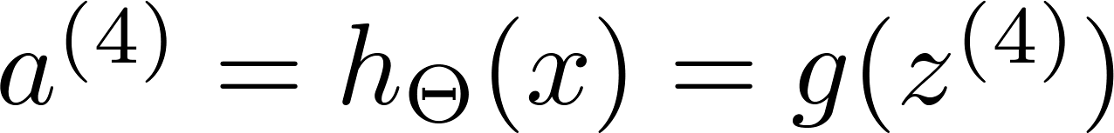
Gradient computation
Given one training example ( , ):
Forward propagation:
Layer 1
Layer 2
Layer 3
Layer 4

Slide 7
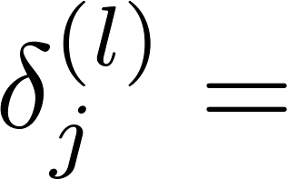

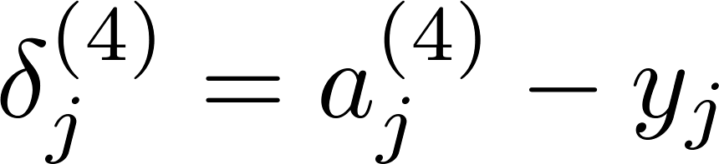
Gradient computation: Backpropagation algorithm
Intuition: “error” of node in layer .
For each output unit (layer L = 4)
Layer 1
Layer 2
Layer 3
Layer 4

Slide 8
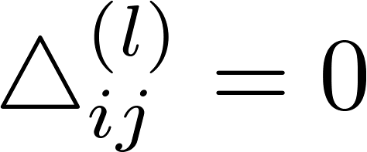


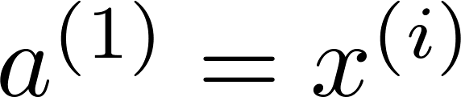

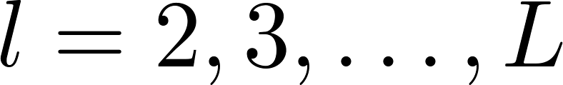

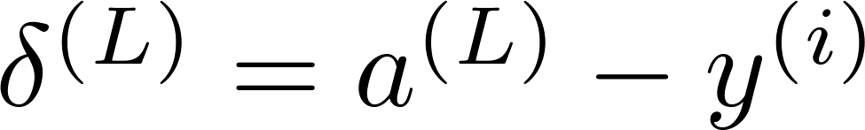
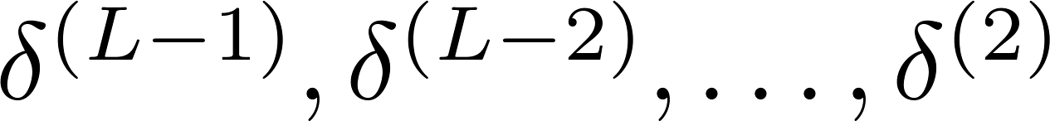
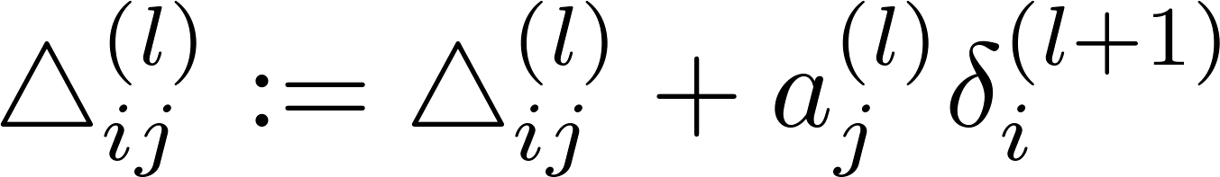
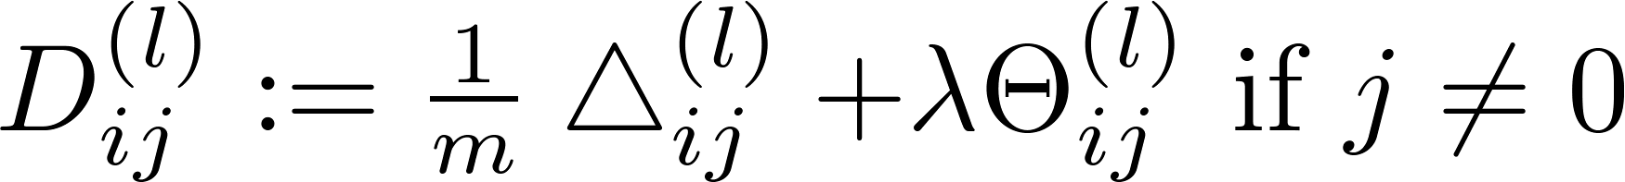
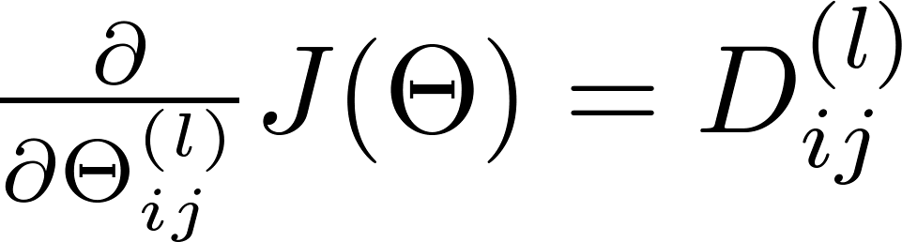
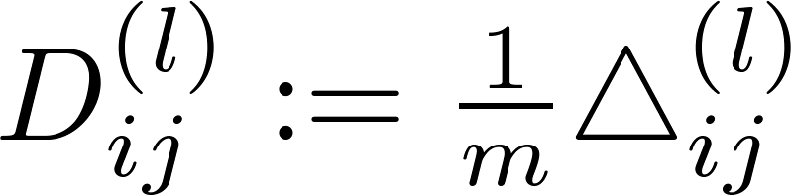

Backpropagation algorithm
Training set
Set (for all ).
For
Set
Perform forward propagation to compute for
Using , compute
Compute

Slide 9
Backpropagation intuition
Neural Networks: Learning
Machine Learning

Slide 10
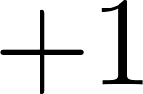


Forward Propagation

Slide 11
Forward Propagation

Slide 12
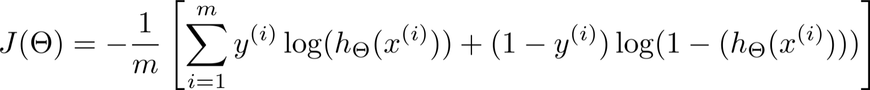


What is backpropagation doing?
Focusing on a single example , , the case of 1 output unit, and ignoring regularization ( ),
(Think of )
I.e. how well is the network doing on example i?

Slide 13







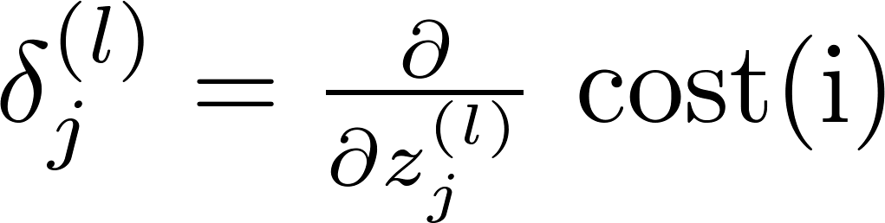

Forward Propagation
“error” of cost for (unit in layer ).
Formally, (for ), where

Slide 14
Implementation note: Unrolling parameters
Neural Networks: Learning
Machine Learning

Slide 15
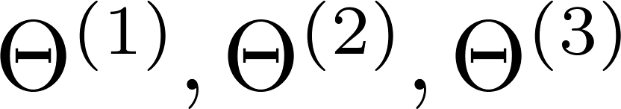
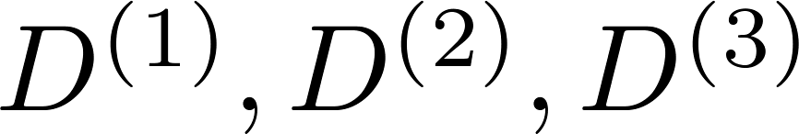
Advanced optimization
function [jVal, gradient] = costFunction(theta)
optTheta = fminunc(@costFunction, initialTheta, options)
…
Neural Network (L=4):
- matrices (Theta1, Theta2, Theta3)
- matrices (D1, D2, D3)
“Unroll” into vectors

Slide 16

Example
thetaVec = [ Theta1(:); Theta2(:); Theta3(:)];
DVec = [D1(:); D2(:); D3(:)];
Theta1 = reshape(thetaVec(1:110),10,11);
Theta2 = reshape(thetaVec(111:220),10,11);
Theta3 = reshape(thetaVec(221:231),1,11);

Slide 17

Learning Algorithm
Have initial parameters .
Unroll to get initialTheta to pass to
fminunc(@costFunction, initialTheta, options)
function [jval, gradientVec] = costFunction(thetaVec)
From thetaVec, get .
Use forward prop/back prop to compute and .
Unroll to get gradientVec.

Slide 18
Gradient checking
Neural Networks: Learning
Machine Learning

Slide 19

Numerical estimation of gradients
Implement: gradApprox = (J(theta + EPSILON) – J(theta – EPSILON)) /(2*EPSILON)

Slide 20

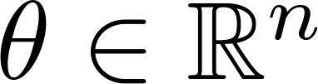
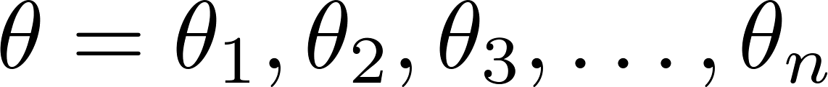
Parameter vector
(E.g. is “unrolled” version of )

Slide 21
for i = 1:n,
thetaPlus = theta;
thetaPlus(i) = thetaPlus(i) + EPSILON;
thetaMinus = theta;
thetaMinus(i) = thetaMinus(i) – EPSILON;
gradApprox(i) = (J(thetaPlus) – J(thetaMinus))
/(2*EPSILON);
end;
Check that gradApprox ≈ DVec

Slide 22
Implementation Note:
Implement backprop to compute DVec (unrolled ).
Implement numerical gradient check to compute gradApprox.
Make sure they give similar values.
Turn off gradient checking. Using backprop code for learning.
Important:
Be sure to disable your gradient checking code before training your classifier. If you run numerical gradient computation on every iteration of gradient descent (or in the inner loop of costFunction(…))your code will be very slow.

Slide 23
Random initialization
Neural Networks: Learning
Machine Learning

Slide 24

Initial value of
For gradient descent and advanced optimization method, need initial value for .
optTheta = fminunc(@costFunction, initialTheta, options)
Consider gradient descent
Set ?
initialTheta = zeros(n,1)

Slide 25
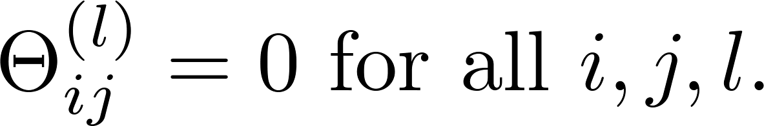



Zero initialization
After each update, parameters corresponding to inputs going into each of two hidden units are identical.

Slide 26
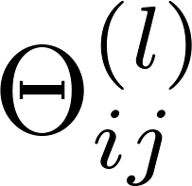
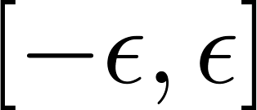
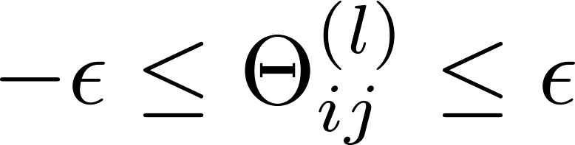
Random initialization: Symmetry breaking
Initialize each to a random value in
(i.e. )
E.g.
Theta1 = rand(10,11)*(2*INIT_EPSILON)
- INIT_EPSILON;
Theta2 = rand(1,11)*(2*INIT_EPSILON) - INIT_EPSILON;

Slide 27
Putting it together
Neural Networks: Learning
Machine Learning

Slide 28
Training a neural network
Pick a network architecture (connectivity pattern between neurons)
No. of input units: Dimension of features
No. output units: Number of classes
Reasonable default: 1 hidden layer, or if >1 hidden layer, have same no. of hidden units in every layer (usually the more the better)

Slide 29
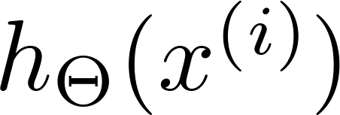

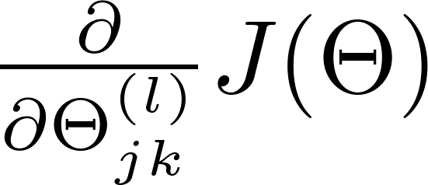
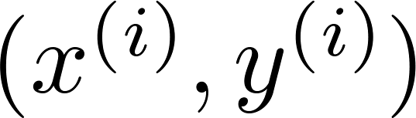

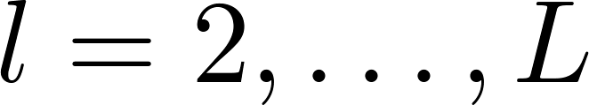
Training a neural network
Randomly initialize weights
Implement forward propagation to get for any
Implement code to compute cost function
Implement backprop to compute partial derivatives
for i = 1:m
Perform forward propagation and backpropagation using example
(Get activations and delta terms for ).

Slide 30

Training a neural network
Use gradient checking to compare computed using backpropagation vs. using numerical estimate of gradient of . Then disable gradient checking code.
Use gradient descent or advanced optimization method with backpropagation to try to minimize as a function of parameters

Slide 31
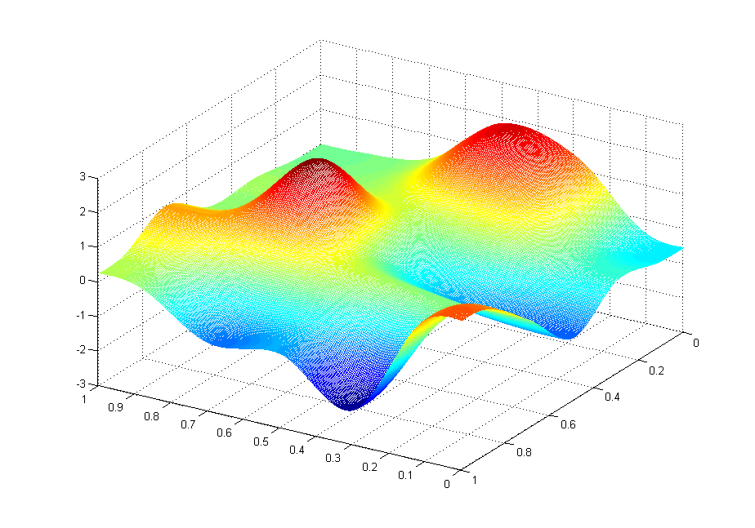



Slide 32
Backpropagation example: Autonomous driving (optional)
Neural Networks: Learning
Machine Learning

