Slide 1
The study of car accidents
Data science Capston
Zihan Ni

Slide 2
The Severity of Car Accidents and Regulations
The car Accidents kill more than 90 people a day in US
It kills about 1.35 million people all over the world
The study of weather, road condition, and light condition would be used for everyone and also government to help regulate the car accidents

Slide 3
Data Cleaning
According to the data from https://s3.us.cloud-object-storage.appdomain.cloud/cf-courses-data/CognitiveClass/DP0701EN/version-2/Data-Collisions.csv, the reports from car accidents were listed.
Firstly, create a new data base only contain the 3 columns, which are weather, LIGHTCOND, and ROADCOND.
Secondly, clear the data row that has missing values.

Slide 4
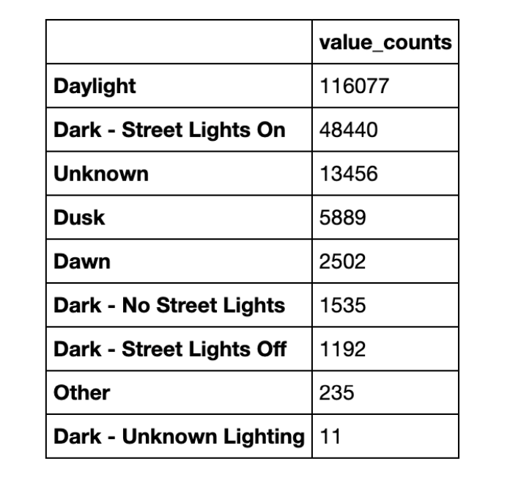
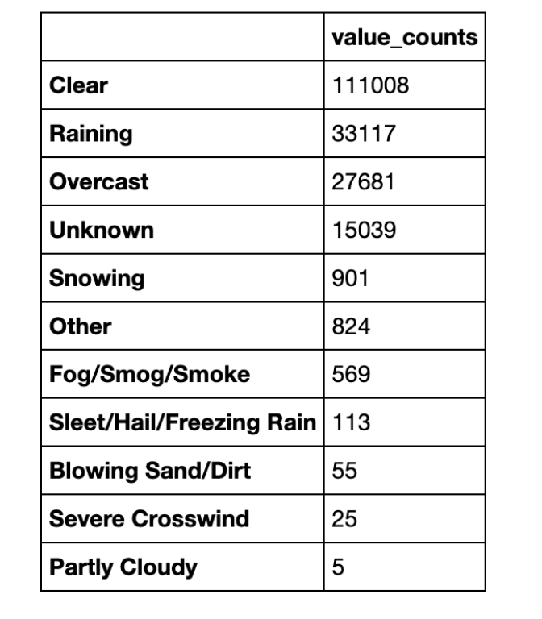
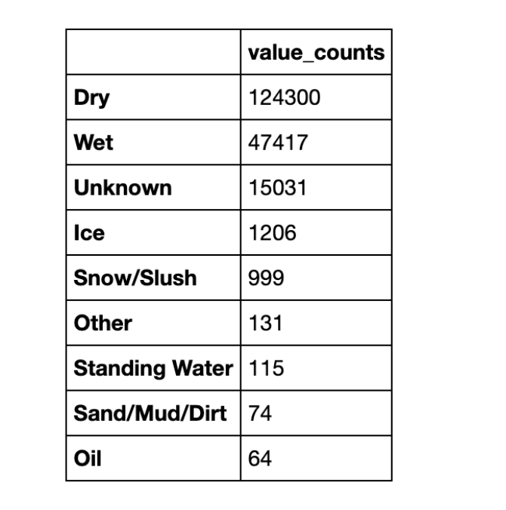
Grouping Data
In order to have a better understading to use the graph to analyze the results, the data is grouped.

Slide 5
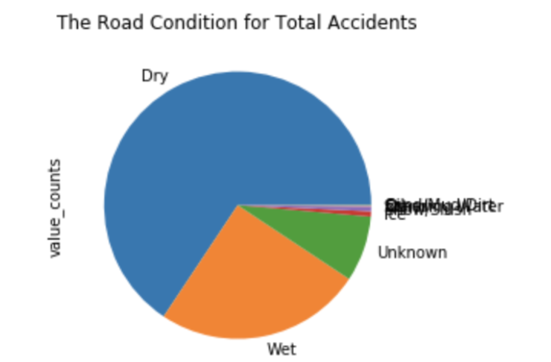
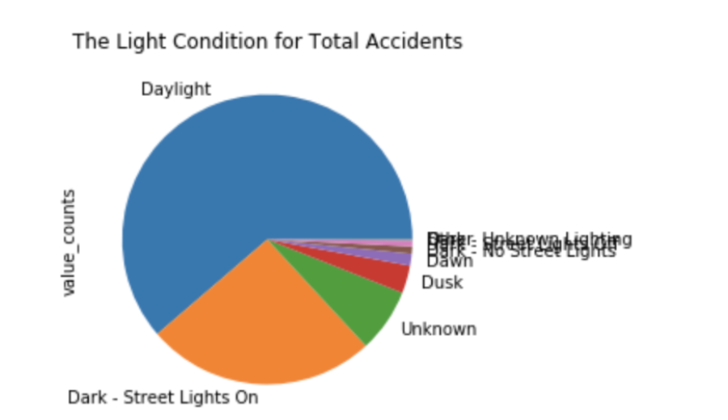
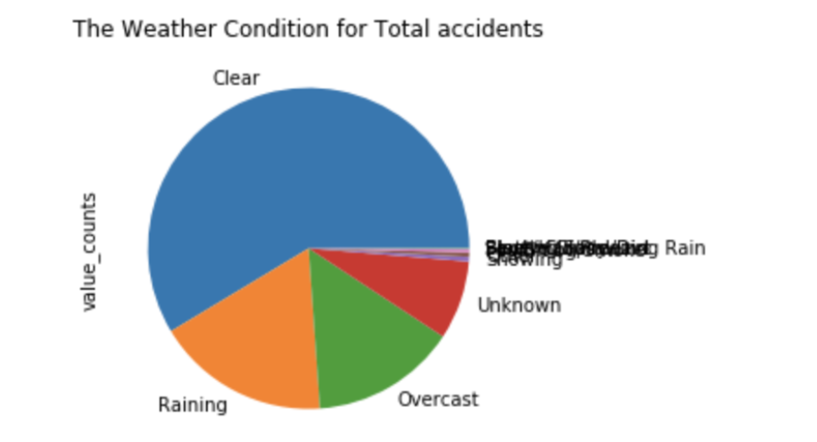
Graph
In order to analyze the data, the pie chart would be used.

Slide 6
Result
According to the first graph, which demonstrate the weather condition, there are 111008, more than 50 percent, car accidents happen in a clear day.
The subsequent diagram shows number of the mishaps under various light conditions. For normal conviction, individuals would will in general hit the article without any lights out and about more than there is adequate light. Nonetheless, the mishaps that occur under the sunlight is more than 50 percent in all cases.
The third graph shows the light condition. The car accidents happened the most under there was enough daylight

Slide 7
Discussion
As indicated by the aftereffect of the diagram, the connection between climate, street condition, and light condition and the fender bender don't fit the basic conviction, which the mishap happens more in the blustery day, wet street, and helpless light condition. The three chart all demonstrates that individuals would cause more mishaps when they feel it is protected—radiant climate, dry street, enough light. Consequently, it is anticipated that individuals would mind less and drive quicker than the time that the climate, street, and light are not appropriate for driving. Additionally, individuals may likewise stay away from to drive out and about when the climate, street, and light are bad, which may likewise cause the low pace of auto collisions.

Slide 8
Discussion
According to the result of the graph, the relationship between weather, road condition, and light condition and the car accident do not fit the common belief, which the accident happens more in the rainy day, wet road, and poor light condition. The three graph all indicates that people would cause more accidents when they feel it is safe—sunny weather, dry road, enough daylight. Therefore, it is predicted that people would care less and drive faster than the time that the weather, road, and light are not suitable for driving. Moreover, people might also avoid to drive on the road when the weather, road, and light are not good, which might also cause the low rate of car accidents.

