Slide 1
Project Management with PERT & CPM
By: some people

Slide 2
Definitions
Program Evaluation and Review Technique (PERT) and Critical Path Method (CPM) are techniques used to plan and manage large-scale projects. They help to coordinate various activities, develop a realistic schedule, and monitor the progress.
Both techniques rely on the use of project networks, which are flow diagrams consisting of activities and events, connected logically and sequentially.

Slide 3
Origins
PERT and CPM were developed independently from one another in late 1950s.
PERT was developed for the Polaris Missile Program by the US Navy special projects office, in collaboration with the Lockheed Martin Missile Division and a management consulting firm Booz, Allen, and Hamilton.
CPM was developed for a wide range of industrial applications, such as manufacturing, construction, and maintenance, by Du Pont and Sperry Rand Corporation.
The two techniques are similar to one another with a few key differences, which will be outlined further on.

Slide 4
Project Networks
A project network is a collection of nodes and arcs. Nodes are shown as circles or rectangles and arcs as arrows connecting the nodes.
There are two types of networks: activity-on-arc (AOA) and activity-on-node (AON).
In AOA, as the name implies, each activity is represented by an arc, while nodes are used to separate activities from one another. As such, the sequencing of the arcs shows the order of precedence for activities.
In AON, the nodes and arcs are reversed, with each activity being represented by a node and with arcs being used to separate activities from one another.

Slide 5
AOA vs AON Networks
AON networks are more intuitive than AOA, which makes them:
Easier to construct.
Easier to understand, especially for inexperienced users.
Easier to revise.
Originally AOA networks were used, but the above reasons caused AON networks to overtake AOA in popularity, so AON will be the focus of this presentation.

Slide 6
Preparing to Construct the Project Network
Break down the project into a list of distinct activities and assign a unique identifier to each activity.
Estimate a reasonable length of time for each activity.
Identify the predecessor activities that must be completed, if any, before each activity can begin.
Optionally arrange all of the above information in a table.

Slide 7
Preparing to Construct the Project Network
Identifier | Activity | Predecessors | Duration (days)
A | Find PERT resources | None | 2
B | Find CPM resources | None | 3
C | Identify key PERT points | A | 1
D | Identify key CPM points | B | 2
E | Identify common points | C, D | 6
F | Write draft content | E | 4
G | Create graphics | E | 1
H | Combine content | F, G | 3

Slide 8

Constructing the Project Network
Start with activities which do not require any predecessors.
Put down the unique identifier selected for each activity and circle it, thereby creating the nodes.
Above each node put down the length of time the activity is expected to take.
The network at this point is shown on the right.

Slide 9
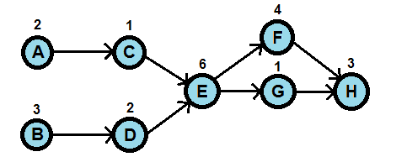
Constructing the Project Network
Next add the activities which require the previous ones as predecessors.
Draw arrows which start at the predecessor and end at the current activity.
Keep repeating the above steps, building the network from left to right, until all activities are recorded.

Slide 10
Critical Path
Now that the network is built, the next step is to determine the critical path and its length.
A path is a possible route through the network and its length is the sum of the lengths of all activities along the path.
The critical path is the longest path through the network and its length is the amount of time that the project is expected to take.
Any delays to activities on the critical path will cause the final project to be delayed by the same amount.
In our example, the critical path is BDEFH and its length is 3+2+6+4+3=18 days, so the presentation will be completed in 18 days.

Slide 11
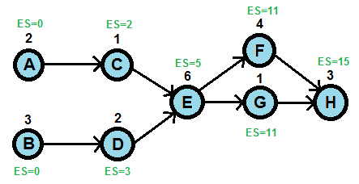
Scheduling Activities
To determine the scheduling, we have to first calculate the earliest start (ES) times for each activity, which is equivalent to the longest earliest finish time of all of its predecessors.

Slide 12
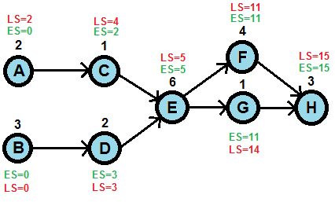
Scheduling Activities
Next we determine the latest start (LS) time for each activity, which is the last day when it can be started without lengthening the critical path and therefore delaying the project. On the critical path, ES will always be equal to LS.

Slide 13
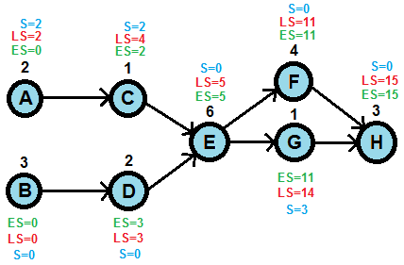
Scheduling Activities
Lastly we determine the amount of slack (S) on each activity, which is the difference between the latest and the earliest start times. On the critical path, the slack will always be zero.

Slide 14
PERT Timeline Deviations
The constructed network assumes that the time duration of each activity can be predicted perfectly, which may not be the case.
In the real world there is a certain variability, which PERT can take into account by considering three estimates for the duration of each activity:
m = the most likely time estimate
o = optimistic estimate, or the shortest possible time
p = pessimistic estimate, or the longest possible time
Recreating the network using the pessimistic and optimistic estimates allows calculating the worst case and best case total project durations.

Slide 15
PERT Timeline Deviations
Identifier | Activity | Predecessors | o (days) | m (days) | p (days)
A | Find PERT resources | None | 1 | 2 | 3
B | Find CPM resources | None | 2 | 3 | 5
C | Identify key PERT points | A | 1 | 1 | 1
D | Identify key CPM points | B | 2 | 2 | 3
E | Identify common points | C, D | 4 | 6 | 9
F | Write draft content | E | 3 | 4 | 5
G | Create graphics | E | 1 | 1 | 2
H | Combine Content | F, G | 2 | 3 | 4

Slide 16
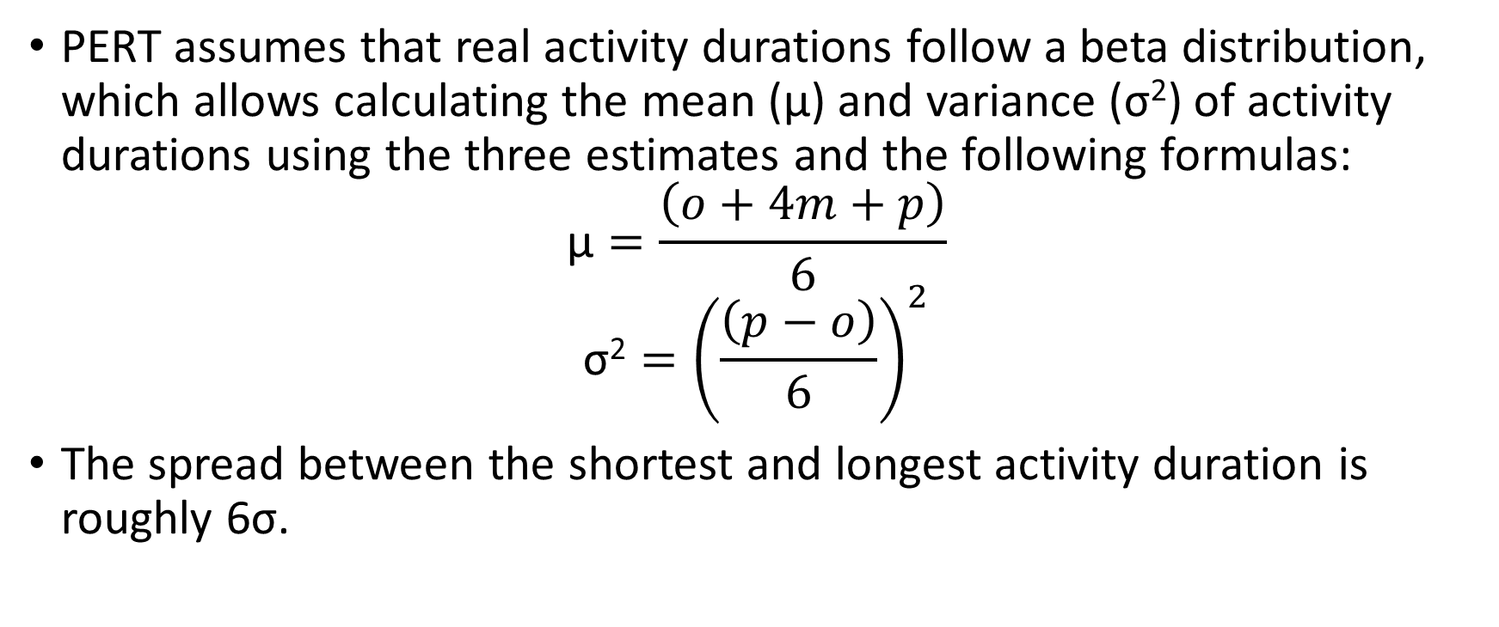
PERT Three-Estimate Approach
PERT assumes that real activity durations follow a beta distribution, which allows calculating the mean (μ) and variance (σ²) of activity durations using the three estimates and the following formulas:
$$\text{μ}=\frac{\left(o+4m+p\right)}{6}$$
$$\text{σ}\text{2}={\left(\frac{\left(p−o\right)}{6}\right)}^{2}$$
The spread between the shortest and longest activity duration is roughly 6σ.

Slide 17
PERT Three-Estimate Approach
Identifier | Activity | Predecessors | o (days) | m (days) | p (days) | μ (days) | σ² (days²)
A | Find PERT resources | None | 1 | 2 | 3 | 2 | 0.11
B | Find CPM resources | None | 2 | 3 | 7 | 3.5 | 0.69
C | Identify key PERT points | A | 1 | 1 | 1 | 1 | 0
D | Identify key CPM points | B | 2 | 2 | 3 | 2.17 | 0.03
E | Identify common points | C, D | 4 | 6 | 10 | 6.33 | 1
F | Write draft content | E | 3 | 4 | 5 | 4 | 0.11
G | Create graphics | E | 1 | 1 | 2 | 1.17 | 0.03
H | Combine content | F, G | 2 | 3 | 4 | 3 | 0.11

Slide 18
PERT Three-Estimate Approach
The probability of completing the project within a certain time can be calculated, however it requires making three assumptions:
The critical path will be the same, despite variations in activity durations.
Each activity duration is statistically independent.
The total project duration follows the normal distribution.
These assumptions are reasonable, as long as there are at least 5 different activities.

Slide 19
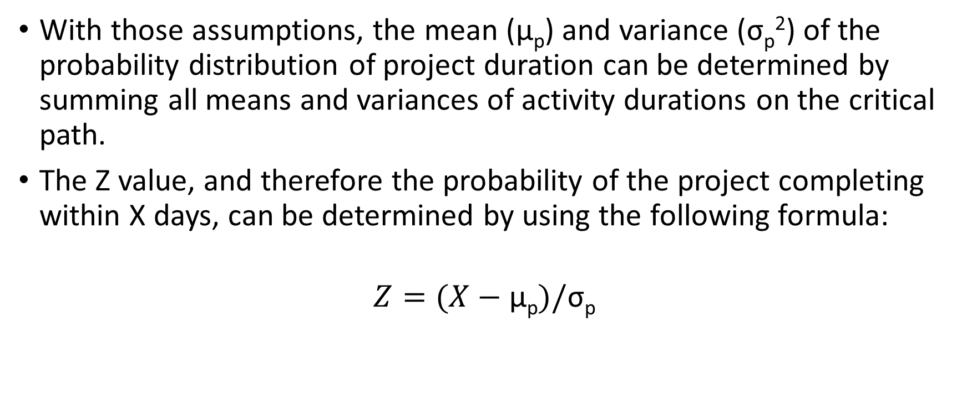
PERT Three-Estimate Approach
With those assumptions, the mean (μ_{p}) and variance (σ_{p}²) of the probability distribution of project duration can be determined by summing all means and variances of activity durations on the critical path.
The Z value, and therefore the probability of the project completing within X days, can be determined by using the following formula:
$$Z=(X−\text{μ}\text{p}\text{)}/\text{σ}\text{p}$$

Slide 20
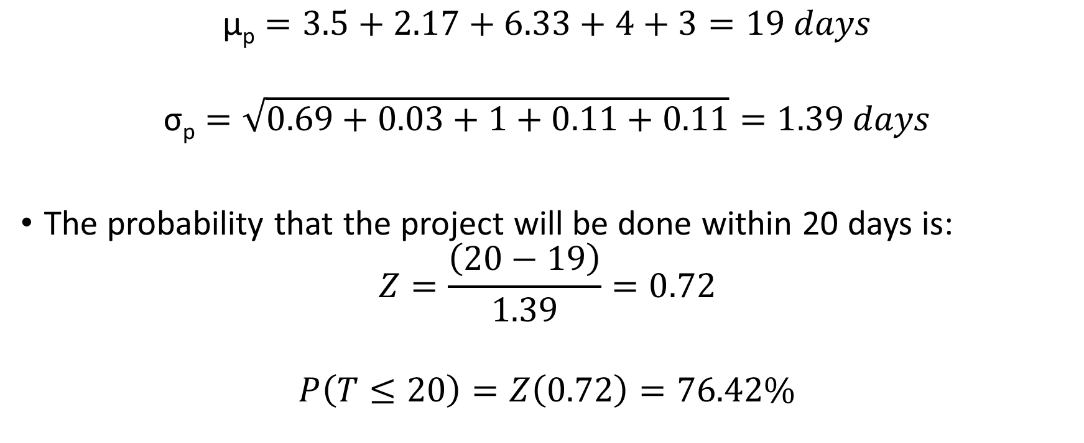
PERT Three-Estimate Approach
$$\text{μ}\text{p}=3.5+2.17+6.33+4+3=19 days$$
$$\text{σ}\text{p}=\sqrt{0.69+0.03+1+0.11+0.11}=1.39 days$$
The probability that the project will be done within 20 days is:
$$Z=\frac{\left(20−19\right)}{1.39}=0.72$$
$$P\left(T≤20\right)=Z\left(0.72\right)=76.42\%$$

Slide 21
CPM Time/Cost Tradeoff
CPM gives a method of calculating the cost of speeding up project completion time, or the tradeoff between time and cost.
Crashing an activity involves paying extra costs to speed up its duration.
The normal point (n) is the duration of the activity without crashing, and the crash point (c) is the duration with maximum crashing.
There is assumed to be range of different possibilities between the normal and crash points, and the cost of crashing is assumed to be constant between n and c points.

Slide 22
CPM Time/Cost Tradeoff
Identifier | Activity | Predecessors | c (days) | n (days) | Crashing Cost ($/day)
A | Find PERT resources | None | 1 | 2 | 5
B | Find CPM resources | None | 1 | 3 | 15
C | Identify key PERT points | A | 1 | 1 | n/a
D | Identify key CPM points | B | 2 | 2 | n/a
E | Identify common points | C, D | 4 | 6 | 12
F | Write draft content | E | 3 | 4 | 7
G | Create graphics | E | 1 | 1 | n/a
H | Combine content | F, G | 2 | 3 | 20

Slide 23
CPM Time/Cost Tradeoff
Marginal cost analysis can be used to calculate the minimum cost of speeding up the project, essentially by looking for the cheapest activity crashing cost along the critical path.
Our project can be sped up by 1 day for $7, 2 days for $7+$12=$19 days, and so on up to a maximum of 6 days for $81.
Combined with PERT’s probabilistic three-estimate approach, this time/cost tradeoff can be used to determine the cost of getting a particular probability of finishing the project within a particular time, however this requires making an additional assumption that crashing does not change the variance of activity durations.

Slide 24
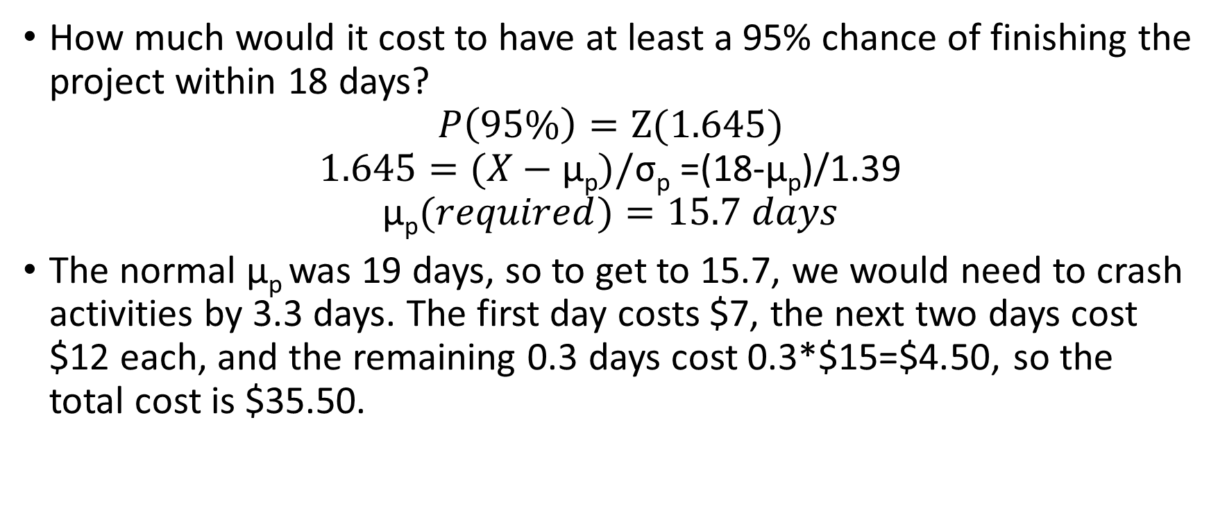
Combining PERT and CPM
How much would it cost to have at least a 95% chance of finishing the project within 18 days?
$$P\left(95\%\right)=Z(1.645)$$
$$1.645=(X−\text{μ}\text{p}\text{)}/\text{σ}\text{p} \text{=(18-}\text{μ}\text{p}\text{)/1.39}$$
$$\text{μ}\text{p}(required)=15.7 days$$
The normal $\text{μ}\text{p}$was 19 days, so to get to 15.7, we would need to crash activities by 3.3 days. The first day costs $7, the next two days cost $12 each, and the remaining 0.3 days cost 0.3*$15=$4.50, so the total cost is $35.50.

Slide 25
PERT vs CPM Differences
 | PERT | CPM
Number of Time Estimates | 3 | 1
Main Focus on Determining | Total time | Time to cost tradeoff
Ideal Activities | Unpredictable, unique activities | Predictable, repetitive activities
Ideal Project | Research and development | General manufacturing, construction, and maintenance
Model Type | Probabilistic | Deterministic

Slide 26
References
Hillier, Frederick S., and Gerald J. Lieberman. Introduction to Operations Research. McGraw-Hill, 2007.
Punmia, B. C., and K. K. Khandelwal. Project Planning and Control with PERT and CPM. Laxmi, 2002.

