Slide 1
JavaScript Boot Camp
Because we could all suck less at JavaScript
Jason Offutt
Software Engineer
Central Christian Church
Email: jason.offutt@centralaz.com
Twitter: @jasonoffutt

Slide 2
Some basic facts
JavaScript IS an object oriented language
Very compact language
Elegantly designed object model
Based on ECMAScript standard (browser implementations vary)

Slide 3
A brief history
Created in 1995 at Netscape
Originally called LiveScript
To provide browser hooks for Java Applets
Implemented by Brendan Eich
It was implemented in 10 days

Slide 4
Why JavaScript?
Interpreted
Dynamically typed
Highly extensible
REALLY fast
Cross-platform
The single most important language in technology
Future-proof

Slide 5
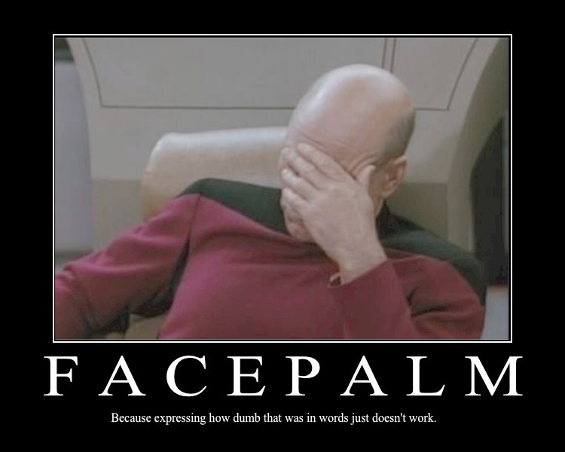
WTF.js?
== vs ===
null & undefined
Syntax oddities
Global scope

Slide 6

There’s good parts too
First class functions
Closures
Prototype
Event Loop

Slide 7
Examples…
Time to write some code
https://github.com/jasonoffutt/refreshcache-2011

