Slide 1
JavaScript Boot Camp
Because we could all suck less at JavaScript
Jason Offutt
Software Engineer
Central Christian Church
Email: jason.offutt@centralaz.com
Twitter: @jasonoffutt

Slide 2
A brief history
Created in 1995 at Netscape
Originally called Mocha, then LiveScript, finally names JavaScript when Sun became involved
To provide browser hooks for Java Applets
Created by Brendan Eich
He was given 10 days to design and implement the language
Currently working as CTO of Mozilla

Slide 3
Some basic facts
JavaScript IS an object oriented language
Very compact language
Elegantly designed object model
Though not without some ugly bits
Standardized in the form of ECMAScript in 1997
JS is one dialect of ECMAScript along with ActionScript, etc
Lead by Eich. MS, Apple, and Google represented on the board

Slide 4
Why JavaScript?
Interpreted
Dynamically typed
Highly extensible
REALLY fast
Cross-platform
The single most important language in technology
Future-proof

Slide 5
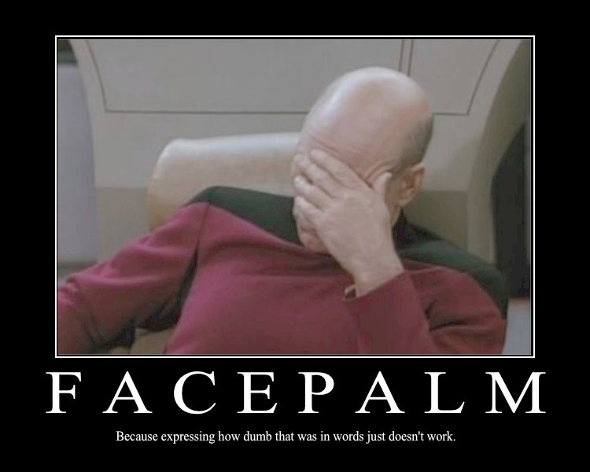
WTF.js
== vs ===
null/undefined/NaN
Syntax oddities
eval, with, etc
Global scope
Notes:
Syntax oddities:
‘with’ statement
Object literals vs constructed objects (new String() does not give you a string, it gives you an object)

Slide 6

There’s good parts too
First class functions
Closures
Prototypes
Event Loop
JSON

Slide 7
Examples…
Time to write some code
https://github.com/jasonoffutt/refreshcache-2011

