Slide 1
Applications of KNN, Random Forest, and Deep Neural Network for Drill Bit Monitoring
Presented by
Jason Pettinato and David Shlimak
Notes:
Presenting:
Zul Karnain: Intro, Background, Goals, Methods
Connor: Imaging Results
Shlimak: Mechanical Results, Conclusions, Suggestions

Slide 2
Introduction
Task
Classify drill bit faults by analyzing vibration data with various machine learning techniques
Background
Signal data from accelerometers is challenging to interpret without significant processing and analysis
Machine learning allows for proactive fault detection based on live data
Approach
Processed data in time, frequency, and Morlet domains, implemented KNN, Random Forest, and Deep Neural Network
Notes:
TiAl alloys typically consist of two major phases: α2 phase (Ti3Al) with hexagonal structure and γ phase (TiAl) with tetragonal structure.
These ordered phases exhibit low ductility, especially in their binary state.
Alloying improves ductility and fracture toughness by relaxing slip mode restrictions, altering ordering kinetics, introducing ductile second phases like β or β2, and modifying transformation behavior during heat treatment.
Typical TiAl alloy compositions are described as Ti–(42–49)Al–(0.1–10)X, with X representing alloying elements like Nb, Cr, V, Ta, Mo, Zr, W, Si, C, and B.
Alloy constitution and microstructures (equiaxed, duplex, nearly lamellar, fully lamellar) significantly influence mechanical properties.

Slide 3
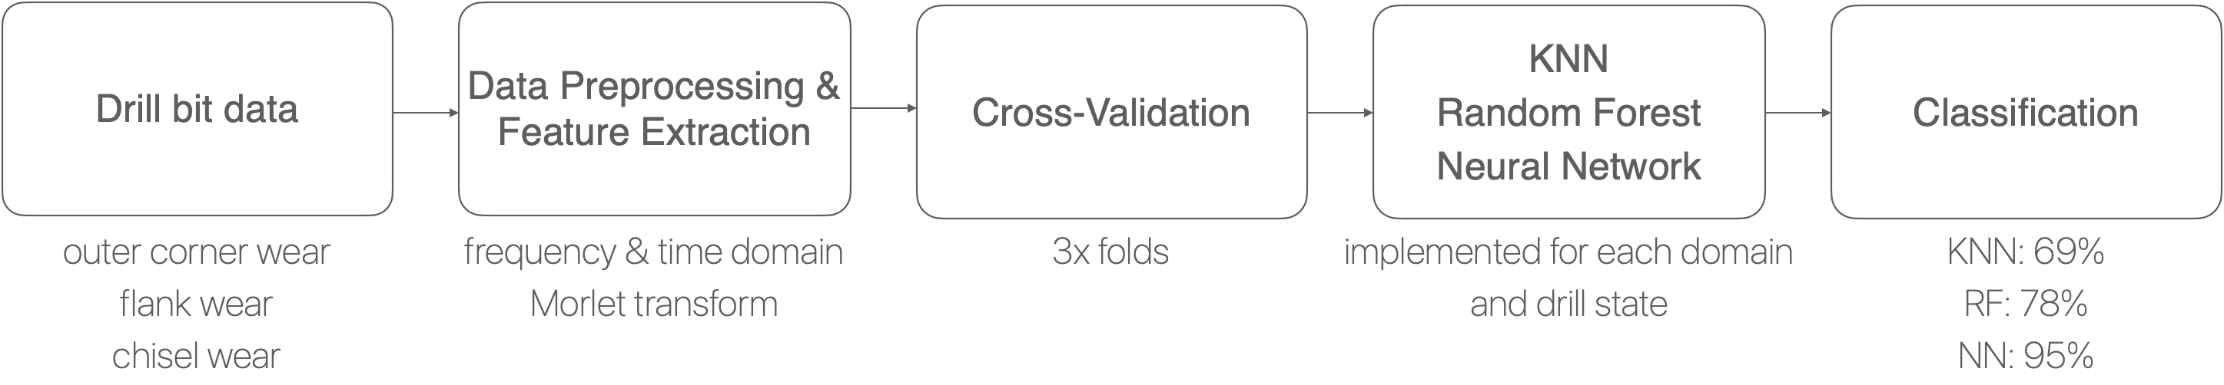
Methods: Overview
Key Takeaway: Applied KNN, Random Forest, and Deep Neural Network models to classify drill bit data. Maximum accuracy = 95%.

Slide 4
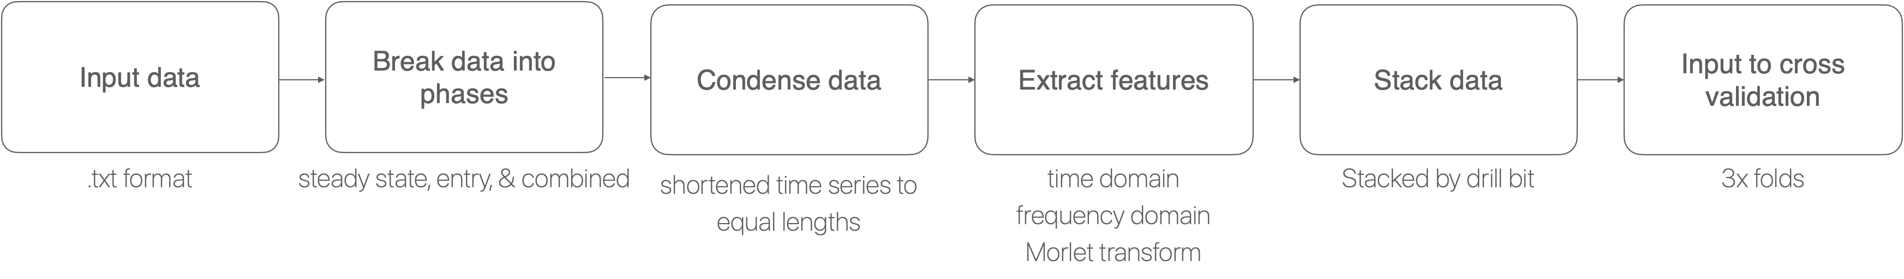
Data Processing
Key Takeaway: Cleaned data, separated by phase and domain, then performed cross validation for each model.

Slide 5
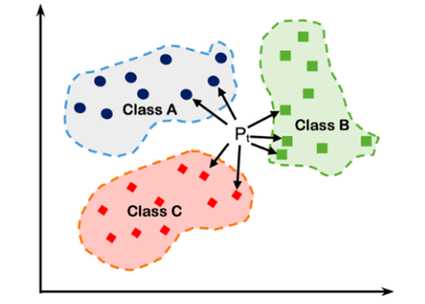
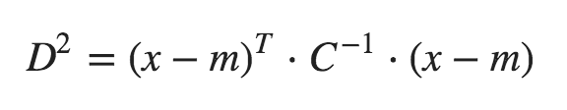
KNN
Theory
KNN chooses the data and decides which class the data belongs to using weighted voting
Best results with 3 neighbor voting and Mahalanobis Distance
Model 1 | Domain | KNN
 | Time | 0.2
 | Frequency | 0.666
 | Motlet | 0.466
Model 2 | Domain | KNN
 | Time | 0.31
 | Frequency | 0.58
 | Morlet | 0.483
Model 3 | Domain | KNN
 | Time | 0.416
 | Frequency | 0.692
 | Motlet | 0.43
Key Takeaway: KNN had a peak accuracy of 69%

Slide 6
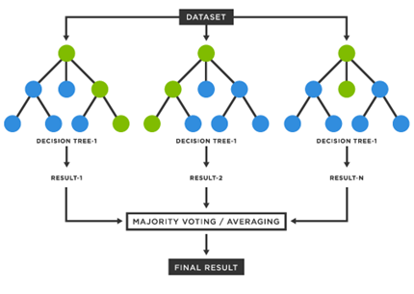
Random Forest
Theory
Random Forest generates many 'trees' and uses them to perform classification of the drill types using an aggregation of each result
Model 1 | Domain | Random Forest
 | Time | 0.283
 | Frequency | 0.783
 | Morlet | 0.55
Model 2 | Domain | Random Forest
 | Time | 0.36
 | Frequency | 0.716
 | Morlet | 0.6
Model 3 | Domain | Random Forest
 | Time | 0.358
 | Frequency | 0.708
 | Morlet | 0.55
The random forest used n = 500 trees
Key Takeaway: The random forest was easy and effective with a max accuracy of 0.78

Slide 7
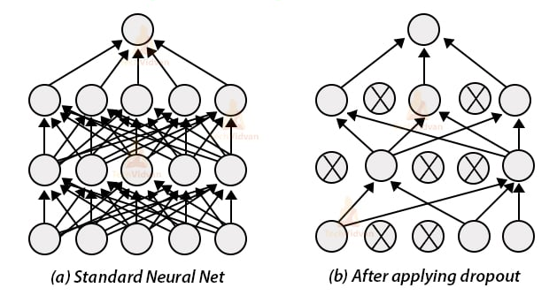
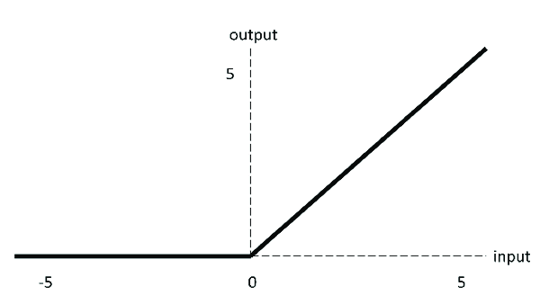
Deep Neural Network
Theory
Neural Networks can approximate any function, and are very effective at a wide range of complex tasks
Chosen Architecture
Combination of fully connected layers
batch normalization layers
ReLU activations
dropout layers
Key Takeaway: The neural network had a 95.05% accuracy

Slide 8
Results
Deep Neural Network = 95.0%
Deep Neural Network = 94.9%
Deep Neural Network = 95.1%
Morlet
Morlet
Morlet
Key Takeaway: Deep Neural Network outperformed all other models. Combining entry and steady-state resulted in highest accuracy.

Slide 9
Results and Conclusions
Key takeaway
  Implemented KNN, Random forest, and Deep Neural Network to achieve maximum accuracy of 95%
Discussion and Next steps
  Experiment with additional pre-processing
  Use additional features in the frequency domain
  Introduce different windowing sizes for the frequency data
  Try different activation functions and layer sizes

