Slide 1
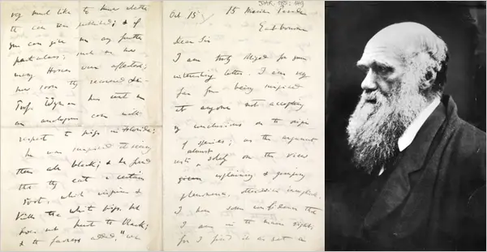
Dear Mr/Mrs? Dear Dr/Revd?
Predicting the gender & occupation of Darwin’s correspondents Shivani Aggarwal | Megan Briers | Tom Harris | Jason Wood

Slide 2
Problem
Our core question is: how much can we tell about who Darwin is writing to just from the languages he uses?
Many letters in the correspondence have missing information about the recipient. We are interested in building a tool to predict this information to assist the work of Editors in assessing unclassified and newly discovered letters.
We looked at two kinds of information: the recipient’s sex and their occupation.

Slide 3
Methodology
We use a simple natural language processing model to represent each letter as a vector recording which of Darwin’s most commonly used 5000 words feature in the letter.
We extract the recipients’ sex and occupations, where they are given, from the nameregs files and match them with the letter vectors to make a labelled dataset.
We then fit simple machine learning models to the labelled data, assess their accuracy, and make predictions on letters where the sex and occupation information is unavailable.

Slide 4
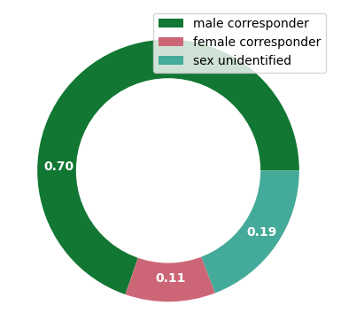
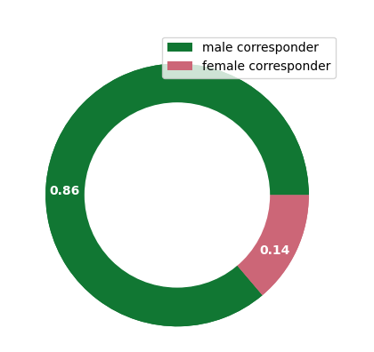
Sex – Dear Mr/Mrs
Predicting the sex is a warm-up exercise for harder prediction questions.
We can predict the sex of Darwin’s recipient with 95% accuracy … but 95% of Darwin‘s recipients are men!
Our model doesn’t always guess the recipient is a man, but it’s hard to beat that assumption on accuracy.

Slide 5
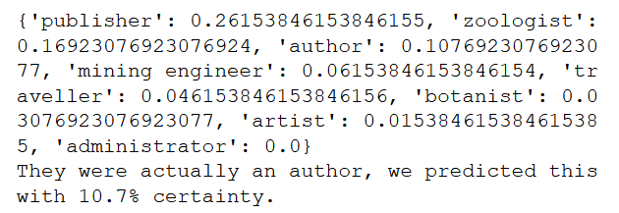
Occupation – Dear Dr/Revd
Our framework for sex inference can be readily adapted for occupation inference.
Occupation is not systematically recorded in the data. We remediate this by focussing on the most common occupations only.
We can generate a list of likely candidate occupations for each letter.

Slide 6

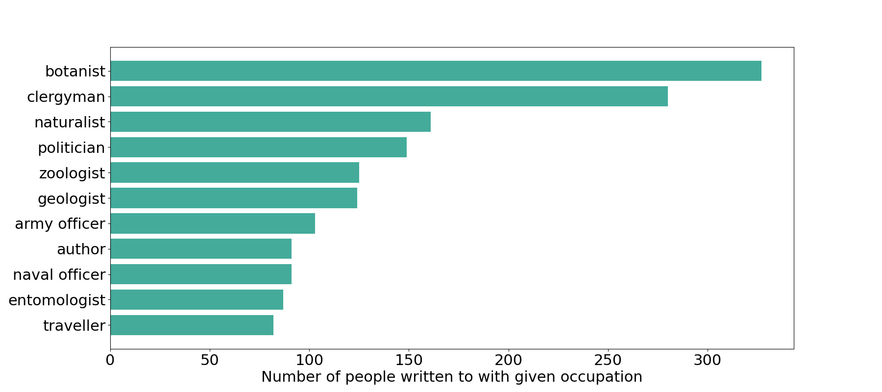

Slide 7
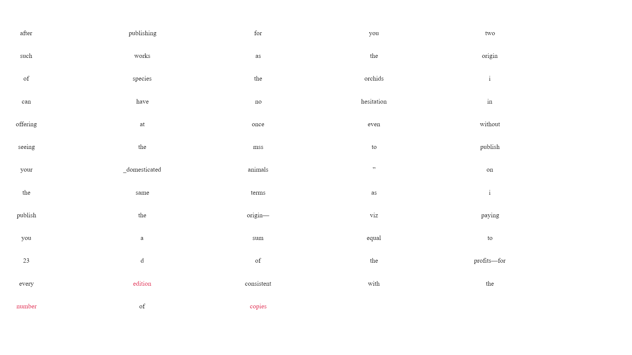
Occupation – Dear Dr/Revd
One of Darwin’s letters separated into individual words
and key words selected by the occupation prediction model.

Slide 8
Conclusions
Sex prediction can be done relatively accurately (without just assuming the correspondent is a man).
We provide a proof of concept for occupation inference. Though accuracy is limited, it could be taken further with a more thorough extraction of occupancy information from the data and with a more sophisticated language model.
Our model could also be adapted for further investigative work, for example clustering the letters for topic analysis.

Slide 9
Questions?

